Slide 1
Ghana-EU Voluntary Partnership Agreement
Meeting of Competent Authorities
28th September, 2023
Chris Beeko
Director, Timber Validation Department

Slide 2
Key Milestones
2023
Adoption of FLEGT Action Plan to Go-live
2018
Annex Amendments Completed
2017
Underpinning Legality Legislation passed
2014
Start of Operation of GhLAS
2010
Start of Implementation
2009
Signing & Ratification Ghana-EU VPA
2007
Start of Negotiations

Slide 3

Ownership of Policy through Improved Stakeholder Engagement
Inclusive approach to policy-making through creation of multi-stakeholder deliberative platforms
Stakeholder views incorporated in policy
Promotes ownership of policies

Slide 4
Continuous Improvement through Timber Legality Audit
Technical audit conducted by ISO Certified Auditors
Enhanced transparency in implementation of forest management prescription
Transformational shift in forest sector regulatory environment
forest offenses are more easily detected,
clear procedure for addressing non-compliances and ease of singling out non-compliant actors
Clarity in pattern of non-compliance
Benefits law enforcement and capacity building

Slide 5
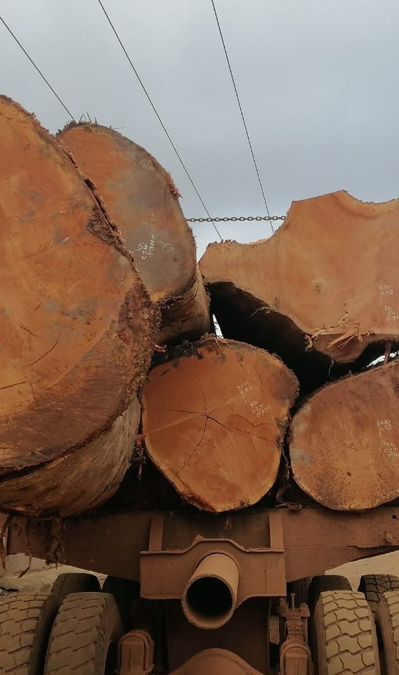
From timber tracking to a system for strengthening sector management
Accumulation of timber legality data across the supply chain translates to vital forest management information
System now upgraded to:
  accommodate decision support functions
  provide basis for strategic decision-making on forest resources towards sustainable forest management
  incorporate utility portals for the – Private Sector, Public and EU Competent Authorities

Slide 6






Data Collection/Reconciliation along Supply Chain
[The Legality Assurance System – GhLAS]
Only legally compliant consignments can make it to the market
The WTS exercises the requisite robustness to identify wood flow inconsistencies

Slide 7
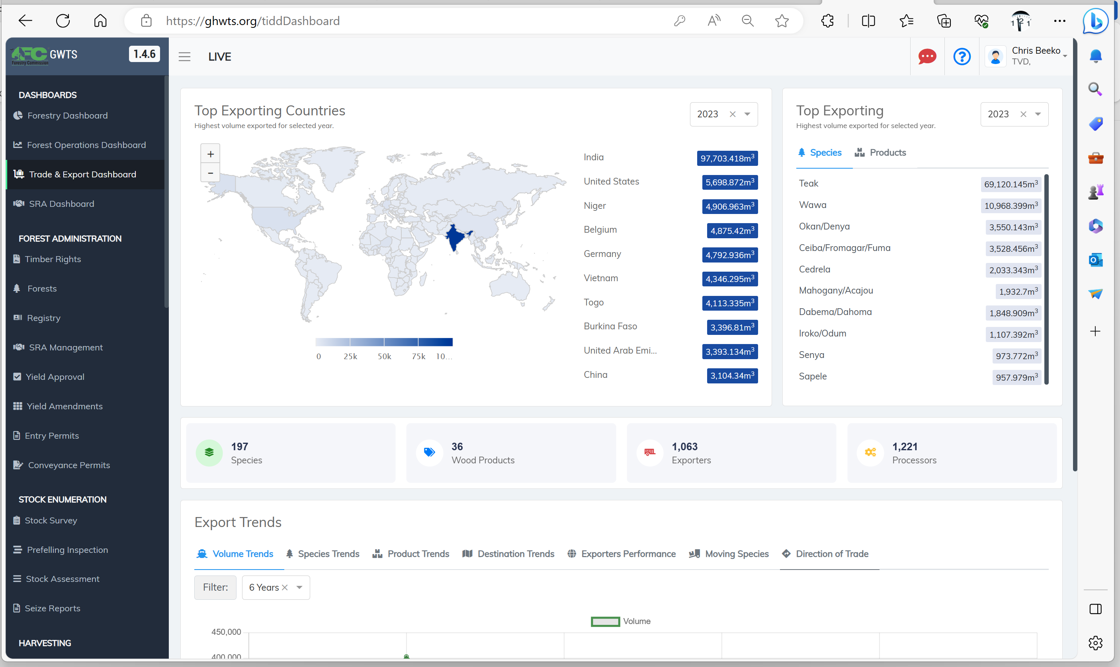

Slide 8
Reflections
Exports to EU has dipped significantly since 2007 (start of negotiations)
60% → < 15% value
Incentive remain to operate a Timber Legality Assurance System
Gains are clear – there is a transformation in the governance environment
Improvement in application of forest management prescription has direct bearing on sustainability
Legality → sustainability

Slide 9
End
cbeeko.hq@fcghana.org

