Slide 1


EUTR & the Ukraine Conflict – Problematic imports
Presentation to EUTR/FLEGT Expert Group, 28th September 2023

Slide 2









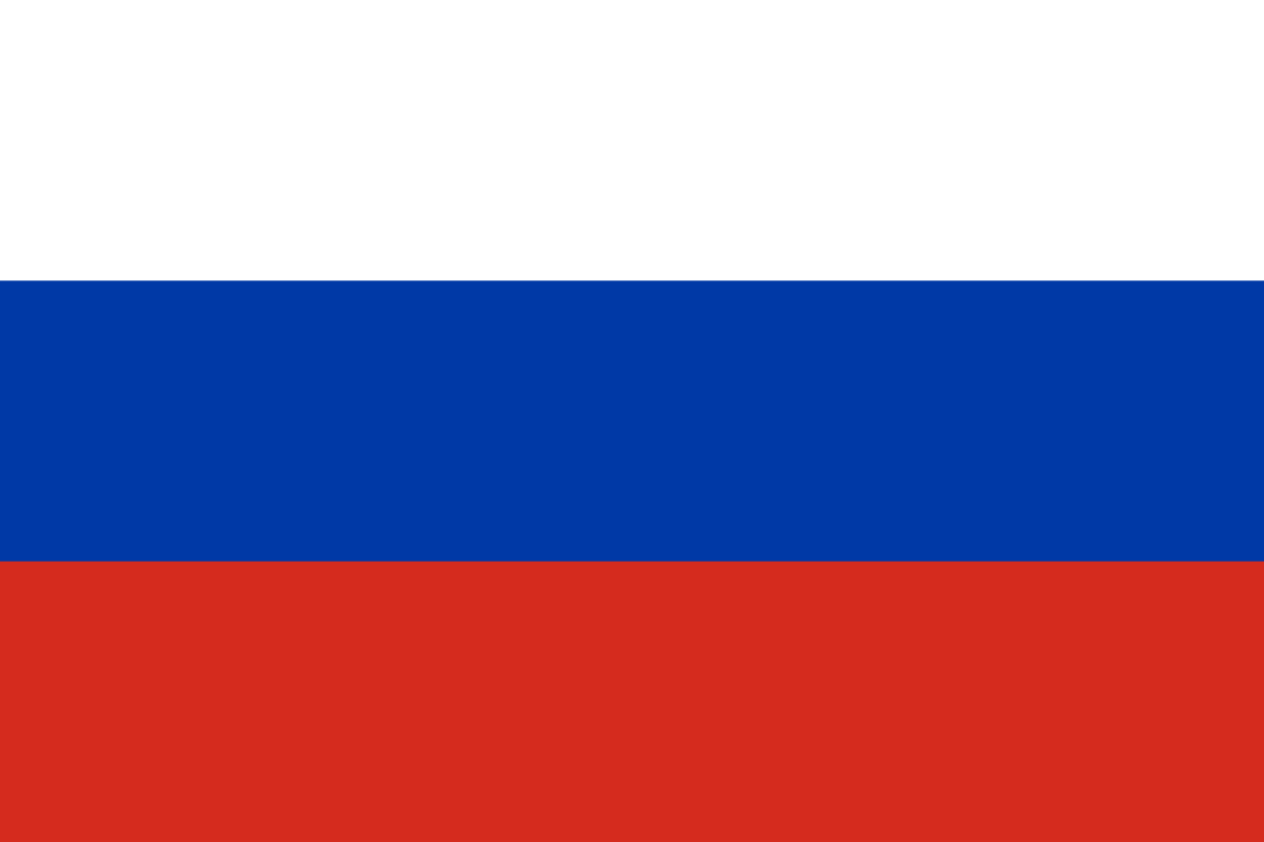
Three supply chains of greatest concern
1. Imports of EUTR-non-compliant wood furniture from Belarus
€5 million per month
2. Imports of timber from CAR linked to Russian Wagner group
€2 million per month
3. Laundering of sanctioned Russian plywood into the EU
€18 million per month

Slide 3
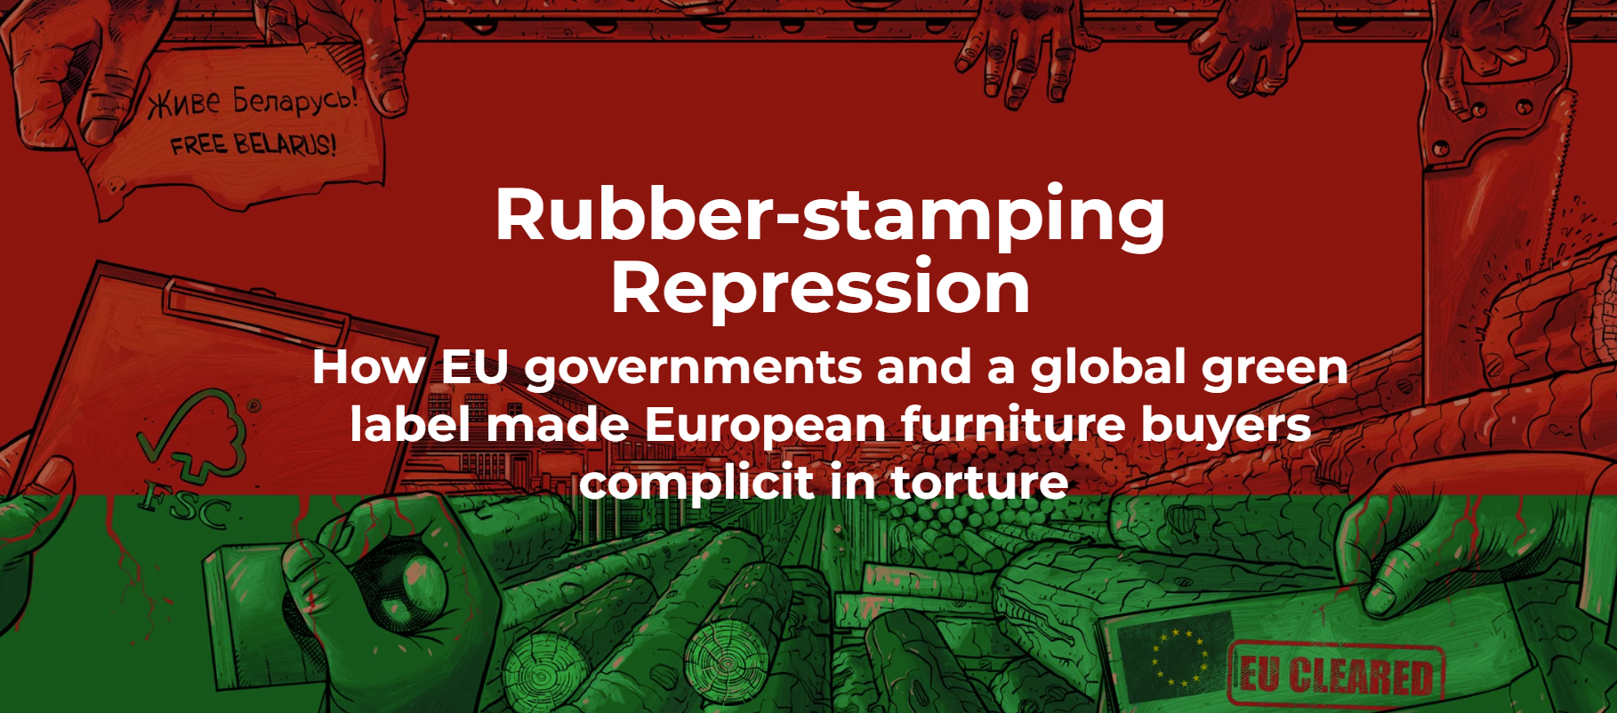
1. Belarus Furniture imports
RECAP
Belarusian furniture not yet covered by EU sanctions, but in April 2022 this grouping agreed it was ‘impossible’ for such products to be EUTR-compliant, given withdrawal of FSC/PEFC and limits to travel in Belarus.
Despite this, imports have continued almost unchanged. What reduction has occurred has mostly been due to IKEA voluntary boycott.
Earthsight showed in Nov 2022 that these imports are linked to torture of political prisoners and funding a Lukashenko slush fund.
Findings and data shared with this group in Feb 2023. At the meeting in February, German CA said enforcement was already ongoing.
UPDATE
Voluntary boycott imposed by the largest remaining EU retail chain selling Belarusian furniture (XXX Lutz).
In August 2023, the EU imposed fresh sanctions on officials from three prisons mentioned in our report- IK2, IK17 and Penal Colony No. 4 for women.

Slide 4
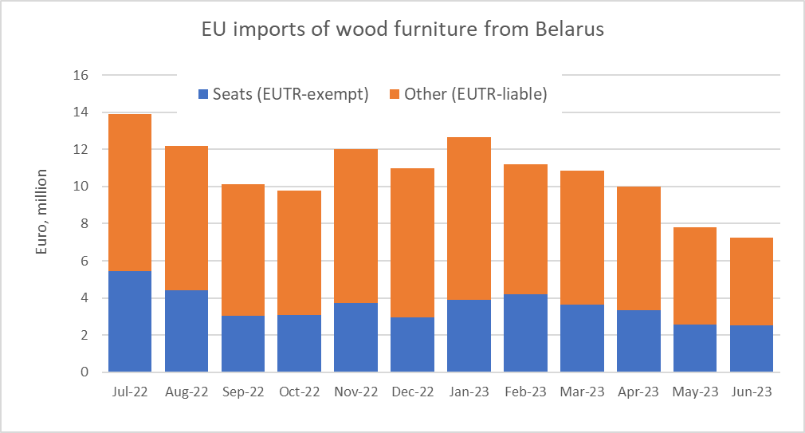
What has changed since March?
Volumes have declined but remain substantial. €4.7 million in most recent month (Jun 2023) for which data available.
Austria, Italy, Spain and Bulgaria – halted imports.
Poland, Germany, Netherlands, France, Slovakia, Czechia – decreased
Lithuania, Romania, Estonia, Latvia, Hungary - increased
Source: Eurostat

Slide 5
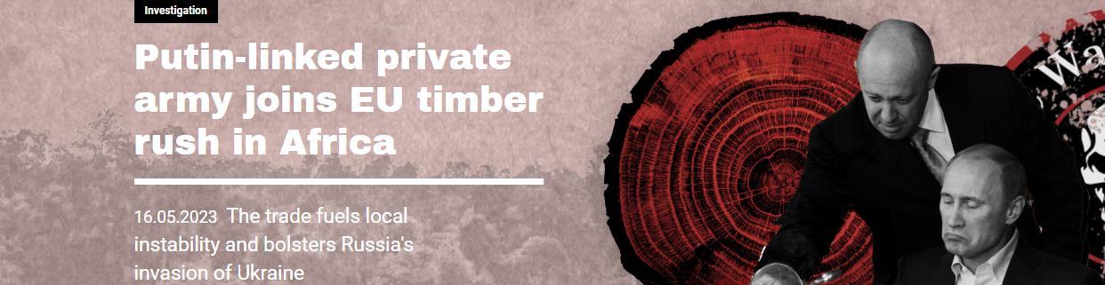
2. Wagner-CAR investigation May 2023
RECAP
Shipment records revealed exports of timber from Wagner-linked firm Bois Rouge in Central African Republic to France and Denmark
One of the EU companies concerned also confessed to shipments into Spain, and said relevant staff were sacked and Spanish authoritiess alerted
EU imports of timber from CAR are growing rapidly; all are problematic, because the security situation makes DD impossible, and Wagner are providing security to timber produced by others.

Slide 6
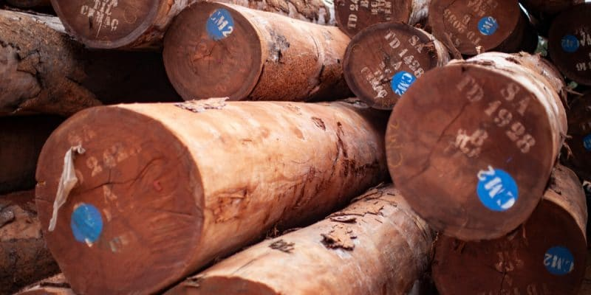
UPDATE:
No further shipments from Wagner-linked Bois Rouge or under its new name Wood International Group. Company has now been sanctioned in the UK and US but not yet in EU.
But we know that Wagner is providing security for convoys of timber leaving CAR, so ALL CAR wood exports are potentially tainted.
Wider problem with EUTR-non-compliant imports of timber from CAR also continues. Imports continue to rise – record €2.55m in June 2023

Slide 7
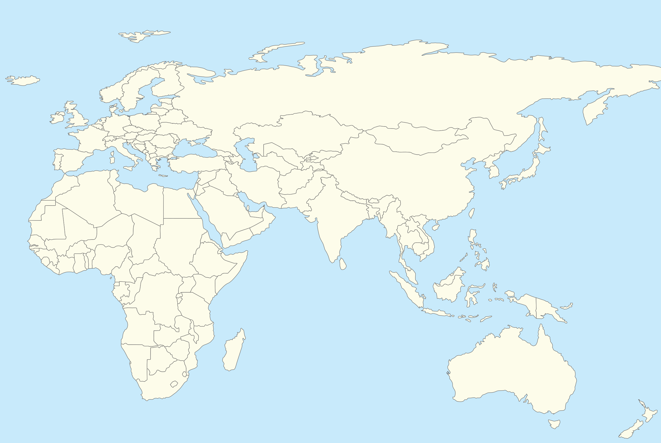

3. Laundering of sanctioned Russian ply into the EU
Russian birch ply mills
16,000 m³ / mth
KAZAKHSTAN
Estimated €518 m (retail value) of illegal imports to-date
5000 m³
4000 m³ / mth
TURKEY
CHINA
Birch plywood – most high-value wood product being exported by Russia into EU pre-sanctions
Evidence of laundering:
- big, implausible increases in imports from Kazakhstan, Turkey and China
- tip-offs from industry sources about specific cases
- leaked documents from a leading Russian supplier
- offers made to EU firms and undercover reporters
Scale of laundering:
> 500 containers/trucks a month – worth €21m. €145m Aug 2022-Aug 2023

Slide 8
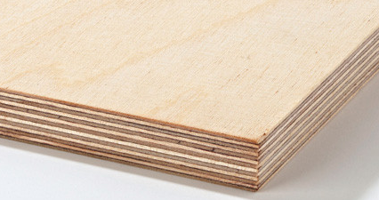
A growing problem
Latest – €21 million/mth
Invasion
Sanctions take effect
Lithuania crackdown
Earthsight alert
Difference = suspect imports - €18 mill/mth
Pre-conflict – €3 million/mth

Slide 9
Also importing in 2023:
- Italy
- Netherlands
- Denmark
- Croatia
- Cyprus
QUADRUPLED during first half of 2023
Shifted from Lithuania after crackdown there
Big decline late 2022 after strong enforcement
Sudden increase in Jun 2023

Slide 10


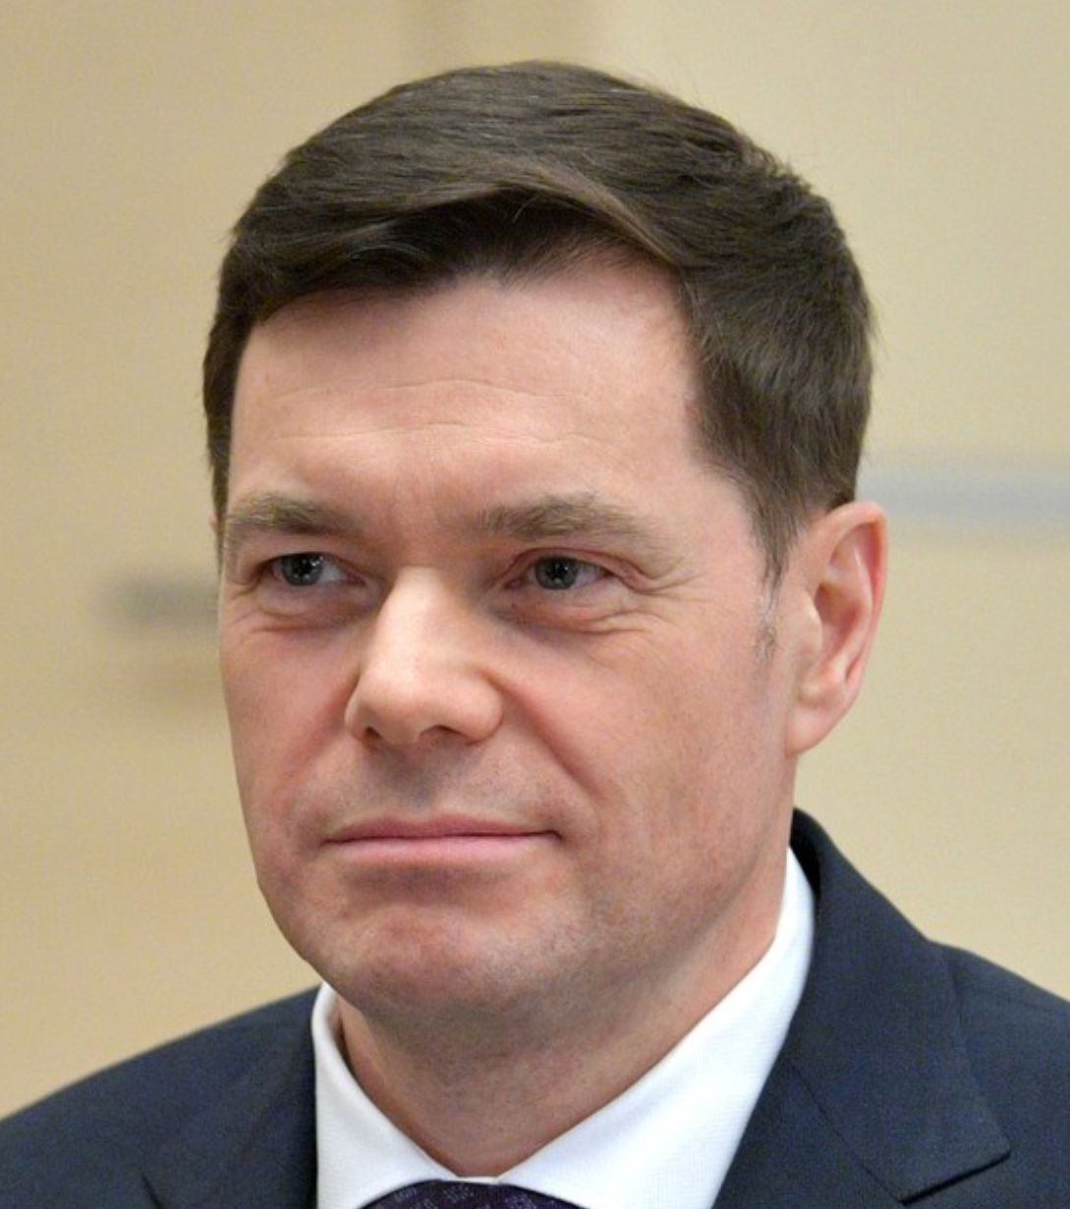

Alexei Mordashov
Vladimir Yevtushenkov
- Met with Putin on day of the invasion
- Toured occupied Crimea with Putin in 2015
SANCTIONED by EU, UK, US
SANCTIONED by UK, Cze
Shifted ownership to senior management
NB does not include >70,000m3 of new ply exps from Kaz to EU in H1 2023 suspected of originating in Russia
Shifted shares to his son

Slide 11
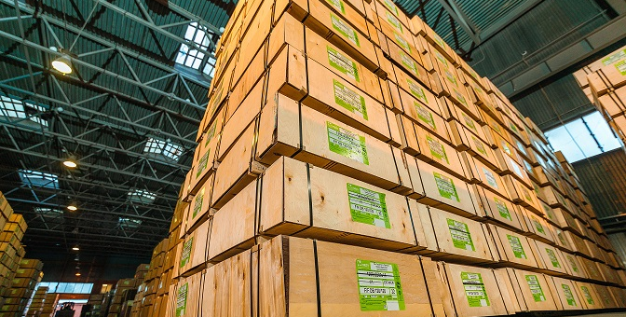
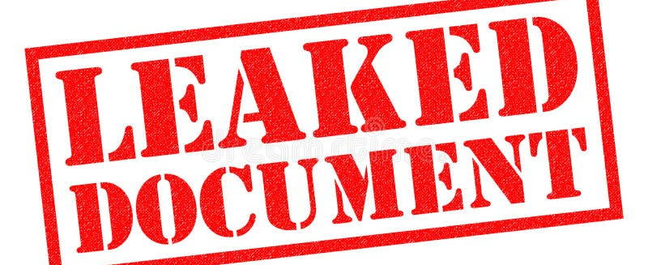
The Sveza Case – March 2023
Leaked documents from inside Russia’s largest logging company
Confirming systematic laundering of birch ply into EU via China and Turkey
Include volumes involved, names of buyers, names of intermediary parties in China and Turkey
Analysis of Russian and Turkish shipment records and trade data by Earthsight provided corroborating evidence
Earthsight provided detailed evidence to relevant authorities in EU countries affected – Germany, Estonia, Lithuania, Portugal, Slovakia, Austria.

Slide 12
The Sveza Case – What happened?
Great difficulty even reaching relevant authorities responsible for sanctions enforcement in MS, let alone getting responses.
EUTR CA’s were more responsive but not themselves empowered to act against sanctions breaches.
We have no confirmation of any seizures or prosecutions which occurred as a result.
Our sources do indicate that Sveza’s laundering operations into the EU have been substantially reduced.
Most likely our evidence led to actions by authorities sufficient to scare importers into changing their behaviour, without being sufficient to prove wrongdoing and lead to punishments.
The absence of such punishments is one reason why wider laundering of Russian plywood has continued to grow since.

Slide 13
Key things to consider
Evidence indicates shipments are being genuinely routed via these third countries.
There may be some minor further processing going on in these countries in some cases, but not enough to confer ‘origin’
In all cases, the shipments will be accompanied by ‘Certificates of Origin’ which are false or fraudulently/corruptly issued. It is unlikely any confirmation of this could be obtained through contact with the issuers in the third countries.
Isotopic analysis cannot yet provide proof as to whether birch originated in Russia or Kazakhstan
Labels / markings on the goods themselves may provide proof of the real origin. Don’t rely only on documentation provided.
Ultimate proof will be available in the telecommunications records of interactions between the various parties involved. Emails may need to be seized to provide final proof.

Slide 14
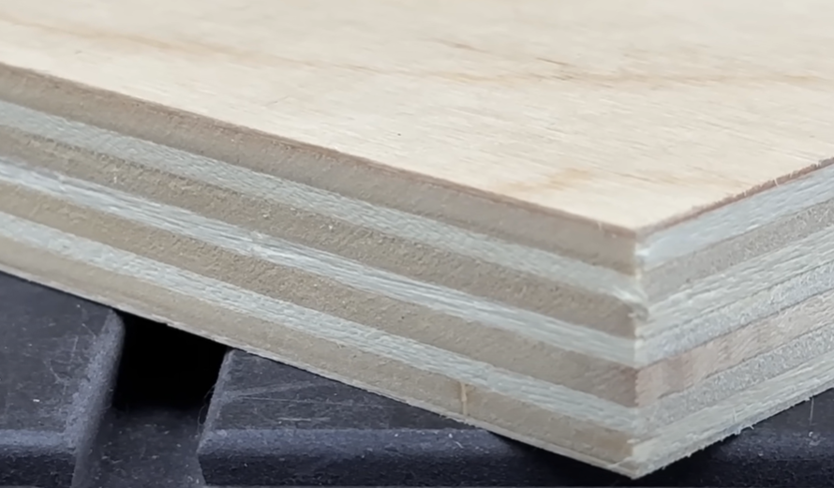
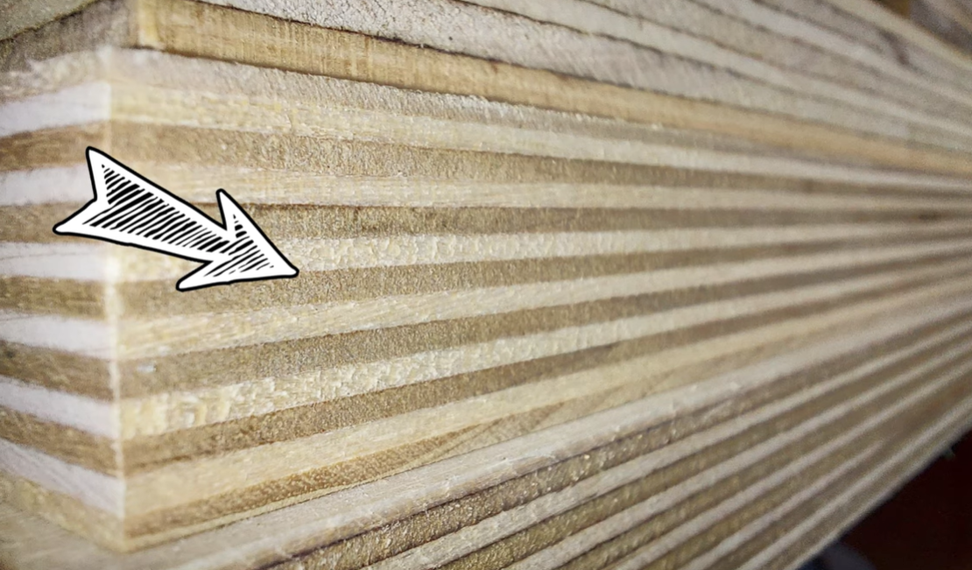
Key things to consider
Legitimate birch ply from China will be birch-faced only. It is fairly easy to see if plywood is birch throughout.
Birch-faced ply
Birch-throughout ply
Much thinner surface layer.
Thicker inner layers.
Fewer layers overall for a given board thickness
Made in China and Vietnam
All layers same thickness
More layers for given board thickness
Likely to have been made in Russia

Slide 15
Key things to consider
Even if the goods were truly manufactured in third countries, and therefore sanctions-compliant, they are still likely made with Russian raw materials, and not EUTR compliant.
A joined-up approach is needed. Crackdowns in one MS or regarding one laundering country just shift the problem elsewhere.
FSC Chain-of-Custody certificates issued to suppliers in Turkey and Kazakhstan CANNOT be relied on.
It is unlikely that EU importers are innocent dupes. Our sources tell us the laundering is common knowledge in the industry, and real Russian-made birch ply easily distinguishable to experts from cheaper local products.
While ideally action would be taken by Customs authorities for breaches of sanctions legislation, EUTR authorities have the advantage that due diligence shifts the burden of proof.

Slide 16
The final scores!
26 of 27 Member States received non-compliant wood – only Sweden kept a clean sheet

Slide 17
Recommendations
BELARUS furniture:
- firm action which trade data show was taken by EUTR CA in Belgium following the April 2022 guidance shows this is possible
- suggests the problem elsewhere is with political will
- Poland, Germany and Lithuania are where action is needed most urgently
- At a minimum, CAs in these countries must identify key importers, and write to them warning them of likely non-compliance
- European Commission must monitor and ensure appropriate action is taken in key Member States, and consider formal steps against non-compliant MS
CAR Logs and lumber:
- EC should issue formal guidance to CAs
- Consult with relevant rights groups on what (if any) proof could plausibly be provided that wood was not produced by Wagner or money paid to them for security in transport

Slide 18
Recommendations
RUSSIAN Birch ply laundering:
- successful crackdown by Lithuania in late 2022 shows this is possible
- formal guidance should be issued to EUTR CA’s, including an independent assessment of what isotope technology can and cannot do
- formal guidance should be issued to all EU importers, warning them of the risks associated with handling these goods, the absence of any reliable means of ensuring legality, and the high penalties potentially applicable under EUTR and sanctions legislation
- EUTR CAs must encourage and support action by Customs authorities charged with sanctions enforcement in their countries
- that action must take account of what we know about how the trade operates
- action most urgently needed in Poland (Kaz route), but also Latvia (Kaz, Turk), Spain (Turk, China), Bulgaria (Turk), Italy (China), Lithuania (Kaz)

Slide 19
HOW
CAN HELP
Data: shipment records for Kazakh and Turkish exports of birch ply, giving identities of EU importers and foreign suppliers; same for CAR
Either summaries or raw data or both. Regular updates.
Other advice or assistance based on intel from our sources
THANK YOU
Get in touch: taraganesh [AT] earthsight.org.uk

