Slide 1
EU Fertiliser Market analysis
European Commission, DG Agriculture and Rural Development AGRI.E.1 Governance of the Agri-food Markets

Slide 2
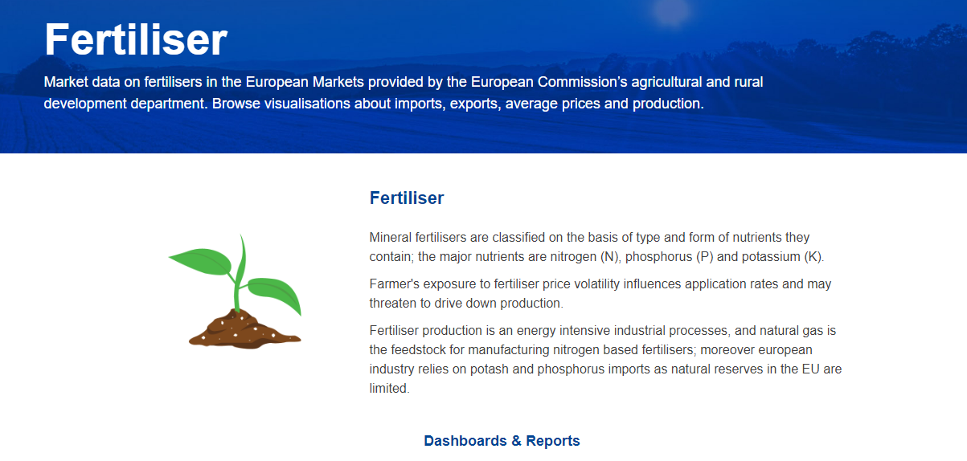
EU Fertilisers market analysis
Production of fertilisers and nitrogen compounds
Yearly fertiliser import trends
Nitrogen fertilisers and urea share in imports
Fertilisers imports from Russia
Impact of mid-east tensions on EU fertiliser market
Average prices by nutrient in EU
Fertiliser affordability vs cereal prices
European Commission | Agri-food data portal | Agricultural markets | Fertiliser (europa.eu)
Fertilisers market observatory - European Commission

Slide 3
Production of fertilisers
Monthly index of manufacture of fertilisers and nitrogen compounds (EU-20)
2021 = 100
Average Jan-Sep 2024 = 86,9
Average Jan-Sep 2023 = 80.4
Source: Eurostat, short-term business statistics

Slide 4
Yearly fertiliser import trends variation relative to the 10y average
Source: Eurostat, Comext – elaborated by DG AGRI
Agri-food data portal _Fertiliser trade

Slide 5
Nitrogen fertilisers trade
2024 (tonnes)
Comparison Jan-Oct 2024 with 10-year average for same period
7 mil. t imports: +5%
5.5 mil. t exports: -8%
Source: Eurostat, Comext – elaborated by DG AGRI
Agri-food data portal _Fertiliser trade

Slide 6
Nitrogen fertilisers imports
Growing market concentration
Source: Eurostat, Comext – elaborated by DG AGRI
Agri-food data portal _Fertiliser trade

Slide 7
Urea imports
Significant rise in market concentration
68% of tot. N - fertilisers imports
65% of tot. N - fertilisers imports
62% of tot. N - fertilisers imports
2014-2021 Urea =
55% of tot. N - fertilisers imports
The top three suppliers account for ~88% of the market share
Source : Agri-food data portal _Fertiliser trade

Slide 8
Fertilisers imports from Russia and Belarus tonnes & share
2024: RU Leading supplier to EU
Estimated and based on Comext data until October 2024

Slide 9
Fertilisers imports from Russia and Belarus tonnes & share
2024: RU Second EU trade partner
Estimated and based on Comext data until October 2024
Notes:
K:March 2022: the EU imposed a full ban on potash imports from BY.
K:April 2022: the EU introduced an import quota of 2,4 mln tonnes on imports of potash fertilisers from RU

Slide 10
Impact of Middle-East tensions on EU fertiliser markets
EU imports share 2023-2024
Phosphate and phosphatic fertilisers
Nitrogenous fertilisers
Potash and potassic fertilisers
Total from Middle East countries + Egypt: 27,7%
Total from Middle East countries + Egypt: 28.1%
Total from Middle East countries: 21,1%
Notes:
K: Imports share from Israel and Jordan significantly increased in the latest years (post Belarus ban).

Slide 11
EU average fertiliser prices by nutrient trends
Russian invasion of Ukraine
Middle East conflict
P +3.5% YoY
K -19% YoY
N -13% YoY
Source: Agri-food data portal- fertiliser prices

Slide 12
Fertiliser affordability to cereal prices
Fertiliser affordability slightly improved Y-o-Y in Oct.24
Less affordable
More affordable

Slide 13
Thank you

