Slide 1
Avoiding errors in declaring personnel costs in Horizon 2020 grants
Brussels, 20 January 2021
#HorizonEU
Common Audit Service
Dinos Alevizopoulos, Head of Sector - Audits

Slide 2
Errors. Why do they occur?
Misunderstandings of the rules;
Lack of attention to the detail of the provisions of the grant agreements.
Notes:
The Common Implementation Service is striving to ensure that the errors and their consequences are properly mitigated and diminished

Slide 3

The consequences of errors:
Beneficiaries
Non-optimal use of funding available
Recoveries
European Commission
Scrutiny of the Budgetary Authority and ECA
Increased error rate
Increased ex post audit efforts
Corrective measures

Slide 4
The error rate
Population
€
Sample
∑ neg_adj
€
€
Error Rate % =
€
∑ aud_amount

Slide 5
H2020 Audit
Assurance elements
Assessing Legality Regularity of H2020 project payments
Residual error rate – acceptable level
General control objective: To get a residual error rate as close as possible to 2%, without necessarily expecting it to get under 2%.

Slide 6
Audit in H2020 – Main detected errors
Personnel costs – due to:
Incorrect productive hours calculation
Incorrect remuneration costs - e.g. estimated
Incorrect time working on action claimed
Other - e.g. unreliable/missing timesheets

Slide 7
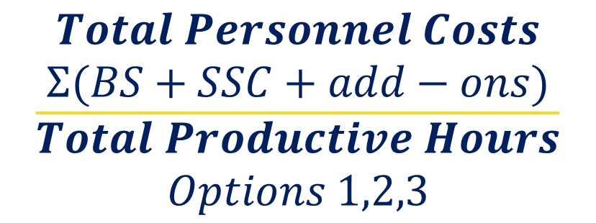
Make sure that you Personnel cost is correct
$$\frac{\begin{aligned}Total Personnel Costs \\ Σ(BS+SSC+add−ons)\end{aligned}}{\begin{aligned}Total Productive Hours \\ Options 1,2,3\end{aligned}}$$
x
Hours Worked

Slide 8
Make sure that your Time Recording is:
Consistent with HR records;
Properly dated and signed;
Not in excess of your full time employment;
Sufficient in terms of information.

Slide 9
Make sure that the numerator is correct
Personnel costs
Hourly rate =
Productive hours
Eligible personnel costs
Include:
Salaries
Social security contributions (employers' and employees')
Taxes and other costs included in the remuneration if they arise from national law or the employment contract
Do not include:
Any ineligible item (article 6.5)
Any costs included in other budget categories (e.g. indirect costs)

Slide 10
Make sure that the denominator is correct
Personnel costs
Hourly rate =
Productive hours
Annual productive hours
1720 hours
you must use this option if the employment contract does not specify the working time conditions or if the "annual workable hours" cannot be determined
Individual annual productive hours
Standard annual productive hours
Formula: annual workable hours + overtime - absences
According to the beneficiary's usual accounting practices. Minimum threshold: annual productive hours ≥ 90 % of the standard annual workable hours
Advice
!

Slide 11
Avoid errors by making sure that:
      Your time charged to the project is correct;
      Time records meet the GA’s conditions;
      Remuneration in the numerator is correct;
      Productive hours in the denominator are correct.

Slide 12
Avoid errors by making sure that:
      Personnel cost formula reconciles;
      Transaction listing reconciles;
      Employment Contracts are in place;
      Final test is performed before you press the button ☺

Slide 13
Thank you
for your
attention & participation !

