Slide 1
PERSONNEL COSTS

Slide 2
The Framework Programmes timeline
2007 2014 2021
Cost reimbursement
Each Programme has its own rules !
Horizon Europe
Lump sum grants
Unit costs grants (MSCA)

Slide 3

What is it?
Personnel costs
Cost of the time worked for the Horizon 2020 project by:
  your employees,
  seconded staff,
  owners of participants that are Small and Medium-sized Enterprises (if you are an SME),
  and, subject to conditions, other persons working for you under other types of direct contracts (for example some types of consultants).

Slide 4
Finding your way
Personnel costs
SME owners
Actual costs
Average costs
1B Project-based remuneration
1A Non project-based remuneration
Additional remuneration?
Basic remuneration
Monthly
Annual
Not eligible
Eligible?
Hourly rates
Above the cap
Within the cap
1720
Individual
Standard

Slide 5
Calculation
Hours worked
•
Hourly rate
EUR/hour
Time records
Formula in the Grant Agreement

Slide 6

Hours worked
You can only declare hours really worked on the project
You cannot declare:
  → Budgeted time (e.g. what you indicated for the budget)
  → Estimated time (e.g. a person’s 'guessing')
  → Time allocation (e.g. x % of the time of the person)
REMEMBER!
You must record in time-sheets the time the person worked in the project!
!

Slide 7
Hourly rate: HOW?
Personnel costs
Personnel costs
Hourly rate =
Productive hours
Productive hours
Personnel costs
Real salary, social security contributions, taxes and other costs included in the remuneration that arise from national law or the employment contract
Productive hours
Subject to conditions
1720
Individual
Standard
Recommended

Slide 8

Hourly rate: WHEN?
ONCE IN EACH FULL FINANCIAL YEAR
Annual personnel costs
Annual hourly rate =
Annual productive hours
For the months running from the end of the last financial year until the end of the reporting period you must use the hourly rate of the last financial year.
!
Or, if you prefer it, once PER MONTH
Monthly personnel costs
Monthly hourly rate =
Monthly productive hours
!
Be careful! There are special rules for this option.

Slide 9

Double ceiling
Your must ensure that:
the total number of hours declared in EU and Euratom grants for a person for a year is NOT higher than the number of annual productive hours used for the calculation of the hourly rate
the total amount of personnel costs declared (for reimbursement as actual costs) in EU and Euratom grants for a person for a year is NOT higher than the total personnel costs recorded in the beneficiary’s accounts (for that person for that year).
∑ hours declared ≤ total annual productive hours
∑ cost declared ≤ total personnel costs for the person

Slide 10
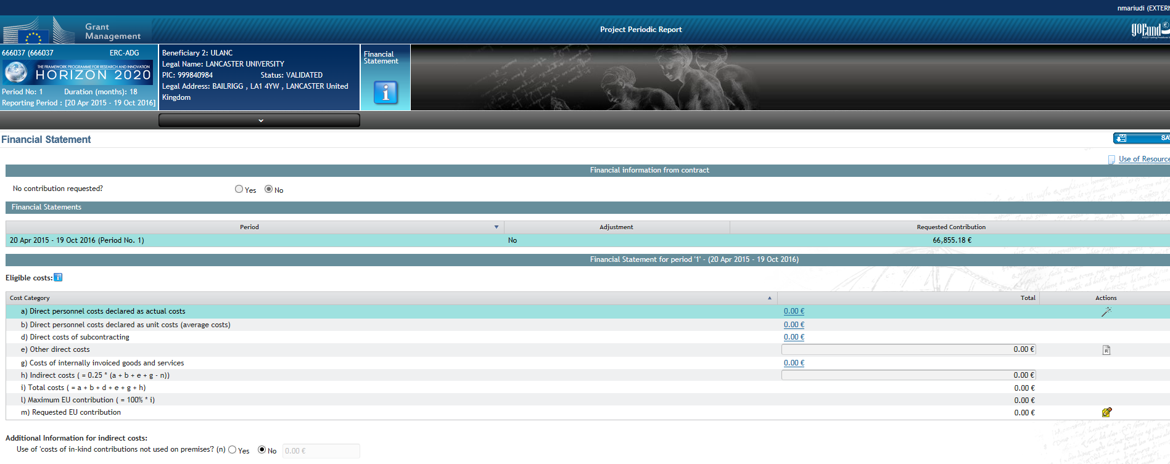
Worried about it?
Why don’t you try the Personnel Cost Wizard?
Wizard entry point

Slide 11



Special case you should know about
I want to pay to my employees more than their normal salary for their work in this prestigious grant
Well, if you do it only for European Union grants, we cannot accept it
That’s different, then you are under Project-based remuneration
But I always do so with all prestigious grants!
There are specific rules you need to apply !

Slide 12

Special cases you should also know about
I am the owner of a Small of Medium-size enterprise (SME) and I do not get a salary because I am not an employee
You must use the ‘SME owner’s unit cost’; which is a fixed hourly rate defined by the Commission.
Dividends, consultancy contracts, service contracts, etc. are not accepted for calculating the costs of SME owners!
I also have consultants, who are not my employees, working in the project, how I declare them?
➲ You must check article 6.2.A.2 in your grant; you might have to declare them as subcontractors…

Slide 13
ADDITIONAL INFO:
I want to read…
Horizon 2020 Annotated Grant Agreement http://ec.europa.eu/research/participants/data/ref/h2020/grants_manual/amga/h2020-amga_en.pdf
Horizon 2020 On-line Manual https://ec.europa.eu/research/participants/docs/h2020-funding-guide/index_en.htm
I read, but it is still not clear…
National Contact Points
https://ec.europa.eu/info/funding-tenders/opportunities/portal/screen/support/ncp
Research Enquiry Service
http://ec.europa.eu/research/enquiries

