Slide 1


Instructions for use
This template has been built with custom styles and formats aligned to the new brand identity.
All charts, org charts, tables and smart graphics have the custom colour palette and font styles embedded. Choose the style that best suits the presentation of your information.
Inserting charts as images and including photography will increase the file size – include lower resolution files.
The Coffey orange should only be used in headers, sub headers and bullets – avoid using it in charts, tables and graphs.
Secondary colours are only used in charts, tables and graphs – avoid using as headers, sub headers and bullets.
Bolder tones are best used for charts – as they appear clearer on screen.
Please do not change the primary colour set ups.
Headlines on pages: if they are one line in length please ensure they are presented in black. If the headline/title splits across two lines – please retain the first line in black and put the second line in the Coffey Orange (select from custom colour palette).
Good practices in EU Regional policy communication
Ben Ward
January 13th 2014

Slide 2
Inspiring communication across the EU
Contents
Introduction and Background to a study for DG REGIO
Good practices in the MSs
DG REGIO communication
Questions and discussion

Slide 3

Inspiring communication across the EU
Coffey Evaluation and Research
Example I&C assignments
Acquired by Coffey in 2009
Work in EU, UK domestic, and international development evaluation markets
Evaluation on EU Regional Policy communication (DG REGIO)
Ex ante evaluation of campaign on violence against women (DG JUSTICE)
Evaluation of ESF communication activities (DG EMPL)
Evaluation of DG TRADE’s communication strategy

Slide 4
Inspiring communication across the EU
Evaluation of EU Regional Policy communication (DG REGIO)
1. Insights into Regional Development communication across the EU
2. Assessment of DG REGIO communications

Slide 5
Evidence base
Task 1
8 MS in-depth case studies
1. Desk research
2. 135 interviews (~17 per MS)
- EC: Geo desk officers, Reps
- Primary Communicators: Managing Authorities
- Secondary Communicators: Officials from implementing orgs
- Informed observers: Journalists, NGOs, evaluators
Task 2
DG REGIO comms survey
- 213 respondents
Info Regio website survey
- 358 respondents
Stakeholder Interviews
- 22 (EU inst., ED info centres, journalists, academia)
Benchmarking
- World Bank, Regional Development Australia, DG AGRI

Slide 6
Inspiring communication across the EU
Evaluation of EU Regional Policy communication (DG REGIO)
1. Insights into Regional Development communication across the EU
2. Assessment of DG REGIO communications

Slide 7


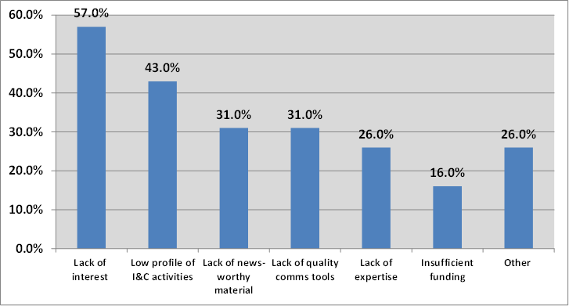

Regional Development Communication - Challenges

Slide 8
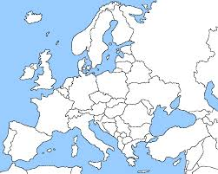








Inspiring communication across the EU
Background: Where did we go?
Field work limited to eight Member States
Not in a position to visit / assess all Operational Programmes
This is not exhaustive! There are many other examples of good practice
Not saying that these would work in your context!

Slide 9
Inspiring communication across the EU
Background: Good practice criteria
Good Practice Criteria
 | Extent to which the tool is…….
1. Language | Accessible to the TA (i.e. simple & clear wording)?
2. Content | Has content relevant to the TA (i.e. not too technical, not too generic)?
3. Design | Attractive? Eye-catching? User-friendly?
4. Outreach | Reaches the TA / generates media interest?
5. Novelty effect | Different? Innovative? Unlike others of the same kind?
6. EU visibility | Extent to which the EU forms part of the communication?
7. EU message | Extent to which the key messages defined by DG REGIO are clearly conveyed?

Slide 10

Do MAs target the general public?
Saxony

Slide 11
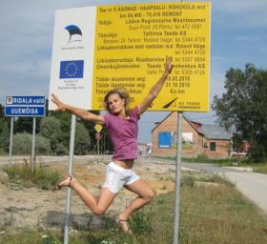
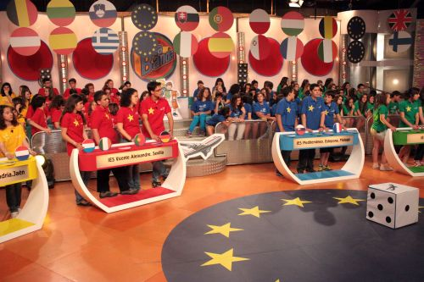
Competitions
Estonia: Photo competition
Spain: “Andalucía se mueve con Europa”

Slide 12






Visual identity and branding
France
Saxony

Slide 13

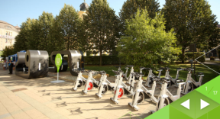

Physical installations
Hungary: The “huge numbers” campaign
Installation in Budapest showing the average number of tons of greenhouse gases saved annually
Installation in Debrecen showing the exact sum of the length of new and renovated roads in kilometres

Slide 14

Media relations
Swedish Agency of Economic and Regional Growth
Media analysis
Media strategy
Internal communication workshops
Story-telling workshops for beneficiaries

Slide 15
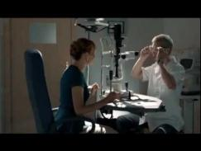

Audio-visual materials
Poland: “Everyone benefits,
not everyone sees it”
Germany: “Also quite nice” (Brandenburg)

Slide 16
Inspiring communication across the EU
Evaluation of EU Regional Policy communication (DG REGIO)
1. Insights into Regional Development communication across the EU
2. Assessment of DG REGIO communications

Slide 17
Communication expectations
The Commission is expected to play an active role in communicating Regional Policy among citizens across the EU.
85% of survey respondents supportive

Slide 18
DG REGIO communication – SWOT
Strengths | Weaknesses
- Media relations have been enhanced with the arrival of the new spokesperson - DG REGIO Open Days and other events are assessed positively by stakeholders consulted | - Conservative and risk averse communication approach (too much focused on process and outputs) - Communication not sufficiently embedded in DG REGIO’s staff roles
Opportunities | Threats
- Upcoming period is an opportunity for more strategic communication - Story-telling can bring the Commission closer to the media and the general public | - Regional media don’t look at EU regional policy as a phenomenon with a European dimension - Growing euro-scepticism and more immediate concerns in many EU countries

Slide 19
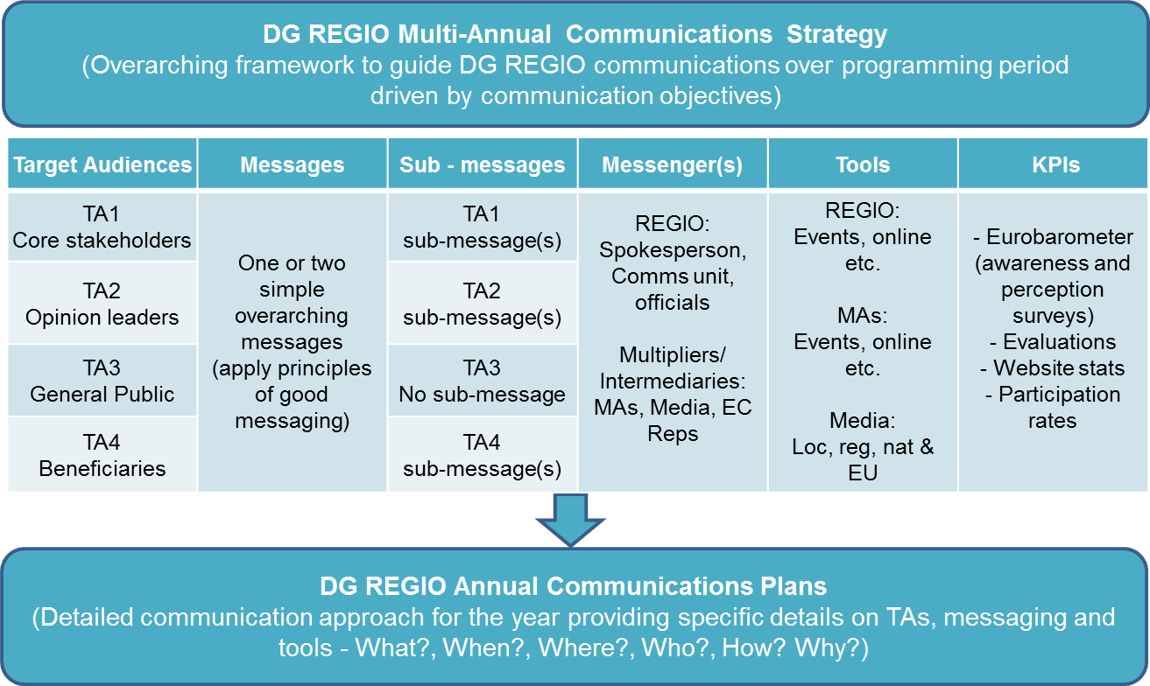
Recommendations

Slide 20


Wider Audiences Vs Specialist audiences
Inform network
EC Reps & ED Network
MSs & Regions
Regional, local authorities
Economic & social partners, CSOs
Students, teachers & researchers
Tax payers
But what about……..children, youth, young adults, adults, families, retired, employed / unemployed, professionals, men, women, migrants……..
Nat, Reg, Local media
Beneficiaries

Slide 21
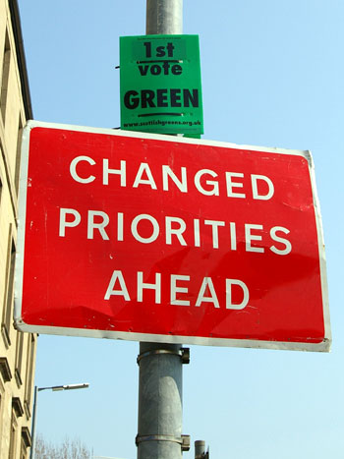
Focussed communication Vs broad coverage
Potentially higher chance of a “real and lasting impact” in terms of raising awareness
Focus could be on specific:
- MSs (by geography, GDP)
- Sectors / Themes
“One size fits all” communications very difficult in European context

Slide 22
ESIF – implications for regional policy communication?
ESIF umbrella brand
DG REGIO communicates jointly with AGRI, MARE and EMPL
ESIF for general audiences
ERDF / ESF etc. for specific audiences
ESIF
ERDF
ESF
CF
EAFRD
EMFF

Slide 23
Inspiring communications across the EU
Thank you
Ben.Ward@Coffey.com

