Slide 1
GROUP OF HIGH-LEVEL SPECIALISTS ON THE FUTURE OF COHESION POLICY Capabilities for regions to support net-zero-carbon transitions and implications for cohesion policy
Dr Paula Kivimaa
Research Professor, Finnish Environment Institute
Brussels, March 9, 2023
Second meeting – Enhancing resilience of regions against emerging challenges
Notes:
Huom! Kuvallisesta kannesta ei ole erillistä asettelupohjaa. Mikäli haluat käyttää esityksessäsi kuvallista kantta, älä poista tätä sivua.
Kansikuvan vaihtaminen:
1. Klikkaa kuva aktiiviseksi ja paina hiiren oikealla ja valitse > Vaihda kuva
2. Klikkaa kuva aktiiviseksi ja rajaa kuva sopivaksi > Kuvan muoto > Rajaa
Muista päivittää kuvaajatieto vasempaan yläkulmaan sekä lisätä kuvalle alt-teksti:
1. Klikkaa kuva aktiiviseksi
2. Klikkaa hiiren oikealla ja valitse > Muokkaa vaihtoehtokuvausta

Slide 2
Introduction
Climate urgency! Climate change continues to advance, and we see increasingly its impacts unfolding via a growing number and scale of forest fires, floods, heat waves, and other extreme weather events.
Intertwined with other global developments, e.g., current health and geopolitical crises, increasing energy demand, growth in hybrid influence, Arctic issues, critical material supply issues
Global trends combined with local developments that differ substantially from region to region
E.g., reliability of the energy system, phase out of fossil fuels, opportunities for renewable energy
Increasingly horizontal governance of pursuits towards carbon neutrality is required
considers other policy objectives and sectors, without compromising the carbon neutrality goals
Insights from sustainability transitions research
Considers socio-technical systems change (e.g., food, energy, transport, water)
Oriented to how new innovations (niches, technological innovation systems) emerge in interplay with destabilising socio-technical regimes, and ‘landscape’ conditions (above external factors)
Has provided concrete tools (e.g., transition arenas, niche processes) and relevance to policymakers (e.g., EEA report “Sustainability Transitions: Policy and Practice)

Slide 3
Five key capabilities drawing from sustainability transitions research (combined with current world turbulenses)
Shared visioning and institutional change
Intermediating and orchestrating
Unlocking and destabilising high-carbon regimes
Managing change and resilience to respond to disruptions
Transformative innovation policy

Slide 4
Capability 1: Shared visioning & institutional change
Actions | Implications for future cohesion policy
Explicit and inclusive vision building processes (desired end-states for sustainable systems) E.g. Stockholm-Mälaren Region ’Positive Food Future’ | Shared terminology and links to other EU processes, e.g., Partnerships for Regional Innovation (PRI) Using Partnership Principle to increase inclusivity
Supportive legislative and organisational changes (destabilise high-carbon systems, remove barriers) E.g., Finnish Transport Service Act | Funding tied to ‘reforms’ similarly as in the RRF; set as enabling condition
Political ambition and long-term political commitment (exceeding election cycles) E.g. UK carbon budgets | Carbon neutrality vision as an enabling condition?
Matching public & private sector resources for multiple socio-technical pathways (drawing on regional opportunities & capabilities) | Link to required co-financing rate? Regular progress reviews
Notes:
The importance of visions is that they function as shared narratives for a range of actors (e.g., policy makers, businesses, citizens, the civil society); create credibility for the sustainability direction pursued, and; describe ‘what technologies and resources will be used, what kind of services will be offered to people, what institutions and policies will be needed, and how people could live their day-to-day lives’ (Geels et al. 2019 p. 106).

Slide 5
Capability 2: Intermediating and orchestrating
Actions | Implications for future cohesion policy
Assessing the level of transition intermediarion (what actors and processes exist, what kind of gaps are found that need intermediation and orchestration?) | Conducting cross-region assessments about transition intermediation in regions and delivering best practices
Estabilising new intermediaries (organisations, roles, platforms) E.g. Carbon Neutral Municipalities Network | Setting up an intermediary body / function to give support across regions. This may need to be tied with, e.g., EU RTD policy or Interreg, if possible, or creating enabling conditions for member states to set up cross-region climate neutrality intermediaries
Create new intermediary functions for response and resilience E.g. collecting & disseminating foresight, or coordinating body for emergy supplies | Guidelines for how to advance transition intermediation in a regional context
Notes:
The importance of visions is that they function as shared narratives for a range of actors (e.g., policy makers, businesses, citizens, the civil society); create credibility for the sustainability direction pursued, and; describe ‘what technologies and resources will be used, what kind of services will be offered to people, what institutions and policies will be needed, and how people could live their day-to-day lives’ (Geels et al. 2019 p. 106).

Slide 6
Capability 3: Unlocking high-carbon regimes
Actions | Implications for future cohesion policy
Phase out and exnovation: Identification and phased out removal of structures that support high-carbon technologies and infrastructures E.g. removal of fossil fuel subsidies for the energy sector and agriculture | Increasing the climate targets of cohesion policy programmes from the present (ERDF (30%) and the Cohesion Fund (37%)) Guidelines and enabling conditions on unlocking high-carbon structures Funding tied to ‘reforms’ similarly as in the RRF; se as enabling conditions
Changing governance culture towards deep learning and unlearning E.g. allowing experimentation and ‘failure’ for civil servants | Increasing the climate targets of cohesion policy programmes from the present (ERDF (30%) and the Cohesion Fund (37%)) Funding tied to ‘reforms’ similarly as in the RRF; se as enabling conditions
New regional industrial and innovation policies, placing focus on the emergence of new socio-technical systems, providing new employment and opportunities | Linking regional industrial and innovations development to the EU Green Deal and the Partnership for Regional Innovation (PRI)
Just transition mechanisms that address intergenerational issues, justice from a global perspective, and provide compensation | Further developing the EU Just Transitions Mechanism and ESF+
Notes:
The importance of visions is that they function as shared narratives for a range of actors (e.g., policy makers, businesses, citizens, the civil society); create credibility for the sustainability direction pursued, and; describe ‘what technologies and resources will be used, what kind of services will be offered to people, what institutions and policies will be needed, and how people could live their day-to-day lives’ (Geels et al. 2019 p. 106).

Slide 7
Capability 4: Managing change and resilience to respond to disruptions
Actions | Implications for future cohesion policy
Need for stewarding capacity to respond to disturbances, knowledge about system dynamics, strengthening self-organisation, and monitoring and continuous learning | Developing specific tools for regions to increase their stewarding capacity for future crises and disturbances. PRI playbook may be useful
Need for anticipatory capacity by creating foresight about potential future developments and risks, and response plans | European-wide information sources and platforms to provide up-to-date knowledge E.g. Good examples are the EU assessment on critical materials resilience (European Commission, 2020) and the State of the Environment Report (European Environment Agency, 2020).
Empowerment for regional resilience building: Connecting regional opportunities with global developments, and empowering citizens and communities | Guidelines for how to empower citizens and communities.
Notes:
The importance of visions is that they function as shared narratives for a range of actors (e.g., policy makers, businesses, citizens, the civil society); create credibility for the sustainability direction pursued, and; describe ‘what technologies and resources will be used, what kind of services will be offered to people, what institutions and policies will be needed, and how people could live their day-to-day lives’ (Geels et al. 2019 p. 106).

Slide 8
Capability 5: Transformative innovation policy
Actions | Implications for future cohesion policy
TIP as a complementary approach to vision building and unlocking high-carbon regimes. | Improved coordination and coherence between cohesion policy, smart specialisation for sustainability (PRI) and EU missions
Creating inclusive innovation policy processes for achieving SDGs | Linking just transition processes to more inclusive innovation policy processes.
Experimental policy instruments and spaces for public-private collaborations E.g. drawing suggestions from PRI Playbook or the Transformative Innovation Policy Consortium
Picture source: Schot et al., 2018
Notes:
The importance of visions is that they function as shared narratives for a range of actors (e.g., policy makers, businesses, citizens, the civil society); create credibility for the sustainability direction pursued, and; describe ‘what technologies and resources will be used, what kind of services will be offered to people, what institutions and policies will be needed, and how people could live their day-to-day lives’ (Geels et al. 2019 p. 106).

Slide 9
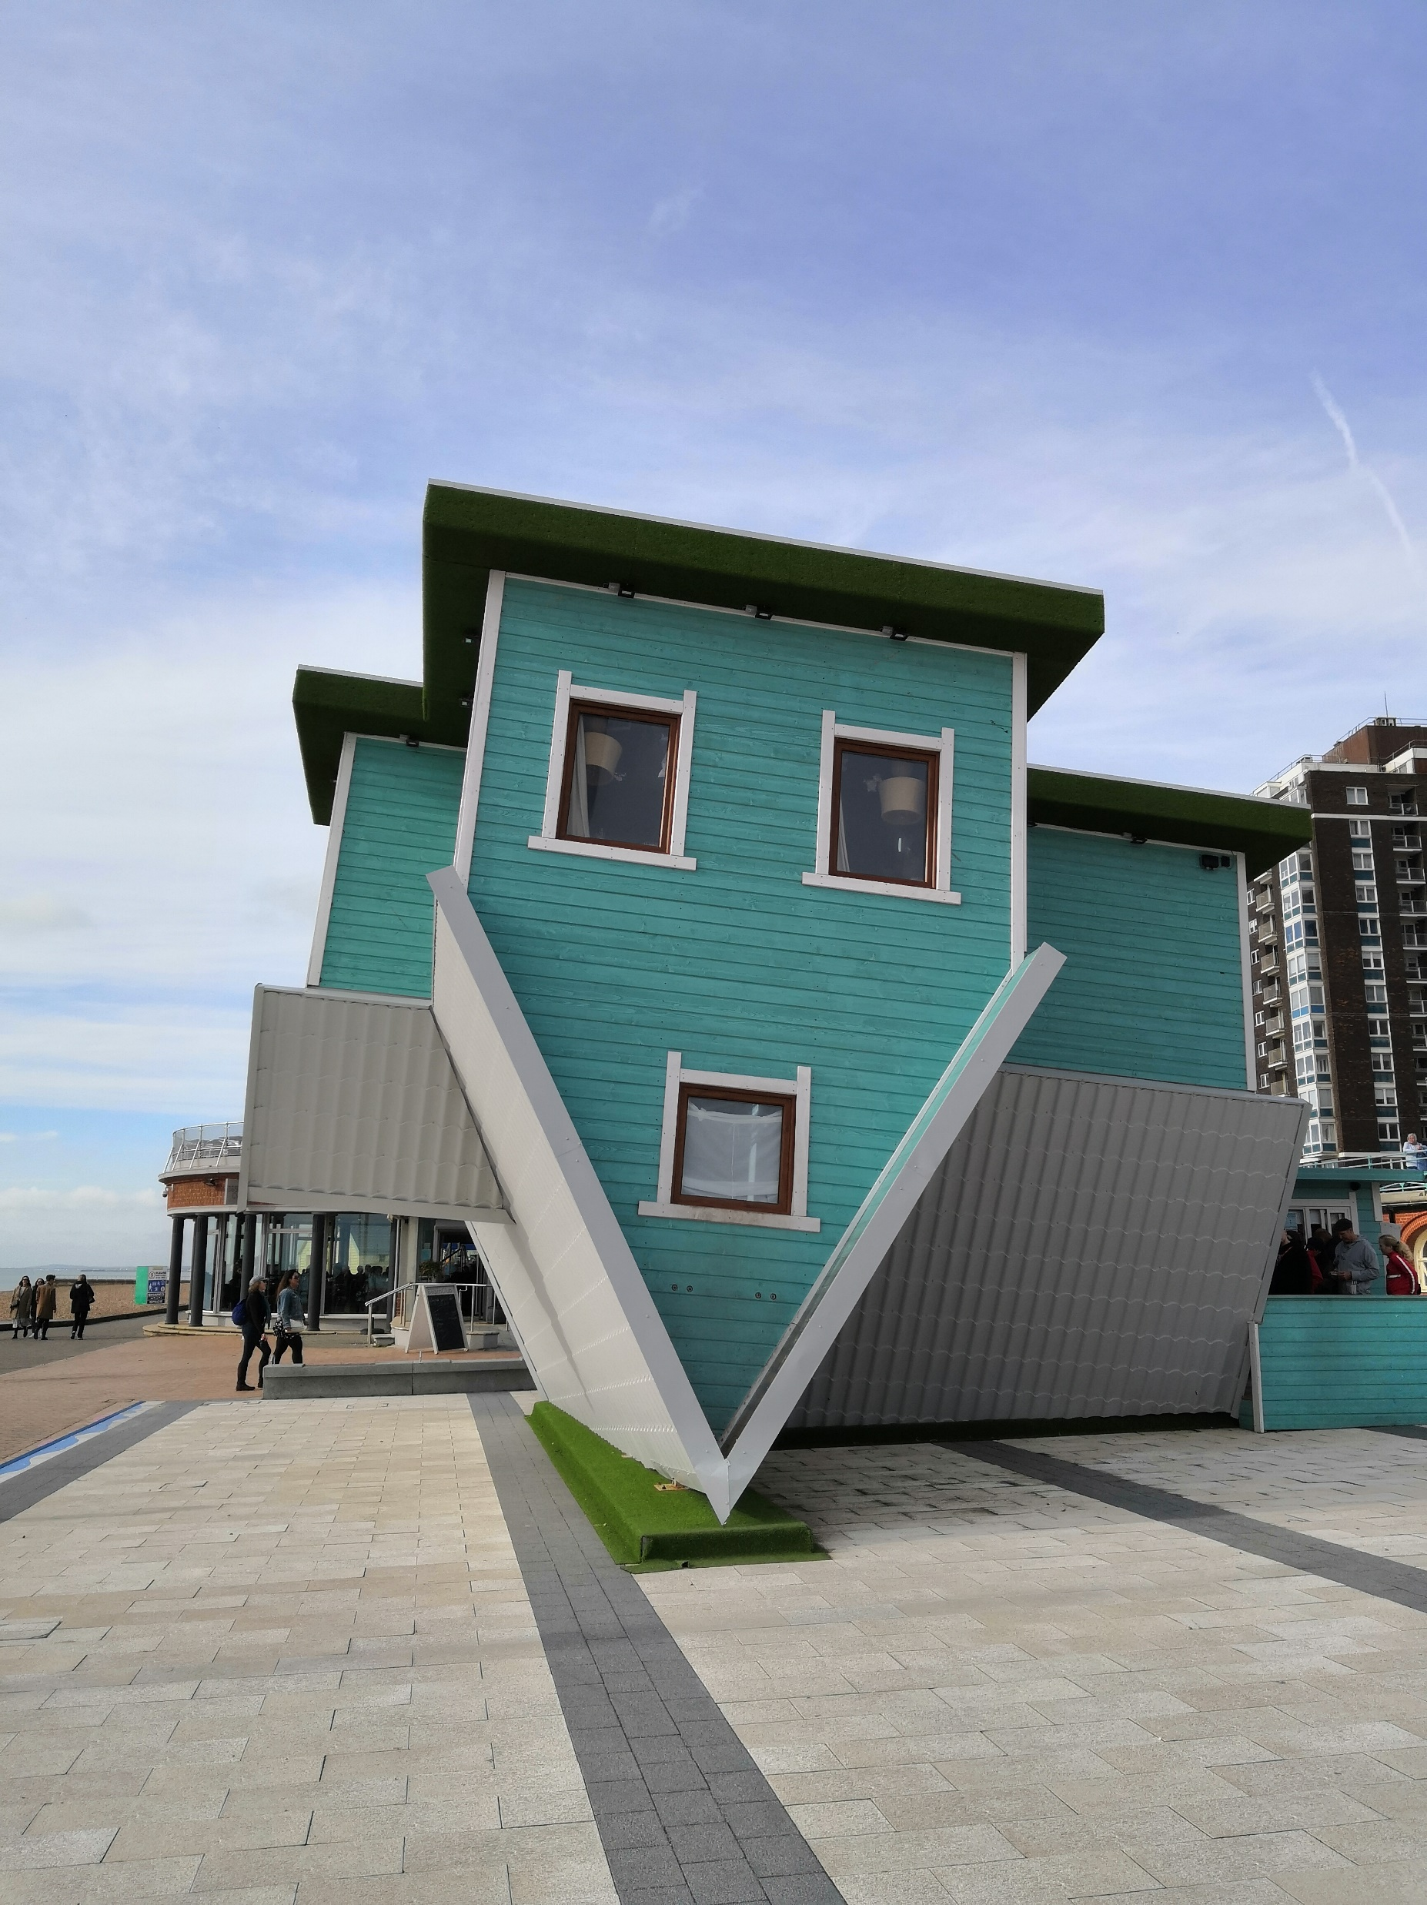
Opportunities for post-2027 cohesion policy
To increase the climate target of cohesion policy programmes, which creates a basis of member state and regional vision building and institutional changes.
To utilise the model of the EU Recovery and Resilience Facility (RRF), where funding is tied to specific reforms and their implementation.
To create other enabling conditions, such as the process and delivery of new carbon neutrality visions (with concrete pathways and actions) and the identification or creation of a cross-regional carbon neutrality transition intermediary which aids regional progress.
To connect with and further improve horizontal coherence between other EU initiatives, such as EU RTD policy and smart specialization (PRI), the Green Deal and EU missions.
To improve vertical coherence between EU, national and regional policies via the above measures as well as providing guidelines on transition vision building, intermediation, phase out and just transitions.

Slide 10
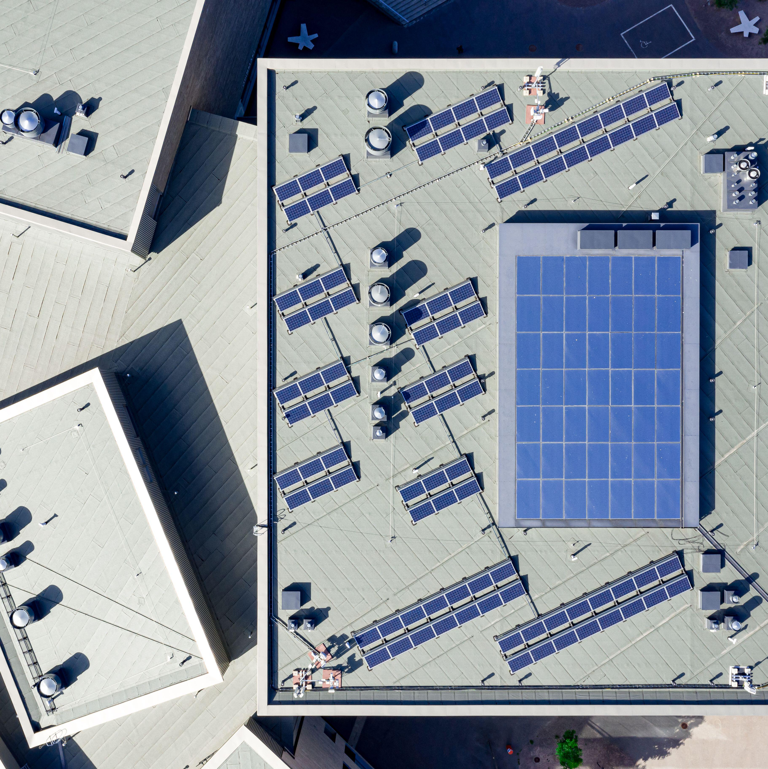
For EU member states and regions
Help identify place-based processes and future opportunities that advance net-zero-carbon transitions but also build resilience against future external developments and crises.
Encourage institutional change and the creation of new innovations and industries, drawing also from advancements in transformative innovation policy.
Bring potential for attracting new resources into regions via the changes taking place.

Slide 11
Thank you!
Email: paula.kivimaa@syke.fi
Twitter: @paulakivim

