Slide 1
GROUP OF HIGH-LEVEL SPECIALISTS ON THE FUTURE OF COHESION POLICY How to reinforce the place-based approach of cohesion policy?
Professor Raquel Ortega-Argilés
University of Manchester
The Productivity Institute & Manchester Institute of Innovation Research
Brussels, May 23, 2023
Fourth meeting – Role of place-based policies and development strategies

Slide 2
Introduction and outline
Interregional and interregional country inequality in Europe has diminished in the last decades thanks to Cohesion Policy, among other national place-based initiatives. However, the effect of policy implementation and grand challenges such as automation or globalisation have contributed to increasing disparities across European regions and communities.
Innovation is among the most important drivers of economic development, productivity, and socio-economic cohesion. R&T&I public support could potentially contribute to reaching wider spatially balanced economic benefits and, ultimately, economic cohesion.
Smart Specialisation has been one of the major pillars of the last years of European Cohesion Policy and the local and regional innovation and entrepreneurship agendas in Europe. Still, the consequences of their implementation have not been seen spread evenly across the European territory.
Outline of the presentation:
Illustration of current research:
The uneven effects of research and innovation policies on regional development and economic cohesion.
The uneven effects of technological diversification on regional productivity.
The uneven effects of grand challenges (globalisation and automation) in European regions and workers.
Insights for EU Cohesion Policy

Slide 3
I. The uneven effects of research and innovation policies on regional development and economic cohesion.

Slide 4
Interregional Inequalities in the EU
Figure 1. The Long-Run Evolution of Interregional Inequality, 1900-2010
Interregional inequality in Western Europe was generally much higher in the early decades of the twentieth century when cross-country productivity variations were also much more significant.
During the second half of the century, interregional variations fell markedly across Europe as international convergence processes developed (Maddison 2006).
At the end of the century, two interesting cases show opposite evolutions - Germany after the reunification showing drops in their inequality and the UK increasing in recent decades.
Source of data: Roses and Wolf (2019)
Selection of countries: Austria, Belgium, Denmark, Finland, France, Germany, Italy, The Netherlands, Norway, Portugal, Spain, Sweden, Switzerland and the United Kingdom
Source: Carrascal-Incera, A.; McCann, P.; Ortega-Argiles, R. and Rodriguez-Pose, A. (2020) UK Interregional Inequality in a Historical and International C⁴omparative Context, National Institute Economic Review, 253.

Slide 5
Interregional Inequalities in the EU
Interregional inequalities in the UK are amongst the greatest in Europe after Belgium and Italy. Over more than three decades, UK government policy has proved to be very ineffective at addressing these inequalities.
The UK Government, through its latest iteration of industrial strategy, seeks to improve productivity across regions to achieve goals of more balanced growth.
The new Levelling Up agenda is a good test bed to understand how economic cohesion measures may or may not work in a highly uneven setting like the UK one.
Figure 1. The Long-Run Evolution of Interregional Inequality, 1900-2010.
Source of data: Roses and Wolf (2019)
Selection of countries: Austria, Belgium, Denmark, Finland, France, Germany, Italy, The Netherlands, Norway, Portugal, Spain, Sweden, Switzerland and the United Kingdom
Source: Carrascal-Incera, A.; McCann, P.; Ortega-Argiles, R. and Rodriguez-Pose, A. (2020) UK Interregional Inequality in a Historical and International Comparative Context, National Institute Economic Review, 253.

Slide 6
Regional productivity and business R&D are geographically uneven in the UK …
Figure 3. Total R&D expenditure by region 2019 (£ millions)
Figure 2. Output per hour UK regions

Slide 7
Clear uneven distribution of public R&D…
There is a clearly unbalanced distribution of Public R&D funds across English regions.
The combined figure of research councils and Innovate UK shows that 59.3% of the funds in 2020/21 were spent in Greater South East (GSE) regions.
Table 1. Proportion of research council and Innovate UK regional spend in England regions FY2020/21
Region | Research councils | Innovate UK | UKRI Total
North East | 2.7% | 3.7% | 3.4%
North West | 7.8% | 3.2% | 7.4%
London | 21.6% | 15.4% | 22.1%
East Midlands | 4.7% | 8.4% | 6.5%
South East | 22.9% | 20.6% | 24.9%
South West | 5.2% | 9.1% | 7.1%
East of England | 12.5% | 7.7% | 12.3%
West Midlands | 4.3% | 20.6% | 10.1%
Yorkshire and the Humber | 6.5% | 3.4% | 6.2%
Total (£ million) | 3,763 | 1,526 | 5,289
Source: UKRI and ONS (HM Government, 2022c, pp. 34)

Slide 8
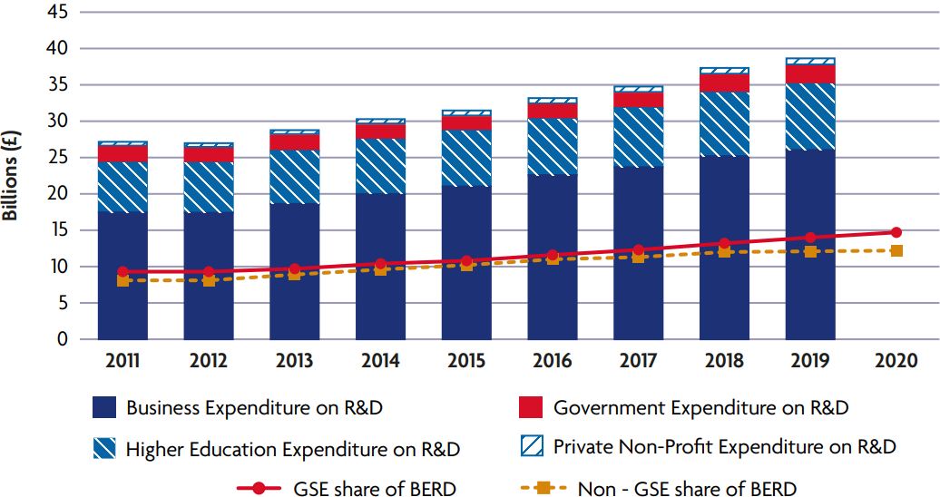
Clear uneven distribution of R&D…
Since, 2018, BERD in the GSE has risen, while plateauing across the rest of the UK in aggregate
Figure 4 Gross expenditure on research and development, UK, 2011 to 2019; business expenditure on research and development within and outside the Greater South East, UK, 2011 to 2020
Levelling Up Mission 2: By 2020, domestic public investment in R&D outside the Greater South East will increase by at least 40%, and over the Spending Review period by at least one-third. This additional government funding will seek to leverage at least twice as much private sector investment over the long term to stimulate innovation and productivity growth.
Principal objective(s): boosting productivity, pay, jobs and living standards by growing the private sector, especially in those places where they are lagging.
Source: UK Government (2022) Levelling up white paper technical annexe
Source: Ma, Ortega-Argiles and Lyons, 2023

Slide 9
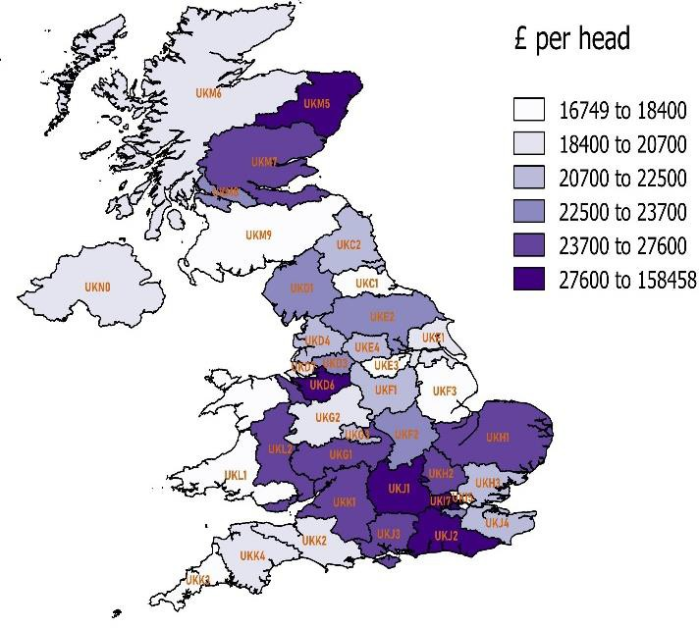
THE UK Levelling up white paper: R&D MISSION
Multiregional Input-Output (MRIO) Model
The structure of production in a particular region may differ substantially from the one of a national input–output table or from the one of another region. The smaller the economic area, the more dependent that economy is on trade with “outside” areas.
Figure 5. Regional GVA per head NUTS2 2016
Increased Demand R&D Investment for
Region 1
Increased Production (employment, value added) effect
Region 1
Spillover effect
Feedback effect
Whole UK,
41 regions NUTS2
Increased Production (employment, value added) effect
Region 2
Domestic Multipliers, Leakages, Spillovers and feedback effects.
The SEIM-UK Project website
Source: Own elaboration

Slide 10
THE UK Levelling up white paper: R&D MISSION Scenario Building
R G =Original Regional Government R&D spending
G =Original Total Government R&D spending
Source: Ma, Ortega-Argiles and Lyons, 2023
In all scenarios G E R D 40% uplift + 2xbusiness match funding

Slide 11
THE UK Levelling up white paper ex-ante evaluation: R&D MISSION Total Effects
The results show the change in the aggregate effect of additional public funding in three scenarios in terms of output, FTE employment and GVA in £m for the UK
Table 2. The change in the aggregate effect of additional public funding in three scenarios in terms of output, FTE employment and GVA in £m for the UK
 | Scenario 1 Equal Uplift |  | Scenario 2 Redistributive |  | Scenario 3 Market Driven
 | Value | % | Value | % | Value | %
Output Difference (£m) | 7229.7 | 0.21% | 7201.7 | 0.21% | 7252.8 | 0.21%
Employment Difference (FTE) | 73,590 | 0.25% | 73,576 | 0.25% | 74,040 | 0.25%
GVA Difference (£m) | 4338.9 | 0.21% | 4300.4 | 0.21% | 4344.1 | 0.21%
Source: Ma, Ortega-Argiles and Lyons, 2023
The overall effect is similar for all three scenarios, given an equivalent amount of additional funding

Slide 12
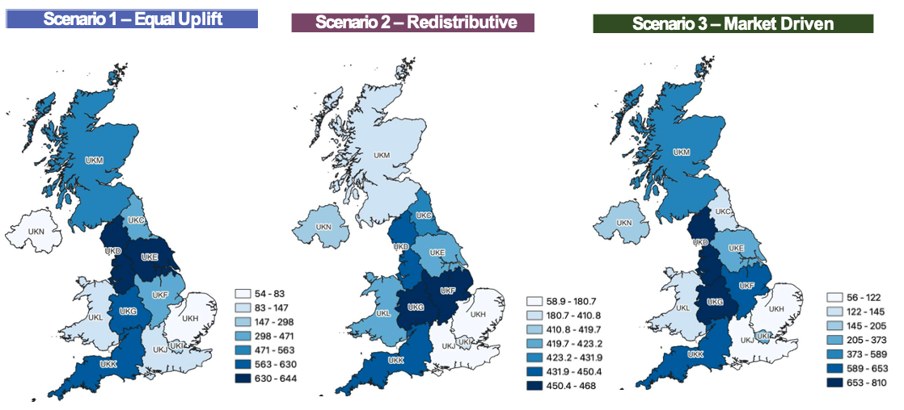
THE UK Levelling up white paper ex-ante evaluation: R&D MISSION Regional Impact
R&D Regional Impact – Regional GVA Change (£m)
Figure 6.A Regional GVA change (in £m) Scenario 1 – Equal Uplift
Figure 6.B Regional GVA change (in £m) Scenario 2 – Redistributive
Figure 6.C Regional GVA change (in £m) Scenario 3 – Market Driven
Source: Ma, Ortega-Argiles and Lyons, 2023

Slide 13
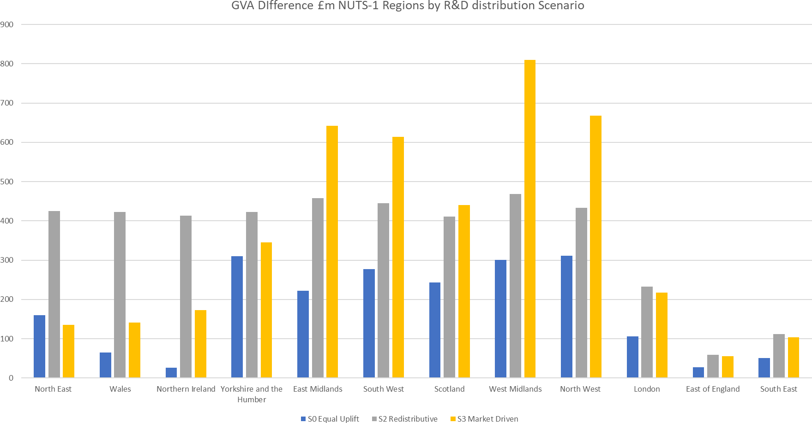
THE UK Levelling up white paper ex-ante evaluation: R&D MISSION Regional Impact comparison (GVA difference)
Figure 7. GVA Difference £m NUTS-1 Regions by R&D distribution Scenario
Each scenario has a different regional effect. The redistributive scenario benefits all the regions more equally.
Source: Ma, Ortega-Argiles and Lyons, 2023

Slide 14
Takeaways (I) from an R&D mission ex-ante analysis
Public funds redistribution programs can contribute to rebalancing national economies by promoting higher sub-national productivity and job creation. However, the logic of intervention of the programs should consider important regional effects as a result of the way the funds are distributed.
UK interregional input-output analysis finds that innovation-related investment policies which favour regions which previously had lower levels of public funding generate the largest overall returns.
Regions which are highly connected in terms of income and knowledge networks always benefit from such policies, even if the funding is mainly directed to other places. The reason is that the stimuli to local production and trade also ripple through the interregional trade linkages, thereby benefiting those regions which are already well-connected.
These findings imply that innovation-related investments in many economically less advantageous regions are not a drag on the overall economy. Rather, they act both as a catalyst for narrowing interregional gaps and enhancing aggregate growth.

Slide 15
II. The uneven regional effects of technological diversification on regional productivity.

Slide 16
Uneven Effects of technological diversification on regional productivity in the EU
4 6 8 10 12
268 EU regions
Multilevel Modelling
Technological coherence and the entropy-variety dimensions of relatedness influence regional labour productivity growth in a non-linear manner
150
100
50
0
Labourproductivity, quadR == 1 Labourproductivity, quadR == 2 Labourproductivity, quadR == 3 Labourproductivity, quadR == 4
Fitted values Fitted values Fitted values Fitted values
Figure 8. Quadrants of regional technological relatedness (coherence) and regional productivity (excluding London)

Slide 17
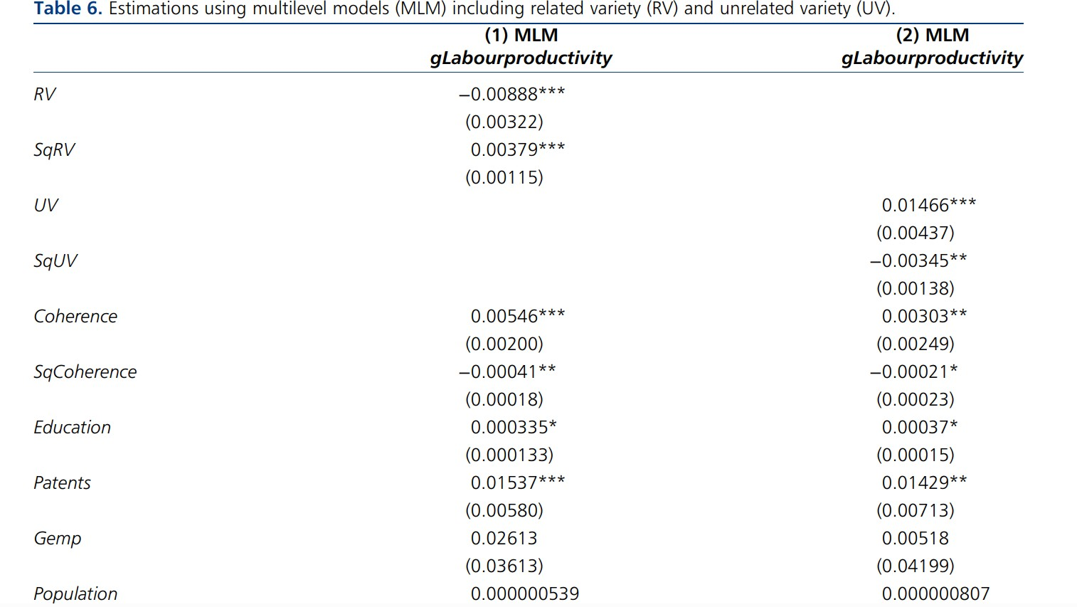
Uneven Effects of technological diversification on regional productivity in the EU
Table 3. Estimations using multilevel model (MLM) including related variety (RV) and unrelated variety (UV)
‘U’-shaped relationship between entropy-variety and productivity.
Inverted ‘U’-shaped relationship between technological coherence and productivity.
regional productivity growth needs both technological diversification and diversity.

Slide 18
Uneven Effects of technological diversification on regional productivity in the EU
Relatedness and variety among a region’s knowledge base components are fundamental to improving regional productivity
Concerning diversification, regions must invest in their existing technological capabilities and more distant knowledge domains.
Table 3. Estimations using multilevel model (MLM) including related variety (RV) and unrelated variety (UV)

Slide 19
Takeaways (II): Technological relatedness, coherence and regional productivity.
Building technological relatedness enhances regional productivity up to an average level of regional productivity, beyond which productivity begins to fall. Similar findings are evident from the UK research regarding the non-linear effects of industrial embeddedness.
Enhancing relatedness and embeddedness are such core principles of RIS3 smart specialisation. However, this research suggests that once a region moves beyond average productivity performance, greater technological relatedness or embeddedness leads to adverse “lock-in” types of effects.
In economically weaker regions or regions far away from the technological frontier, local knowledge- and innovation- related investments must be increased to boost regional technological coherence, relatedness and embeddedness to improve the resilience of the innovation system.

Slide 20
III. The uneven effects of globalisation and automation in European regions and workers.

Slide 21
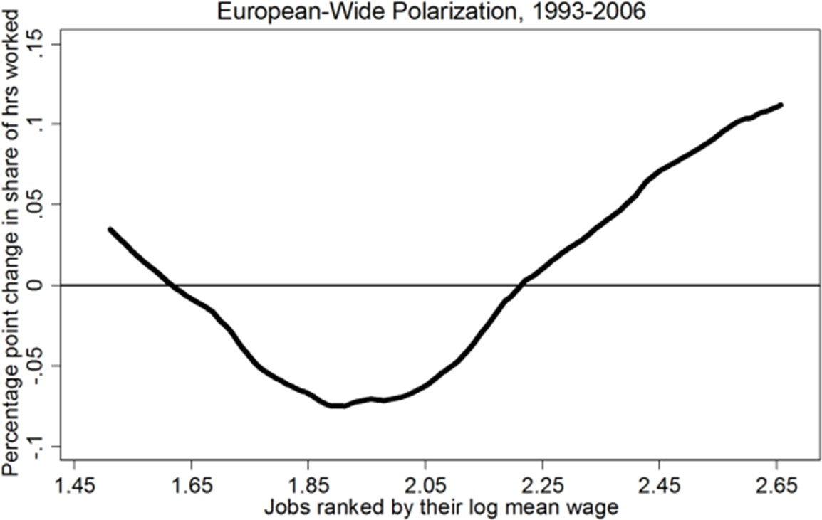
Employment polarization (European level)
Figure 9. European-Wide Polarization
Source: Terzidis and Ortega-Argiles (2021)

Slide 22
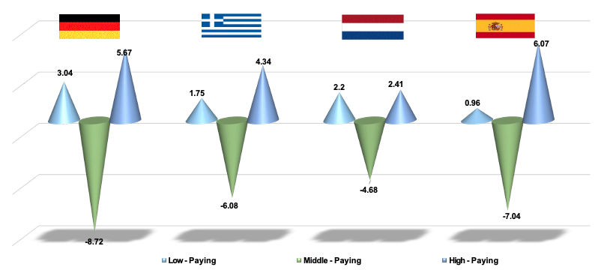
Employment polarization (European national level)
Figure 10. Omnipresence of employment polarization (U – shaped employment pattern) in dissimilar economies
Source: Terzidis and Ortega-Argiles (JRegSc, 2021)

Slide 23
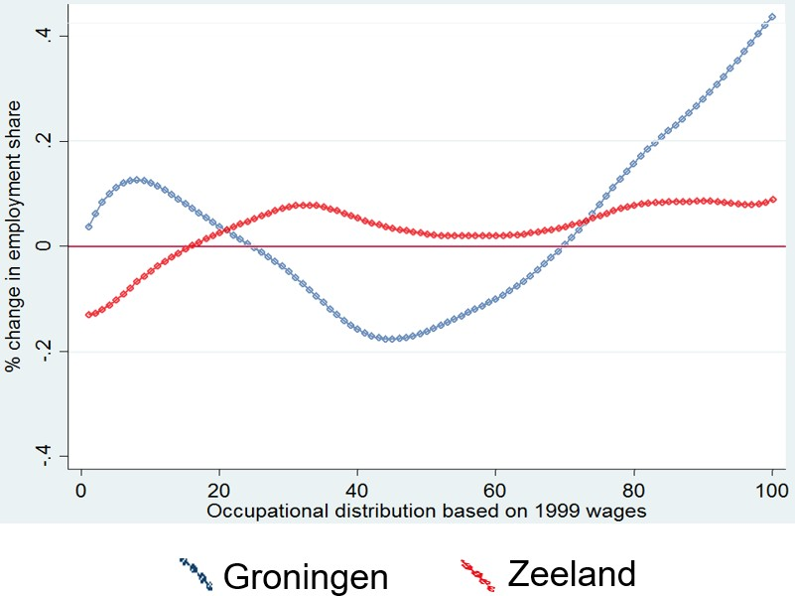
Employment polarization in the Netherlands (sub-national level)
More specifically, the regional pattern for
polarization involves:
Higher start-of-period per capita income
Greater share of high skill employment
(ICT and financial sector)
Labor utilization at a sub-optimal level
Lower population density
Clear effect of routinization affecting negatively lower paid jobs and positively higher paid jobs
Figure 11. Employment polarization in the Netherlands
Source: Terzidis and Ortega-Argiles (JRegSc, 2021)
National employment trends are not homogeneously represented in the sub-national level

Slide 24
Uneven geographical effects to big challenges (globalisation, automation, etc.)
Technological progress:
European heterogeneity in the results (Nordic countries more likely to benefit more)
More likely to harm low-skilled employment
Process innovation more likely to show negative effects
Firm level analysis more likely to provide positive effects
International trade:
More likely to benefit medium and high-skilled employment
Negative outcomes more likely from industry-level studies
Regional analyses less likely to report positive effects of trade.

Slide 25
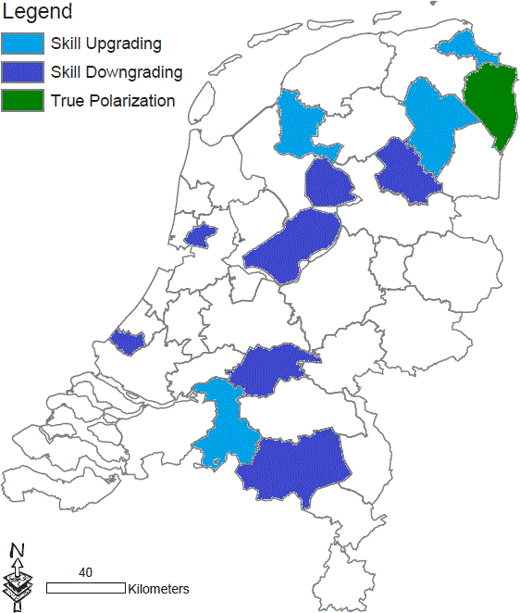
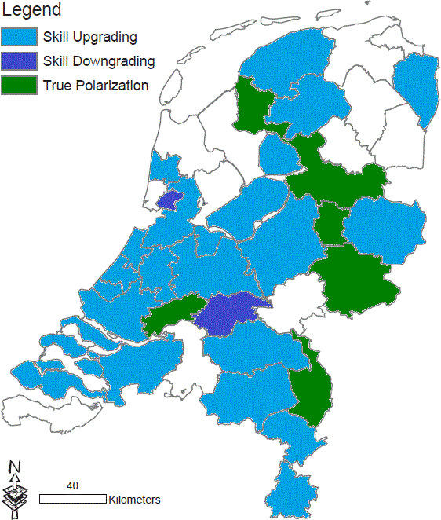
Job polarisation index - Regional analysis
Figure 12.a Job polarisation index
Entire labor market– Year: 2004
Figure 12.b Job polarisation index
Entire labor market– Year: 2010

Slide 26
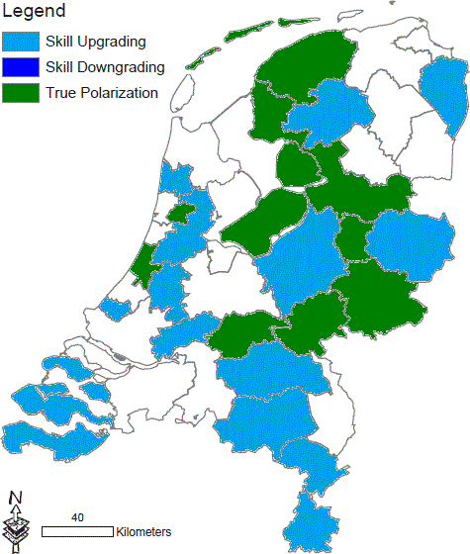
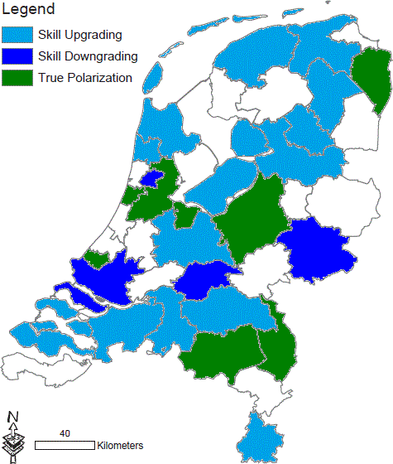
Job polarisation index – Regional gender analysis
Figure 13.a Regional employment polarisation by gender
Male employees – Year: 2010
Figure 13.b Regional employment polarisation by gender
Female employees – Year: 2010

Slide 27
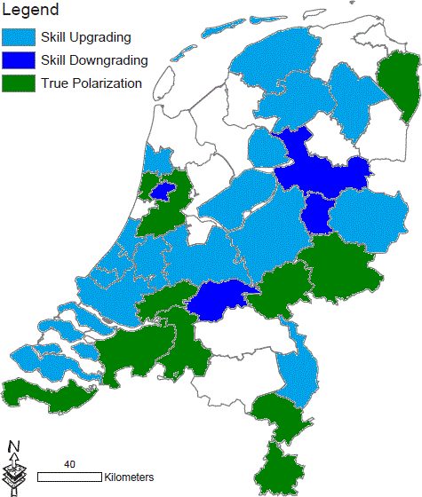
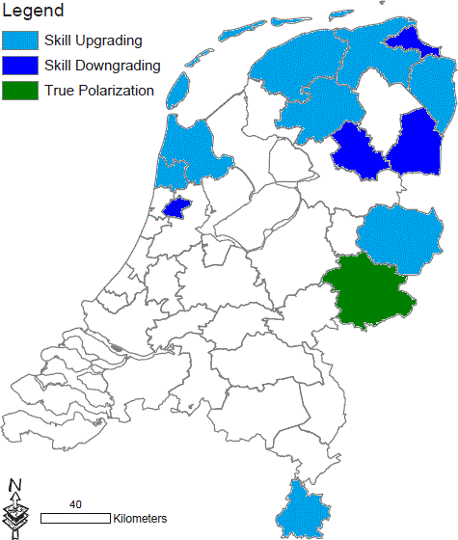
Job polarisation index: Regional age analysis
Figure 14.a Regional employment polarisation by age group
Young employees – Year: 2010
Figure 14.b Regional employment polarisation by age group
Old employees – Year: 2010

Slide 28
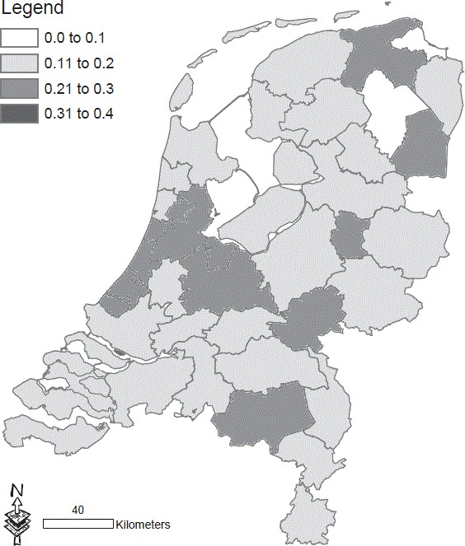
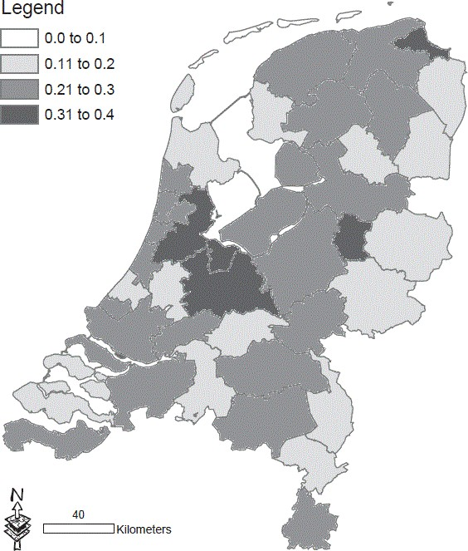
Skill mismatch index – Regional analysis
Figure 15.a Skill mismatch index regional analysis
Entire labor market– Year: 1999
Figure 15.b Skill mismatch index regional analysis
Entire labor market– Year: 2011

Slide 29
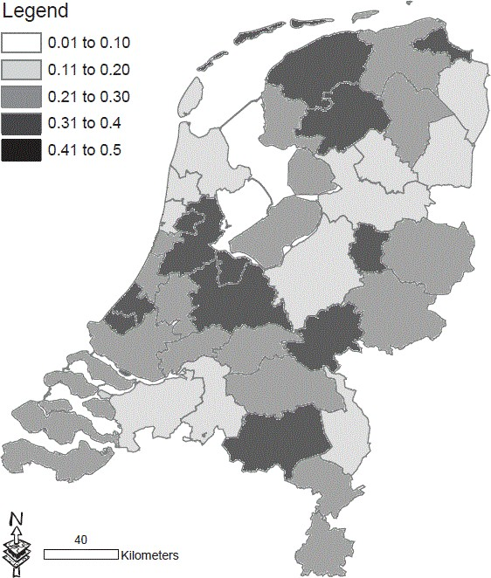
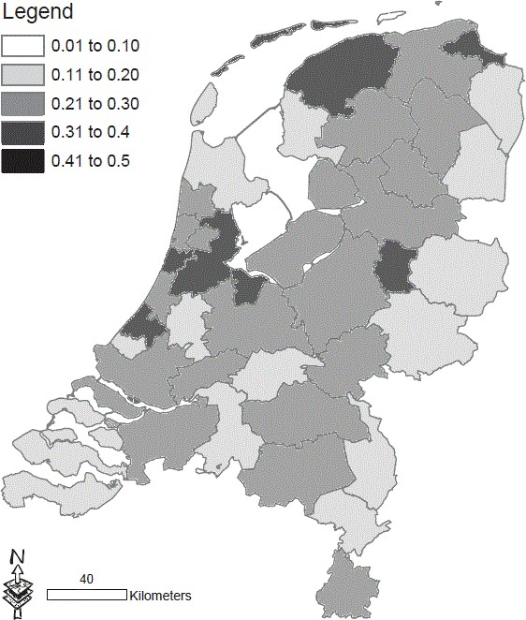
Skill mismatch index – Regional gender analysis
Figure 16.a Skill mismatch index by gender
Male employees – Year: 2011
Figure 16.b Skill mismatch index by gender Female employees – Year: 2011

Slide 30
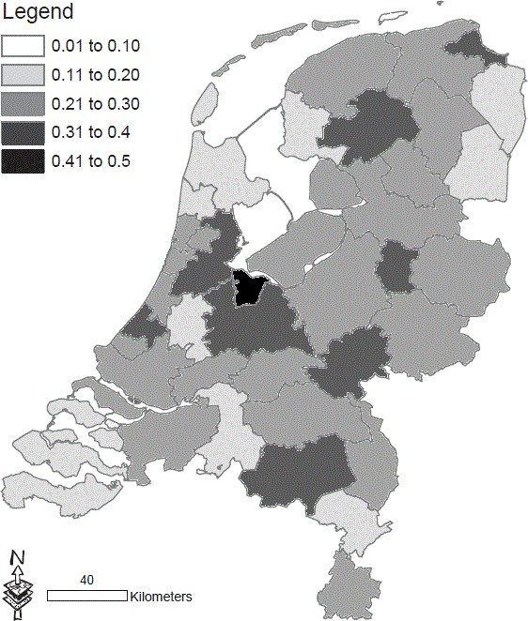
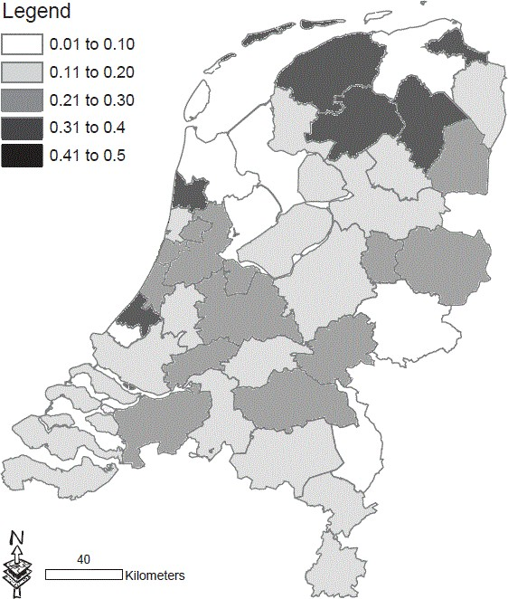
Skill mismatch index – Regional age analysis
Figure 17.a Skill mismatch index by age group
Young employees – Year: 2011
Figure 17.b Skill mismatch index by age group
Old employees – Year: 2011

Slide 31
Regional uneven effects of shocks/grand challenges
Uneven effects of automation and globalisation in Dutch local labour markets wage distribution. Male and Young workers are the most affected. But female workers too.
 | Routine Task Intensity (automation) | International Trade (Globalisation)
REGIONAL ANALYSIS | Automation affects the entire labour market Positive effect in the case of high paid occupations Negative effects in the cases of low and medium paid occupations | It affects positively low and high-paid jobs Offshoring to China positively affects low-paid jobs while negatively high-paid jobs Offshoring to Europe has a positive effect on high-paid jobs
GENDER ANALYSIS | Automation affects the entire labour market Positive effect in the case of higher-paid occupations in both female and male labour markets Negative effects in the cases of low and male medium-paid occupations | International trade – Offshoring – affects different male and female labour markets. Offshoring to China positively affects male labour market and negatively female labour market
AGE ANALYSIS | Automation affects more young employees. Positive effect in the case of high-paid occupations Negative effects in the cases of low and young medium-paid occupations | International Trade affects mainly senior workers Offshoring to China positively affects low and high-paid senior workers Offshoring to Europe has a negative effect on medium-paid jobs for young employees and a negative effect on low and higher- paid jobs in senior workers’ jobs

Slide 32
Takeaways (III) Impact of automation and globalisation in local labour markets
The global impacts of automation and import competition led to greater job polarisation affecting different labour market segments.
From the research examining job polarisation in The Netherlands, job polarisation is a more serious phenomenon amongst younger workers.
In Europe, job polarisation is not necessarily an urban phenomenon, as is the case in the US. Job polarisation is also evident in smaller centres, and places specialised in either high or low-technology sectors.
Taken together, regional performance in Europe is determined by the regional endowments and how resilient regions are to exogenous shocks—observed US sub- national patterns may differ in Europe. More European sub-national evidence is needed to understand the consequences of this phenomenon.

Slide 33
For weaker regions…
To increase the diversity of the related technologies, activities and market segments around the existing core technologies, skills and competences of the local economy;
Enhance the middle-skills components of the local economy;
Increase the local multipliers for knowledge-related activities and investments.
In economically weaker regions, smart specialisation offers opportunities to make progress on all three priorities, but making progress on all three priorities requires local and regional collaboration and coordination across different arenas.

Slide 34
Reflections

Slide 35
Increasing local multipliers by improving the local innovation system
Local knowledge capacity
Advanced knowledge and technology driven
regions
New opportunities for local activities
New local Development Pathways
Local technological skills
Local institutional system
High local outcomes at the
short term and long-term
High multipliers (internal and
external)

Slide 36
Increasing local multipliers in less developed regions in improving the place-based innovation system comes by….
Local knowledge capacity
New opportunities for local activities
New local Development Pathways
Local technological skills
Local institutional system

Slide 37
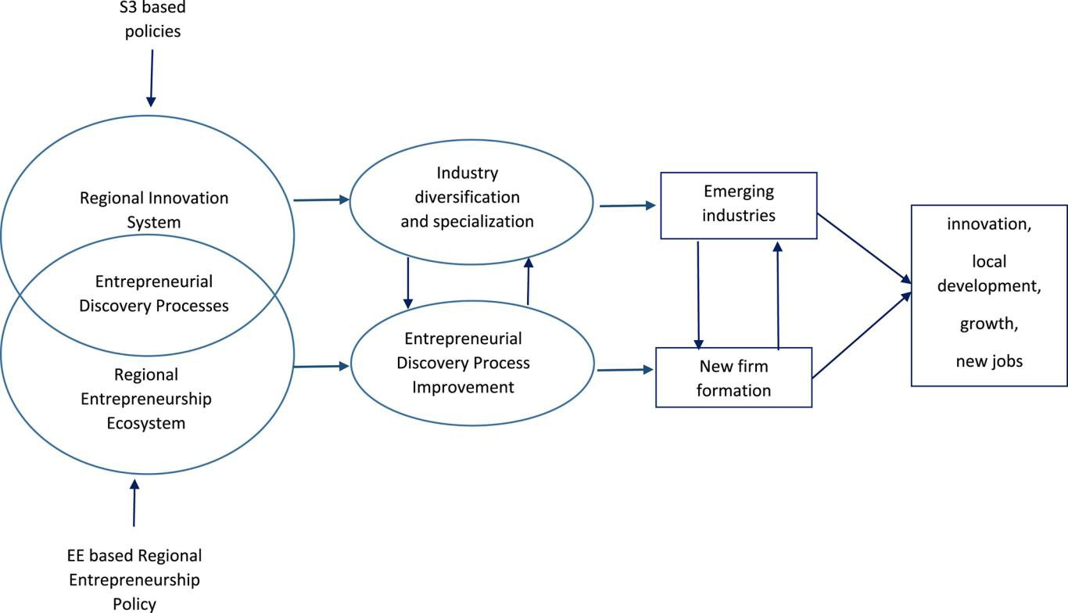
Increasing Regional Innovation: Localised Knowledge and Innovation Impacts Systemic approaches – RIS or Smart Specialisation
Systemic approaches – allowing for the understanding of potential factors that can cause bottlenecks
Table 4: The structure of the Regional Entrepreneurship and Development Index
Structure of the REDI 3 Sub-indexes /14 Pillars |  | National and Regional Institution Variables | Regional Level Individual Variables
Entrepreneurial Aspiration Sub-index | Financing | FINANCIAL INSTITUTIONS | INFORMAL INVESTMENT
 | Globalization | CONNECTIVITY | EXPORT
 | High Growth | CLUSTERING | GAZELLE
 | Process Innovation | TECHNOLOGY DEVELOPMENT | NEW TECHNOLOGY
 | Product Innovation | TECHNOLOGY TRANSFER | NEW PRODUCT
Entrepreneurial Ability Sub-index | Competition | BUSINESS STRATEGY | COMPETITORS
 | Human Capital | EDUCATION AND TRAINING | EDUCATION LEVEL
 | Technology Sector | ABSORPTIVE CAPACITY | TECHNOLOGY LEVEL
 | Opportunity Start -up | BUSINESS ENVIRONMENT | OPPORTUNITY MOTIVATION
Entrepreneurial Attitudes Sub-index | Cultural Support | OPEN SOCIETY | CARRIER STATUS
 | Networking | SOCIAL CAPITAL | KNOW ENTREPRENEURS
 | Risk Acceptance | BUSINESS RISK | BUSINESS ACCEPTANCE
 | Start-up Skills | QUALITY OF EDUCATION | SKILL PERCEPTION
 | Opportunity Perception | MARKET AGGLOMERATION | OPPORTUNITY RECOGNITION
Szerb, Ortega-Argiles, Acs and Komlosi 2020
Source: authors’ own construction.

Slide 38
Increasing local knowledge and technological multipliers by promoting local collaboration…
Regions with higher multipliers are the ones that have a more resilient local innovation system.
Intraregional collaboration is key to obtain the higher results in business and local growth performance.
Complementarities between research and innovation inputs from different sectors (higher education and research, business, public sector) will provide the higher multipliers.
Bringing actors from different disciplines (hard sciences, social-sciences) will ensure that the outputs of the programs are used in the broader set of local activities generating the highest impact.
Promote horizontal cooperation (alliances) or vertical cooperation (value chains)
Specialist testing and trialling laboratories
Linking local firms with local universities or research institutes on funding projects aiming at enhancing local technological diversification.
Increasing local multipliers by local collaboration with local partners
SMEs and start-ups should be priority focus on these activities

Slide 39
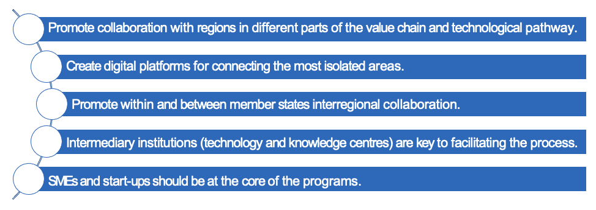
Increasing local knowledge and technological multipliers by promoting external connectedness…
Regions with higher multipliers are the ones that have better (internal and externally) connected systems.
Interregional collaboration is key to obtaining higher business and local growth performance results by complementing and filling in gaps in local innovation systems.

Slide 40
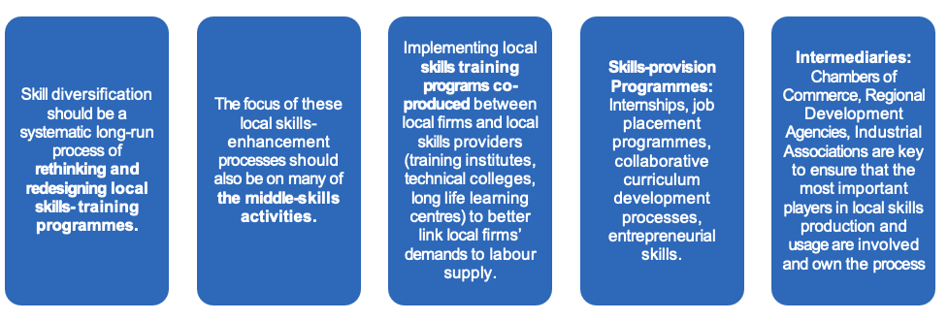
Special attention to the increase of skills diversification in local labour markets
Most recent shocks have affected particularly the middle parts of the local skills distribution. Special attention should be devoted to them.
Thoughtful strategies involving evidence-based analysis on the composition of skills-mismatches distributions, job polarisation patterns, workers and activities/tasks more affected… are key to understand the problem at the local level and have an action plan that is shared locally.

Slide 41
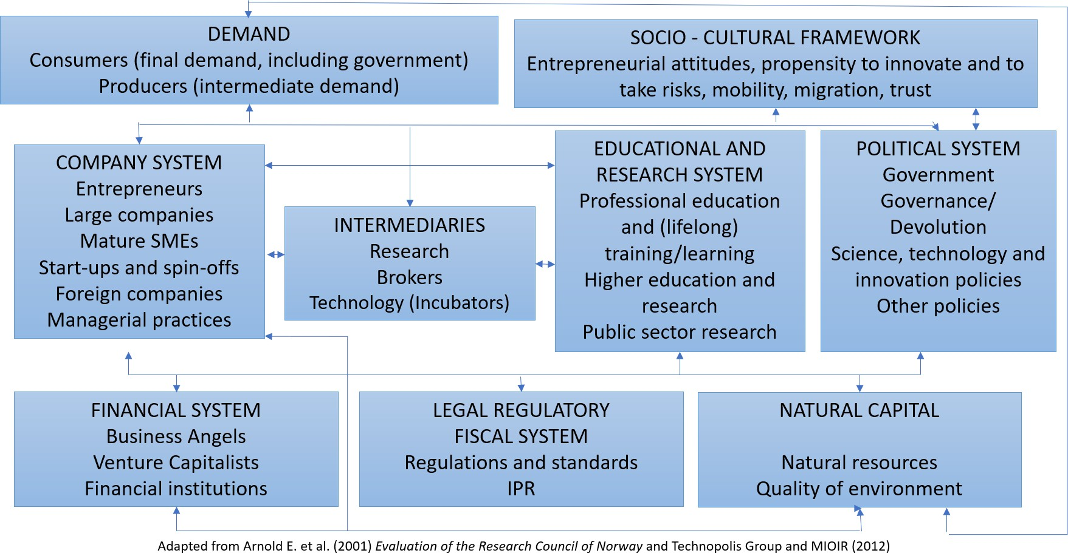
Special attention to the improvement of the local institutional system
Having the right local institutions is key to promoting place-based successful strategies.
In many member states: education policy, industrial policy, and legal and fiscal regulations are implemented at the national level; to improve local systems, better coordination at different levels of government should be promoted considering:
The local/Regional/National socio-cultural framework
The Local/Regional/National financial system
The Local/Regional/National legal regulatory fiscal system
The Local/Regional/National and Supranational Political system
Promoting Policy Sharing and Learning across different levels of government.
In particular, dealing with grand challenges such as the climate emergency, depopulation, demographic initiatives shared by locations will have a higher multiplier as they promote synergies rather than duplication at different governmental levels.

Slide 42
Better evaluation and dissemination
Better evaluation and ex-ante, concurrent and ex-post assessment of place- based initiatives.
New evaluation centres that allow increasing understanding of who will be affected or benefit from programmes
Improving evaluation and assessment capacity and skills at the local level.
Providing platforms to share knowledge across sub-national places.
Better dissemination of the effects of cohesion policy to a much wider audience.
e.g., Competence centres have proven useful in engaging with the right stakeholders to produce evaluation and assessment of policies and programs (e.g., public procurement) and to disseminate the results and impacts.

