Slide 1
INFORM EU Capacity building Building “good” PPT slides
Megan GARDNER BLASCO

Slide 2
AGENDA
Introduction
Slides: Design and Content
Visuals and story-telling
Interactive elements
Q&A / sharing of experience
Conclusions

Slide 3
Think about design
Use “PPT Designer”
Inspiration
Combine your ideas
Use it as an assistant
Incorporate suggestions
Use of colours
Highlight
Maximum of 3

Slide 4
Slides are not a script
Handouts ≠ Presentation slides
Visual aid
Complementary to the presenter NOT competing for attention
“Our brain thinks in titles”
Notes:
CONTENT

Slide 5
Work in steps
Can I visualise anything – Use a picture, graph etc.
Do I need to split the content across several slides?
Can I make this slide lighter?
Put everything you need and want on your slide

Slide 6
Slides: Design & Content
Slide design
Use “PPT Designer” for inspiration - Do not have to follow everything it suggests, can do a combination
Don’t use too many colours on a slide, stick to a maximum of 3
Colour can be a tool to highlight information
Slides are not a script
Slides are a visual aid
Try not to read directly off the slides
There is a difference between slides received as handouts and slides used in a presentation
Make sure your slides do not compete with you / the presenter
Work on your slides in steps
Put everything you need and want on your slide to begin with
Look at it and decide is there too much, can I make this slide lighter and easier to read, do I need to split it into several slides
Can I visualise anything – Use a picture, graph etc.
Slide 1
Slide 2
Slide 3
Notes:
EXAMPLE OF STEP-BY-STEP: ILLUSTRATE BASE SLIDE TURNING INTO PREVIOUS SLIDES

Slide 7
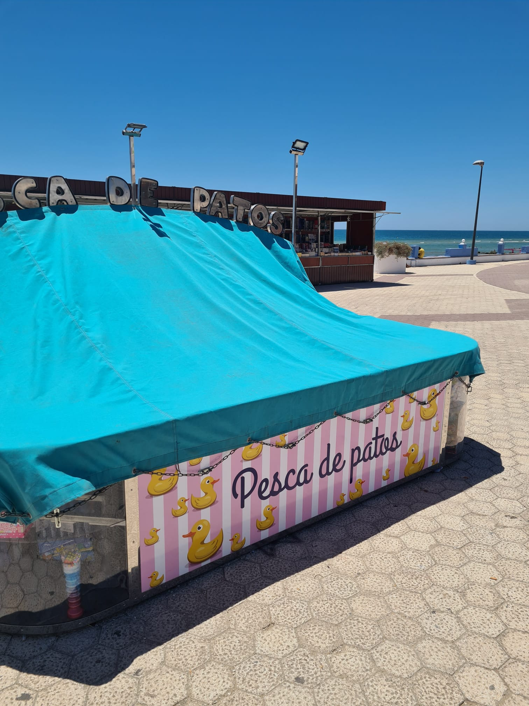
Using pictures
Share an anecdote
Notes:
Anecdote: Duck anecdote – hidden in house
Story: Serge filming the urchins
Discussion: What is happening in this photo? What do we get out of the project visits at Inform EU plenaries?
Application example: Telling a project story

Slide 8
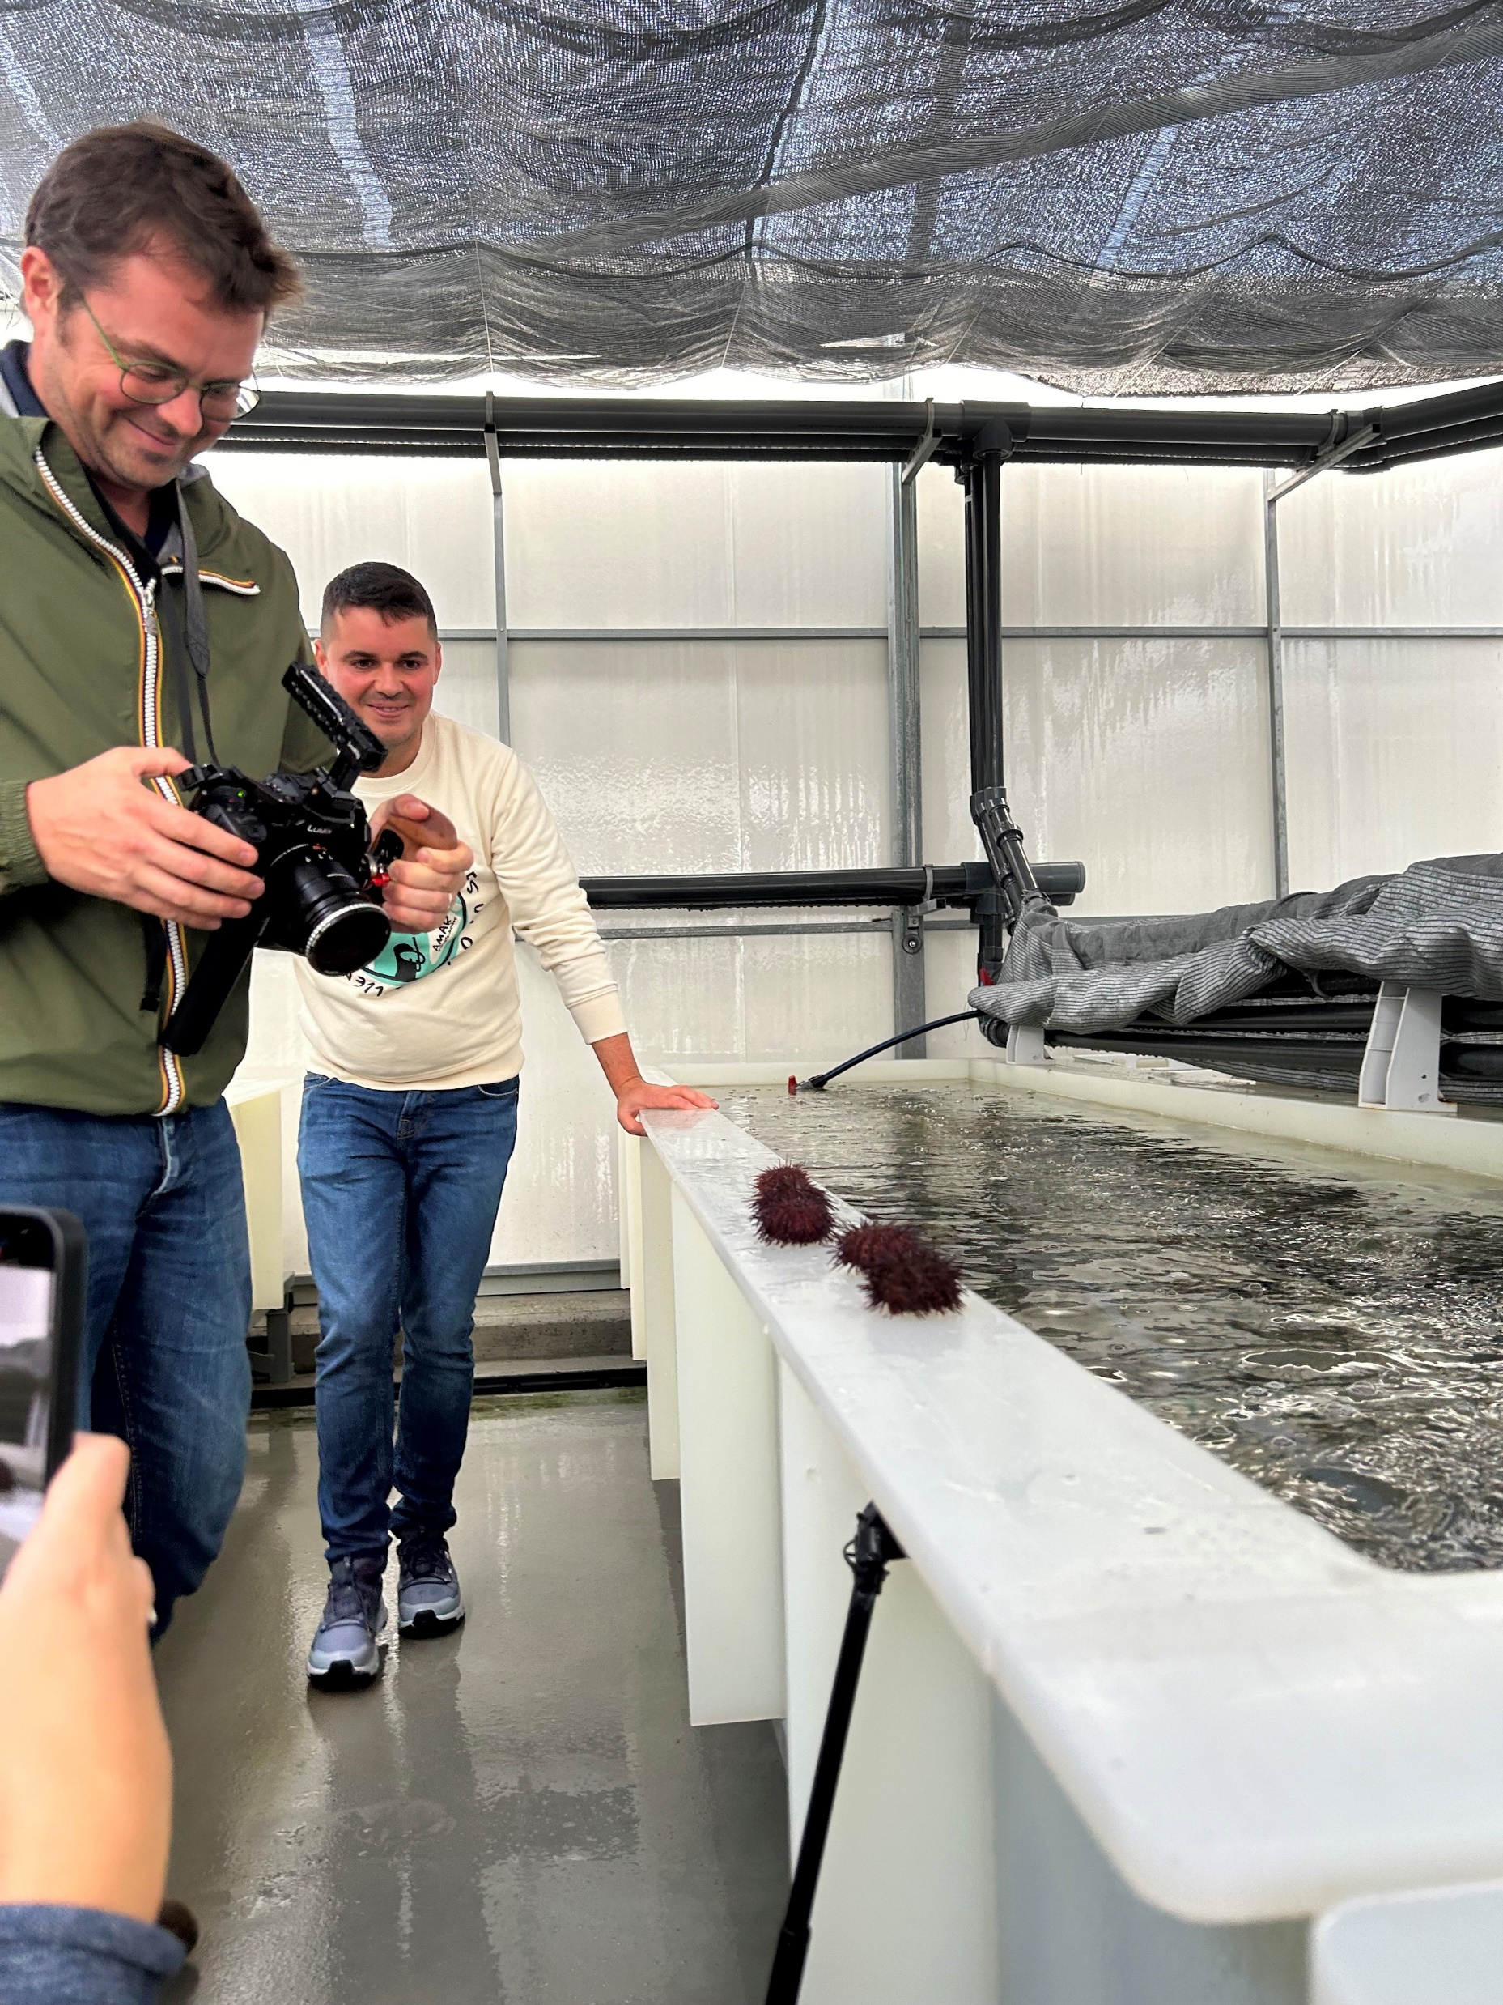
Using pictures
Tell a story
Notes:
Anecdote: Duck anecdote – hidden in house
Story: Serge filming the urchins
Discussion: What is happening in this photo? What do we get out of the project visits at Inform EU plenaries?
Application example: Telling a project story

Slide 9
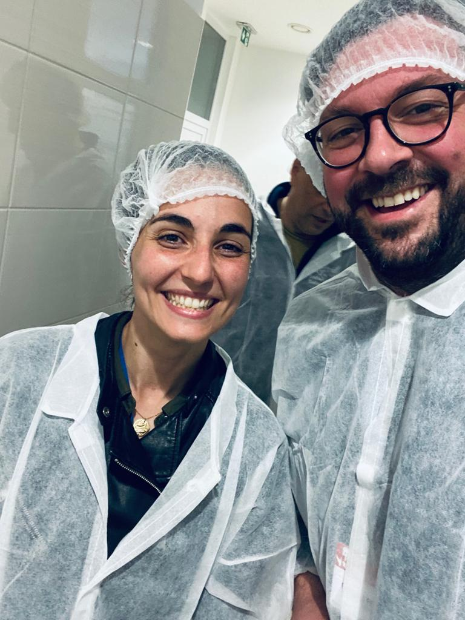
Using pictures
Spark a discussion
Notes:
Anecdote: Duck anecdote – hidden in house
Story: Serge filming the urchins
Discussion: What is happening in this photo? What do we get out of the project visits at Inform EU plenaries?
Application example: Telling a project story

Slide 10
Using pictures
Share an anecdote
Tell a story
Spark a discussion
Notes:
Anecdote: Duck anecdote – hidden in house
Story: Serge filming the urchins
Discussion: What is happening in this photo? What do we get out of the project visits at Inform EU plenaries?
Application example: Telling a project story

Slide 11
Notes:
STORY TIME

Slide 12
Getting Czechs to eat more fish – How EU funding helped a small company achieve its bold culinary mission
Mission: To increase fish consumption in the Czech Republic.
Innovation: Offers a variety of fish-based products tailored to Czech tastes.EU
Funding: Received support from the European Maritime Fisheries Fund at various stages of development.
Product Range: Produces fresh fillets, prepared products, and sausages made from fish meat.
Marketing Strategies: Overcomes challenges of seasonality and competition with meat products through innovative marketing and direct-to-consumer sales.
Success: Scaled up operations and became a regional example of successful non-traditional production.
Notes:
Classic, more traditional qlide, BUT too much text, overwheming, what do we focus on, competes with the presenter

Slide 13
Getting Czechs to eat more fish – How EU funding helped a small company achieve its bold culinary mission
Mission
Innovation
Funding
Product Range
Marketing Strategies
Success
Notes:
Better, but there is another way to go even more visual and not compete with the presenter

Slide 14
Before we begin…YOUR MISSION
QUESTION 1: Why does the fish farm focus on catfish?
QUESTION 2: How did the project overcome seasonality challenges?
QUESTION 3: How many separate operations did the funding support?
Notes:
STORY TIME MISSION

Slide 15
Notes:
Jan Hora, originally from Southern Bohemia, a region known for carp farming, is a serial entrepreneur with a dream to get more Czechs eating fish. Putting his entrepreneurial skills to the test, he set up a fish farm to utilise the excess heat that his existing biogas plant produces, by heating the water for his fish farm.

Slide 16
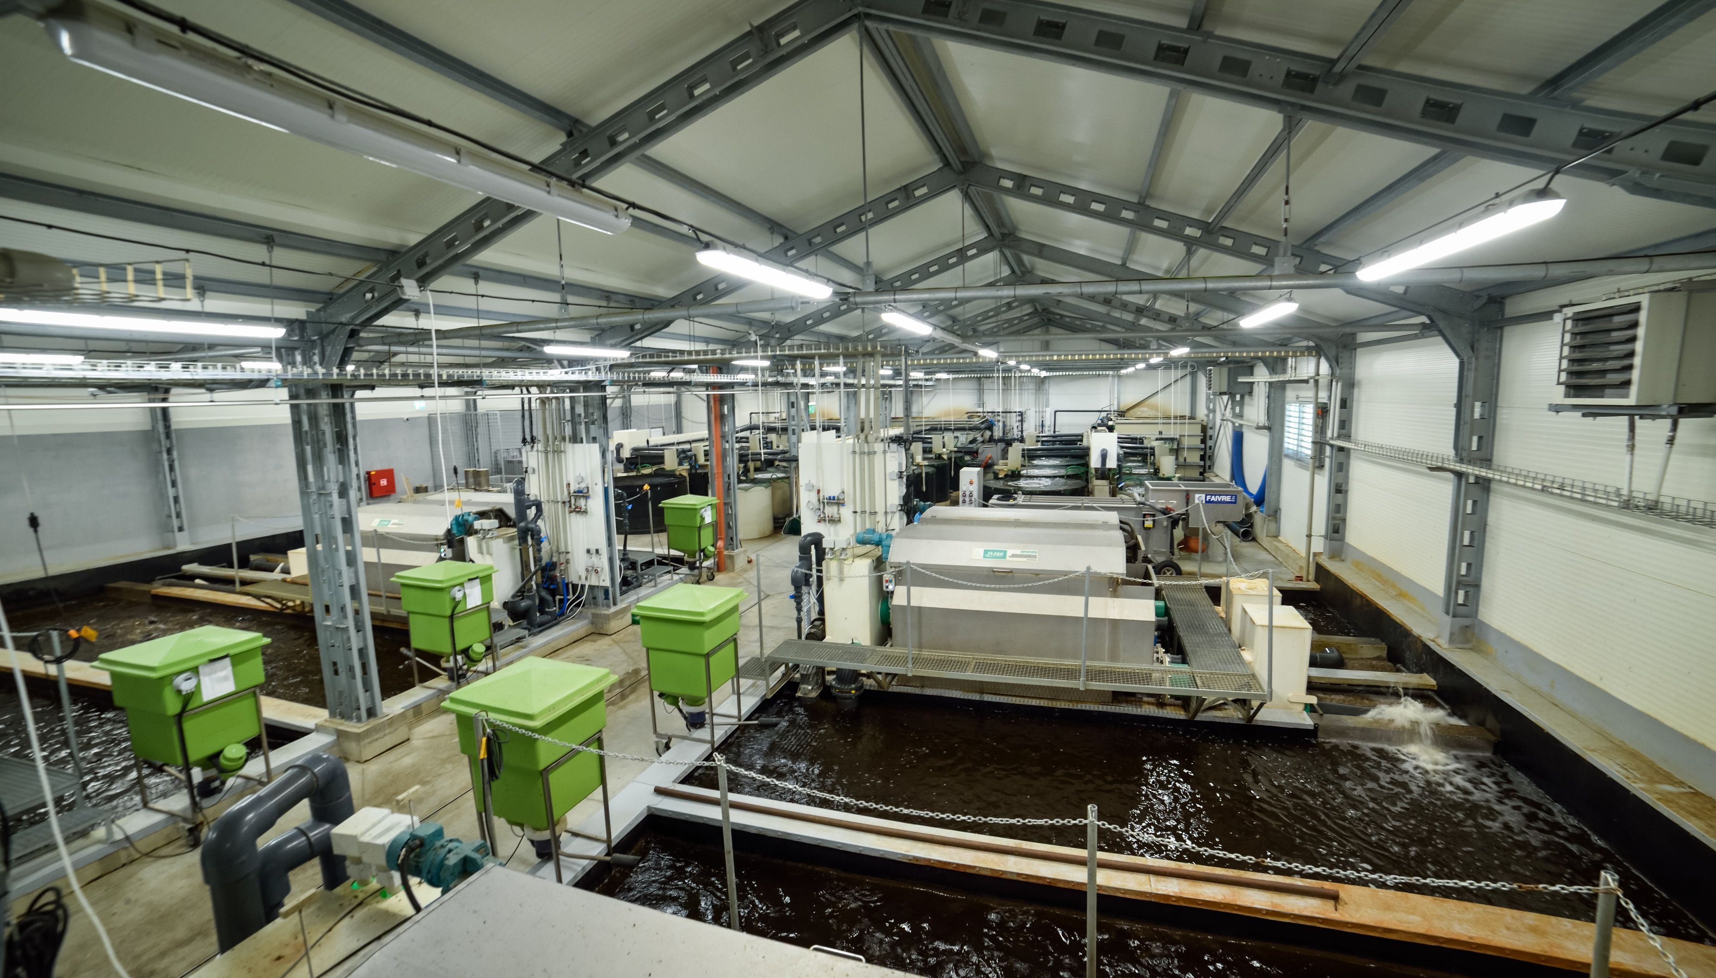
Notes:
However, despite Jan's passion for fish, the Czech market favours meat, making a fish farm a difficult business to maintain. Not ready to give up on his dream, Jan's company, Tilapia sro., experiemented with species, and landed on catfish as the solution. Catfish thrives easily, and their meat has a similar texture to veal, popular in the Czech Republic.

Slide 17
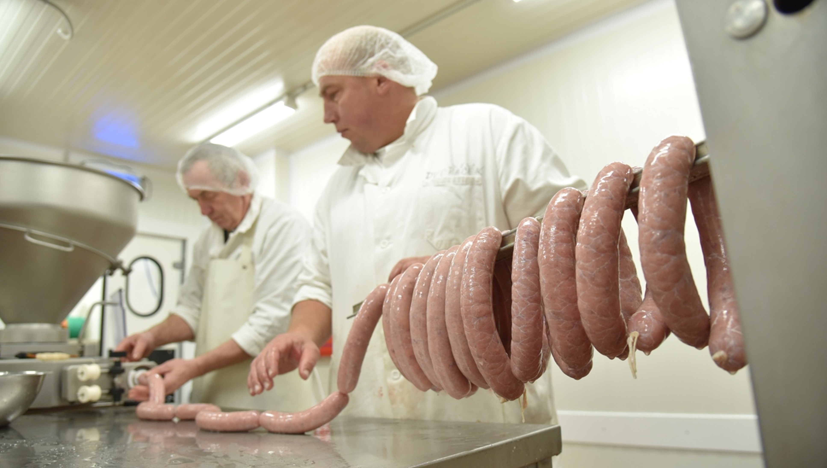
Notes:
Seeing an opportunity to bring more fish into Czech diets, the company began to identify the fish consumption barriers and innovate to solve them.
Firstly Czechs mainly eat fish at Christmas, not so much at other times of year and focus on carp rather than other species. The company tackled this through year-round marketing, reminding the market about fish throughout the year and developed a variety of products.

Slide 18
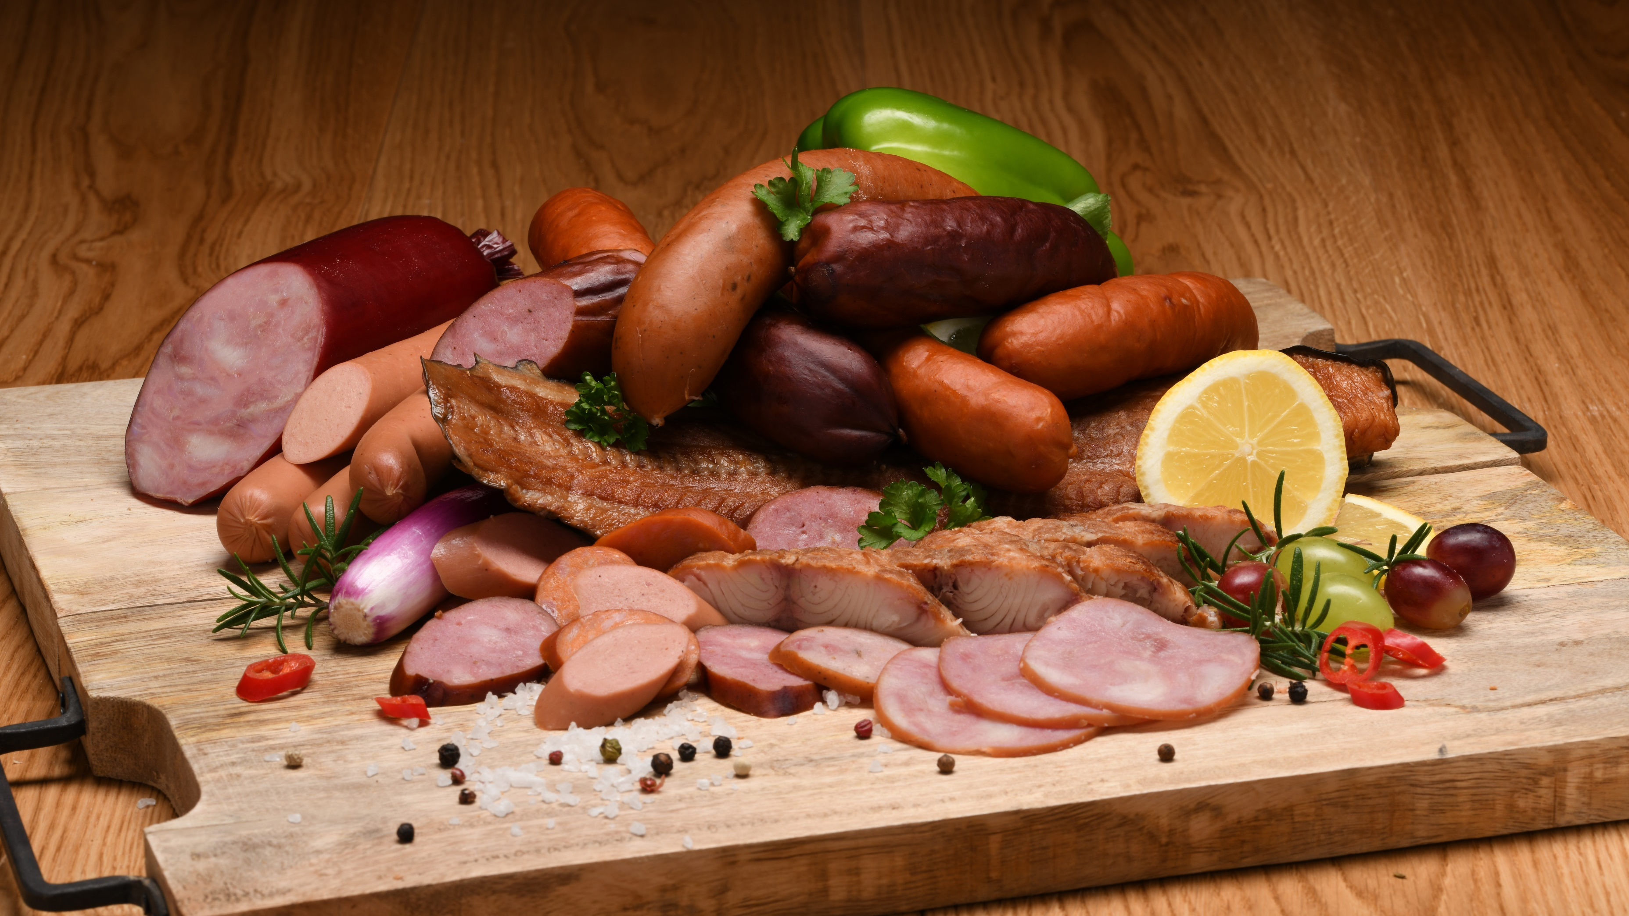
Notes:
Secondly, despite being the national favourite, carp has many small bones, making it difficult to prepare. In response, Tilapia sro adopted “fish without bones” as their slogan and made this their website address to attract customers looking for a solution.
Finally to compete with the market's love for meat, the company developed fish-based products that resemble popular smoked meats, like sausages.

Slide 19
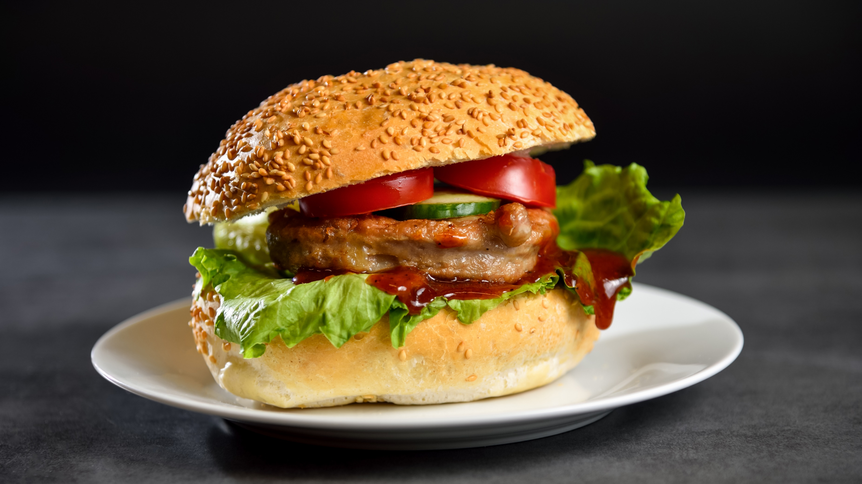
Notes:
Thanks to EU funding, Jan was able to turn his mission of "Teaching Czech's to eat fish" into reality, with the European Maritime Fisheries Fund (EMFF) supporting Tilapia sro. at various stages of its development. The support covered 16 separate operations, ranging from financing for farming equipment, processing machines, transportation and opening physical & online shops.

Slide 20
Mission accomplished?
QUESTION 1: Why does the fish farm focus on catfish?
QUESTION 2: How did the project overcome seasonality challenges?
QUESTION 3: How many separate operations did the funding support?

Slide 21
Why a mission?
Setting a task and expectation
Grabbing attention
Providing interaction
Information retention
Repetition
Summary
Information retention

Slide 22
Notes:
Q&A Expérience sharing

Slide 23
Conclusions
Work in steps
Experiment with pictures and visuals
Stick to 3 colours
Resist the script temptation
Notes:
HOMEWORK (Or further food for thought ☺): 1. Take an existing slide from a presentation, 2. Apply the breakdown steps, 3. Develop another version of the slide

