Slide 1
Communication “Harnessing Talent in Europe’s Regions”
DIALOGUE WITH CPR PARTNERS
15 June 2023

Slide 2
Background and context
Overall demographic context of the EU (2023 demography report https://commission.europa.eu/system/files/2023-01/the_impact_of_demographic_change_in_a_changing_environment_2023.PDF ) with asymmetric impact on regions
Initial focus on “brain drain” (letter of mission of VP Suica)
lack of data on flows
trade off with free movement of persons
elasticity and cyclical nature of emigration
The concern is more the capacity of regions to dispose of the (skilled) labor force needed for their development
First deliverable of the European Year of Skills

Slide 3
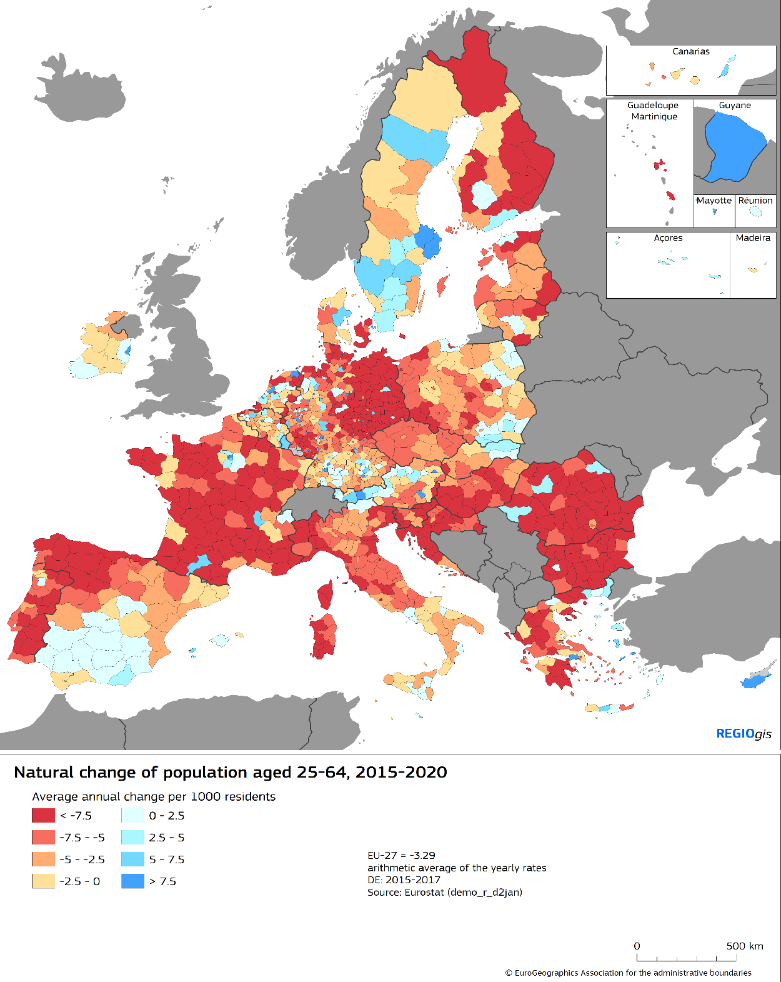
Demographic transition
Demographic transformation of Europe is taking place caused by ageing, lower birth rates and migration flows
3.5 million decrease of EU working age population between 2015 and 2020
Further shrinking expected, with 35 million persons decrease by 2050
Mostly driven by natural changes
Some regions are more impacted than others, increasing regional disparities

Slide 4
Demographic trends and their impacts
Focuses on regions identified as most affected by Talent Development Trap:
46 regions in a talent development trap (16% of EU population)
36 regions at risk of falling into talent development trap (13% of EU population)
Risk of labour and skills shortages, insufficient productivity growth and innovation :
Overall lack of competitiveness
Hampering development pattern and the achievement of the twin transitions
Risk for these regions, predominantly rural and less developed, to be left behind

Slide 5
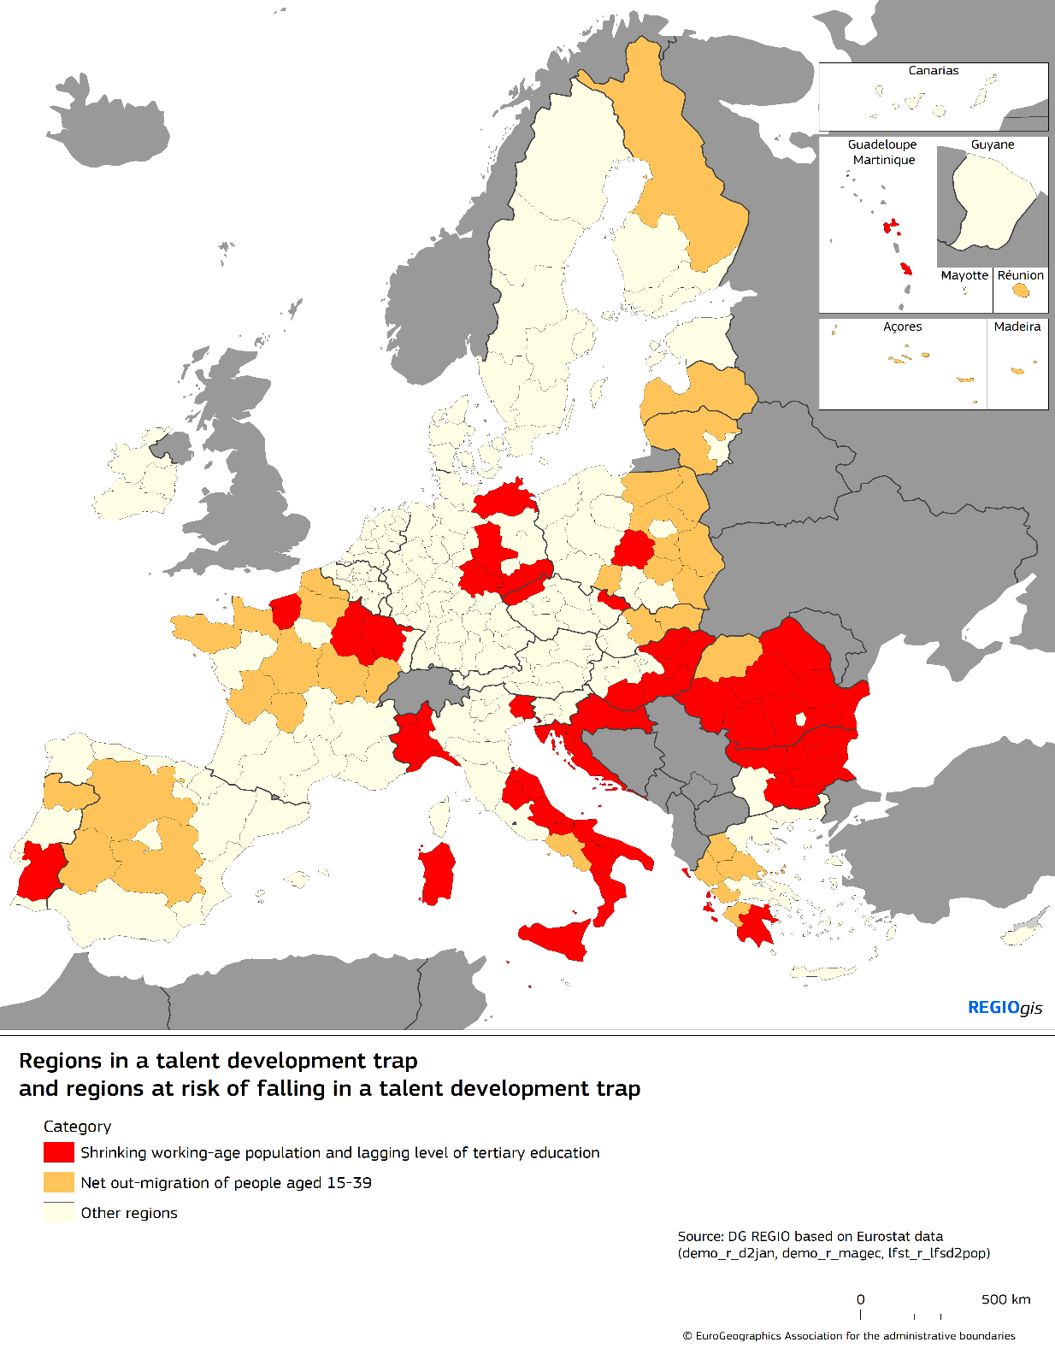
Talents needed to offset the impact
Regions affected by sharp workforce decline and low/stagnating share of tertiary educated in a talent development trap
Regions with net out migration of their younger cohort at risk of falling into a talent development trap

Slide 6
These regions face specific challenges
Lower performances than EU average with regard to:
Efficiency of labour market :
Lower employment rates – including for persons with tertiary education
Higher unemployment rates
Higher employment gender gap
Educational systems:
Lower share of tertiary educated, including for younger cohorts
Higher rate of early leavers
Higher rates of NEET (no employment, neither in education or training)
Lower rate of adult learning
Lower accessibility to services : digital divide and access to universities
Lower quality of public governance
Overall lower attractiveness of these regions for talents, unable to provide quality job opportunities
Indicators detailed in Annex

Slide 7
Decline is not inevitable
These challenges can be overturned, as untapped potential
Need for investments and reforms, steered by European Semester
Several EU initiatives and instruments are detailed to address these challenges
Several examples of successful regional and national experiences prove that challenges can be taken up
New “Talent Booster Mechanism” to be launched in 2023 and based on 8 pillars

Slide 8
Talent Booster Mechanism - 1
Direct support earmarked for
Regions in talent development trap to elaborate and implement tailored and comprehensive strategies to train, attract and retain talents
Regions at risk of falling into such traps to develop new approaches to demographic transition and talent development
Financial assistance, though resources available under :
Technical Support instrument,
Interregional Innovation Investments (I3) – enhanced attention paid to identified regions
European Urban Initiative – targeting shrinking cities
Cohesion policy (notably through 2024-25 midterm review) – 2024 Country reports will address the situation

Slide 9
Talent Booster Mechanism - 2
Extensive exchange of experiences and dissemination of knowledge and good practices, through a dedicated website and organisation of events, including targeted thematic and regional working groups.
Signposting to other EU initiatives : dedicated page of the website: initiatives highlighted in the Communication and forthcoming initiatives
Increase of analytical knowledge : addressing data shortages encountered during the preparation on regional development and migration (regional migration flows, access to services).

