Slide 1
EU Cohesion Policy and Europe’s Shifting Economic Landscape
Philip McCann*
Special Adviser to the EU Commissioner for Regional Policy, Corina Creţu
with Lewis Dijkstra EC
and Enrique Garcilazo OECD
University of Groningen
* I am grateful to the European Commission Directorate-General for Regional and Urban Policy and to the OECD Department for Regional Development Policy for allowing me to use their figures and diagrams

Slide 2
1. Structure of Talk
1. Structure of Talk
2. EU Cohesion Policy Reforms
3. Pre-Crisis: OECD Regional Context
4. Pre-Crisis: The EU Regional Context
5. Pre-Crisis: The EU Urban Context
6. Post-Crisis: The EU Regional and Urban Context
7. The Demographic Challenges
8. Conclusions

Slide 3
2. EU Cohesion Policy Reforms
Key Influential reports: Barca (2009) Report; OECD 2009 How Regions Grow; OECD 2009 Regions Matter
New ideas from many sources – economics, international development, science policy, economic geography, political science - Rodrik, Foray, Ostrom etc
Data on shifting economic landscape – evidence OECD, 5th and 6th Cohesion Reports
Shock effects of the 2008 global economic crisis
- EU convergence to divergence

Slide 4
2. EU Cohesion Policy Reforms
Key EU Cohesion Policy reform elements
Conditionalities
Results-orientation and the use of results indicators for monitoring, evaluation and learning
Smart specialisation
Strengthened partnership principle
More integrated approach CSF
ITIs and CLLD approaches
Enhanced urban agenda

Slide 5
3. Pre-Crisis: OECD Regional Context
OECD patterns of growth (urban intermediate rural etc) were very heterogeneous across countries
Similar probabilities of above average growth – but higher dispersion higher for rural regions
Benefits of urban concentration and agglomeration are neither linear nor infinite- limited in many OECD countries
OECD (2009a,b, 2011, 2012) evidence that endogenous factors were critical for regional growth

Slide 6
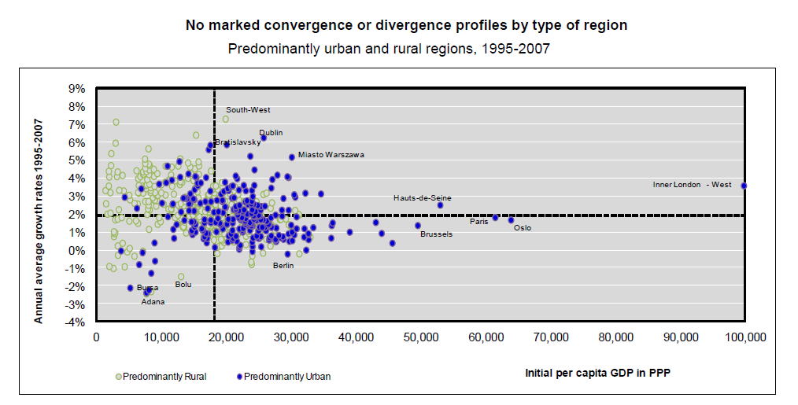

Slide 7
3. Pre-Crisis: OECD Regional Context
Post-2000 Productivity levels were dominated by global cities
‘Major Hubs’ accounted for less than one-third of economic growth – and their share was falling
Productivity growth was dominated by intermediate areas and many rural areas
Growth role of non-core regions across OECD was increasing
Distance-related effect in US (Partridge et al. 2011)
Not particularly distance-related in Europe prior to 2004

Slide 8
The most dynamic OECD regions over 1995-2007..
average rank (1== highest)
population
pop density
8

Slide 9
3. Pre-Crisis: OECD Regional Context
Two-thirds of growth was driven by non-core areas → convergence processes
Regions with less than 75% GDP per capita account for approximately 40-50% of growth
45-60% of growth is accounted for by regions with below national average GDP per capita
Smaller non-core areas were growing faster across the OECD than core and larger regions
OECD average interregional migration – 0.4% per annum and falling for ten years prior to the 2008 Gobal Financial Crisis
Long term falls in the rates of entrepreneurship

Slide 10
4. Pre-Crisis: The EU Regional Context
Role of major cities was significant in UK, France, Spain, Poland, Czech Republic
Polycentric systems in The Netherlands, Northern Italy, Germany
Urban-urban migration in rich EU countries
Rural-urban migration in Mediterranean and CEECs
Regional convergence
Overall urban share of EU GDP accounted for by metropolitan regions of >250,000 hardly changed 2000-2006

Slide 11
4. Pre-Crisis: The EU Regional Context
1990-2002 primacy of urban areas across EU: urban > intermediate > rural
Post 2002 shift in favour of non-core locations in many EU countries in terms of population growth and productivity growth
EU-15: intermediate areas and rural areas growing faster than urban areas
EU-17 urban growth still dominates
Different patterns in different countries – no simple story
Dutch reversal Broersma and van Dijk (2008) JEG

Slide 12
5. Pre-Crisis: The EU Urban Context
2000-2008 UK, France, Netherlands, Spain – population of metro regions grows at a lower rate than national population
GDP share of primarily urban areas in EU15 remained almost constant over the decade.
Many small and medium sized cities displayed high productivity levels and growth
Complex polycentric EU-wide network structure connectivity appears to be more important than urban scale, national scale, specialisation or diversity (Bel and Fageda 2008; Ni and Kresl 2010: Taylor 2012)

Slide 16
6. Post-Crisis: The EU Regional and Urban Context
Primarily urban areas and remote rural areas are the weakest regions in Europe in the aftermath of the crisis
Rural areas close to the cities and intermediate areas are the most robust types of European regions
Large cities are vulnerable
Different story to North America and much of the international literature

Slide 31
6. Post-Crisis: The EU Regional and Urban Context
Cities exacerbate national post-crisis trends → growing countries are driven by growing cities and declining countries are weighed down by declining cities
Urban advantages relating to employment and productivity post-crisis are oriented towards EU13 economies while EU15 face severe urban disadvantages
Convergence → divergence. Greater emphasis on the challenges facing lagging regions

Slide 32
6. Post-Crisis: The EU Regional and Urban Context
Effects of the real estate-related debt on the real economy are more pronounced in cities
Real estate shock effects are dominated by cities → induced effects in the real economy
Population ageing and population decline
More than one third of Europe’s cities are declining in population prior to the crisis and this has been exacerbated by the crisis
Fiscal positions of sub-national government?
Long term financial basis of public investments in urban development?

Slide 33
7. The Demographic Challenge to Cities and Regions
Working age population v non-working age
By 2050 Western Europe labour supply < 1990s levels and in Japan < 1970s levels
By 2030 EU working age population will fall by 6%
By 2030 the working age population will fall by 12% in Germany, Spain and Portugal, by 7% in Ireland, by 4% in Netherlands, and will increase by 2.3% in UK and by 8% in Sweden.

Slide 34
7. The Demographic Challenge to Cities and Regions
Increases in age-related expenditure and services by 4.1% of GDP across Europe and 4.5% across Eurozone
UK older age cohort increases from 9.7m in 2013 to 15.8m in 2030.
UK falling national tax revenues due to higher age-related tax exemptions – extremely difficult to adjust - institutional problem
Working age versus non-working age

Slide 35
7. The Demographic Challenge to Cities and Regions
OECD urban areas account for 56% of OECD population and metropolitan urban areas > 500,000 account for 47.9% of OECD population
1950-2010 – share of > 65 increased fourfold and > 80 increased by 14-fold and these rates are both inceasing
100 large OECD cities of over 300,000 are shrinking, up from 10 in 1950, and 30 are in Europe
One third of EU’s metro regions of over 250,000 were shrinking pre-crisis

Slide 36
7. The Demographic Challenge to Cities and Regions
By 2025 a quarter of the global population > 65. In 1950 it was 7% and only 1% > 80
Old age distinction now 65-75 and > 75
Metropolitan urban areas – 0.8% lower share of older people than non-metro areas
Across OECD core metro areas are 1.1% younger than metro hinterland areas
North and western Europe core metro are younger than hinterlands but southern Europe is the reverse

Slide 37
7. The Demographic Challenge to Cities and Regions
Metro areas ageing rate of 23.8% compared to metro areas population growth rate of 18.2%
OECD city categories – ageing and slow growth - 118/275 (43%) metropolitan urban areas
OECD city categories – young but ageing rapidly - 80/275 (29%) metropolitan urban areas
OECD city categories – young and ageing slowly - 78/275 (28%) metropolitan urban areas

Slide 38
7. The Demographic Challenge to Cities and Regions
Type I cities will reach peak population and will then decline
Type II will face shifting demands
Type III face the least challenges or disruption
Migration of human capital is a crucial element here as this determines the underlying economic base

Slide 39
7. The Demographic Challenge to Cities and Regions
Relatively ageing and increasing incomes and wealth – regions with high amenity and leisure migration
Relatively youthful and increasing in incomes and wealth – buoyant regions and cities with in-migration
Ageing and declining – facing out-migration of youth

Slide 40
7. The Demographic Challenge to Cities and Regions
Age-related built environment
Age related housing wealth and affordability
Across OECD 76% of older age cohort are home owners, 15% are tenants and 9% are with subsidised rents
Wealthier countries in Europe have lower shares of home ownership
20%-35% of older age cohorts live alone

Slide 41
7. The Demographic Challenge to Cities and Regions
Sub-national government health and social care expenditure have increased by 1.5% since 2000 and doubled since 1970
2007-2030 Age related expenditure by local authorities forecast to increase by 250% in real terms
‘Pragmatic downsizing’
‘Managing’ urban decline is extremely difficult

Slide 42
7. The Demographic Challenge to Cities and Regions
City and regional growth models assume contant (ish) positive growth in population, GDP, real or nominal prices
Constant real or nominal prices with population growth
Nominal price growth with constant population – macro-stability targets
Urban boundaries with small population increases makes city planning straightforward

Slide 43
7. The Demographic Challenge to Cities and Regions
For constant nominal GDP the growth of per capita productivity growth must counteract the effect of population decline
Nominal GDP growth is essential for public finance
Limited evidence for such neo-classical effects - role of negative externalities tends to dominate
Over supply of under-utilised infrastructure

Slide 44
7. The Demographic Challenge to Cities and Regions
Maintenance and depreciation costs
Bankruptcies, failures and vacancies happen sporadically – scattergun holes in land markets
Urban planning becomes very difficult in population decline context
Land values falling in real and nominal terms
Land assembly and contiguity challenges
Danger of assets being shorted, but also hold-out positions

Slide 45
7. The Demographic Challenge to Cities and Regions
Possibilities for urban policy financial investment vehicles mixing financial and non-financial returns
Devolved governance is highly problematic in some cases
Relatively higher transaction costs lead to relatively (absolutely) higher transition costs

Slide 46
8. Conclusions
The seeds for many aspects of the EU regional and urban economies post the 2008 crisis were evident in the pre-2008 era
Urban areas offer major development and policy possibilities – growth, innovation and experimentation – and also imply major challenges
Demographic change – population ageing and population decline - imply significant long-term impacts for governance, policy and development trajectories

