Slide 1
The Public Animateur: place-based innovation and the smart state Kevin Morgan School of Geography & Planning Cardiff University
DG Regio/ERSA Lecture
European Commission
Brussels
17 June 2016

Slide 2
Overview
Reprising the state in political economy
classical and contemporary conceptions
Place-based innovation in Europe
the smart state presumption of RIS3
Plight of public sector/lagging regions
challenge of lagging regions

Slide 3
State discourse
“It has become impossible to think straight about the state.
The only permissible discourse is to talk of shrinking,
fragmenting and privatising it – opening it up to competition
and market forces. It is accepted as axiomatic that a public
institution will be bureaucratic, self-serving and…lazy.”
(Will Hutton, The Observer 18 October 2015)

Slide 4
Adam Smith on the State
Arguably the most used and abused thinker
in the history of political economy.
“Little else is requisite to carry a state to the
Highest degree of opulence from the lowest
barbarism, but peace, easy taxes, and a
tolerable administration of justice; all the rest
being brought about by the natural course of
things.”
(Adam Smith)

Slide 5
Adam Smith on the State
The Wealth of Nations has been misconstrued as a
plea for pure laissez-faire.
But it is also a plea for a smart state - to temper
the noxious effects of the market, social privilege
and the division of labour.
Apart from peace, security and justice, the smart
state was duty bound to promote public works
and especially public education.

Slide 6
The neo-liberal critique
Politically based on a zero-sum view of state and market (less
of former = more of latter).
Theoretically informed by Hayekian insights:
Informational: the state cannot be a surrogate for the decentralised information processing capacity of markets.
Interventionist: industrial policy will induce rent-seeking, so states cannot and should not engage in “picking winners.”

Slide 7
The entrepreneurial state
A recent critique of the neo-liberal critique is Mazzucato’s
book, The Entrepreneurial State, which aims to:
change the way we talk about the state
prove the state can be innovative and risk-taking
show how the smart technologies of the iPhone were all funded by the state
But DARPA is used to illustrate the thesis - a unique mission-driven US defence agency .
Underplays the creativity of Apple/overplays the creativity of the public sector.

Slide 8
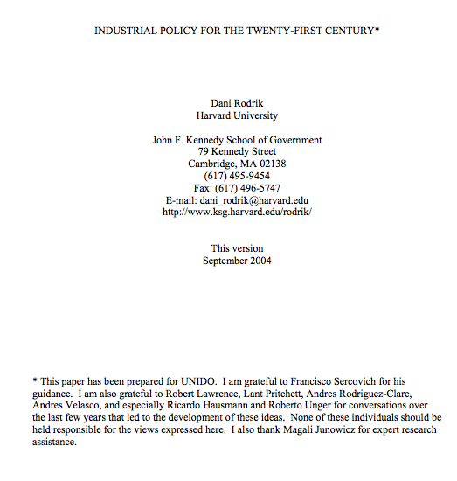
The experimentalist state
The most persuasive critique of the critique is the
experimentalist approach (Rodrik/Sabel)
the state lacks information, but so does the private sector!
firms and states need to collaborate to learn together in a trial-and-error process of social experimentation
the aim is to elicit information, find joint solutions, and evaluate outcomes through diagnostic monitoring
this is the smart state thesis adopted by Foray and presumed in RIS3

Slide 9
Experimentalist governance
EG is “a recursive process of provisional goal-setting and revision
based on learning from the comparison of alternative approaches...”
(Sabel and Zeitlin). It involves joint goal setting between central and
local units where the latter have broad discretion to meet the goals of
the project.
Projects are subject to a continuous process of diagnostic monitoring -
the primary aim of which is to build problem-solving capacity not to
police compliance.
Sabel argues that RIS3 needs more diagnostic monitoring or it could
degenerate into business as usual.

Slide 10
Barriers to experimentalist state
EG is compelling in principle but challenging in practice because...
Feedback is critical - but stymied by fear, power and hierarchy.
Failure is not tolerated - but the public sector is invited to be more
experimental and less risk averse.
Learning is vital – but time and space are not afforded to monitoring,
evaluation and revision.

Slide 11
Regional innovation policy
Regional innovation policy is 26 years old and its effects remain
ambiguous, like Cohesion Policy more generally -
“One of the major challenges for EU Cohesion policy is that, after 25
years of implementing the policy, the evidence for its effectiveness is so
inconclusive. Academic research and evaluation studies have reached
widely differing conclusions on the results of interventions through
Structural and Cohesion Funds.”
(Bachtler et al, 2015)

Slide 12
Share of innovation-related investment in EU Cohesion Policy
Programming Period | % | Value (€bn)
1988-1993 | 4 | 2
1994-1999 | 7.6 | 7
2000-2006 | 11 | 21.5
2007-2013 | 25 | 86
2014-2020 | 45 | 166

Slide 13
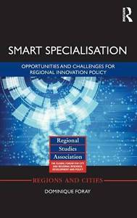
Hyper-fast policy
RIS3 concept has been rapidly embraced by the
EC, OECD and the World Bank.
Described as “the brilliant career of a relatively
simple idea...produced at the right
moment” (Foray).
EC support helped the concept to avoid “the fate
of being buried in the great cemetery of good
ideas that were never tested or applied” (Foray).
No pilot actions for RIS3 - the biggest innovation
policy experiment in history.

Slide 14
Smart state presumption
RIS3 presumes the existence of a smart state because it asks a lot of
the regional state and other public bodies (eg universities).
Key aspects of the “smart state” include:
quality of government
public sector competence
public procurement capacity
entrepreneurial discovery process
responsive political elites committed to innovation

Slide 15
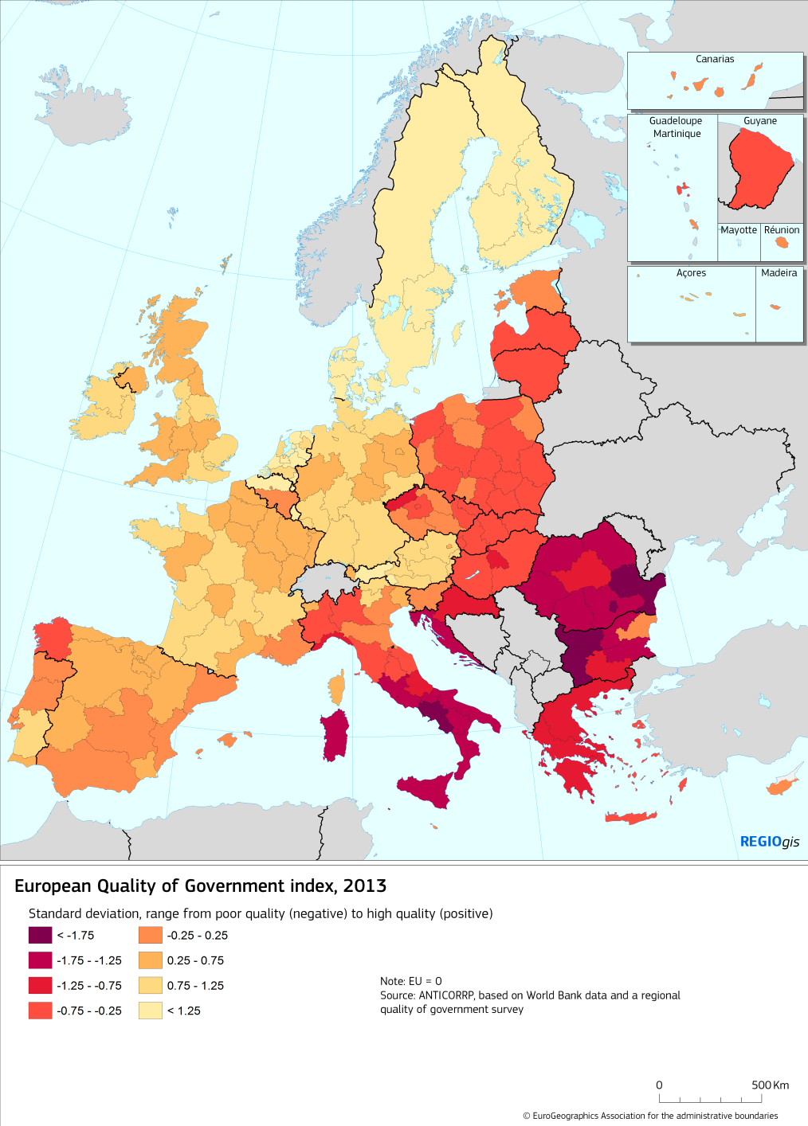
Quality of Government Index
Poor governance can stymie innovation and economic growth and trap regions in a “low growth equilibrium.”
Poor governance makes for poor and unresponsive public services.
Poor governance is cause and consequence of fraud and corruption.
Poor governance compromises the impact of Cohesion Policies as it reduces absorptive capacity.

Slide 16
Absorptive Capacity

Slide 17
Public sector competence
Public procurement accounts for nearly 20% of EU GDP and has
untold potential to effect social/economic/ecological change.
But it is the biggest source of irregularities in EU regional policy
and this weakens the power of public purchase.
The academy has done too little work on the scope for/barriers to
the power of purchase.

Slide 18
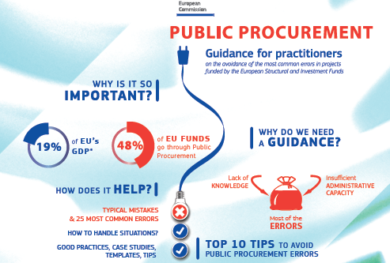
Public procurement guide
Low cost still dominates the practice even though the guidelines allow public bodies to seek values for money and not just value for money.
Power of purchase is stymied by poor skills and low political commitment.
Public procurement is the sleeping giant of regional innovation policy.

Slide 19
Entrepreneurial discovery
The core of RIS3 (for Foray) is the process of “entrepreneurial
discovery” in which the smart state identifies new R&I priorities
alongside firms and universities etc.
But many regions still cling to the linear model of innovation in the
(mistaken) belief that university research inputs = innovation outputs.
Big disconnect here with the academy, where the linear model was buried
over 20 years ago
What can be done about university science silos?

Slide 20
Regional elites/usual suspects
RIS3 needs to address under-performing elites because they
correlate with low QoG innovation
Need to hold elites to account through local and extra-local means:
through local civil society (eg the Integrity Pacts pioneered by Transparency International).
through national/supra-national conditionalities (eg the ex-ante conditionality of RIS3).
the “double movement” Barca formula for place-based development.

Slide 21
Eviscerated public sector
Many governments in thrall to a pre-Keynesian creed that aims to
eliminate the deficit and shrink the state.
A shrunken state is a disempowered state that lacks the capacity to offer
smart state solutions
Public sector becoming more important to innovation in sectors – health,
social care, education, energy, transport, agri-food, built environment –
that contribute to smart, sustainable and inclusive growth.
“Third wave” innovation needs a smart state

Slide 22
Public sector in lagging regions
Lagging regions are the biggest challenge to Cohesion Policy and the
smart state presumption.
Cohesion policy trends – from infrastructure to innovation and from
absorption to results etc - are very challenging for lagging regions.
Quality of institutions and calibre of networks are critical to the success of
RIS3.
Credibility/legitimacy of the state needs to be enhanced - by curating the
RIS3 process not controlling it – especially in lagging regions.

Slide 23
Lagging Regions
The Lagging Regions project presumes a smarter public sector
because it aims to foster “knowledge triangle” linkages in 2 types of
lagging region:
low growth regions in Southern Europe
underdeveloped regions in CEE countries
Case of North East Romania:
lack of regional powers
lack of university engagement
EC projects (like P2P and HESS) can help, but …
devolution of power is key to the valorisation of local knowledge

Slide 24
State as curator
Public sector must play a more catalytic role in RIS3 process.
By using its convening power to broker new networks within the region (to
promote triple and quadruple helix partnerships).
By using its curating capacity to foster trans-regional networks and value
chains (like the Vanguard Initiative).
Smart states are valued for their competence in the network not for their
status in the hierarchy (and for deploying soft power as well as hard)

Slide 25
Summary
Smart states can make a big difference to innovation and
development (if they have the institutional capacity/political
leadership).
RIS3 presupposes a smart state but latter is far from the norm (and
public sector innovation is stymied by lack of feedback, learning
and fear of failure).
Shrinking the state is counter-productive as a (smart) public sector
is a key actor in the era of place-based innovation and societal
challenges – especially in our lagging regions.

