Slide 1
On the policy space of smart specialisation strategies
Dominique Foray
ERSA Lecture
March 4, 2016
DG for Regional and Urban Policy

Slide 2
In search for effective policies to drive positive structural changes (diversification, modernisation, new industries) in European regional economies

Slide 3
Policy to drive structural changes
Horizontal policy
The innovation policy space - 1

Slide 4
Policy to drive structural changes
Horizontal policy
Likely to drive structural changes through mechanisms such as:
Mobility
Spin-off, start up
Diversification of firms
Networking
(Boschma and Frenken, 2011)
The innovation policy space - 1

Slide 5
Horizontal Policy is not enough
These policies failed in many cases (less developed/transition regions)
Horizontal policy did not reduce the knowledge gap
When the knowledge gap has been some what reduced, this did not translate into real economic progress
Innovation requires not only that « the basics are right » but also specific capabilities and resources
In top regions these are provided by the main actors of innovation
In less advanced regions, « firms are home alone » (S.Berger)
Local ecosystems and capabilities as the « third boundary conditions »
Need for a policy to support the emergence of ‘complete’ systems of innovations in particular activities where future competitive advantages can be built

Slide 6
Advanced manufacturing technologies in the footwear industry
Animal genetics for breeding
Biotech & ICT in fischeries and canning industry
Microsystems of innovations emerge from connections between entrepreneurs, suppliers, research, lead users, etc.. to open and explore a new domain of opportunities
The new activities are complementing existing structures with the aim to transform them
The economic value of building local capabilities does not mean it is a closed process for an autarkic region
Internet application and e-commerce for tourism services

Slide 7
But this is another logic of policy which is sector non neutral or sector specific…
..and it is necessary:
« The idea that the government can disengage from specific policies and just focus on general framework conditions in a sector neutral way is an illusion based on the disregard for the specificity and complexity of the requisite publicly provided inputs and capabilities » Hausmann and Rodrik, 2006

Slide 8
Policy to drive structural changes
Horizontal policy
Sector non-neutral policy
The innovation policy space - 2

Slide 9
Supporting the emergence of micro-systems of innovation in various sectors is an expensive policy
Different activities require different things
This is haute couture rather than ready to wear
The local government cannot address all potential capabilities needs for all new activities
« We are doomed to choose » (Hausmann and Rodrik, 2006)
RIS3 : choice of (specialisation in) activities aiming at transforming sectors (or establishing new ones)
How to solve the choice problem?

Slide 10
Policy to drive structural changes
Horizontal policy
Sector non-neutral policy
Top down
Central planning mode
The innovation policy space - 3

Slide 11
The usual (old fashioned) response: government as the omniscient planner.
The principal knows ex ante what to do and set the incentives for the firms to execute the plan

Slide 12
Policy to drive structural changes
Horizontal policy
Sector non-neutral policy
Top down
Central planning mode
Cluster policy based on Government dictating what technology in what region
The innovation policy space - 3

Slide 13
Issues of distorsions, picking winners, government failures, policy capture and anti-competitive effects
“Although it is certainly true that not everything can be done at once, focus on selected areas for large investments to the neglect of the rest of the economy is a highly questionable strategy. Why it would be preferable to allocate scarce capital so that some activities have excellent infrastructures while others must manage with seriously deficient structure is not clear: without further evidence, it would appear to be a distortion”. (A.Krueger)
Krueger is right..but this does not mean we should give up any sectoral non-neutral policies

Slide 14
Policy to drive structural changes
Horizontal policy
Sector non-neutral policy
“What if, as I and many others assume, there are no principals…with the robust and panoramic knowledge needed for this directive role ?” (Sabel)
Top down
Central planning mode
The innovation policy space - 4

Slide 15
Policy to drive structural changes
Horizontal policy
Sector non-neutral policy
RIS3
(new industrial policy)
Top down
Central planning mode
The innovation policy space - 4

Slide 16
Policy to drive structural changes
Horizontal policy
Sector non-neutral policy
RIS3
(new industrial policy)
Top down
Central planning mode
Development policy – Hausmann and Rodrik
Mission-oriented policy – Foray, Mowery and Nelson
High tech policy – Aghion and Akcigit Trajtenberg
Self-organizing industry investment boards – Romer
Smart specialisation – Foray, David and Hall

Slide 17
Policy design issues
Choices are inevitable to undertake strategic actions; mistakes need to be minimized
Mistake type 1 : the Government has the perfect knowledge and knows ex ante what should be done.
In RIS3, specialisations are not given ex ante
Mistake type 2 – choices are made at sectoral level
Mistake type 3 – choices are made for ever (as in the world of Ricardo)

Slide 18
Design principle 1 Entrepreneurial discovery
The government does not have innate wisdom or the ex-ante knowledge about future priorities.
The knowledge about what to try and where to go is not obvious and not visible! It is hidden – It needs to be discovered!
From Hayek to Sabel
The discovery process forms an integral part of political action
E means entrepreneurial (in a broad sense) : firms, universities, public research, lead users, communities
D means discovery, i.e. opening and exploring a new domain of opportunities –mainly through the integration and recombination of different types of knowledge

Slide 19
Entrepreneurial discovery cont.
ED precedes innovation
Not an extraordinary event
In many cases ED is internalized in large companies
In many other cases it requires networks and collaboration
ED has a strong informational dimension – its social value
ED matters twice
As a generic step of many processes of positive structural changes - to open and explore a new domain of opportunities for diversification, modernisation, etc..
As a solution to the information problem that the Government faces when comes the time of choices
Based on this information, the Government can select a few number of new activities according to criteria about potential impact, feasibility , proximity to market, significance for the regional economy, number of actors involved, etc.

Slide 20
Design principle 2- No sectoral prioritisation
What is prioritized is not a sector but the new activity aiming at transforming the sector or establishing a new one (meaning that the strategy only involves the segment of the sector which is part of the new activity)
Sectoral prioritization creates distorsions
Activity level is the right one to see in detail the pieces of the knowledge economy that a region or country can take as a basis for its smart specialisation strategy

Slide 21
Design principle 3- RIS3 has an experimental nature
A few bets are placed on various domains
RIS3 is a living document
After 5/6 years a new activity is no longer new (as a success or a failure it needs to exit)
New discoveries happen all the time and a few very new activities need to be integrated in the strategy

Slide 22
Programs to maximize e.d.
e.g. call for proposals, platforms
Pre-identfication of potential areas
Priorities
RIS3 portfolio of activities at t
Ex ante assessmentSelection
Pre-identification of « opportunities areas»
ed
ed
1
ed
2
Pre-identification of « sector areas»
ed
ed
3
No pre-identification
Level of granularity between sectors and micro-projects. It matters for ED
ed
Supporting micro-systems of innovation
Ex post evaluation

Slide 23
Programs to maximize e.d.
e.g. call for proposals, platforms
Pre-identfication of potential areas or not
Priorities
RIS3 portfolio of activities at t
Ex ante assessmentSelection
Smart-inn
Micro-systems
3S Mems
1
Local and sustainable production of the agro-food sector
2
Micro D2
Micro-technics for the luxury industry
3
innov therapy
Smart mobility
Région Franche-Comté
Supporting micro-systems of innovation
Ex post evaluation

Slide 24
Programs to maximize e.d.
e.g. call for proposals, platforms
Pre-identfication of potential areas or not
Priorities
RIS3 portfolio of activities at t+5
Ex ante assessmentSelection
Pre-identification of « opportunity areas»
ed
ed
1
ed
2
Pre-identification of « sector areas»
ed
4
ed
5
ed
3
No pre-identification
RIS3 is a living document
ed
Supporting micro-systems of innovation
Ex post evaluation

Slide 25
A smart specialisation strategy involves..
.. putting in place a process:
to identify sectors and emerging domains where structural changes are desirable
to stimulate (and learn from) entrepreneurial discovery processes (edp)
to concentrate resources on a few number of activities (emerging from the edp)
to help these activities to grow (specific capabilities and complementary resources)
to measure progress
to re-initiate the process at any time

Slide 26
Policy to drive structural changes
Horizontal policy
Sector non-neutral policy
RIS3
(new industrial policy)
Top down
Central planning mode
Beyond Principal-Agent
gouvernance
Centrality of
entrepreneurial
discovery

Slide 27
Lessons from the EU experiment?
Great impact : “Smart specialization (SS) program of European Commission is currently the biggest experiment in innovation and industrial policy in the world and possibly biggest ever undertaken” (Kutzesnov and Sabel)..
…but ex ante conditionality as a key factor
Price to pay (implementation)
No time for pilot study
One size fits all
« Specialisation » : is there a better word?
The language of ED and RIS3 becomes common place in Europe but what we see being implemented in practice is often the rethoric not the substance

Slide 28
Risks of incrementalism? Regions being locked in (trapped in) trajectories of minor innovation
This is not a risk – just the philosophy of RIS3:
In innovation there is not just one game in town – there are different orders of innovation
For many regions, the key point is not inventing at the frontier but rather generating innovational complementarities in adopting sectors
These types of complementarity actions (adoption of ICT or biotech, local innovations in trad. sectors,..) may be less flashy, less overtly innovative, and yet these ultimately constitute the key to economy-wide growth
Based on a good RIS3, a ‘secondary region’ can at least become a good follower
Capable of allocating R&D and other innovative inputs so as to lever the growth potential of the prevalent KET (GPT) invented elsewhere

Slide 29
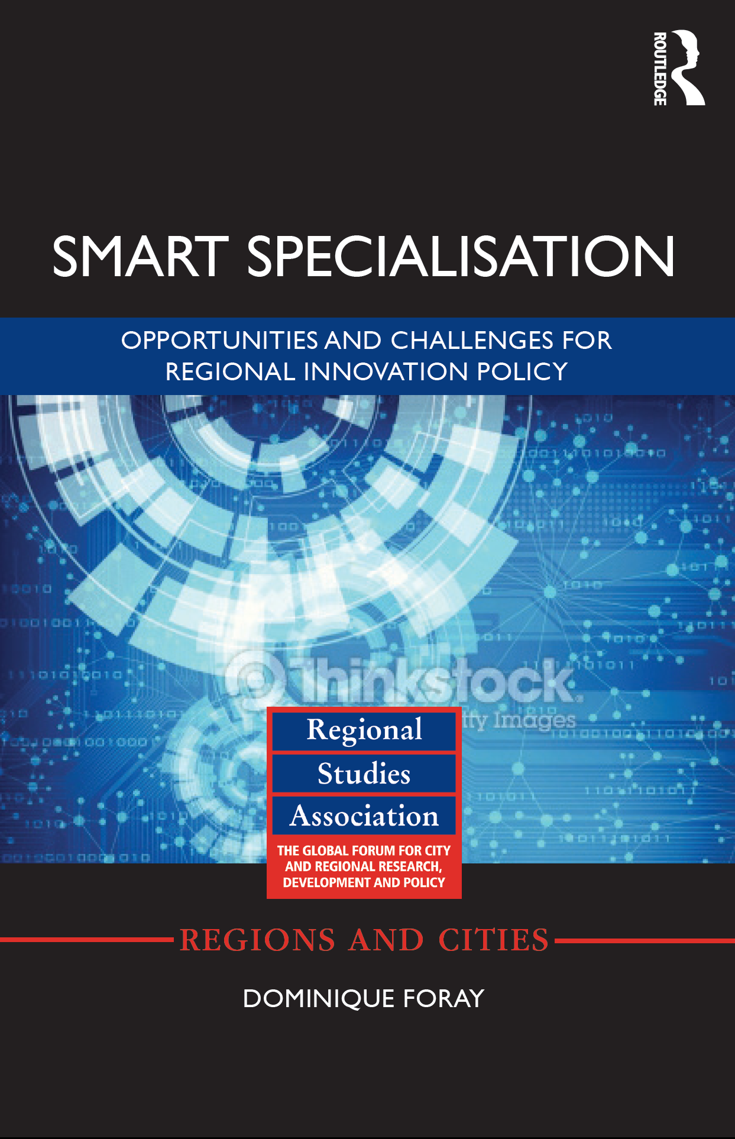
Thank you

