Slide 1


Slide 2

Bringing European cooperation to your region
Juraj Droba, president of Bratislava Region

Slide 3

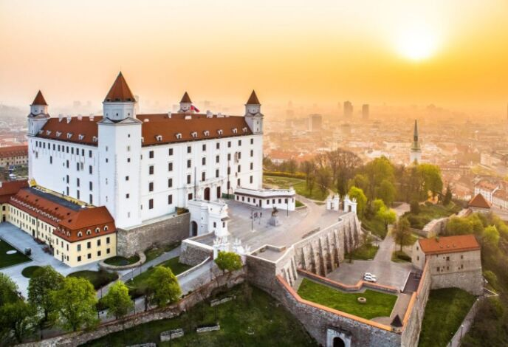
Bratislava Region
Metropolitan area
11 % of Slovak population
Both urban and rural character
Transport, environmental and social services in high demand
Notes:
Bratislava Region is the most developed region in Slovakia and is one of the most economically productive regions in the European Union. Being the driver of Slovak economy has also its toll and the region has to face various challenges specific for metropolitan regions linked to transport, environment and a huge demand for services that they need to address. 3/5 of European population lives in metropolitan areas and many metropolitan areas faces the same challenges.
One of the challenges is bringing closer the urban and the rural part of the region. If taken seriously, such cooperation can create functional ties and help both the cities as well as the rural area surrounding them.
These challenges need to be reflected both in political priorities and also thematically on EU level. Therefore, I very much welcome the larger flexibility proposed by the European Commission concerning the future of Cohesion policy after 2020.
These times are especially trying for the the EU, taking into consideration Brexit, the negotiations about the future cohesion policy and the slowing down of economic growth in many EU countries.
I would like to highlight the importance of multilevel governance here, the need of subsidiarity principle, which places decisions at the most effective level and as close as possible to the citizens, and enables co-creating policy solutions that reflect the needs of citizens.

Slide 4
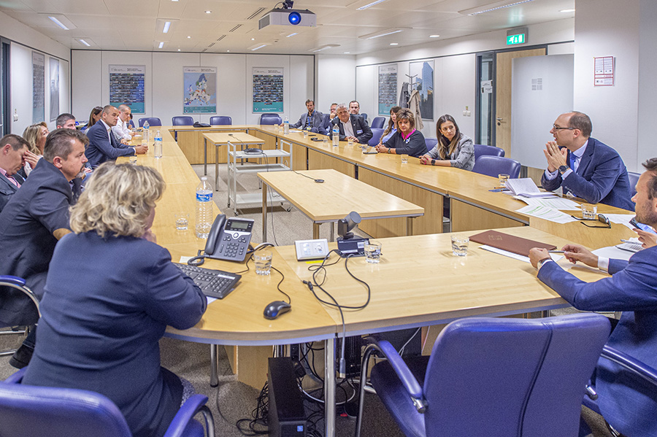
What can we do towards EU
Be in Brussels
Be active
Have valid arguments
Be persistent
Notes:
This workshop is meant for young politicians who are part of the multilevel governance and can influence decisions on different levels. I support very much the engagement of young people in politics and in all levels of governance – from local, through regional up to the national level. Once elected there are many ways how to be active. I can share with you how Bratislava region is tackling this challenge and what we do to make our voice heard.
Here are few tips:
Be in Brussels
Bratislava Region established its office in Brussels already in year 2002 and has 2 full time employed people . Our office not only represents the interests of Bratislava Region in Brussels, forms partnerships with other regions, stakeholders and networks, actively involves also other subjects from the region (schools, enterpsises) to present the potential of the region through organizing seminars, conferences, cultural events and others are the essential activities of the representation.
Be active
Every politician can be actively involved in one way or another. I am for example member of European Committee of Regions, and recently rapporteur of the opinion „The challenges of metropolitan regions and their position in the future Cohesion Policy post 2020“
We have regular meetings with Slovak Permanent Representation, Slovak members of European Parliament and European Commission
Bratislava Region is actively involved in activities taking place in Brussels, as the one today, European Week of Regions and Cities
We are also Managing authority of the Interact Programme, one of only four interregional programmes in whole EU and covering 30 participating countres.
We deliberately build ownership of members of Bratislava Region assembly – we organize study trips for the m to Brussels, they also have the opportunity to meet European Commission, parlamentarians and other interesting stakeholders. These study trips help to build ownesrhip of the regional parlamentarians and also understand better the importance of active involvement in Brussels.
Have valid arguments
Being active on its own is not enough. To be successful, one has to think ahead and have solid argumentation handy at all times. Therefore Bratislava Region built strong strategy department and in the near future, an analytical unit will be established. With this expertise background we are able to prepare the soil for negotiations with regards to all important issues that Bratislava region pursues. Currently, the focal point of our activites are the negotiations about the upcoming programming period 2021-2027 in both objecties of the cohesion policy – investment for growth and jobs and also Interreg/European Territorial Cooperation.
Here, I would like to say a few words on the proposed methodology for the Interreg in the new programming period. Commission proposes new methodology for the allocation of funds per Member State for the European territorial cooperation goal.
The new methodology foresees that mostly the population of the NUTS3 regions, who are living within a range of 25km from the border, as well as the population of NUTS3 regions where more than 50% of the population resides within this 25km range are going to be considered.
Until the period 2014-2020 the methodology for the allocation per Member State was calculated on the basis of the population of the NUTS3 border regions. Therefore there is reason to fear that this method will potentially lead to a massive redistribution or unjustified disadvantage of individual programs compared to the current funding period. Bratislava regions is not fond of such change and would like to keep the methodology as it is set in the current programming period.
Be persistent
None of the above mentioned is one off activity. If you want to achieve our goal and assure change, the active approach has to be constant and long term – one of the recent examples is the upcoming change of the Integrated Regional Operational Programme – more money for Bratislava Region for building new schools, not only reconstruction of existing ones.

Slide 5
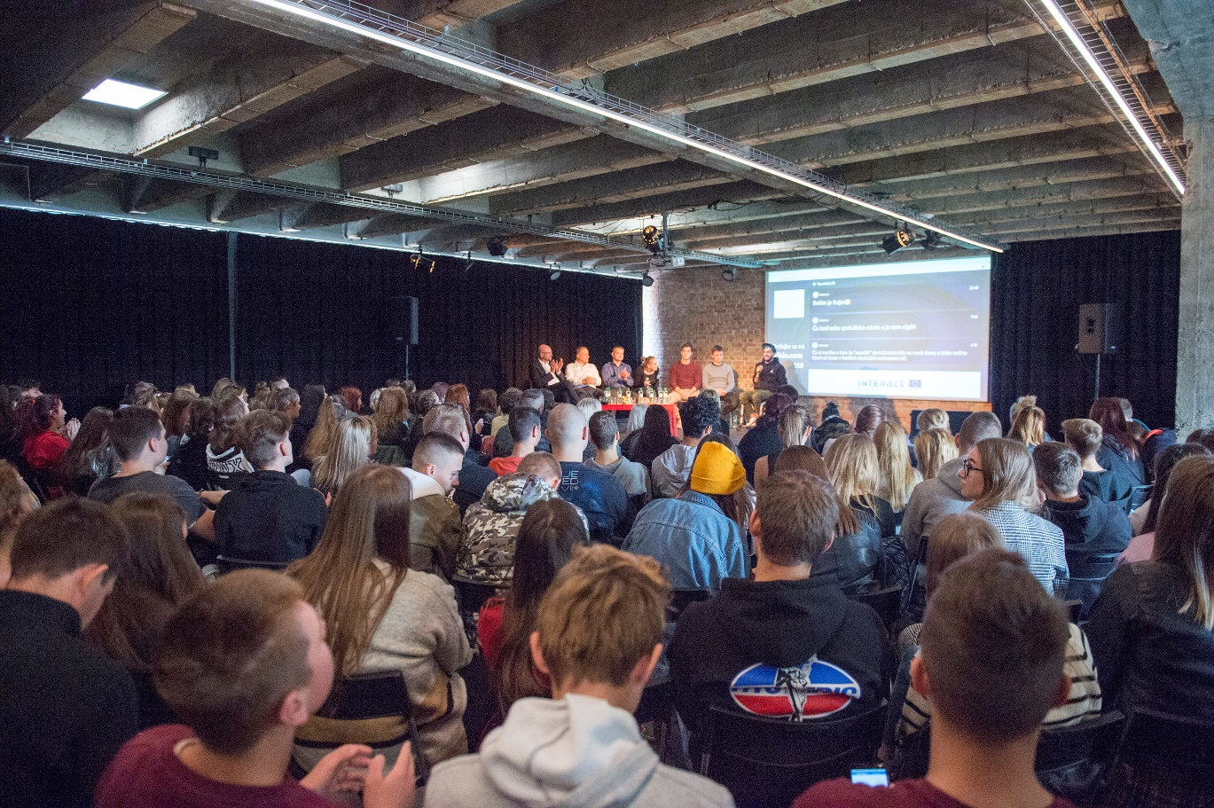
What we can do towards our regional stakeholders
Lead by example
Be involved in Interreg projects and EU affairs
Encourage involvement of different stakeholders in the region
Disseminate the results of our work
Notes:
Another important part of our work is to bring Europe closer to the region in practical life. Ordinary people think that the EU is not close enough and the important decisions are made in the Brussels bubble without them
Lead by example
What we can and should do is make the effort and explain, how the decisions on EU level are made, that people really can influence the decisions by participating in European parliament elections (unfortunatelly, Slovakia, although quite EU-positive country, has very low participation at the EP elections – 22,74% in 2019)
Bratislava regions has very good relationships with Slovak members of European Parliament and other influencers and facilitates various public discussions about EU-related topics.
Another example is in the field of facing the climatic change. Bratislava Region has developed a Catalogue of adaptation measures to climate change for our municipalities as the first region in Slovakia. In order to motivate our mayors to implement proposed measures, we have established a regional financial scheme and now we are going further and working on an Adaptation Plan.
Be involved in Interreg projects and EU affairs
Bratislava region is actively involved in cross-boarder, transnational and interregional Interreg programmes, either as beneficiary in the projects, or even more importantly, as the decision-maker in monitoring committees of some programme, e.g. Slovakia -Hungary, Slovakia –Austria. Thanks to these programmes of cross-border cooperation with Austria and Hungary we have been able to finance important projects, which helped to bring citizens on both sides of the border closer to each other. They can seek for better solutions together, build new partnerships or learn from each other.
The crucial element for effective and timely implementation is to have well-prepared strategic documents and elaborated project proposals, which will enable us to use the EU finance efficiently.
Encourage involvement of different stakeholders in the region
Bratislava region supports municipalities in the preparation of projects, disseminates information about different options how to be involved, encourages municipalities to get involved in EU affairs. We encourage cooperation and exchange of best practices by e.g. peer-to-peer learning.
Also citizens can become more involved in developing regional strategies and we involve them by e.g. public hearings – gathering inputs and recommendations from people and listening to their opinions on the state of the public service.
Disseminate the results of our work
Last, but not least, effective ways of communication have to be sought and used. We can do marvelous things, but if no one knows about them, it is very difficult to persuade citizens, that being part of EU really has and added value for them.
Therefor communication is key. We use the traditional media especially for senior citizens (TV, press) but for the young generation, social media is the platform, where everything happens and we have to find attractive way to pass the message to them in the form of short videos and story telling mainly on Facebook and Instagram.

Slide 6

Thank you for your attention and
looking forward to your questions!
Notes:
Ladies and gentleman, thank you for your attention and I am looking forward to your questions.

