Slide 1
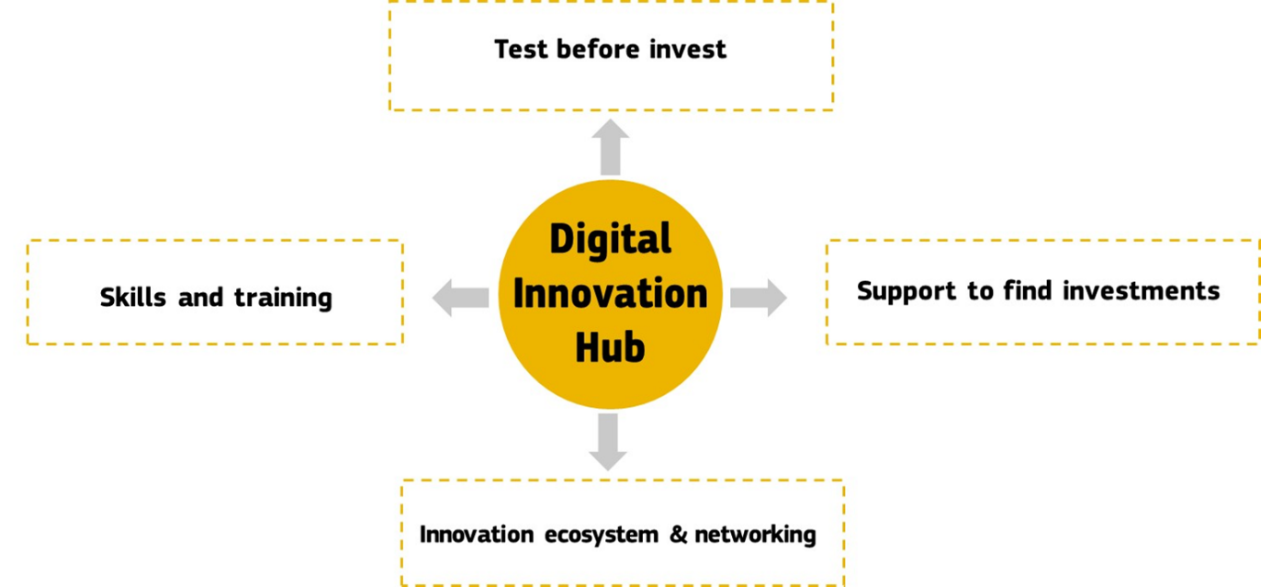
European Digital Innovation Hubs provide technological expertise and experimentation facilities to enable the digital transformation of the SMEs and the public sector.
Digital Innovation Hubs in Digital Europe Programme
Anna Puig-Centelles, DG CNECT A2
Typical participants:
  Research and Technology Organisations
  Technical Universities
In collaboration with:
  Industry associations/Chambers of Commerce
  Clusters
  Enterprise Europe Network
  Accelerators/Incubators
  Innovation agencies
A network of 130-280 EDIHs, co-funded with MS/Regions.

Slide 2
Specialisation of a hub is required, addressing the (future) needs of the industry and public administration.
If ERDF is used for co-funding, it should be in line with the smart specialization.
Digital Innovation Hubs in Digital Europe Programme
Anna Puig-Centelles, DG CNECT A2
DEP | Other Technologies | Application areas | Sector
AI, HPC, or Cybersecurity | Simulation Supply chain integration | Industry 4.0 Circular economy | Manufacturing
 | Remote sensing Photonics | Precision farming | Agri-food
 | Robotics, Simulation | Exo-skeletons, Automated building | Construction
 | Digital solutions for governments, AI, Cybersecurity | Services for citizens, once only principle | Public administration
 | … | … | …
Background documents on DIHs in a regional context:
    Digital Innovation Hubs into Regional Context - A European survey
    Exploring heterogeneous Digital Innovation Hubs in their context - Comparative case study of 6 DIHs
    https://s3platform.jrc.ec.europa.eu/knowledge-repository

Slide 3
Selection Process for EDIHs in DEP
Digital Innovation Hubs in Digital Europe Programme
Anna Puig-Centelles, DG CNECT A2
MS & EC define criteria for EDIH selection.
EC launches expression of interest to MS.
MS designate a list of entities that:
Fulfil the criteria
Will get or already got co-investment
[Based on open and competitive process]
EC launches a restricted Call to the entities designated by MS.
Designated entities submit proposals that are evaluated by the EC with the support of external experts.
EC selects together with MS from those proposals exceeding the pre-defined quality threshold balancing:
regional coverage
technology coverage
sector coverage

