Slide 2
BLISS Project
Output O3 Open Education Resource
Task O3-T1 Training and assessment material
Learning unit :
U3
Communicating the business merits, challenges and implications of blockchain technology
Hours :
50
Abstract :
Introduces how the characteristics of blockchain technology can disrupt and/or innovate existing business models and business processes. Examines existing blockchain-based use cases in industries such as finance, public services, provenance, supply chains etc.

Slide 3
Learning unit
U3
Communicating the business merits, challenges and implications of blockchain technology
Learning outcomes
K5
Interpret the legal, regulatory and consumer challenges to wider blockchain adoption and conformance
Knowledge
Skills
Policy and regulation
Blockchain and Public Policy, Central Banks & governmental regulations
Implications of blockchains for governments, policy makers, law professionals, regulators and society
Recognise potential regulatory and legal frameworks for blockchain operation, including consumer protection, and taxation

Slide 4
Learning unit
U3
Communicating the business merits, challenges and implications of blockchain technology
Learning outcomes
K6
Monitor the intervention of blockchain technology in business models
Knowledge
Skills
Blockchain as innovator of businesses and processes
Blockchain business models
Blockchain emerging trends susceptible to create value for the business
Innovative blockchain solutions and entrepreneurship
Blockchain transforming business and professionalism
Provide detailed examples of the blockchain transforming power in specific contexts

Slide 5
Learning unit
U3
Communicating the business merits, challenges and implications of blockchain technology
Learning outcomes
K7
Analyse blockchain SWOT (Strengths, Weaknesses, Opportunities, Threats) for specific industry scenarios
Knowledge
Skills
Blockchain maturity and strategies
Blockchain adoption metrics, challenges and opportunities
Blockchain business strategies
Project strengths and weaknesses of the Blockchain technology in a given scenario

Slide 6
Learning unit
U3
Communicating the business merits, challenges and implications of blockchain technology
Learning outcomes
K8
Intelligibly present Blockchain industry business models
Knowledge
Skills
Blockchain as business model disruption
Implications of blockchains for corporates, such as disruption by open markets, winner-takes-all, multi-sided market platforms, the role of trust in blockchain markets
How blockchain technology is disrupting existing business models and creating new ones
Describe blockchain business processes and business logics

Slide 7
Learning unit
U3
Communicating the business merits, challenges and implications of blockchain technology
Learning outcomes
K9
Communicate business opportunities behind the limits of the blockchain
Knowledge
Skills
Existing applications
Main disruptive features of different practical blockchain application scenarios, such as in finance, assurance, accounting, business operations, public administration and government services
Outline latest trends in the blockchain technology, and the directions of growth across impacted industries

Slide 8
U3 : Communicating the business merits, challenges and implications of blockchain technology
Frédérique Biennier
INSA of Lyon, France

Slide 9
Table of Contents
Part 1: Promoting Blockchain usage
From traditional economy to digital economy
Blockchain context
New business models or new technologies for existing business models?
Exercises
Part 2: Value models
Traditional value models
Characterizing a blockchain value system
Building the Blockchain value model
Integration of blockchain value models in digital economy collaborative business
Exercises

Slide 10
Table of Contents: PART 1
From traditional economy to digital economy
Blockchain context
New business models or new technologies for existing business models?
Exercises

Slide 11
According to you, how can you qualify the digital economy?
Are there any models qualifying the business environment?
What are the main collaborative ecosystems models?
Which requirements can be fulfilled using a blockchain?

Slide 12
According to you, how can you qualify the digital economy?
In this part you will
  Learn basic elements on digital economy and collaborative ecosystems
  Learn how IT and blockchain technologies have evolved to fit the economic context
  Get information on collaborative ecosystem requirements and how blockchain technology can be an answer

Slide 13
Table of Contents: PART 1
From traditional economy to digital economy
        Business model
        IT evolution
        Collaborative ecosystems
        Requirements for blockchain support
Blockchain context
New business models or new technologies for existing business models?
Exercises

Slide 14
Business model: Value
Characterizing value:
  Aggregating one or more impacts
  Financial, social impact, environmental impact, cultural impact
Global organization
  Internal
    How to produce the product / service
    Identification of the main costs related to investments as well as functioning costs
  Relationships with partners / competitors
    How value is shared
    How to be more attractive than competitors

Slide 15
Business model: Business environment (1)
Red Ocean (Porter 1980)
  Highly competitive environment
  Well known demand
  Value measured in monetary units
  How to survive: differentiated or cheaper product / service
Blue Ocean (Kim and Mauborgne 2002)
  Highly innovative industry
  New demands and markets
  Value is measured in monetary units
  How to survive: creating a new product and the associated market

Slide 16
Business model: Business environment (2)
Purple Ocean
  Mixing both Red and Blue ocean strategy
  Value measured thanks to monetary units
  How to survice: identify innovations to get market advantage
Green Ocean
  Integrating sustainability and environmental impact in the value
  New demand for « green products »
  Sustainability is a driver for innovation
Black ocean
  Closing market to competitors to reduce risks regarding the investments
  Unfair/unethical advantages to survive

Slide 17
Business model: Blockchain market
Disruptive technology
  New demand for distributed trust management
  Distributed and opened applications
Core mining function
  Highly competitive market
  Red Ocean strategy
Blockchain based development
  Mixing both innovation and strong competition
  Blockchain appears as a differentiation mean
Private / semi-private blockchain may be used to « close the market »

Slide 18
Table of Contents: PART 1
From traditional economy to digital economy
        Business model
        IT evolution
        Collaborative ecosystems
        Requirements for blockchain support
Blockchain context
New business models or new technologies for existing business models?
Exercises

Slide 19
IT Evolution: Architecture evolution (1)
Centralized
  Years 60-70
    Main cost related to hardware
    Repetitive tasks
    File system / centralized DB
  Years 90-2000
    Main costs related to the software configuration
    ERP => Standard software
    Centralized organization to support distributed decision
Distributed
  Years 80-90
    Microprocessor => PC
    Main cost related to the software
    Relational DB with interoperable query language
  Years 2000-2010
    SOA
    Web technologies
    More adaptive systems
    Cloud => outsourcing and industrialized organisation

Slide 20
IT Evolution: Architecture evolution (2)
SMAC – IT revolution?
  Front end / back end organization
    Different accesses
      Social media
      Mobile vs traditional systems
    Extend the collaboration requirements
  Generalized XaaS model
    Pay per use
    On demand
  Data are seen as value due to analytical processes
Extend the service and distributed application challenges

Slide 21
IT evolution: requirements (1)
Years 60 - 70:
  Programing is an art!
  High ownership costs
  Development of languages, databases, files systems
  Industrial organization of IT production.
  First attempts towards multi-media…
Years 80 - 95
  Relational databases -> openness provided by SQL
  Object Oriented Programing
  Software packages and “on the shelf” offers
  First step to industrialize of software production

Slide 22
IT evolution: requirements (2)
Years 95 / 2000
  Large scale software packages
    Minor purchasing costs
    Major parametrization costs
  “Proprietary” environments
  “Framework” development
  Start industrialize software production environment
Now
  Communication costs decrease
  Middleware logics
  Pay per use
  Open source software development
    Mutation towards a service-oriented environment
  Increase the call for Distributed Transaction management

Slide 23
IT evolution: Network environment
Internet architecture
  Built incrementally in the 70
  P2P organization
  Few application oriented services
Telcos vision
  Rather prospective => OSI model
  Integration of several service features such as interoperability, synchronization management, application service organization
Web-based technology
  Extend the Internet stack use
  P2P organization
  Extended connectors to deploy collaborative business

Slide 24
Table of Contents: PART 1
From traditional economy to digital economy
        Business model
        IT evolution
        Collaborative ecosystems
        Requirements for blockchain support
Blockchain context
New business models or new technologies for existing business models?
Exercises

Slide 25
Collaborative ecosystems: collaborative organisation
Partner centered collaborative organization
  Main stakeholder and its related business partners
  Mid-term to long-term collaboration
  Centralized vision
Centralized business network
  Main stakeholder with its business partners
  Networked value chain thanks to transversal relationships between partners
  Take advantage of trust developed using the partner centered collaborative organization
  Semi-decentralized vision
Fully decentralized
  Based on the business development and on the client own value chain
  Require developing trust
  Need to interconnect trusted Business Process (BP) in a short-term / mid-term vision

Slide 26
Collaborative Business: Requirements
Various requirements
  Standard process description for Business processes (best practices, legal constraints)
    Example of the SCOR patterns used in the Supply chain
  Expending partner centered organization to e-marketplace
    Increase the competition between potential partners
    Selection / cooptation to join the trusted e-marketplace
  Integration of IoT / WoT information to share production process information
    Adding new process models
    Enriching partners interactions

Slide 27
Collaborative Business: collaboration strategy
Informal collaboration
  Based on trust
  P2P co-operation
  No common processes
Contract-based collaboration
  Activities are coordinated thanks to a common process but Information Systems (ISs) are not integrated
  Contracts support partners interaction
  Trust is enforced by the contractual relationship
Fully integrated cooperation
  Cooperating legacy IS requiring interoperability
  Common process with strong interactions between partners own processes
  Multiple contracts management

Slide 28
Collaborative Business: collaborative BP
Trust management
  Key point to set collaborative organization
  Depends on various criteria
    Human relationships
    Non functional properties related to cost, delay, quality…
Supervision and governance functions
  Necessary to monitor agreements (SLA and business agreements)
  Requires integrating agreements related to different transaction
Organizing the common process
  Is not a simple composition of each partner own process
  Requires managing IS interoperability
  Activity imputability

Slide 29
Collaborative Business: legal constraints
Value-added process management involves paying attention to
  Responsibility limits
  Financial flows
Main requirements
  Electronic Data Interchange
    Standard interoperable documents
    Transaction log management
    Interchange contracts reporting IS interactions
  Trusted parties certification
    Legal accreditation
    Certification process
  Different legal contexts for international collaboration

Slide 30
Table of Contents
From traditional economy to digital economy
        Business model
        IT evolution
        Collaborative ecosystems
        Requirements for blockchain support
Blockchain context
New business models or new technologies for existing business models?
Exercises

Slide 31
Blockchain-based collaboration: requirements
Trust between partners
  Authentication: being sur of the identity of the contracting parties
  Reputation: knowing what has been done before is necessary for cooptation
  Transparency: each partner can control what others are doing to reach the common goal
Transaction management
  P2P and multi-tiers contractual relationships and transactions
  Ledgers are necessary to fulfill legal obligations so that transactions can be tracked
Automating Business Transaction
  Identifying intermediaries involved in the common process
  Tracking IS interactions
  Integration and synchronization of various components

Slide 32
Blockchain-based collaboration: Blockchain characteristics
Digital and distributed ledgers storing signed transactions
  Transactions are stored in blocks and blocks are chained
  Double-spending mechanism
  Shared ledgers increase availability and reduce fraud risks
  Digital signature provides integrity and imputability
  Increased transparency (but no confidentiality)
Extra services
  Smart contract allowing event-based process organization
  Digital identity providing certified authentication process
  Multiple signature mechanisms

Slide 33
Blockchain-based collaboration: benefits
Transparency
  Recorded transactions
  Need to define precisely the transaction information
Collaborative network management
  Identity certification
  Cooptation process registering
Distributed BP
  Record processes interactions
  Identify “launching conditions” for each sub-process

Slide 34
Table of Contents: PART 1
From traditional economy to digital economy
Blockchain context
        Blockchain key principles
        Blockchain characteristics
        Hype cycle
New business models or new technologies for existing business models?
Exercises

Slide 35
According to you, how can you qualify a blockchain project?
Is there only one kind of Blockchain project or several kinds of blockchain?
How to set a blockchain typology?
What are the main components?
Is Blockchain only a buz word or can its hype cycle be characterized?

Slide 36
According to you, how can you qualify the digital economy?
In this part you will
  Learn basic elements on blockchain characteristics to set a typology
  Identify key elements to select a convenient blockchain support
  Get information on blockchain hype cycle

Slide 37
Table of Contents: PART 1
From traditional economy to digital economy
Blockchain context
        Blockchain key principles
        Blockchain characteristics
        Hype cycle
New business models or new technologies for existing business models?
Exercises

Slide 38
Blockchain key principles: Previous works
Time-stamped information
  Digital signature including a time-stamp (1991)
  Use hashing techniques
Merkle tree (1979)
  Store hashed information
  Binary tree organization
  Merging blocks involves computing new hash associated to the “father node”
Strong cryptographic foundation but
  How can the Merkle tree be stored
  How to protect it from attacks

Slide 39
Blockchain key principles: characteristics
From transaction to blockchain
  A block stores
    transactions data
    The previous block hash
  A Merkle tree stores the blocks
    Each block is signed with a hash
Decentralized storage of the Merkle tree
  Distributed ledgers
    Safer storage
  Common governance rule
    How to trust the block validation process

Slide 40
Blockchain key principles: governance rules
Proof of Work (PoW)
  Block’s hash is computed according to a mathematical challenge
    Finding the “nonce” in a bruteforce way
  Requires important computing resources and energy
    Trust depend on the hardware investment and on the “consumed” computing resources
Proof of Stake
  Validator is randomly chosen according to the invested currency
  Avoid heavy computation
    Involves less speculation
Proof of Authority
  List of potential certified validators
  Reputation mark

Slide 41
Table of Contents: PART 1
From traditional economy to digital economy
Blockchain context
        Blockchain key principles
        Blockchain characteristics
        Hype cycle
New business models or new technologies for existing business models?
Exercises

Slide 42
Blockchain characteristics: access control
Permissionless blockchain
  Opened and shared ledgers
  Free access for validators
  Users are identified by their avatar
  Public blockchain
Permissioned blockchain
  Authorized validators
  Restricted access to the ledgers
  Users are associated to well known identities
  Used for private blockchain / consortium blockchain

Slide 43
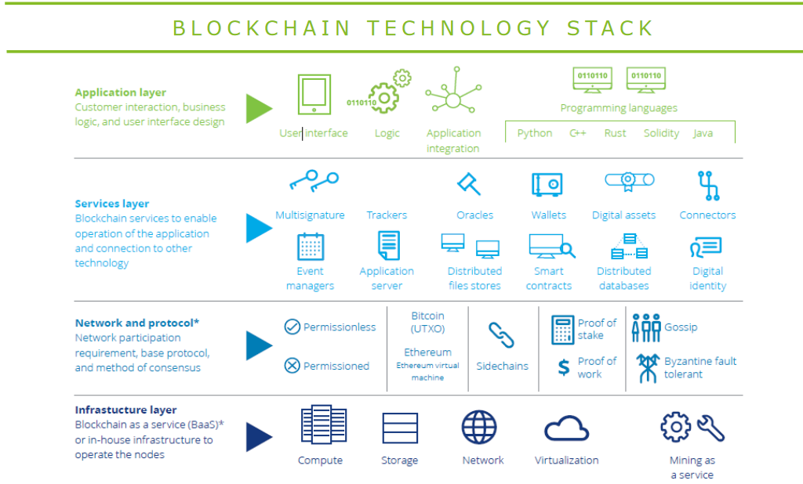
Blockchain characteristics: architecture (1)
Similar to the Cloud stack model
May lead to Blockchain as a Service organisation
Source: https://www2.deloitte.com/content/dam/Deloitte/in/Documents/industries/in-convergence-blockchain-tech-stack-noexp.pdf

Slide 44
Blockchain characteristics: architecture (2)
Infrastructure
  Computing, communication and storage features
  Mining process
    Adapted hardware
    Optimized cryptographic computation
Organisation and protocols
  Blockchain platform
  Validation strategy
  Consensus method
Services
  End user wallet system
  Trusted services: identity management, distributed files/DB, event manager, digital asset management…

Slide 45
Table of Contents: PART 1
From traditional economy to digital economy
Blockchain context
        Blockchain key principles
        Blockchain characteristics
        Hype cycle
New business models or new technologies for existing business models?
Exercises

Slide 46
Blockchain hype cycle
Blockchain 1.0
Blockchain2.0: Smart contracts
Blockchain3.0: Smart contracts + IoT

Slide 47
Blockchain hype cycle: Blockchain 1.0 key elements
First introduced as Bitcoin
Fiat currency
  P2P currency transfer without intermediaries
    But it requires miners!
  No valuable good exchange to support the crypto-currency
Transaction validation
  Solve the double spending problem
  Fees
    Use the blockchain token
    Miners choose “the best transactions” to integrate into blocks
    Paid only if the block is validated

Slide 48
Blockchain hype cycle: Blockchain 1.0 limits
Long delay (10 minutes for a bitcoin block validation)
  Scalability problem
Identity management
  Identity related to a key
  No proven links between the real identity and the avatar
Security risks
  Internal byzantine fault
  Lossing private key
Crypto-currency
  No legal status for the tokens
  Crypto-currency isolation: no exchange mechanisms between different currencies
  Highly volatile value due to speculation of the main actors

Slide 49
Blockchain hype cycle: Blockchain 2.0 key elements
First implementation in Ethereum
Smart contracts
  Distributed application
  Contract based organization
  Event driven
  Integrates the transaction payment
Distributed application
  Open-source
  Manage its own tokens
  Automated transaction execution
  Data and operations are stored in the blockchain

Slide 50
Blockchain hype cycle: Blockchain 2.0 limits
Smart contract legal status
  Computarized transaction and not a contract
  How parties identity can be proven?
  How to be sure of the capacity of the contracting parties?
  Different regulations depending on the hosting countries
Event driven organization
  Allows reactivity
  Different organization than the traditional control driven logic
“Code is law”
  Code cannot be adapted even in case of failure
  Increased security risks
Blockchain delay and scalability?

Slide 51
Blockchain hype cycle: Blockchain 3.0 Key points
Designed to overcome Blockchain 1.0 and 2.0 main limits
  Lack of scalability
  Lack of interoperability
  Lack of sustainability
  Off-line governance strategy lack of transparency
Main characteristics
  Blockchain middleware approach
  New on line governance strategy
    Scalable validation processes
  Integration of private blockchain requirements and characteristics
  Sustainable block management
  IoT integration

Slide 52
Blockchain hype cycle: potential usage
Main characteristics:
  Trust, immutability and consensus
  Potential community and coordination requirements
  Novelty
Picked from the truth about Blockchain (https://hbr.org/2017/01/the-truth-about-blockchain),
Novelty
Localization
Transformation
Single use
Substitution
Coordination

Slide 53
Blockchain hype cycle: Reduced community
Single use
  Blockchain provides a less expensive solution
  Focused solution
  Used to certify and store transactions in a distributed ledger
  Example: micro-payment
Localisation
  Reduced business community
  High novelty
  Mostly FinTech applications
  Example: NASDAQ management

Slide 54
Blockchain hype cycle: large community
Substitution
  Blockchain technology replaces traditional ones
  Use basic blockchain characteristics
    Immutability
    Availability
  Most applications are related to
    Certification (diploma, shipment documents…)
    Exchange (gift cards…)
Transformation
  Rethink applications to fit the digital transformation
  Heavy use of smart contracts
  Example: collaborative and shared economy (energy P2P exchange…)

Slide 55
Table of Contents: PART 1
From traditional economy to digital economy
Blockchain context
New business models or new technologies for existing business models?
Exercises

Slide 56
According to you, how can you set a blockchain project perimeter?
Is Blockchain a new “universal” technology?
Is blockchain a new technology for new business models?

Slide 57
According to you, how can you qualify the digital economy?
In this part you will
  Integrate the knowledge picked from digital economy and blockchain technological contexts to identify how blockchain can be integrated in a collaborative business systems
  Get some elements to promote blockchain usage

Slide 58

What can a blockchain do… and not?
Use case: Hey, I want a cup of coffee, should I use a blockchain ?
  Traditionally: order directly a coffee
  Use existing currencies to pay for the coffee and the service
Before Blockchain

Slide 59




Blockchain 1.0
Easy to pay without taking care of the currency type of the country
trusted exchange
« no charge »
Heavy Carbon cost !
Various real price depending on the cryptocurrency rate
Require adding the cryptocurrency as a payment mean in the reseller information system
Hey, I want a cup of coffee, should I use a blockchain ?
Accepted here

Slide 60


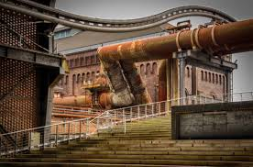
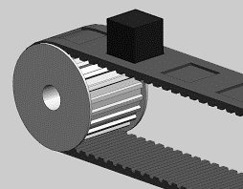

Blockchain 2.0
Define once the ordering conditions and do not take care after that
Choose your own trusted sources to define the contract launching conditions
The contract will be automatically launch depending on external context
Only 1 shot contract
Your reseller will have to establish the contract and its connection with its IS
The smart contract has a registration cost and the carbon cost may be heavy
P2P trusted organization which does not allow multi-tenant contract
Hey, I want a cup of coffee, should I use a blockchain ?
Conditions (time, temperature, stress level…)

Slide 61


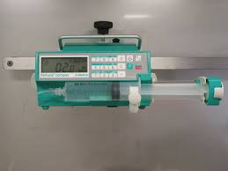

Blockchain 3.0
Fully trusted and distributed process organization
Totally new and distributed collaborative and trusted organization
Block registration cost, carbon impact
Change the application design model
Limited to P2P organizations and requires to set the collaboration chain separately
Hey, I want a cup of coffee, should I use a blockchain ?
Trusted IoT identification
Conditions (time, temperature, stress level…)
Collaborative supply chain organisation

