Slide 1






TEF SCC French node :
We are the MOBILITY French node ,
CITIFACT (SMART CITIES Facilities for Artificial intelligence Conformity assessment and Testing)
UTAC: French certification body for mobility systems
LNE: French reference body for certification and testing of AI systems
UGE: French referent for mobility at academic level
SYSTEMX: Unique French RTO dedicated to digital engineering
CITIFACT (SMART CITIES Facilities for Artificial intelligence Conformity assessment and Testing)
alain.piperno@utac.com , remi.regnier@lne.fr
CITIFACT

Slide 2

TEF SCC : French node
We are the MOBILITY French node/consortium , proposing TRL6-8 services & facilities for
TESTING & CERTIFICATION all AI based vehicles/components/services :
PROTOTYPING & PHYSICAL TESTING ( tracks, benches) for vehicles/systems/services
DIGITAL MODELING & TESTING HIL/MIL/SIL/DIL/VIL for mobility & AI
REGULATION & CERTIFICATION/Standards skills
AI EVALUATION skills (metrics, methods, certification,..)
TRAININGS/AUDITS/EXPERTISES for testing/regulation/safety/cyber
TESTS for Charging/batterie/EMC/acoustic/emission (perfo/regulation)
We are Already working on TESTING & CERTIFICATION for all AI based vehicles/components/services
alain.piperno@utac.com , remi.regnier@lne.fr

Slide 3
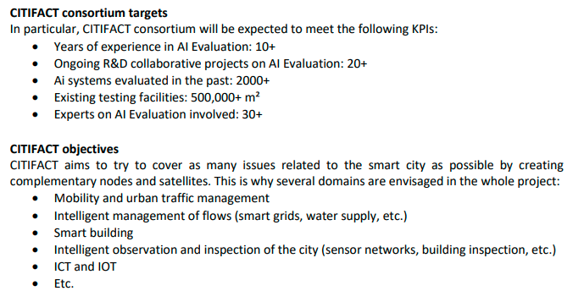
We are open/looking for 3 EUR partners / nodes
CITIFACT (SMART CITIES Facilities for Artificial intelligence Conformity assessment and Testing)
alain.piperno@utac.com , remi.regnier@lne.fr
CITIFACT

