Slide 1
“A truly interoperable e-administration at EU level”
Konstantinos Bovalis -DG DIGIT
Brussels, 29 June 2016
Conference:
“Cyber-Security, Open Data, Interoperability:
Towards a truly smart e-administration”
X
X

Slide 2
What is Interoperability
IT IS ALL ABOUT DIGITAL COLLABORATION
Interact
Mutual goals
Share information
Business processes
Exchange of data
ICT systems
"interoperability” is the ability of organisations to interact towards mutually beneficial goals, involving the sharing of information and knowledge between these organisations, through the business processes they support, by means of the exchange of data between their respective ICT systems.
(*) European Interoperability Framework

Slide 3
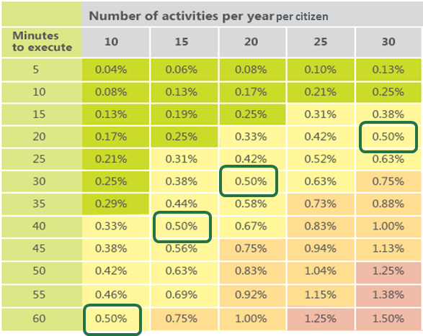
Public Sector
What about savings?
Electric power industry
Health care
5% of total healthcare, or 78$ billion annually in the US (source Griwise.org, 2009)
1% to 3%, or 10$ billion annually in the US (source Griwise.org, 2009)
Building and
construction
Geospatial
Wasted time due to citizens "waiting in the line" (because of lack of interoperability) and impact on GDP
a ROI value of 119% savings to investments (source Griwise.org, 2009)
about 3% of costs are related to software non-interoperability (source McGraw construction, 2007)
Country | 2010 GDP (USD millions) | 5.00%
France | 2.560.002 M$ | 12.800 M$
Germany | 3.280.530 M$ | 16.402 M$

Slide 4
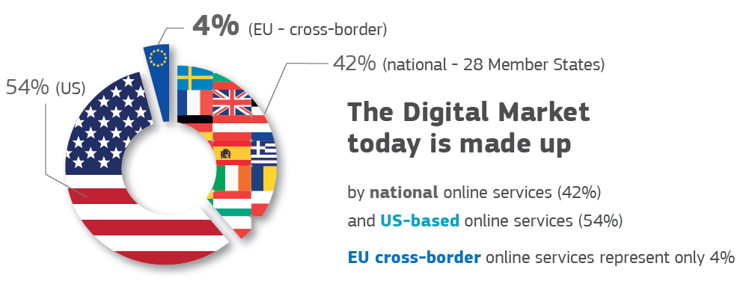
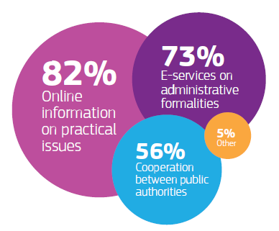
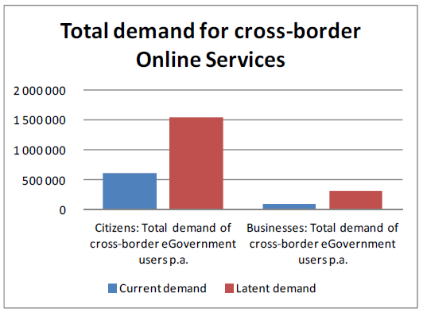
European Single Market – Scene setter
CITIZENS AND BUSINESSES ON CROSS-BORDER MOVE
CITIZENS
BUSINESSES
If you are planning to move to another EU country, what measures would help you to prepare?
In 2012 13,6 m people lived and worked outside their MS (ESTAT)

Slide 5
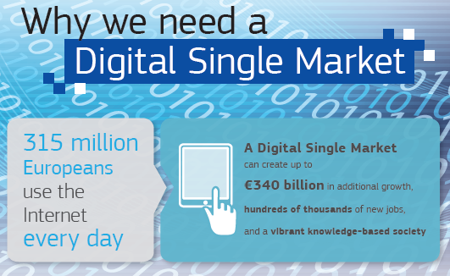
Digital Single Market
… AND WHAT ABOUT THE PUBLIC SECTOR?
Public
sector
50% EU GDP
25% of total employment in EU
Public procurement 19% of EU GDP
e-procurement: 5%-20% of procurement expenditure (€100 - €400 bn annually)

Slide 6
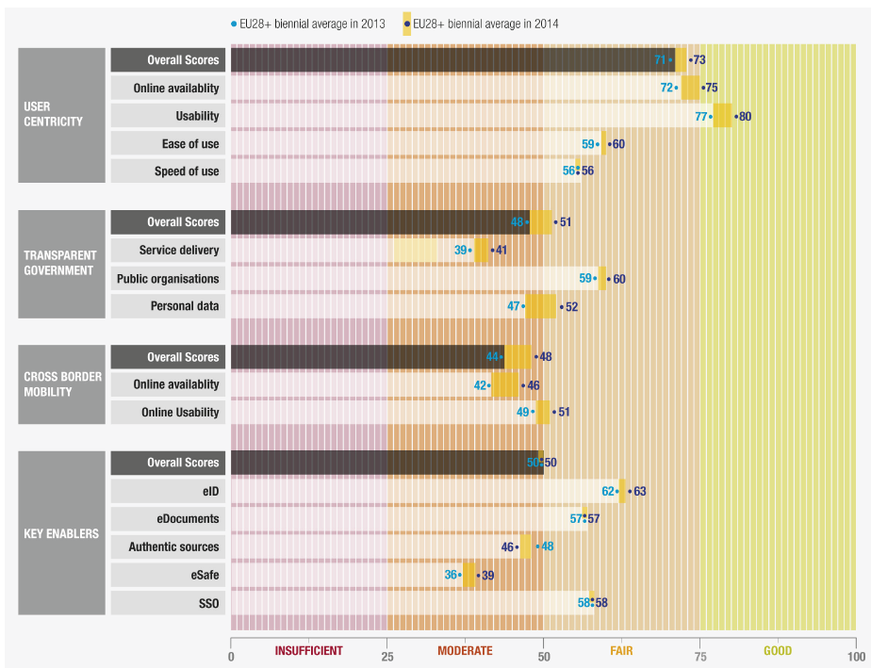
Public Sector
STATE-OF-PLAY OF DIGITAL PUBLIC SERVICES
Still half way to delivering fully open services
Digital Single Market is yet to come
Step-by-step progress

Slide 7
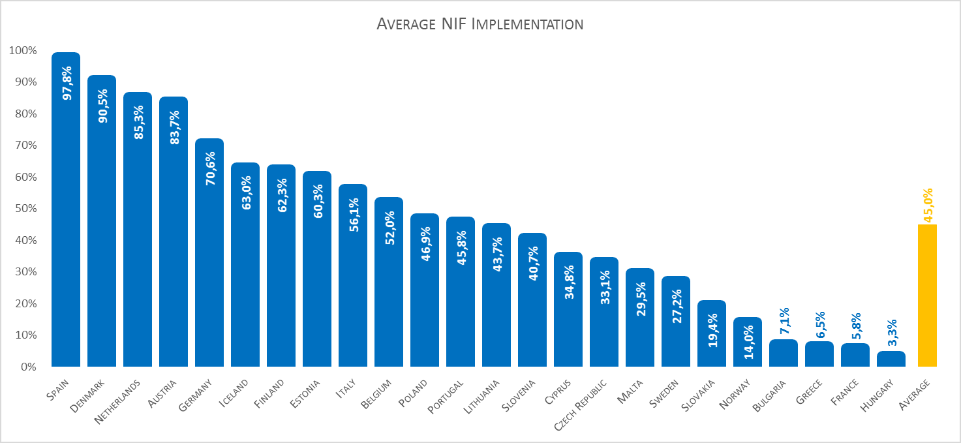
Interoperability & Digital Public Services
DOES INTEROPERABILITY HELP?
# users
Pre-filled forms
Online service completion
Open data
Digital public services score high
where interoperability scores high

Slide 8
EU action on Interoperability
Better policy making
Interoperable
Interconnection
Improved services to citizens and businesses
Once-only
Open services/data
Digital-by-default
One-stop-shop
End-to-end
Interoperable
Information Sharing
Business opportunities
Transparency
Main
principles
Require
Impact on society
${ISA}^{2}$ programme
Guiding instruments
Revision of the European Interoperability Framework (EIF)
Operational instrument
Connecting Europe Facility (CEF)

Slide 9
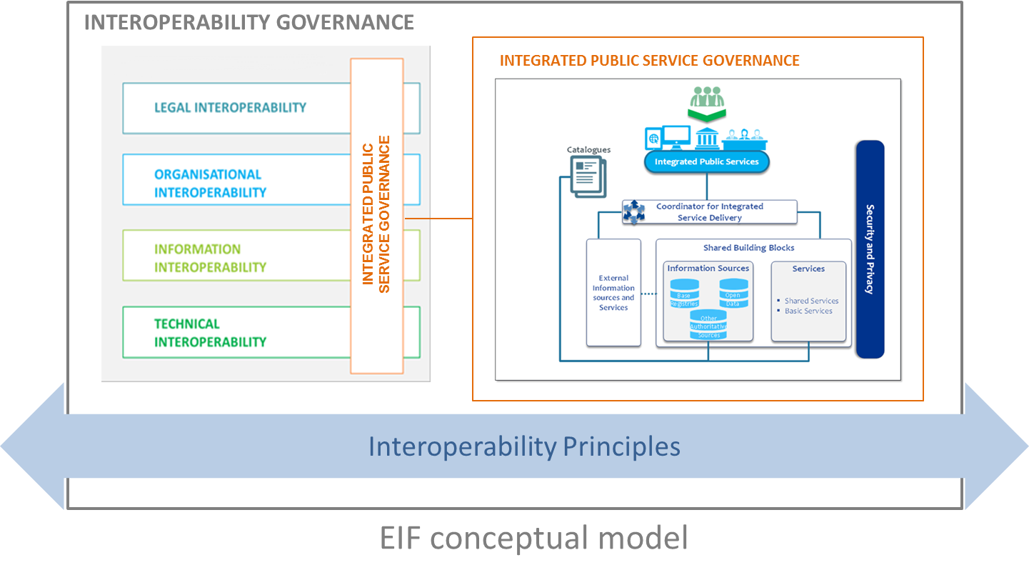
EU action on Interoperability
REVISION OF THE EUROPEAN INTEROPERABILITY FRAMEWORK
example
DSM Roadmap
(2016)
Recommendation 28:
Ensure that legislations are screened with a view to identify interoperability barriers. When preparing legislation for the establishment of a European public services, seek for coherence with relevant legislation, perform a “digital check” and consider data protection requirements.

Slide 10
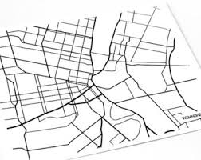
$${ISA}^{2 }Programme$$
THE STRUCTURE
1
Supporting instruments ("City planning")
European Interoperability Strategy (EIS)
European Interoperability Framework (EIF)
European Interoperability Reference Architecture (EIRA)
European Interoperability Cartography (EIC)
2
Key interoperability enablers ("City utilities")
3
Support EU legislation and initiatives
sTesta, TestaNG
Data semantics
Base Registries
Catalogue of Services
eID, eSignature
eProcurement, eInvoicing
Digital Single Market
INSPIRE
HORIZON 2020
Other Policies (Home, Justice, Growth, Competition, Eurostat …)

Slide 11
$${ISA}^{2 }Programme$$
THE SOLUTIONS
01
IOP ENABLERS
Base Registries
Catalogue of Services
sTesta
IPV6
e-TrustEX
e-documents
02
SEMANTIC IOP
ADMS
DCAT-AP
Core Vocabularies
eIDAS (natural/legal person)
03
DATA (ACCES TO, SHARING, OPEN)
Statistical data
Financial data standardization
Business reporting
Big data
Open data
04
GEOSPATIAL
Location interoperability solutions for eGovernment
05
E-PROCUREMENT, E-INVOICING
Prepare CEF e-Procurement DSI
Open e-PRIOR
e-Certis/ESPD
Common procurement vocabularies
06
DECISION MAKING & LEGISLATION
Analysis of participation to policy making
ICT impact of EU legislations
ELI …
07
EU POLICIES
Common Information Sharing Environment
Case Management
08
SUPPORTING INSTRUMENTS
EIS
EIRA & EIC
IMM
CAMSS
EUSurvey
CIRCABC
Joinup
NIFO …
09
ACCOMPANYING MEASURES
Communication
Monitoring and Evaluation

Slide 12
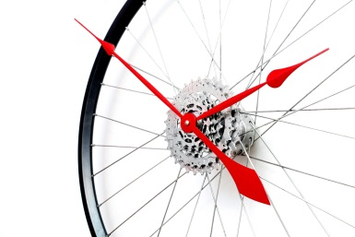
$${ISA}^{2 }Programme$$
LIFECYCLE
3
Adoption:
Commission adopts and budget is released
2016-2020
131 M€
4
2
Implementation:
By the Commission on the basis of public procurement rules
x 5
Evaluation:
Criteria-based selection of proposals to be funded as actions
How can businesses benefit?
Participate to Public Procurements implementing Programme's actions
Use ISA Solutions and specifications to better reach out Public Administrations
1
Submission:
Call for proposals to the Commission services and the MS representatives to the ${ISA}^{2}$Committee

Slide 13
Interoperability within the Commission
SYNERGIES AND EFFICIENCIES REVIEW IN ICT
S
E
R
Implementation of the EIF
Single Electronic Data Interchange Area (SEDIA)
e-Procurement
e-Grants
Enterprise Architecture
Business process harmonisation
Mobile Apps
Digital transformation
Workplace of the future
Consolidation and Standardisation
ICT security
ICT financing

Slide 14
Interoperability within the Commission
REUSABILITY OF COMMON BUILDING BLOCKS
Trans European context
TestaNG [secure network]
eID / ECAS [authentication]
eSignature [electronic signatures]
eDelivery [secure data exchange - distributed]
eTrustEx [secure data exchange - centralised]
Internal corporate
Corporate Notification System [notification]
Corporate Search [search]
Ulysse [authorisation]
eWorkflow [workflow]
eUI [user interface framework]

Slide 15
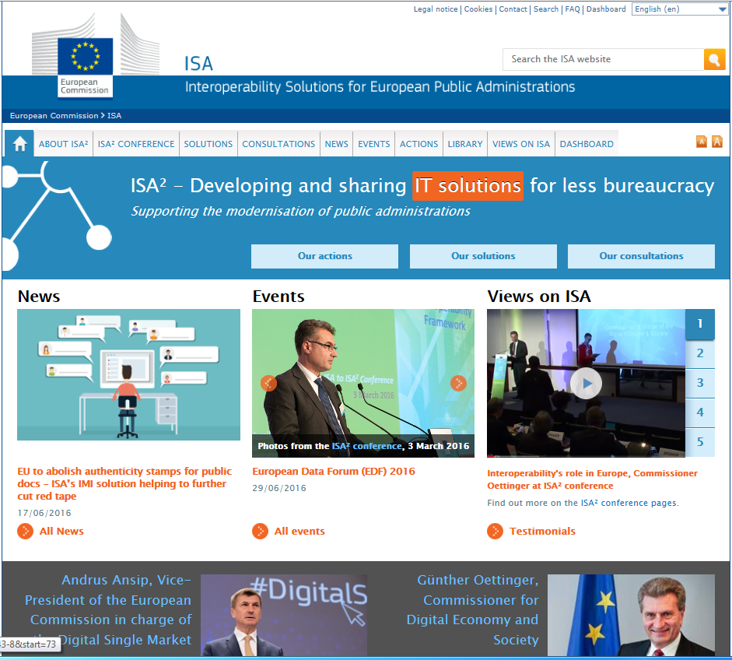
Q & A
Join ISA initiatives at: http://ec.europa.eu/isa/
and @ http://joinup.ec.europa.eu
http://goo.gl/eK1EY
@SEMICeu
http://joinup.ec.europa.eu

