Slide 1

Survey on Web Accessibility Directive transposition and implementation
Alejandro Moledo, EDF Policy Coordinator
WADEX 6th Meeting, Brussels, 28 November 2019
Notes:
Web Accessibility
Alejandro Moledo & Mher Hakobyan
EDF-DG EAC, Brussels, 15 March 2019

Slide 2
About the European Disability Forum
Umbrella organisation of persons with disabilities, run by persons with disabilities
99 member organizations representing 15 % of the EU population (100 million persons with disabilities)
Fight against discrimination and promote the Human Rights of persons with disabilities. UN Convention on the Rights of Persons with Disabilities
Advocacy organisation at European level
Notes:
About the European Disability Forum
Umbrella organisation of persons with disabilities, run by persons with disabilities
99 member organizations representing 15 % of the EU population (100 million persons with disabilities)
Fight against discrimination and promote the Human Rights of persons with disabilities. UN Convention on the Rights of Persons with Disabilities
Advocacy organisation at European level

Slide 3
Objective of the survey
Measure awareness regarding:
Transposition
Implementation
Accessibility statement
Feedback and enforcement mechanisms
Useful insights and examples
Notes:
Objective of the survey
Measure awareness regarding:
Transposition
Implementation
Accessibility statement
Feedback and enforcement mechanisms
Useful insights and examples

Slide 4
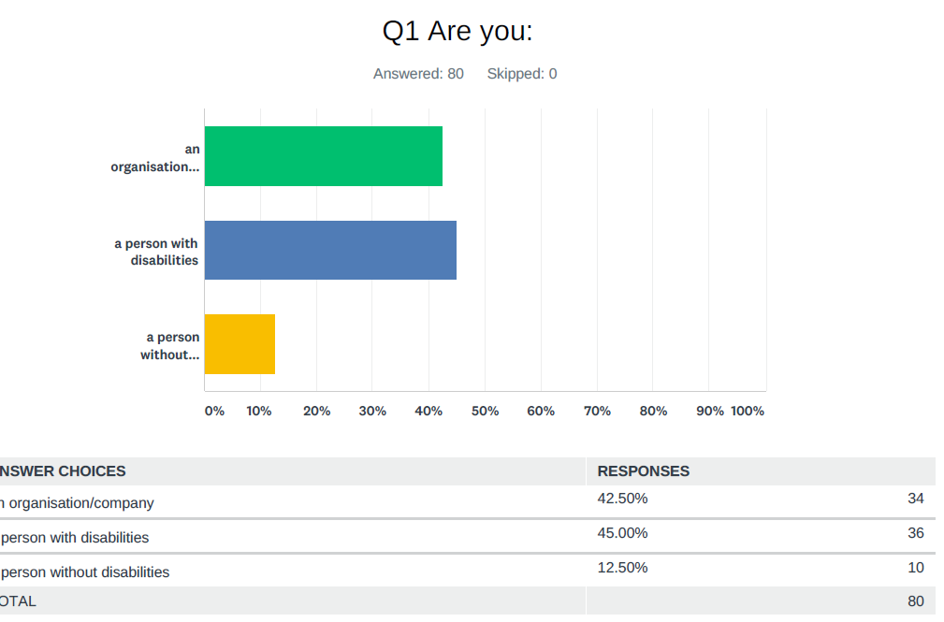
Who responded
Notes:
Who responded
An organisation or company 42,50%
Persons with disabilities 45%
Persons without a disability 12,50%
Total 80 respondends

Slide 5
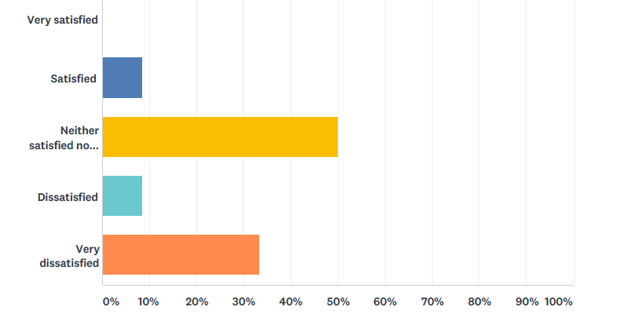
Transposition
Most of the organisations were organisations representing persons with disabilities.
Most of them (91%) were involved in transposition, but 42% are not (very) satisfied with the result
Notes:
Transposition
Most of the organisations were organisations representing persons with disabilities.
Most of them (91%) were involved in transposition, but 42% are not (very) satisfied with the result

Slide 6
Transposition
“It would have been important to consult our organization before the law was adopted.”
“Poor guidance with little support for organisations have led us to having to define our own definitions of things such as substantive revisions”, disproportionate burden process, how long for remedial actions…
“We have a good corporation with a special unit in the XXX government who work with digital access for all. During the last 3 years we have had many meetings with the government trying to make them understand how important it is that all written materials get translated to sign language. At the moment they have translated 12 public guidances into sign language.”
Notes:
Transposition
“It would have been important to consult our organization before the law was adopted.”
“Poor guidance with little support for organisations have led us to having to define our own definitions of things such as substantive revisions”, disproportionate burden process, how long for remedial actions…
“We have a good corporation with a special unit in the XXX government who work with digital access for all. During the last 3 years we have had many meetings with the government trying to make them understand how important it is that all written materials get translated to sign language. At the moment they have translated 12 public guidanaces into sign language.”

Slide 7
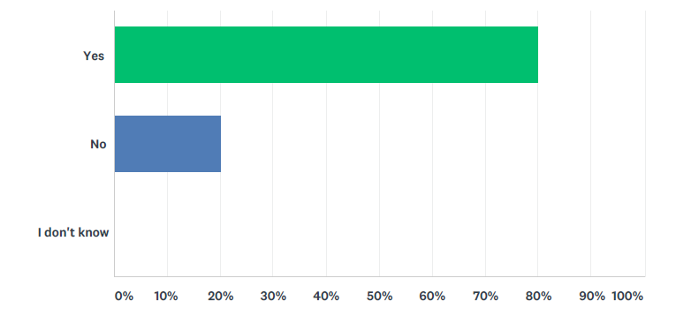
Implementation
The majority of new websites found not accessible (80%)
Notes:
Implementation
The majority of new websites found not accessible (80%)

Slide 8
Implementation
An employment portal “makes use of Adobe Flash to enrol in the public job service”.
“In general, public websites in XXX are terrible. Way too complex, difficult to navigate and find the way out, not working on mobiles or out of mainstream browsers, etc.”
“XXX agency provides grants for sports teams that are inclusive and/or offer sports for people with disabilities. The grant application website is not accessible.” because the menu navigation is through mouse only.
Login procedures
Notes:
Implementation
An employment portal “makes use of Adobe Flash to enrol in the public job service”.
“In general, public websites in XXX are terrible. Way too complex, difficult to navigate and find the way out, not working on mobiles or out of mainstream browsers, etc.”
“XXX agency provides grants for sports teams that are inclusive and/or offer sports for people with disabilities. The grant application website is not accessible.” because the menu navigation is through mouse only.
Login procedures

Slide 9
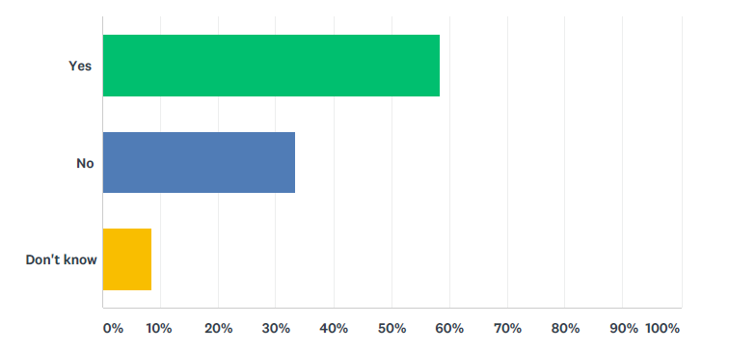
Accessibility Statement
Found an accessibility statement? 58% yes, 38% no.
Notes:
Accessibility Statement
Found accessibility statement? 58% yes, 38% no.

Slide 10
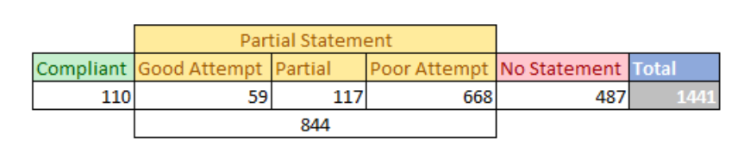
Accessibility Statement
“Note that the content is extremely vague and posted statements are untrue”
Research on accessibility statements at 1441 UK websites:
Notes:
Accessibility Statement
“Note that the content is extremely vague and posed statements are untrue”
Research on accessibility statements at 1441 UK websites: 110 compliant, 844 partially compliant, 487 no accessibility statement

Slide 11
Enforcement body
Majority of respondents did not know which is the responsible body for implementation of the Directive. Only organisations 58% vs 33%:
Notes:
Enforcement body
Majority of respondents did not know which is the responsible body for implementation of the Directive. Only organisations: 58 % vs 33%

Slide 12
Feedback and enforcement mechanism
“As also stated in the WAD, a feedback mechanism about accessibility should be present, but I couldn't find it on any XXX governmental web page, neither anyone could help me there by phone”.
Majority of individual respondents did not know which is the responsible body for implementation and monitoring of the Directive
Notes:
Feedback and enforcement mechanism
“As also stated in the WAD, a feedback mechanism about accessibility should be present, but I couldn't find it on any XXX governmental web page, neither anyone could help me there by phone”.
Majority of individual respondents did not know which is the responsible body for implementation and monitoring of the Directive

Slide 13
Conclusions and recommendations
Not enough involvement of organisations of persons with disabilities – when there is, best results happen
Major accessibility barriers still happen (it is not all about the alternative text in pictures!)
Lack of awareness and understanding regarding the accessibility statement by users (it is for them, not for the experts)
Enforcement body only known by organisations
Notes:
Conclusions and recommendations
Not enough involvement of organisations of persons with disabilities – when there is, best results happen
Major accessibility barriers still happen (it is not all about the alternative text in pictures!)
Lack of awareness and understanding regarding the accessibility statement by users (it is for them, not for the experts)
Enforcement body only known by organisations

Slide 14
Final say
“The legislation is positive but lack of awareness means it is not being implemented fully.”
“A lot of work will need to be done in the next year. There seems not to be any sense of urgency” !!!
Notes:
Final say
“The legislation is positive but lack of awareness means it is not being implemented fully.”
“A lot of work will need to be done in the next year. There seems not to be any sense of urgency” !!!

Slide 15
THANK YOU
.
For more information please contact EDF Secretariat:
Alejandro Moledo: alejandro.Moledo@edf-feph.org
Notes:
THANK YOU!
.
For more information please contact EDF Secretariat:
Alejandro Moledo: alejandro.Moledo@edf-feph.org

