Slide 1
Certificates on the financial statements (CFS) in Horizon Europe
26 June 2024
Common Audit Service
DG R&I – European Commission

Slide 2
Main features and procedures per sub-category
Personnel costs

Slide 3
What are the categories of personnel?
(Art 6.2.A Horizon Europe MGA)
A.2 Persons under direct contract
A.3 seconded persons against payment
A.4 SME owners and natural person beneficiaries
A.5 Volunteers: N/A for HE
A.6 HE Personnel unit cost
A.1 Employees
(or equivalent)
For personnel working under an employment contract (or equivalent appointing act, e.g. for civil servants) and assigned to the action.
Three cases:
Employees with a fixed salary (case 1A)
Employees whose remuneration increases when working in projects (‘project-based remuneration’) (case 1B)
Employees of a beneficiary whose usual cost accounting practice is to calculate average personnel costs (‘average personnel costs’) (case 2)
A.2 Costs for natural persons working under a direct contract other than an employment contract (e.g. in-house consultants)
A.3 costs for seconded persons by a third party against payment.
A.4 Costs for SME owners (i.e. owners of beneficiaries that are small and medium-sized enterprises) or natural person beneficiaries, not receiving a salary
A.6 The costs must be declared as unit costs, using the unit cost (daily rate) approved by the granting authority in accordance with the HE personnel unit cost authorising decision and set out in Annex 2a
Unit costs
Not subject to CFS report

Slide 4
Corporate daily rate formula
Procedures for A.1 Employees
Actual personnel cost for employees (or equivalent) are to be calculated (normally once per reporting period) in accordance with the basic formula set out in art 6.2.A.1 GA and the corresponding AGA section.
Your task: check that the elements for the calculation are correct, in compliance with the rules and the formula has been correctly applied
Day-equivalents
worked in the action
Up to a declarable maximum of:
{((215 / 12) multiplied by the number of months within the reporting period)
multiplied by the working time factor}
Daily rate
{actual personnel costs during the months within the reporting period}
Divided by
{maximum declarable day-equivalents}
Personnel costs
To be calculated per person for each reporting period

Slide 5
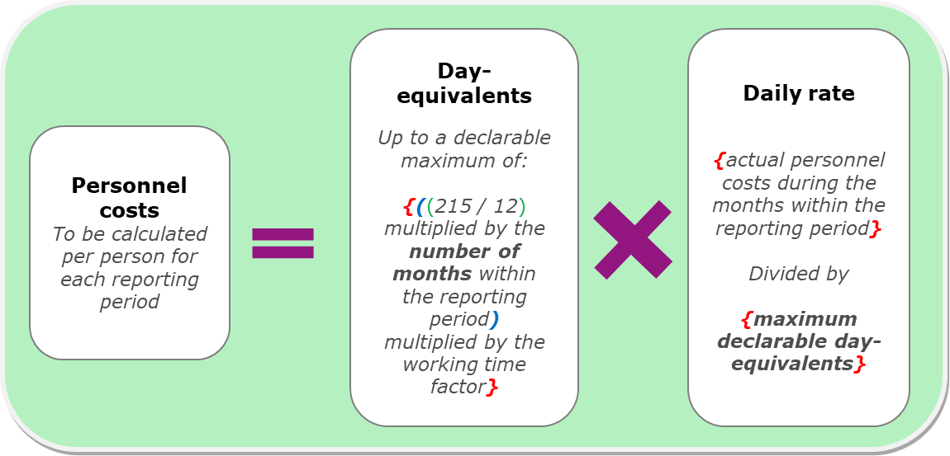
Procedures for A.1 Employees
Day-equivalents worked in the action
Day-equivalents worked in the action
Up to a declarable maximum of:
{((215 / 12)
multiplied by the number of months within the reporting period)
multiplied by the working time factor}
Article 20 of the AGA:
details on the declarations and
how to convert the working time on the action into day-equivalents
WHAT TO CHECK?
number of day-equivalents worked for the action, as recorded in the monthly declaration (Commission template) or another reliable time recording system
Double ceiling
Horizontal ceiling: the actual number of day-equivalents declared across EU and Euratom grants cannot be higher than 215 per calendar year
Reporting period ceiling: the number of day-equivalents to be declared is capped at the maximum declarable day-equivalents per reporting period

Slide 6
Procedures for A.1 Employees
Maximum declarable day-equivalents
Day-equivalents worked in the action
Up to a declarable maximum of:
{((215 / 12)
multiplied by the number of months within the reporting period)
multiplied by the working time factor}
WHAT TO CHECK?
number of months of employment during the reporting period, used for the calculation of the maximum declarable-day equivalents
working-time factor, used for the calculation of the maximum declarable-day equivalents
Pro-rata of 215
During which the person is employed
1 for full-time
0,5 for 50% part-time etc.

Slide 7
Maximum declarable day-equivalents
Procedures for A.1 Employees
Example:
In the reporting period from 01/01/2022 to 31/03/2023, the employee worked full-time in 2022 and 50% part-time in 2023.
The maximum declarable day-equivalents is calculated separately for 2022 and 2023 (because conditions have changed).
12 months of full-time work: ((215 / 12) x 12) x 1.0 = 215
3 months of part-time work: ((215 / 12) x 3) x 0.5 = 27
Total: The maximum declarable day-equivalents for the reporting period are therefore: 215 + 27 = 242

Slide 8
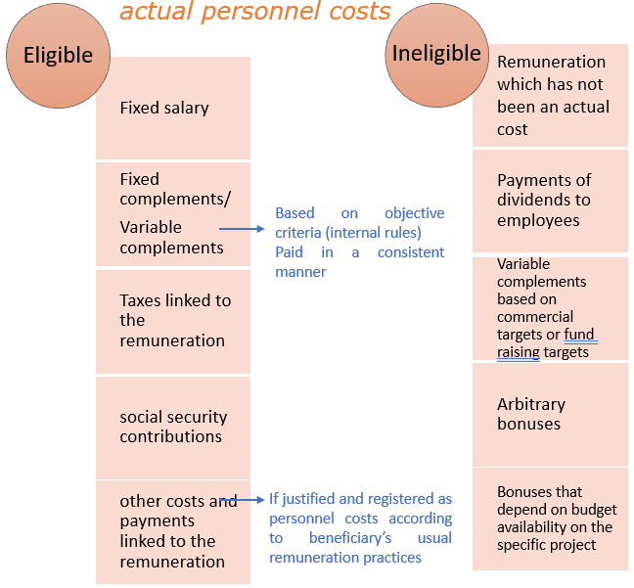
Calculation of the daily rate
Procedures for A.1 Employees
WHAT TO CHECK?
Total personnel costs recorded in the Beneficiary’s statutory accounts for the person, including any eligible components and excluding any ineligible components, during the months within the reporting period.
Daily rate
{actual personnel costs during the months within the reporting period}
Divided by
{maximum declarable day-equivalents}

Slide 9
Information/documents to be checked
Procedures for A.1 Employees
List of the persons included in the sample indicating the period(s) worked for the action, their position and type of contract
Employment contracts or equivalent
Participant's usual policy regarding payroll matters (e.g. salary policy, overtime policy, variable pay/bonuses)
Applicable national law on taxes, labour and social security
Payslips and documents providing proof of payment (checked at least two salary payments per person per year)
Time Records and any other document that supports the personnel costs declared
Data from the accounting system, payroll system and time recording system

Slide 10
Main differences with Horizon 2020
Procedures for A.1 Employees
No different formulas (annual and monthly) or options for productive hours.
No more ‘last closed financial year’ rule.
Single corporate daily rate calculated per reporting period.
Alternatively (if not calculated per reporting period), the calculation may be done separately for each calendar year within the reporting period, if this is consistently applied. In that case, the ‘number of months within the reporting period’ referred to in the basic formula is to be understood as the number of months of the respective calendar year that are within the reporting period (footnote 4, Article 6.2, AGA HE).

Slide 11
A.1 Employees case 1B Additional procedures for: Project-based remuneration

Slide 12
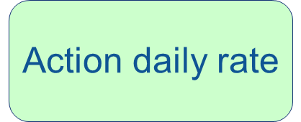
Project-based remuneration – Key features
Additional Procedures if A.1 project-based
remuneration (Case 1B):
What is it and for whom?
Usual remuneration practices of the participant under which a personnel receives supplementary payments for work in projects.
How MUCH CAN BE DECLARED?
Daily rate paid by the participant for the time worked by the person in the action (‘action daily rate’) up to the daily rate that the participant would pay to the person for similar work in national projects (‘national projects daily rate’).
METHODOLOGY?
Compare
Take the lower of the two.
*
VS
*
Based:
Either on regulatory requirements (such as national law or collective labour agreement)
Or on the beneficiary’s written internal remuneration rules
If nothing, use of the so-called ‘fall-back option’ (calculation of an average in the last complete year)

Slide 13
Project-based remuneration
Additional Procedures if A.1 project-based
remuneration (Case 1B):
WHAT TO CHECK?
Check relevant documents to support the calculation of the project-based remuneration.
Recalculate the action daily rate per person for the time work in the action (incl. project-based supplementary payments, bonuses, increased salary, etc.), during the months within the reporting period.
Recalculate the national project daily rate based on regulatory requirements or written internal remuneration rules.
Compare the action daily rate with the national project daily rate and take the lower of the two.
Calculations
The basic formula applies BUT for the daily rate check and recalculate:
If the national project daily rate cannot be determined (no regulatory requirements or written internal remuneration rules), then daily rate = the average in the last complete year: {(total personnel costs of the person in the last complete year) minus (remuneration paid for EU actions during that complete year)} divided by {215 minus (days worked in EU actions during that complete year)}

Slide 14
A.1 Employees case 2 Additional procedures for: average personnel costs

Slide 15
Average personnel costs Unit costs calculated in accordance with usual cost accounting practices (Case 2)
Additional Procedures if A.1 average personnel costs (Case 2):
WHAT TO CHECK?
Obtain a description of the participant’s usual cost accounting practice to calculate unit costs and check:
Calculations
The basic formula applies BUT
Beneficiaries who consistently calculate average rates for their staff as part of their analytical cost accounting system, based on objective criteria, regardless of the source of funding, can use these average rates for the daily rate.
that this practice was applied by the participant for the personnel costs under review
that the employees were charged under the correct category
the daily rate is calculated using the actual personnel costs recorded in the participant's accounts, excluding any ineligible cost or costs already included in other budget categories
if usual practice includes budgeted or estimated elements, then check whether these elements are relevant, used in a reasonable way, correspond to objective and verifiable information
If budgeted figures < 5% of the declared unit cost → they do not play a major role and can be accepted.
If budgeted figures > 5% → they need to be compared with the actual costs.

Slide 16
A.2: Natural persons working under a direct contract other than an employment contract A.3: Seconded persons by a third party against payment Additional procedures

Slide 17
Categories A.2 and A.3 A.2: natural persons working under a direct contract other than an employment contract A.3: seconded persons by a third party against payment
Additional Procedures if A.2 natural persons or
A.3 seconded persons:
WHAT TO CHECK?
The person must be hired under either:
a direct contract signed between the beneficiary and the natural person or between the beneficiary and a legal entity fully owned by that natural person, and which has no other staff than the natural person being hired (A.2) or
a secondment agreement with the employer of the natural person (A.3)
The person must work under conditions similar to those of an employee
The result of the work carried out must in principle belong to the beneficiary
The cost of the person must not be significantly different from costs for employees of the beneficiary performing similar tasks
The lowest of: a) 50% of the average daily rate or b) 25% of the highest daily rate of employees with similar tasks (except for 3rd parties located in different countries)

Slide 18
Categories A.2 and A.3
Additional Procedures if A.2 natural persons or
A.3 seconded persons:
WHAT TO CHECK?
Check the contract and if
specifies a daily rate: this daily rate must be used;
states a fixed amount for the work and the number of days to be worked: daily rate = {(the global amount for the work) divided by (the number day-equivalents to be worked)}
states a fixed amount for the work, but does not specify the number of days that must be worked: daily rate = {(the global amount for the work) divided by (the pro-rata of 215 annual day-equivalents which corresponds to the duration of the contract over the reporting period)}
Calculations
The basic formula applies BUT
the daily rate must be calculated as follows:
A.3: Ensure that the secondment did not entail any profit in the calculation of personnel cost for the seconded person (neither for the participant nor for the seconding third party).

Slide 19
Procedures to be followed for specific cost categories

Slide 20
B1. Subcontracting
Subcontracts must be in line with Article 13 of GA
Subcontracts concern the implementation of action tasks; they imply the implementation of specific tasks which are part of the action;
The use of subcontractors must be indicated in Annex 1 of the Grant Agreement;
No indirect costs (25% flat-rate does not apply on this specific cost category);
Total estimated costs per participant should be set in Annex 2 or through simplified procedure possible under certain conditions;
The Participants have a contractual link with the subcontractors having as their object the purchase of goods, works or services or the implementation of specific actions tasks;
The eligible costs are the prices charged to the beneficiary by the subcontractors (usually containing a profit margin for the contractors or subcontractors but not for the participant).
The participant must award the subcontracts on the basis of best value for money (or lowest price) and absence of conflict of interest.
Costs should be declared in the financial statements under the subcontracting category.

Slide 21
B1. Subcontracting
WHAT TO CHECK?
Perform the general checks for eligibility and ineligibility of costs i.e. obtain invoices, proof of payments and relevant accounting records etc.
Check that the use of subcontractors was foreseen in Annex 1 GA and the total estimated costs of subcontracting are set out in Annex 2 GA.
Identify whether the participant falls under the standard rules (usual purchase practices + no conflict of interest + best value for money/lowest price) or must follow specific rules (contracting authority/contracting entity within the meaning of the EU Public Procurement Directives or existing framework contract).
Check for the sample that the subcontracts have been awarded in line with the internal procedures/usual practices and ensured best value for money and no conflict of interests.
Review the subcontract award process, and check bid evaluation, and selection process to ensure evaluation in accordance with the requirements set out for the subcontract. For example, requests to different providers, proof of assessment of offers and/or assessment of market prices etc. demonstrating that the original selection fulfilled these criteria.
Ask the participant to justify the choice of subcontractor and verification of existence of signed agreements between the participant and the subcontractor.
Review the subcontract to ensure that it contains conflict of interest provisions (e.g. requirements for the subcontractor to disclose any conflicts of interest).
Receive a written confirmation from the participant that subcontracts were awarded in accordance with the principle of best value for money and no conflict of interest.
HOW?

Slide 22
B1. Subcontracting
Specific approach for 'contracting authorities' & 'contracting entities
Obtain and review the applicable national law on public procurement.
Check that the subcontracting procedure was carried out and complied with the applicable national law on public procurement:
Confirm publication of calls if compulsory by the applicable national rules;
Confirm that the subcontracts were awarded to the entity ranked first in the selection process;
Confirm that the minimum number of offers was obtained as foreseen in the applicable national rules;
Confirm that the minimum advertising time foreseen in the applicable national rules was respected;
Verify if the final contract price equals to (or does not exceed) the original offer.
If the participant is a contracting authority/contracting entity and did not comply with the national rules on public procurement, costs are not eligible (because of non-respect of best value for money).

Slide 23
C1. Travel Costs
Participant complies with its usual accounting practices on travel costs;
Must be necessary for the action;
Must be incurred for the personnel of the participant and under certain conditions for experts.
WHAT TO CHECK?
Perform the general checks for eligibility and ineligibility of costs i.e. obtain invoices, proof of payments and relevant accounting records etc.;
Check travel costs against P's internal policy/usual practices on traveling;
Check that purchases were made according to the principle of best value for money (best price-quality ratio) or the lowest price and no conflict of interest;
Check travel costs vis-à-vis list of staff of the project;
Check dates of travelling with dates charged on monthly declaration of time worked;
Check dates of travelling with the period of the action;
Check dates of expenditures with the duration of the event;
Enquire Participant on necessity of travel cost;
Check travel events vis-à-vis GA and annexes;
Check that for combined travel, costs were charged to the action only up to the cost that would have been incurred if the travel would have been made exclusively (proven by records) for the action and allowable by the applicable travel policy of the Participant.
ATTENTION! entertainment or hospitality costs, tips, private costs (TV, laundry, etc.) are not eligible costs

Slide 24
C2. Equipment costs – Options available in the HE MGA
Four options:
[OPTION 1 by default: depreciation only] [OPTION 2 if selected for the call: full cost only] [OPTION 3 if selected for the call: depreciation and full cost for listed equipment] [OPTION 4 if selected for the call: full cost and depreciation for listed equipment]
Options 2, 3 and 4 are exceptions, if justified by the nature of the actions and the context of the use of the equipment or assets (i.e. for a limited number of calls, notably for calls for which the purpose is for instance to have participants developing prototypes)
Option 2, 3 and 4 can only be activated in a specific grant if it was selected for the call by the granting authority
!
Always check which option/provision is set out in the grant agreement at stake

Slide 25
C2. Equipment - If depreciation only:
WHAT TO CHECK?
Perform the general checks for eligibility and ineligibility of costs i.e. obtain supporting docs/invoices, proof of payments etc.
Check that costs were accounted in the accounting system and written off in accordance with international accounting standards and the beneficiary’s usual accounting practices;
Check that the sampled equipment was used in connection with the action implementation;
Check existence of the asset through inspection;
Ensure that depreciation is calculated on the acquisition value;
Check that the depreciation costs were accumulated during the action duration;
Check that the participant did not charge depreciation from a date before reception of the equipment;
Check if the action was suspended, that no depreciation costs were charged during the suspension period;
Check that the depreciation costs do not exceed the equipment purchase price. The depreciable amount (purchase price) of the equipment must be allocated on a systematic basis over its useful life (i.e. the period during which the equipment is expected to be usable).
NOTE: This is usually a default option for most programmes.

Slide 26
C2. Equipment - If full cost only:
WHAT TO CHECK?
Check that the Grant Agreement explicitly allows that purchases of equipment specifically for the action (or developed as part of the action tasks) and may be declared as full capitalised costs (instead of depreciation cost).
Check that the capitalised costs correspond to the costs incurred in the purchase or for the development of the equipment, infrastructure or other assets.
Check that costs recorded under a fixed asset account of the participant in compliance with international accounting standards and the participant’s usual cost accounting practices.
Check no double charging of costs (in particular, no charging of depreciation costs for the prototype or pilot plant to the grant or another EU grant).
Check that costs for renting or leasing equipment do not exceed the depreciation costs of similar equipment, do not include any financing fees and there is no double charging of costs.
NOTE: Equipment that does not comply with the specific conditions for full cost (e.g. equipment purchased prior to the action but used for the action) must be declared using the normal depreciation cost.

Slide 27
C2. Equipment - If depreciation and full cost for listed equipment:
WHAT TO CHECK?
Similar procedures are followed as described above under cost category C.2 (depreciation only and full costs only);
For the equipment charged at full acquisition cost, check that the equipment purchased specifically for the action (or developed as part of the action tasks) costs may exceptionally be declared as full capitalised costs, if these assets are listed under art. 6.C.2

Slide 28
C2. Equipment - If full cost and depreciation for listed equipment:
Similar procedures are followed as described above under cost category C.2 (depreciation only and full costs only);
However, for the equipment used for the action that are listed under art. 6.C.2, the costs must be declared as depreciation costs.
Check that these assets are listed under art. 6.C.2 as equipment whose costs must be declared as depreciation costs.

Slide 29
C3. Other goods and services
Contracts – Other goods and services
These contracts do not cover the implementation of action tasks, but they are necessary to implement action tasks by participants.
Do not have to be indicated in Annex 1 of the Grant Agreement.
Indirect costs are eligible – 25% flat rate
The participant must award the contractors on the basis of best value for money (or lowest price) and absence of conflict of interest.
The eligible costs are the prices charged to the participant by the contractors or subcontractors (usually containing a profit margin for the contractors or subcontractors but not for the participant).

Slide 30
C3. Other goods and services
WHAT TO CHECK?
Perform the general checks for eligibility and ineligibility of costs i.e. obtain invoices, proof of payments and relevant accounting records etc.;
Check that the goods, works or services were purchased specifically for the action, and they were correctly allocated to the action;
Check the actual existence of the sampled items by obtaining supporting document invoices;
Check that the costs charged to the action were accounted in line with the participant’s usual accounting practices;
Check that the contracts did not cover tasks described in Annex 1 GA (these should be charged as subcontracting costs);
Check that the goods were not placed in the inventory of durable equipment (otherwise they should be charged as equipment costs).
!

Slide 31
D1. Financial support to third parties
Awarded by the Participant as part of grants, prizes or similar forms of support.
Option to be used ONLY if included in the Grant Agreement.
Fulfil the conditions for FSTP recipients, which are set out in Annex 1 of the GA.
Fulfil the general eligibility conditions
Must be declared as actual costs (or very exceptionally as units' costs)
Participant
Financial support to third parties as part of the action activities
As a principal, participants are not allowed to provide financial support under the Grant Agreement to themselves or their affiliated entities, but there are limited exceptions under certain conditions.
!
Costs for non-financial support or support given in-kind (e.g. vouchers) must be declared in other costs categories and not as financial support to third parties.

Slide 32
D1. Financial support to third parties
WHAT TO CHECK?
Check that the costs for providing financial support to third parties were declared eligible in the Grant Agreement;
Check that the maximum amount of financial support to each third party is not more than the amount per recipient set out in the Data Sheet or otherwise agreed with the granting authority;
Check that the support is implemented in accordance with the conditions set out in Annex 1 GA and include at least the following minimum conditions;
For grants (criteria for calculating the exact amount of the financial support, criteria and procedures for giving financial support, the persons or categories of persons that will be supported etc.)
Prizes (eligibility and award criteria, amount of the prize, payment arrangements etc.)
Check the existence of signed agreements/acceptance forms between the participants and the recipients;
Perform the general checks for eligibility and ineligibility of costs i.e. linked to the action and incurred by the participant (proof of payment, no re-invoicing to other entities) during the duration of the action in accordance with its usual cost accounting practices.

Slide 33
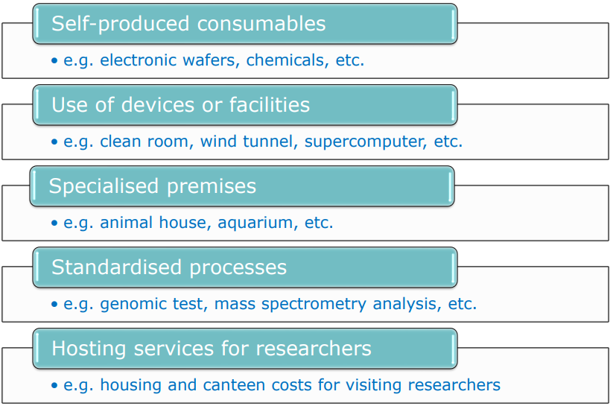
D2. Internally invoiced good and services
WHAT?
Costs for goods and services which are produced or provided within the participant’s organisation directly for the action and the beneficiary values on the basis of their usual cost accounting practices.
EXAMPLES:
Wider reliance on participant’s usual cost accounting practices for the unit cost calculation with:
No application of the 25% flat-rate on top of the unit cost (H2020 rules)
instead, possibility to accept actual indirect costs allocated via beneficiary’s usual key drivers in the unit cost calculation ((e.g. power supply costs allocated to a clean room on the basis of the square meters it occupies, general administrative costs such as those stemming from the HR, legal or accounting departments).
Internally invoiced goods and services do NOT need to be referenced in Annex 1

Slide 34
D2. Internally invoiced good and services
Ineligible costs
Goods or services purchased, and costs of goods or services internally invoiced which are not directly used for the action:
bank interests;
provisions for future expenses;
cost declared under other cost categories (e.g. personnel cost, equipment depreciation cost) any other ineligible costs (see Article 6.3).
The unit cost must be adjusted to remove: − cost elements that are ineligible under the Grant Agreement (even if they are part of the participant’s usual methodology for determining the unit cost for their internal invoices).
WHAT NOT?
The costs must be declared as unit costs in accordance with usual cost accounting practices.

Slide 35
D2. Internally invoiced good and services
WHAT TO CHECK?
Check that the sampled internally invoiced goods and services were necessary in connection with the action implementation;
Obtain or enquire the methodology and usual accounting practices used to calculate costs of internally invoiced goods and services;
Perform the general checks for eligibility and ineligibility of costs i.e. supporting documents are reconciled with the sampled items claimed, are actually used/produced, are addressed to the participant etc.;
Verify that the same unit cost has been applied in a consistent manner in other transactions not involving the EC grants;
Verify that the commercial price is not used as the unit cost for internal invoices charged to the grant;
Verify that the unit cost is calculated using the actual costs recorded in the Participant’s accounts;
Check that the amount per unit, for providing internally the good or service, has been calculated using the actual direct and indirect costs recorded in the participant’s accounts, attributed either by direct measurement or on the basis of cost drivers in line with participant’s accounting practices.

Slide 36
In-kind contributions
IN-KIND CONTRIBUTIONS AGAINST PAYMENT
No more special Article (corporate approach)
In-kind contributions against payment provided by third parties are declared by the participant in the relevant costs category depending on their nature; (declared under personnel costs, other goods and services etc.);
Costs fulfil the eligibility conditions set out for the cost category where they were classified based on their nature;
Indirect costs calculated on top via the 25% flat-rate.
IN-KIND CONTRIBUTIONS FREE OF CHARGE
Specific provisions (Art 6(1) & Art 9(2)) HE MGA (stemming from Horizon Europe specific legal base);
In-kind contribution free of charge are mentioned in Annex 1 GA (or approved in a periodic report; simplified approval procedure);
They must be declared under the relevant cost category (i.e. as if they were costs incurred by the participant);
Only direct costs must be reported;
Indirect costs calculated on top via the 25% flat-rate (with exceptions, like for internal invoicing).

Slide 37
In-kind contributions
IN-KIND CONTRIBUTIONS AGAINST PAYMENT
Check that in-kind contributions against payment provided by third parties are declared by the participant in the relevant cost category depending on their nature.
Check that the costs fulfil the eligibility conditions set out for the cost category where they were classified based on their nature.
IN-KIND CONTRIBUTIONS FREE OF CHARGE
Check that third parties and in-kind contributions are mentioned in Annex 1 GA (or approved in a periodic report; simplified approval procedure)
Check that costs declared do not exceed the costs incurred by the contributing third party for the in -kind contribution, by obtaining invoices, accounting entries, etc.
Check that costs of the third party fulfil the eligibility conditions (refer to art. 6.1).
Check that there are binding arrangements between the participants and the third party and ensure the rights of bodies mentioned in art. 25 are also ensured towards the third party giving in-kind contributions.

Slide 38
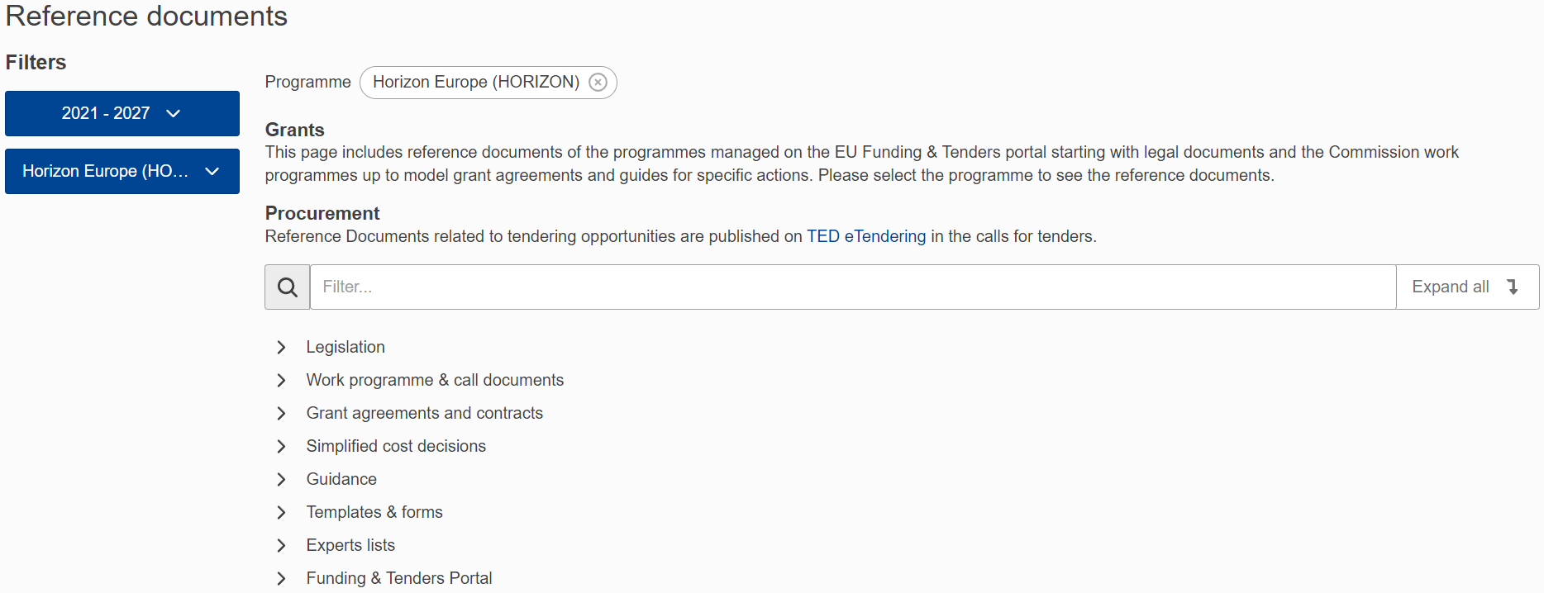
Looking for more information?
Other reference documents are available on the Funding & Tenders Portal:
Reference Documents | EU Funding & Tenders Portal (europa.eu)
Helpdesk questions:
Helpdesk & Support Services | EU Funding & Tenders Portal (europa.eu)

Slide 39
Thank you!
# HorizonEU
http://ec.europa.eu/horizon-europe

