Slide 1
Certificates on the financial statements (CFS) in Horizon Europe
26 June 2024
Common Audit Service
DG R&I – European Commission

Slide 2
GENERAL PROCEDURES APPLICABLE TO ALL COST CATEGORIES
Types of audit procedures
Legal framework and usual practices
Reconciled detailed breakdown and FS
Sampling
General eligibility conditions and ineligible costs
Currency and conversion into euro
DISCLAIMER: INFORMATION NOT LEGALLY BINDING

Slide 3
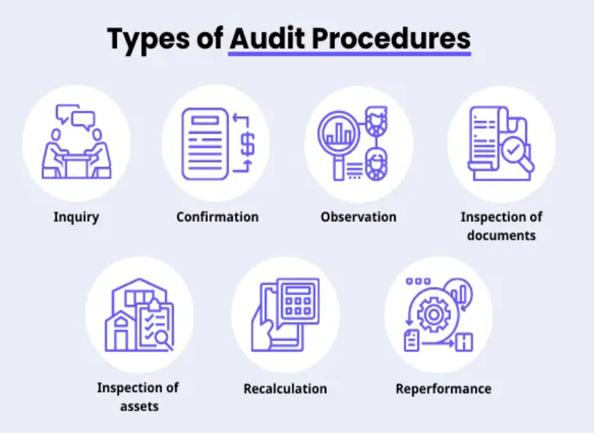
What are the Types of Audit Procedures?

Slide 4
Legal framework and usual practices
Legal Framework
Internal Procedures- Usual Practices
Get an understanding of the Participant’s internal procedures and usual accounting practices for all categories and that comply.
Audited annual statutory accounts and previous audits in EU actions
Ensure that the statutory accounts are not qualified for reasons affecting the audited costs categories.
The agreed-upon procedures refer to the relevant Grant Agreement provisions and cost categories, to enable the practitioner to find them easily.
Get an understanding of the Grant Agreement and Annotated GA especially the applicable rules for the different costs category.
Enquire Participant whether previous audits in EU actions identified systemic errors which might affect the audited costs categories

Slide 5
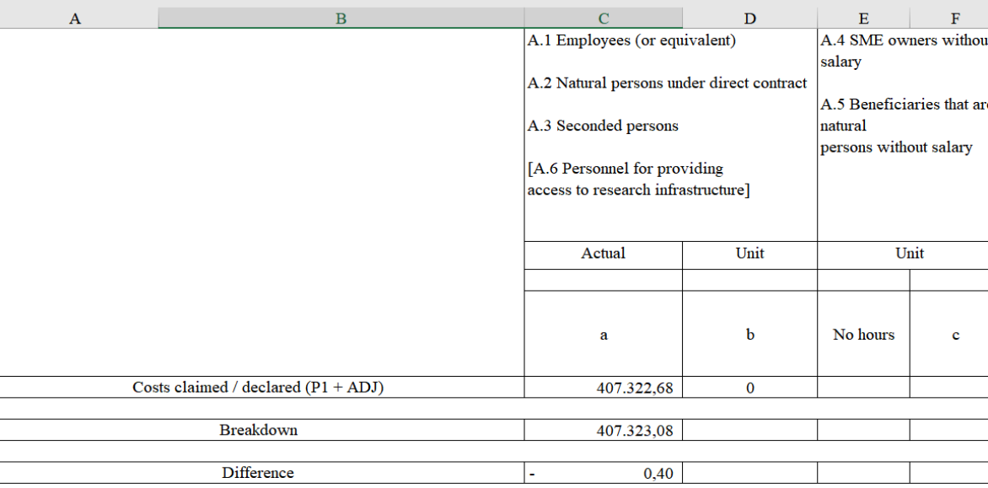
Reconciled Detailed Breakdown and FS
The first step is to reconcile the detailed cost breakdown received from the Participant [Annex III ] with the approved Financial Statements, per reporting period for all the costs categories.
If there are differences in the reconciliation between the breakdown of costs and the Financial statements approved by the Financial Officer (FO), you should check whether:
are reasonably small (rounding, small corrections). Those can be considered as rounding differences or unexplained differences.
are reasonably high (considering auditor’s judgement and common sense). The differences should be further explained by the Participant.

Slide 6
Sampling
The sample should be selected randomly for each cost category declared. A random selection identifies items from across the whole population so that each item has an equal chance of selection.
Random selection is applied through random number generators, for example, random number tables or the function in excel RANDBETWEEN (1;n).
The sampling should be done at the level of the ACTION and NOT at the level of the PERIOD.
Each sub-category of “other direct costs” needs to be considered separately. These categories are prone to random sampling, as very often these costs are atomized in many small amounts.
POPULATION MORE THAN 10 ITEMS?
DEFINITION OF 1 ITEM
A. PERSONNEL COSTS | 1 PERSON
B. SUBCONTRACTING | 1 CONTRACT
C1. TRAVEL | 1 PERSON EVENT
C. OTHER DIRECT COSTS | 1 LINE IN THE BREAKDOWN
NO
YES
Test
ALL
Items
Test 10% of the total items for each cost category (minimum 10 items)

Slide 7
General eligibility conditions
Costs must be actually incurred
Costs must be identifiable and verifiable
Costs should comply with the applicable law i.e. labour, taxes social security, etc.
Costs must be declared under one of the budget categories set out in Article 6.2 and Annex 2
Costs must be incurred in the period set out in Art. 4
Costs must be incurred in connection with the action
Costs are supported by documentations and are addressed to the Participant
Incurred by the beneficiary and not by any other entity
Should not be re-invoiced to other entities
Costs recorded in the beneficiary’s account
Costs accounted as per the Participant’s usual cost accounting practices and applicable accounting rules of the country where the Participant is established
Costs are necessary to achieve the actions’ objective and cannot be used to finance activities other than those approved by the Commission
Costs incurred during the action duration
Exception:
Costs cannot include costs under the budget categories that did not appear in the action estimated budget. However, this condition is automatically ensured by the IT system in Horizon Europe
Costs should be actual and not estimated/budgeted
Costs before the project period that relate to the kick-off meeting are eligible
Costs after the project period relate to final reporting
Costs that are directly linked with the implementation of the action can be directly attributed to the direct costs categories.
Costs are actually paid by the Participant ( or netted off)
Costs are invoiced or paid later than the end date, if debt existed during the action duration and final costs are known at the final report.
Costs must be complied with the applicable (national) law

Slide 8
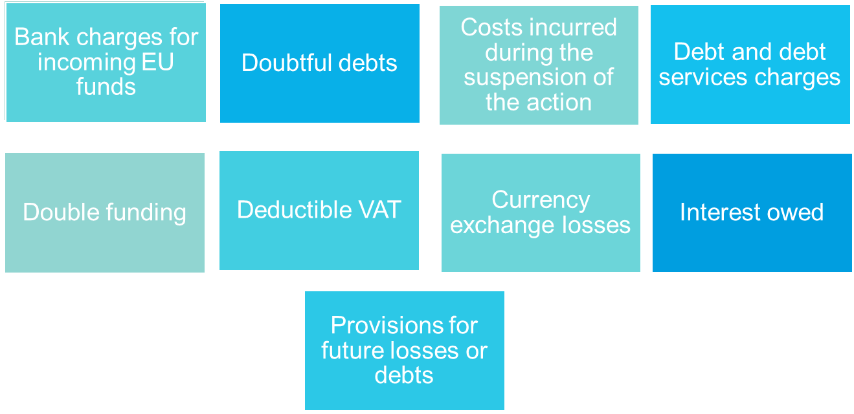
Ineligible items
Costs should not include any ineligible items such as:

Slide 9
Currency and conversion into euro
Financial statements need to be drafted in EURO.
Participants with accounting established in a currency other than the euro must convert the costs recorded in their accounts into euro, at the average of the daily exchange rates published in the C series of the Official Journal of the European Union, calculated over the corresponding reporting period ( ECB website).
If no daily euro exchange rate is published in the Official Journal, use average of the monthly accounting exchange rates published on the European Commission website (InforEuro).
Participants with accounting established in euro must convert costs incurred in another currency into euro using their usual accounting practices.

