Slide 1
Lump Sum Funding in Horizon Europe: How does it work? How to write a proposal?
European Commission, DG rtD
Common Implementation Centre
16 May 2024

Slide 2
Why do we use lump sum funding?
Reducing the financial error rate
Following the ECA annual reports 2019 and 2020, there is wide agreement that the error rate in the R&I Framework Programmes must be reduced
Lump sums are a key measure to achieve this in Horizon Europe
Significant simplification potential
Funding based on reimbursement of real costs remains complex and error-prone. Little scope for further simplification
Lump sums remove the obligation to report actual costs and resources
Easier to use for beneficiaries with limited experience
Focus on content
Focus less on financial management and more on content

Slide 3
Why do we use lump sum funding?
Easier access to the programme
Very small share of beneficiaries have more than 100 grants:
Large entities
Dedicated staff and procedures to deal with actual costs
Vast majority of beneficiaries have only 1 or 2 grants per programme
Most of them SMEs or newcomers
Little or no previous experience
Need a simple funding model

Slide 4
Common understanding needed We need to explain lump sums, but we see no blocking issues
We are aware of concerns
More work to set up a proposal
Less flexibility in grant management
Higher financial risk, leading to fewer newcomers, fewer SMEs, less ambitious proposals
We are aware of misunderstandings
Budget details are only needed for lump sums (not true)
Lump sum payments depend on a successful outcome (not true); partially completed lump sum work packages will not be paid (not true)
In actual cost grants, beneficiaries have fewer obligations; reimbursement only requires correct invoices and is independent of other partners (all not true)

Slide 5
Two lump sum options
Type 1
Lump sum fixed in the call for proposal
Type 2
You define the lump sum in your proposal
Except ERC Proof of Concept, all topics in the 2023-2024 Work Programme are Type 2.

Slide 6
Writing a lump sum proposal
To write a lump sum proposal, you:
Use the standard Horizon Europe application form
Present the objectives and methodology of your project and address the expected outcomes and impacts as in any Horizon Europe proposal
Describe in detail the activities covered by each work package.
To define and justify the lump sum, you need to provide a detailed budget table with cost estimations.
The detailed budget table is an Excel file. You must download it from the online submission system, fill it and submit it as an annex to the Part B of your application form.

Slide 7
Writing a lump sum proposal
In this detailed budget table, you provide cost estimations for each cost category per beneficiary (and affiliated entity if any) and per work package.
The cost estimations must be an approximation of your actual costs. They:
are subject to the same eligibility rules as in actual costs grants
must be in line with your normal practices
must be reasonable / non-excessive
must be in line with and necessary for your proposed activities.
The cost estimations are used to generate in the detailed budget table a breakdown of lump sum shares per work package and per participant.
Details and instructions on how to fill in the lump sum detailed budget table are provided in the Funding & Tenders portal.

Slide 8
Project design – Work packages
Work package distribution
A work package (WP) is a major sub-division of the work plan of your project.
Work packages with a long duration may be split along the reporting periods (e.g., Management, Dissemination and Exploitation, etc.). In this way, the relevant activities can be paid at the end of the reporting period.
As many as needed but no more than what is manageable
A single activity is not a WP
A single task is not a WP
A % of progress is not a WP (e.g. 50 % of the tests)
A lapse of time is generally not a WP (e.g. activities of year 1)

Slide 9
Splitting work packages - example
Single long-duration work package
Split work packages, same content
Splitting WPs along the boundaries of reporting periods allows activities to be reimbursed at intermediate payments.
It is possible that the resulting work packages contain the same tasks (e.g. project management). In this case, there is no need to repeat the same description for each split work package in the proposal (part B, table 3.1b).
Splitting *

Slide 10
Evaluation of a lump sum proposal
Your proposal will be evaluated by independent experts against the standard evaluation criteria: excellence, impact, and implementation.
The cost estimations will be assessed against the proposed activities under the implementation criterion.
Experts will:
ensure that the cost estimations are reasonable and non-excessive
evaluate whether the proposed resources and the split of the lump sum allow completing the activities described in the proposal.
If the experts find overestimated costs, they make concrete recommendations on the budget that are recorded in the Evaluation Summary Report. This will be reflected in a modified lump sum amount in the grant agreement.
Cost estimations that are clearly overestimated or underestimated lead to a decreased score under the implementation criterion.

Slide 11
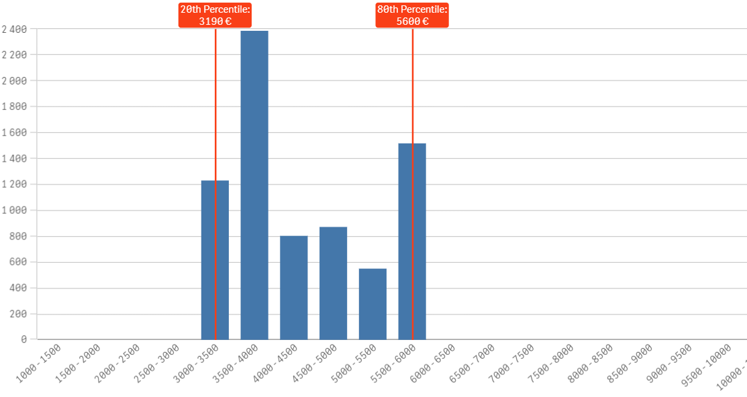
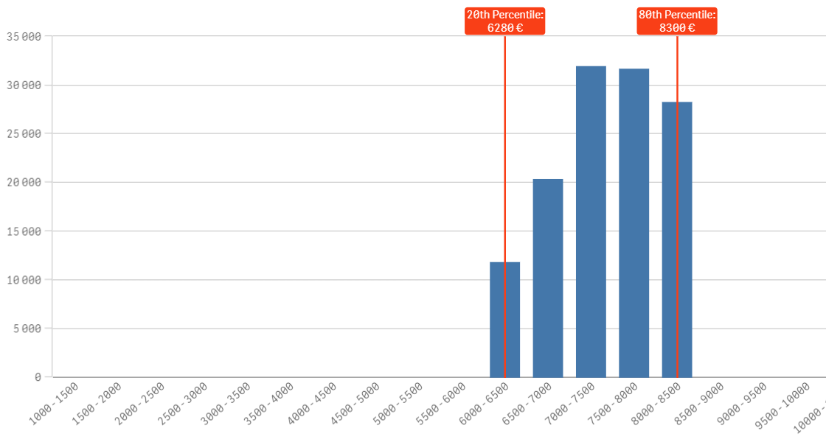
Horizon dashboard for lump sum evaluations
Evaluation experts must use the dashboard as an orientation to ensure that budgets are reasonable and non-excessive.
For each combination of country and organisation type selected, the dashboard displays the distribution between the 20th and the 80th percentile, and the median personnel costs.
Based on grants signed from 2022 (data last refreshed: Apr. 2024).
Applicants justify high personnel costs in the ‘Any comments’ tab of the Excel detailed budget table.
Personnel costs for Research Organisations in Romania
Total person-months
Personnel costs for Research Organisations in Germany
Access the dashboard here
Average personnel costs (per month per person)

Slide 12
Grant preparation
We follow the standard process to prepare the grant agreement.
The grant agreement for your project will be based on the Model Grant Agreement for lump sum grants.
The ‘no negotiation’ principle applies. The grant agreements is prepared on the basis of the proposal you submitted. However, some changes might be necessary:
correcting obvious errors and inconsistencies
other changes necessary to comply with applicable rules
adjustment of the lump sum to the amount specified in the Evaluation Result Letter
The breakdown of lump sum shares per beneficiary and per work package is included in the grant agreement as Annex 2. The submitted detailed lump sum budget table is not part of the lump sum grant agreement.
Once the lump sum is fixed in the grant agreement, it will not be questioned if the prices for goods or services change later on.

Slide 13
Budget allocation
Budget allocation (annex 2 to the grant agreement)
 | WP1 | WP2 | WP3 | WP4 | WP5 | WP6 | WP7 | WP8 | Total
Beneficiary A | 250.000 |  |  | 50.000 | 300.000 | 250.000 |  | 300.000 | 1.150.000
Beneficiary B |  | 250.000 | 350.000 | 50.000 |  |  | 100.000 | 150.000 | 900.000
Beneficiary C | 100.000 | 100.000 |  | 50.000 |  | 280.000 |  |  | 530.000
Beneficiary D |  | 120.000 |  | 50.000 |  |  | 100.000 | 150.000 | 420.000
Total | 350.000 | 470.000 | 350.000 | 200.000 | 300.000 | 530.000 | 200.000 | 600.000 | 3.000.000
Shares of the lump sum per beneficiary
Lump sum
=
Maximum grant amount
Shares of the lump sum per WP
You can use the budget as you see fit as long as the project is implemented as agreed. The actual distribution of the lump sum is invisible to us.
Budget transfers between work packages and/or partners require an amendment if the consortium wants to reflect them in the grant agreement.

Slide 14
Payment schedule
Types of payments:
Same function and same rules as for other grants
Coordinator distributes the amount according to consortium agreement
One or more
We pay the shares of the lump sum set out in Annex 2 for the work packages completed & approved in the reporting period
Closes the financial aspects of the grant
Partial payment for partially completed WPs possible
Releases the amount retained for the Mutual Insurance Mechanism
Pre-financing payment
Interim payment(s)
Payment of the balance

Slide 15
Amendments
Possible amendment types
(examples)
Changes in the work plan
Changes of the lump sum shares
Adding or removing participants
Additional activities to be subcontracted
Transfer of tasks between beneficiaries
Change of the project duration / reporting periods
Lump sum grants can be amended.
Same procedure and conditions as for all Horizon grants.
Lump sum work packages that have already been paid cannot be amended.
A technical review is needed to amend Horizon 2020 lump sum grants (no longer needed under Horizon Europe).
Deviations from the work plan can also be flagged in the periodic report (simplified procedure).

Slide 16
Reporting and payment (1)
Use the standard reporting template
The coordinator declares work packages as Completed or Not Completed. This should be justified by the technical periodic report.
An incomplete work package can be completed and paid in a subsequent reporting period.
At the final reporting period, it is possible to declare Partially Completed work packages, and to enter the percentage of completion.
The completion of work packages is not based on a successful outcome, but on the completion of activities as described in the description of action.

Slide 17
Reporting and payment (2)
The financial report is much simplified and to a large extent automated.
The financial statement for all beneficiaries is automatically generated (based on the accepted work packages and the corresponding lump sum shares).
 | WP1 | WP2 | WP3 | WP4 | WP5
Beneficiary A | 250.000 |  |  | 50.000 | 300.000
Beneficiary B |  | 250.000 | 350.000 | 50.000
Beneficiary C | 100.000 | 100.000 |  | 50.000
Beneficiary D |  | 120.000 |  | 50.000
Total | 350.000 | 470.000 | 350.000 | 200.000 | 300.000
Interim payments pay the lump sum shares for completed work packages.
Final payments can also pay partially completed work packages.
✓
✗
✓
✗
Payment = 350 000 + 0 + 350 000 + 0 = 700 000 €

Slide 18
Acceptance of work packages
Work packages are accepted if the activities have been carried out. We can also accept them when all essential tasks have been completed, when equivalent tasks have been carried out, or when deviations have been justified.
Lump sum projects can be amended according to scientific-technical needs (or deviations can be justified in the reports). Use these mechanisms to make completion of work packages feasible.
Before a lump sum work package (that you declared completed) is rejected as incomplete, you are invited to respond to the observations of the project officer.
If the rejection is upheld the lump sum share concerned is not paid at that point in time. You should complete the work package later and declare it at the end of any subsequent reporting period.
If it is not possible to complete a work package by the end of the project (e.g., for technical reasons or due to force majeure), the lump sum is paid partially in line with the degree of completion. The decision on the partial amount is taken on a case-by-case basis. You will be able to provide observations.

Slide 19
Acceptance of work packages – in practice
H2020 lump sum pilot:
Closed grants comprise 53% of all work packages (May 2024)
At final payment
99% were paid as declared (incl. 20 work packages where beneficiaries declared less than 100% completion)
1% were partially rejected
At intermediate payment
Rejection of work packages is rare, < 1%
No evidence of increased financial risks for beneficiaries
of which
Lump sum work packages in H2020

Slide 20
Ex-post controls
Checks, reviews and audits for:
Proper implementation of the action (e.g. technical review)
Compliance with the other non-financial obligations of the grant, e.g.
IPR obligations
Ethics and integrity
Open science
Dissemination
Etc.
No financial checks, reviews and audits by EU services

Slide 21
Keeping records
Consortium needs to keep (e.g.)
Technical documents
Publications, prototypes, deliverables
…any document proving that the work was done as detailed in Annex 1
Consortium doesn't need to keep*
Time-sheets
Pay-slips or contracts
Depreciation policy
Invoices
…any documents proving the actual costs incurred
Documentation required by good research practices such as lab books
*Participants still need to comply with financial record keeping obligations outside the grant agreement, if any (e.g., under national law or internal procedures)
Same as for all Horizon Europe grants

Slide 22
Resources available
One dedicated lump sum page on the Funding &Tenders Portal with:
Video tutorials
Overview of lump sum funding
Guidance documents
What do I need to know? & Quick guide
Reference documents
Model Grant Agreement Lump Sum
Studies
European Commission assessment (October 2021)
Events
Future events
Past events and recordings
European Parliament (STOA) study on lump sums in Horizon 2020 (May 2022)
Decision authorising the use of lump sum contributions under the Horizon Europe Programme
Frequently asked questions
Detailed guidance for participants
Lump sum briefing slides for experts
Horizon dashboard for lump sum evaluations
Detailed budget table

Slide 23
Next steps
Continuous monitoring of lump sum grants, adjustments if necessary
A follow-up study to the 2021 assessment is under preparation
Ex-post control strategy under preparation (technical reviews)
Stepwise phasing in:
2% lump sums in 2021-2022
> 10% lump sums in 2023
Nearly 30% lump sums in 2024
Possible further increase from 2025

Slide 24
Thank you!
# HorizonEU
http://ec.europa.eu/horizon-europe

