Slide 1
Amendments (AMD) – The business process and IT tools
Coordinators’ day – Grant Management
October 4, 2022

Slide 2
Amendments – key business features
Process cycle fully managed online (via F&T Portal)
Can be requested by both parties (Consortium/EU)
Revision by the EU (before signature & submission) – mandatory step
Time-bound process: 45-day time limit for the receiving party to sign
Collaborative process, but only the Coordinator (COO) signs & submits
Requests submitted after the signature of the GA and before the end date of the project
Withdrawal possible (before the counter-signature)

Slide 3
Amendment Request
It consists of a structured set of information and documents including:
Changes encoded in the eGrants Management System (F&T Portal);
Request letter: list of changes requested, reasons and list of supporting documents, if any;
Amendment core: legal document listing the clauses amending the GA
Supporting documents: updated GA Data sheet, Annex 1 (if AT21), Annex 2 (if AT41) …

Slide 4
Amendment Process – Consortium requested
Launch
2. Prepare
3. Lock
for review
4. EU revision
5. Signature of PLsign
& submit
6. EU Signature
limit for cancellation
limit for withdrawal
If sent back, the COO encodes the changes required and resubmits for review
If validated, the COO can sign and submit

Slide 5
Amendments IT Tools
Horizon Europe

Slide 6
Launch a request for amendment
Log in to the F&T Portal → My projects → Manage Project (Actions menu)
Only the Primary COordinator COntact can launch an amendment request
PCoCo
Disclaimer: The following screenshots are used for demonstration purposes only.

Slide 7
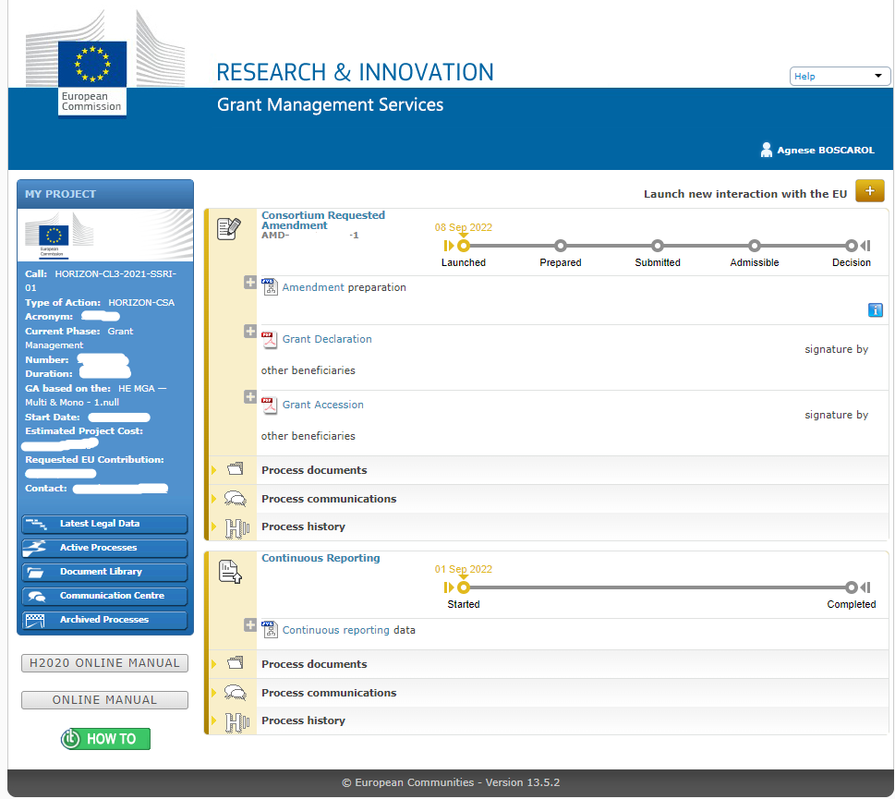
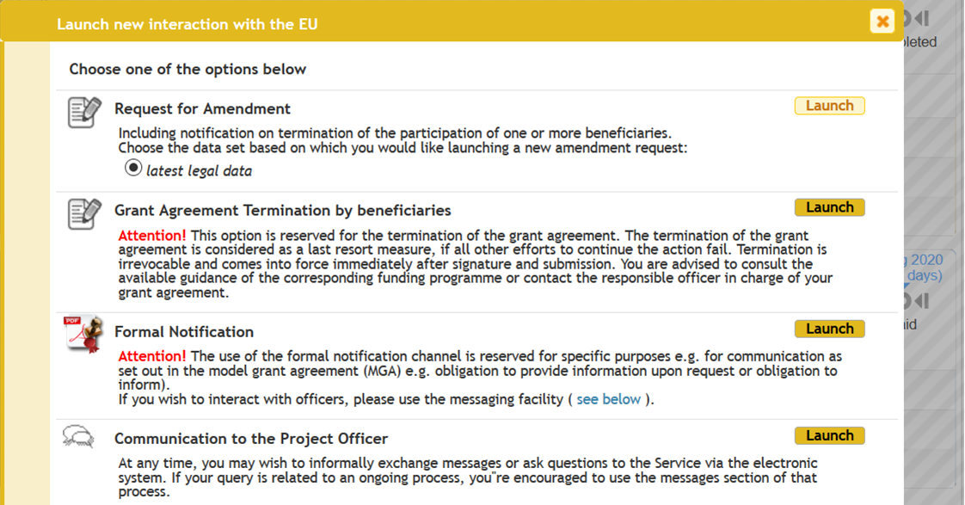
Launch a request for amendment
Previous rejected or withdrawn AMD available
B
Latest legal data option by default
A

Slide 8
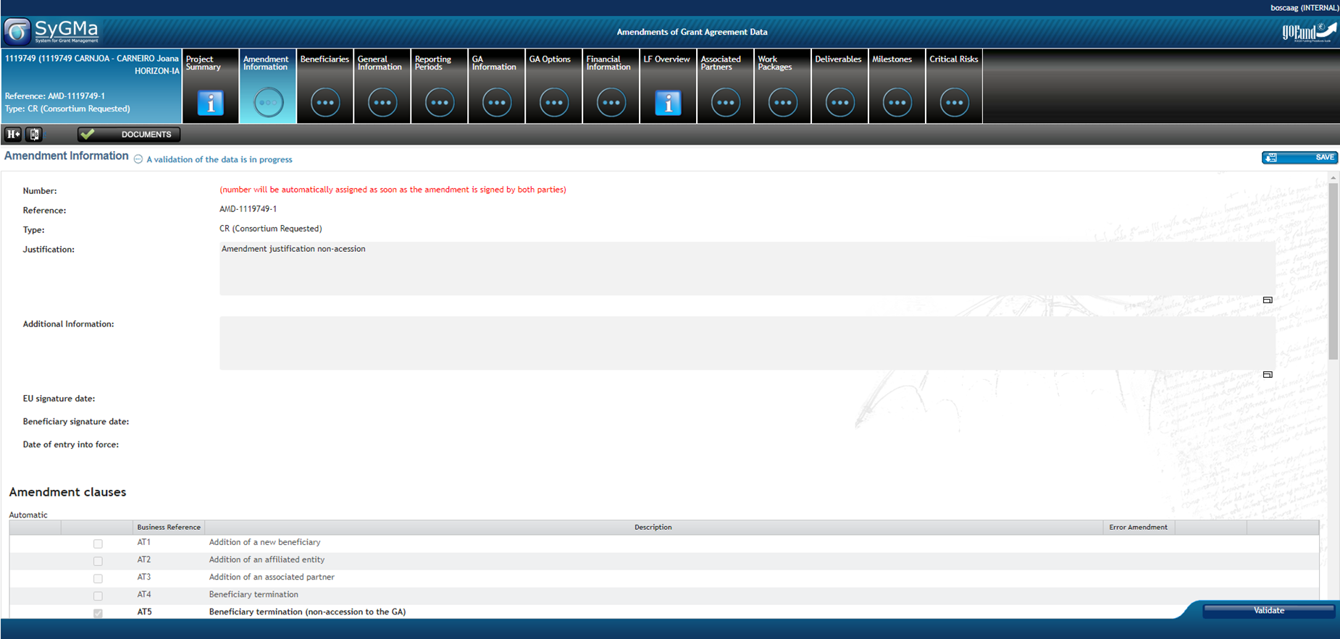
Prepare a request for amendment
This justification will be included in the request letter which will be automatically generated by the system as a single PDF document
List of available AMD clauses

Slide 9
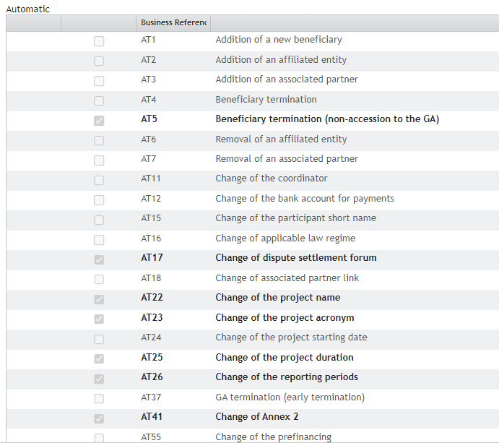
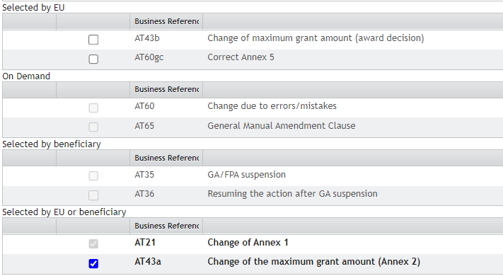
AMD clauses (AT…)
Based on changes to the GA, the system will automatically select the appropriate AMD clause
One single AMD request might include several changes, as a consequence several AMD clauses.

Slide 10
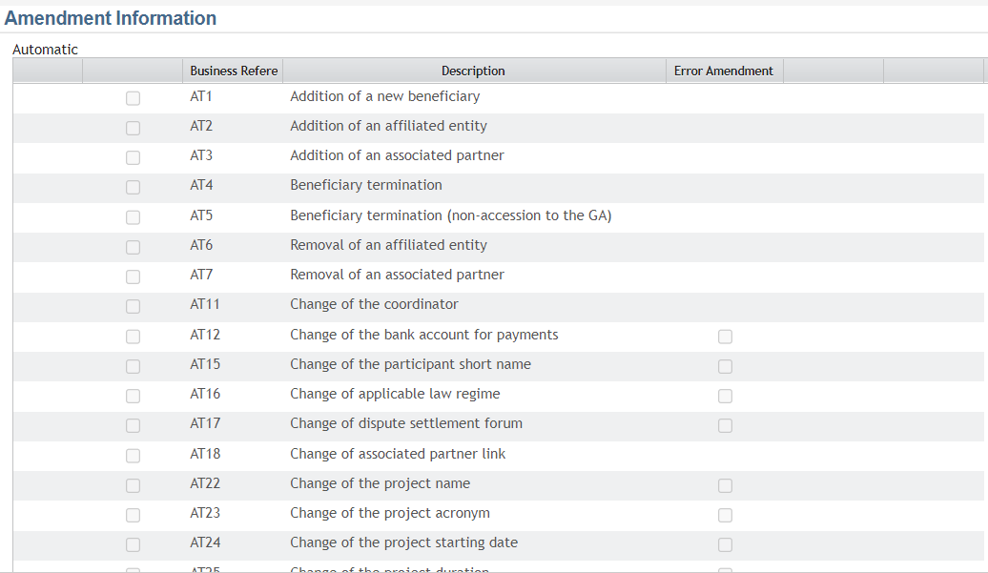
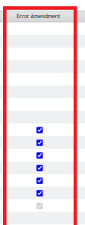
AMD clauses (AT…)
New list of amendment clauses for the MFF 21-27
New: Some clauses can be marked as Error Amendment (EU officer only can activate the flag)

Slide 11
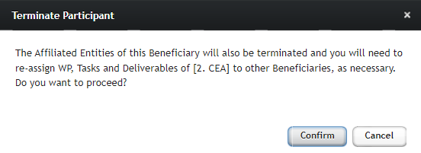
Prepare a request for amendment Example: Beneficiary termination (AT4)
Affiliated Entities are automatically removed in case of BEN Termination

Slide 12
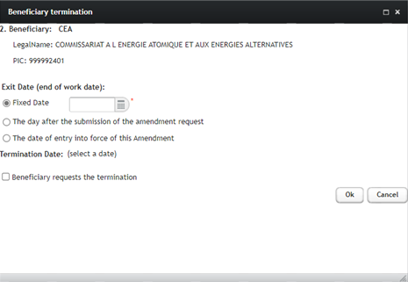
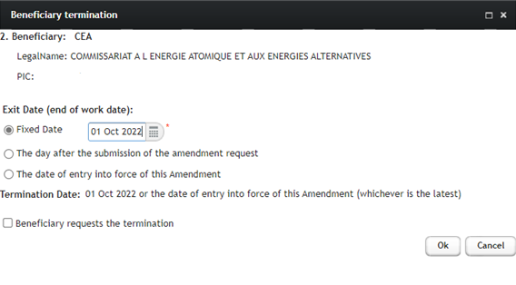
Prepare a request for amendment Example: Beneficiary termination (AT4)
Exit date (End of work date): it marks the date on which the participant actually stops working on the action. It will be added to the list of participants in the Data Sheet (point 2)
The termination date will be automatically calculated after the selection of the exit date. Since it can be only in the future, it will be a fixed date or the entry into force of the AMD, whichever is the latest.

Slide 13
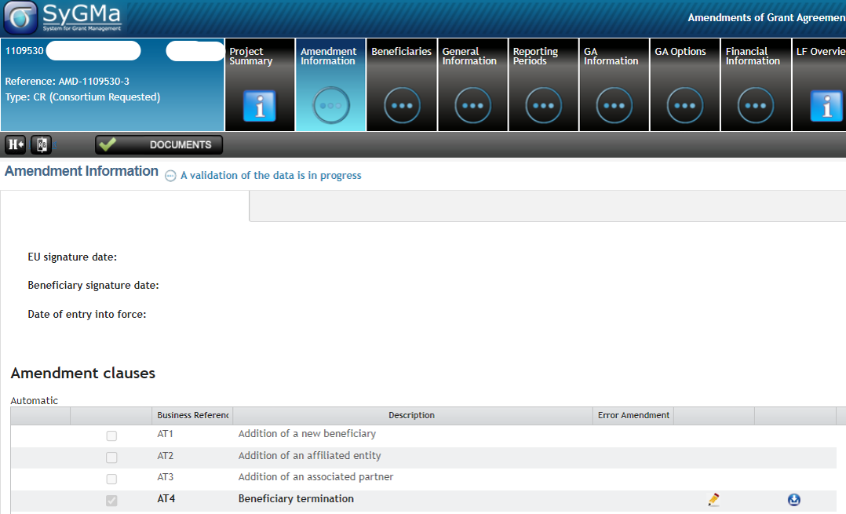
Prepare a request for amendment Example: Beneficiary termination (AT4)
Based on the changes encoded, AT4 will be automatically flagged in Amendment Information tab

Slide 14
Prepare a request for amendment Example: Beneficiary termination (AT4)

Slide 15
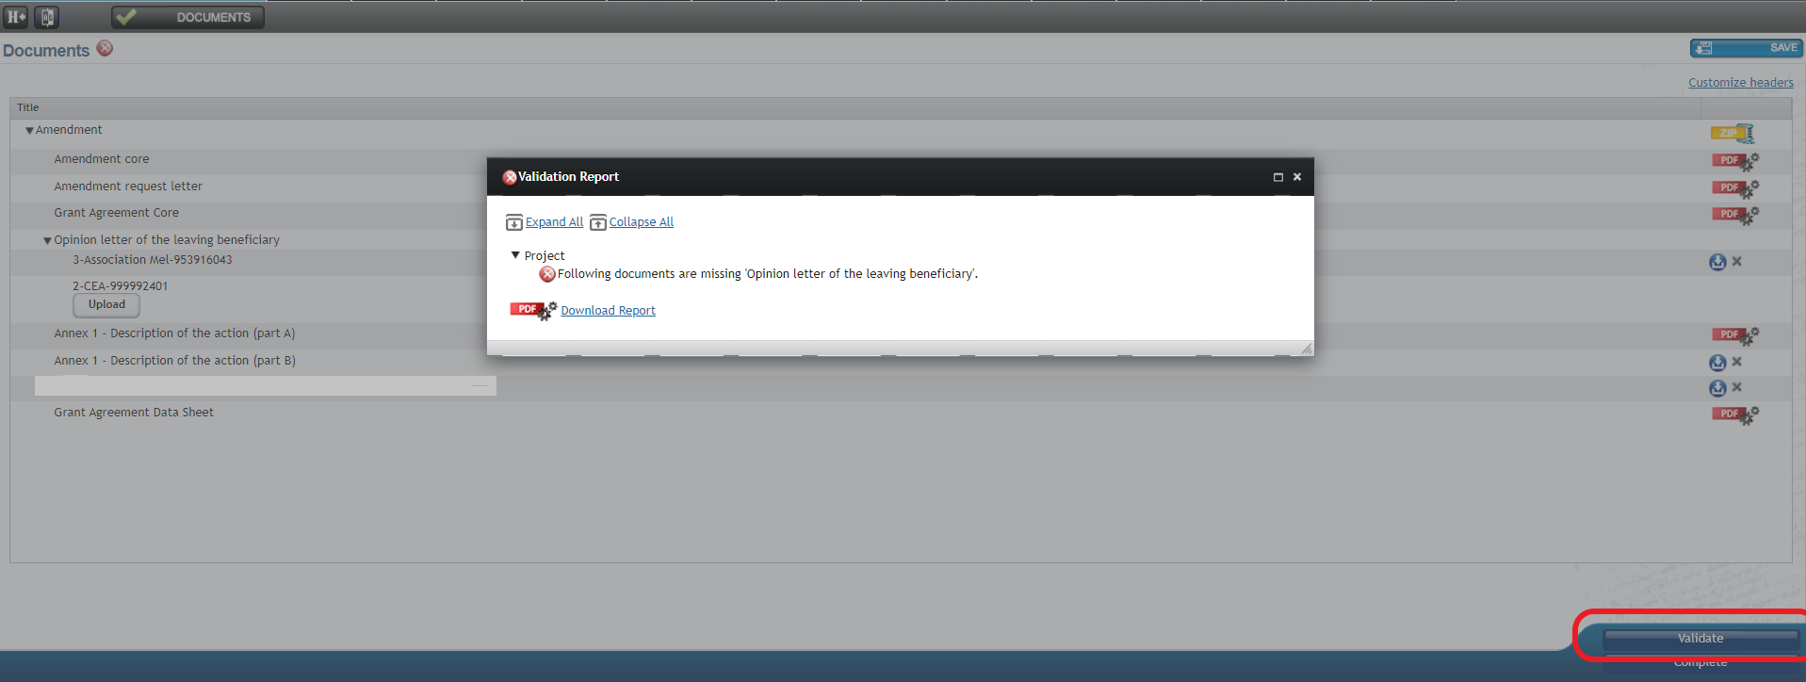
Prepare a request for amendment Example: Beneficiary termination (AT4)
Beneficiary termination triggers the termination reporting process (technical and financial). A notification is sent to COO and BEN as they both have to provide their input.

Slide 16
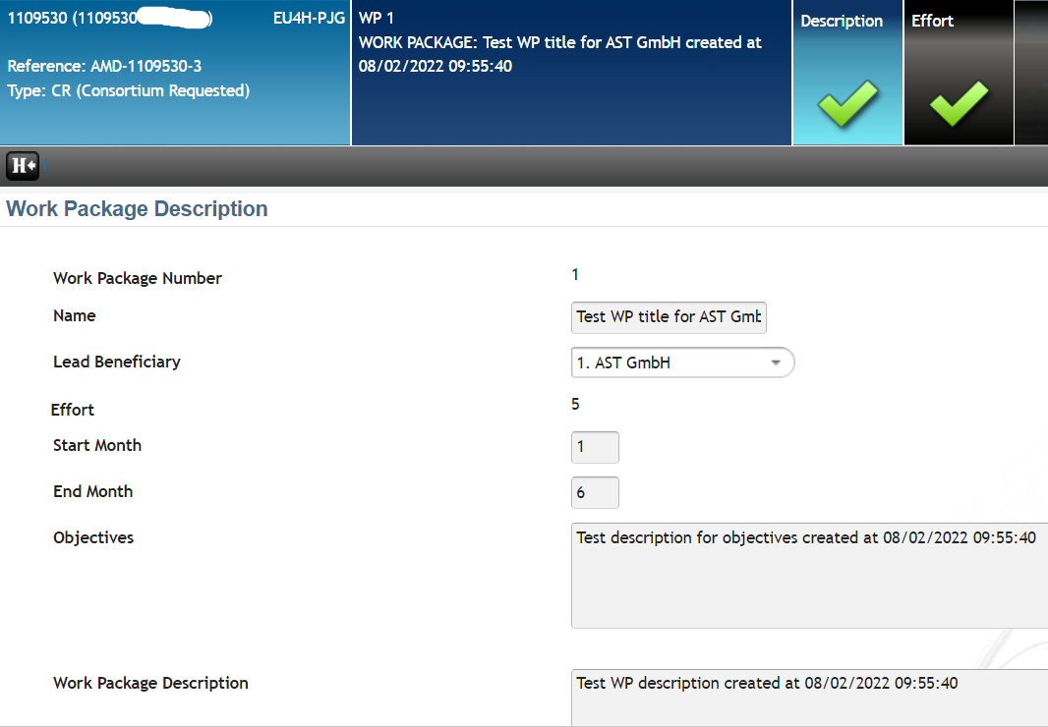
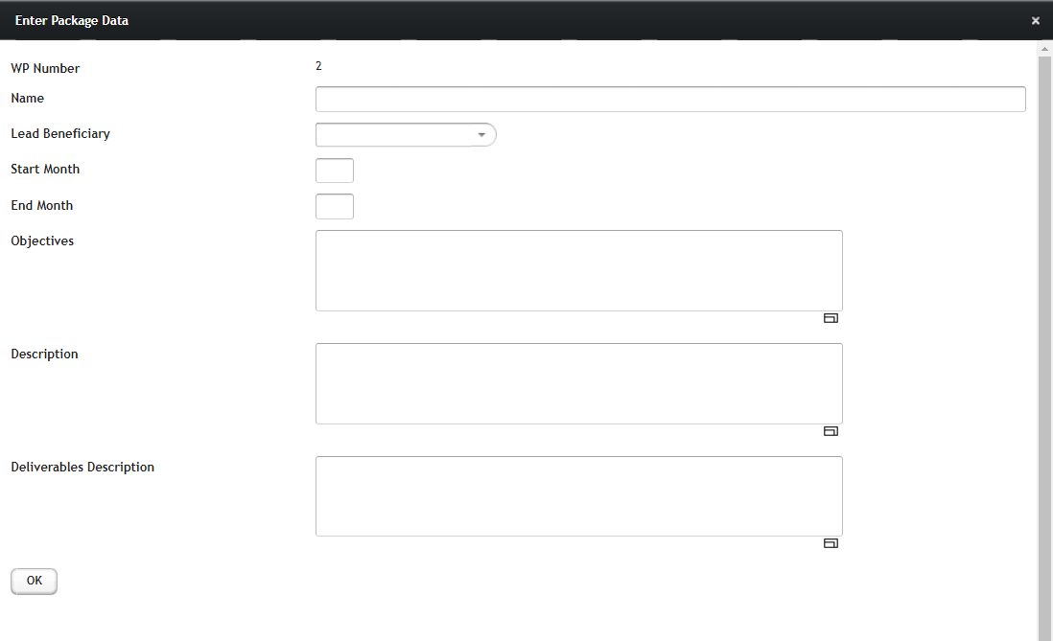
Prepare a request for amendment Example: Change of Annex 1 (AT21)
Due to changes in the consortium composition or in the project plan and/or activities, Annex 1 has to be updated to reflect those changes. For example, changes in WPs’ structure, reassignment of tasks to a different or new BEN, etc.

Slide 17
Prepare a request for amendment Example: Change of Annex 1 (AT21)
Updated Annex 1 part B has to be uploaded as a single PDF document. Delete the previous version and upload the new one, reflecting changes having an impact on the description of the action (part B).

Slide 18
Send to EU for revision (“lock for review” step)
PCoCo
CoCo
The PCoCo/CoCo performs the action. As soon as the request is locked, a PDF is generated. The process will move to “prepared” step.
At this point, the request can be sent to the EU for revision.

Slide 19
Sign & submit
The EU assess your request. If approved, the COO LEAR receives a notification to sign the AMD.
The Project legal signatory signs the request. The flow moves to “Submitted” step.
! When adding a new BEN, DoH and Accession forms must be signed before the AMD request is submitted. After submission, no correction is possible.
PLSIGN
If the EU sends the request back for revision, the PCoCo/CoCo receives a notification explaining the reasons for rejection. A new loop (prepare, lock, revise) is launched.

Slide 20
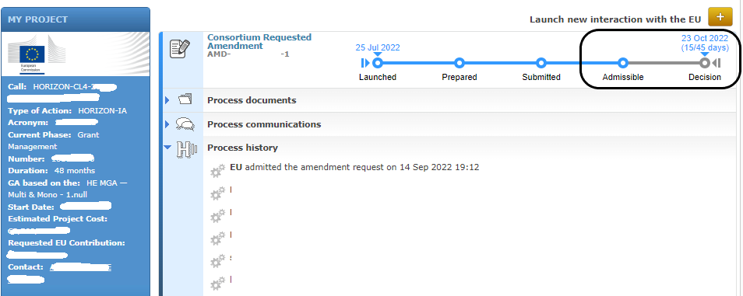
EU assessment and validation
45-day time limit starts when the flow moves to “Submitted” step. Time elapse and process history are always available.

Slide 21
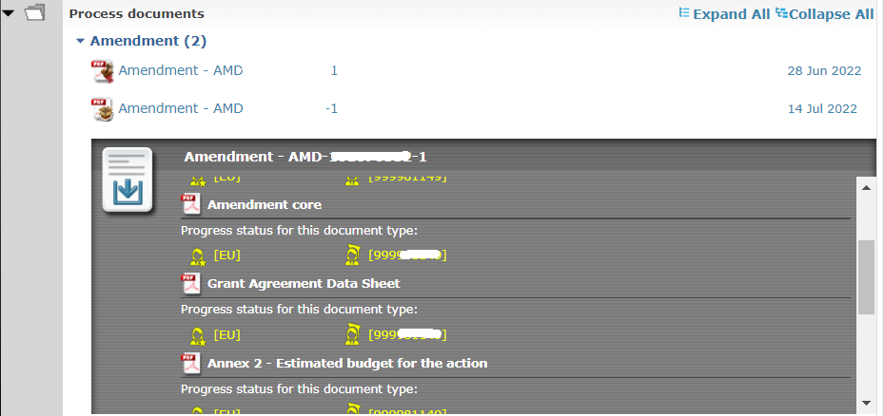
Amendment signed
Process documents available:
consolidated AMD
single files composing the AMD request

Slide 22
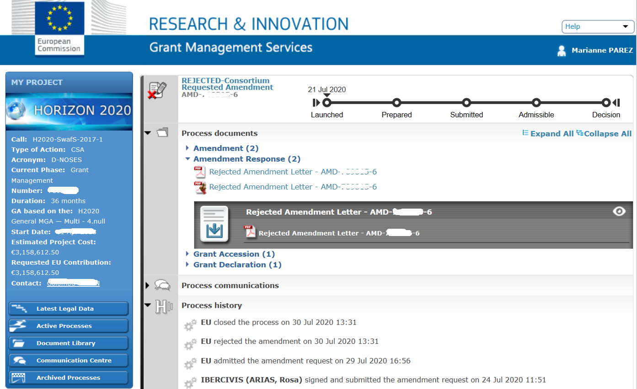
Rejection
Rejection is notified in writing and within the 45-day deadline

Slide 23
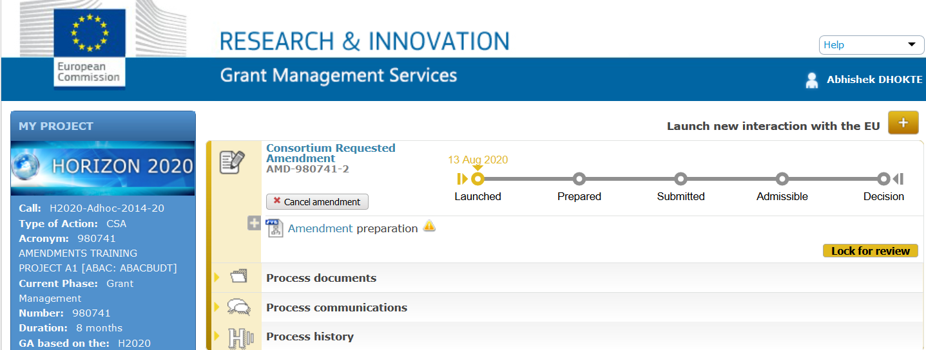
Cancellation
An AMD request can be cancelled before it is signed by the Coordinator
A cancelled AMD is filed under “Archived processes”. It can’t be edited nor resumed

Slide 24
Withdrawal
After signature and submission of the Amendment request, and before counter-signature, only the PLSign can withdraw the request. The EU services will be notified. The AMD will be filed under “Archived Process” in the system. If withdrawn, it can be resumed, edited and resubmitted.

Slide 25
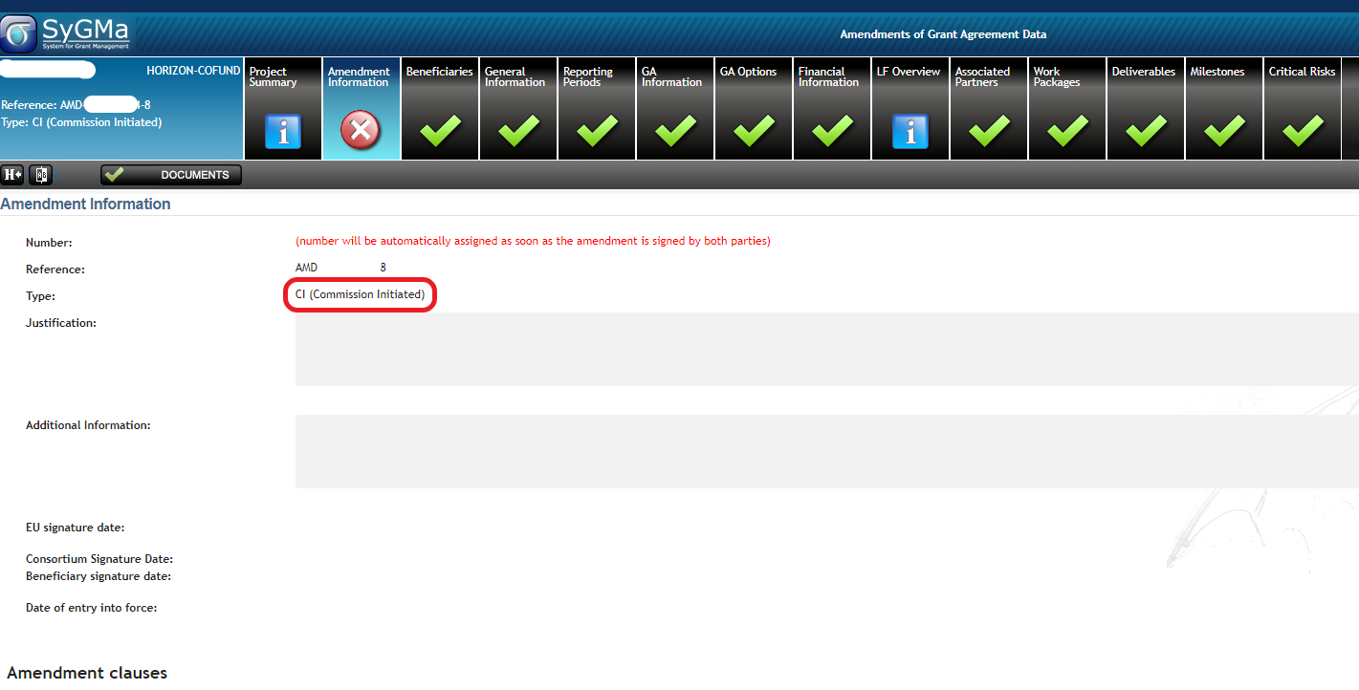
EU-initiated AMD
In case of an EU-initiated AMD, the PLSign and the PCoCo/CoCo will receive a notification with the request to sign the amendment or, if in disagreement, to inform the EU within the same deadline (45 days) together with the reasons why.

Slide 26
Takeaway messages
Check out guidance material and reference documents in advance;
Before you start, request the validation of legal entities if need be;
Define what has to be changed, what is needed;
Prepare lean requests. Consider urgency and reduce complexity, whenever possible;
Use a concise and clear language in the formulation of the justification. List all the changes requested in a structured way and in line with the changes introduced in the system;
Collaborate with the Project Officer. Consult with them in case of doubts, discuss with them the appropriate way to proceed before launching an amendment;
Be transparent in case you face difficulties; try to come up with a plan if need be

Slide 27
IT Tools - Guidance documents
Amendments - Online Manual - Funding Tenders Opportunities (process overview)
How to launch an amendment - IT How To - Funding Tenders Opportunities
List of AT clauses published at How to prepare an amendment - IT How To - Funding Tenders Opportunities
Online Manual (last update 15.09.22)
Amendment Guide (soon available)

Slide 28
Thank you!
# HorizonEU
http://ec.europa.eu/horizon-europe

