Slide 1
REA Central Validation Service: legal validation and financial capacity assessment
Horizon Europe Coordinators' Day
15 June 2022
Pietro SAMPERI - REA D4.04 Alberto ROMERO QUICIOS - REA D4.02

Slide 2
Presentation outline
REA Central Validation Service
Registration of participants
Legal validation: legal existence and legal status
Legal Entity Appointed Representative (LEAR)
Financial Capacity Assessment (FCA)
Guidance documents

Slide 3
REA Central Validation Service (REA CVS)
Verifies legal existence and legal status of entities
Validates the appointment of Legal Entity Appointed Representatives (LEAR)
Validates legal changes of validated entities requested by LEARs
Assesses Universal Takeovers of validated entities
Creates Legal Entities and Bank Account Files in cooperation with DG BUDG
Prepares the Financial Capacity Assessment for the RAO
Performs third country control analysis
Performs ex-post status verifications (e.g. SME & MID cap status checks)

Slide 4
Validation Process Overview
Registration
Verification & validation of legal data
LEAR
FCA
Organisations have to register in the Participant Register
Based upon legal documents
Mandatory for all validated participants
Financial Capacity Assessment if needed
COMMUNICATION VIA PARTICIPANT REGISTER

Slide 5
Registration of an organisation (at proposal stage)
Search for a registered organisation
New registration

Slide 6
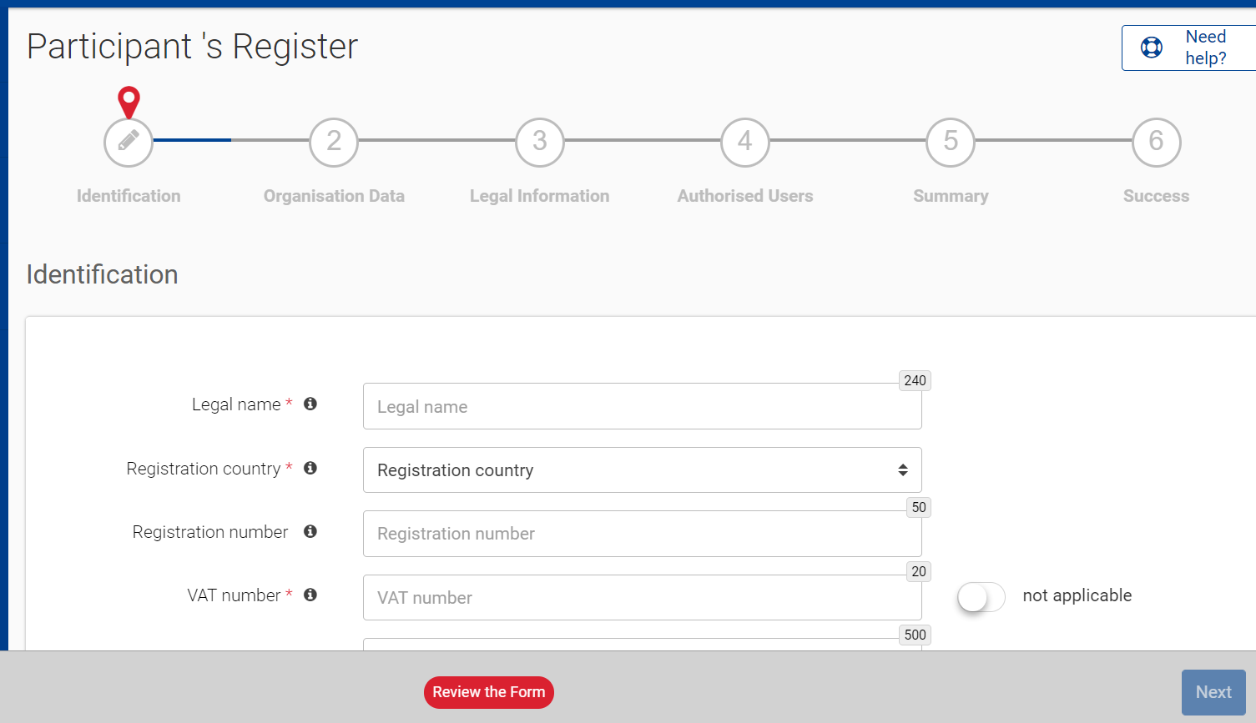
How to register in the Participant Register
Identification (duplicate check)
(e.g. Legal name, VAT number)
Organisation data
Legal information
Authorised users
(e.g. Name, e-mail address of the self-registrant and the back-up)
Registration completed
New Participant Identification Code (PIC) in a “declared” status

Slide 7
Validation Process Overview
Registration
Verification & validation of legal data
LEAR
FCA
Organisations have to register in the Participant Register
Based upon legal documents
Mandatory for all validated participants
Financial Capacity Assessment if needed
COMMUNICATION VIA PARTICIPANT REGISTER

Slide 8
Legal validation
Registration data is verified by REA Central Validation Service before the signature of the Grant Agreement or Contract
The legal validation of a participant in the Single Electronic Data Interchange Area (SEDIA) is done once, when the entity has to sign its first Grant Agreement or Contract
It is reused for future participations in EU grant and procurement actions

Slide 9
Validation Rules
Validation is always performed on the basis of supporting documents, in accordance to EU Financial Regulation and the Rules on Legal Entity Validation, LEAR Appointment and Financial Capacity Assessment for EU Grants and Tenders
Validation is required for all beneficiaries and linked third parties
PICs of third parties, frequently included in the consortium during the GAP, must be introduced in the Funding & Tenders Portal's Grant Management Services System

Slide 10
Legal entity existence
‘Legal entity’ means any natural or legal person created and recognised as such under national or international law. It must have legal personality and, acting in its own name, be able to exercise rights and be subject to obligations.
If an organisation does not have legal personality, it is validated only if:
has representatives who have the capacity to undertake legal obligations on its behalf and
can offer equivalent guarantees for the protection of the EU financial interests as a legal person, in particular equivalent financial and operational capacity.
In case the organisation does not have its own independent legal personality and does not meet the above criteria, it must use the PIC of the legal entity to which it is associated (e.g. University department, branch of a multinational company).

Slide 11
Legal entity status
Supporting legal documents define the legal statuses of a participant.
Why are legal statuses important?
programmes may have differences in terms of funding rates (e.g. non-profit entities)
programmes/calls may establish specific eligibility criteria (e.g. SMEs, middle-capitalisation companies)

Slide 12
Special legal statuses
private entity or public body
non-profit or for profit organisation
small or medium sized enterprise (SME)
middle-capitalisation enterprise (mid-cap)
non-governmental organisation (NGO)
civil society organisation
international organisation (IO)
research organisation
secondary or higher education establishment

Slide 13
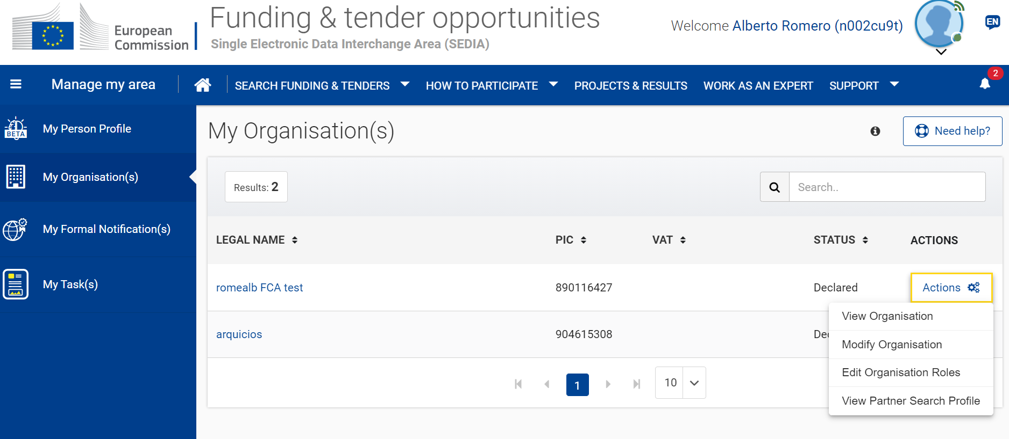
How to log in the Participant Register
EU Login

Slide 14
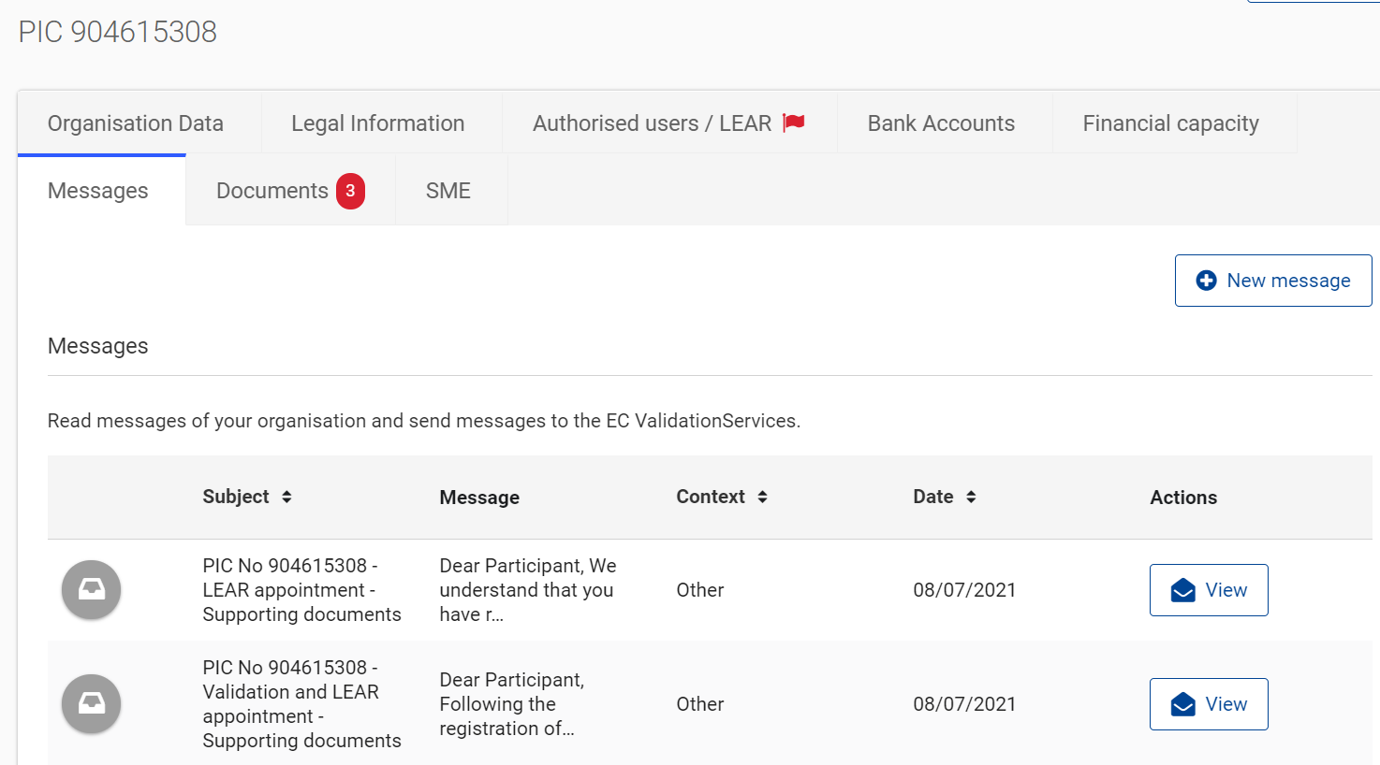
Legal validation documents Requests in Participant Register

Slide 15
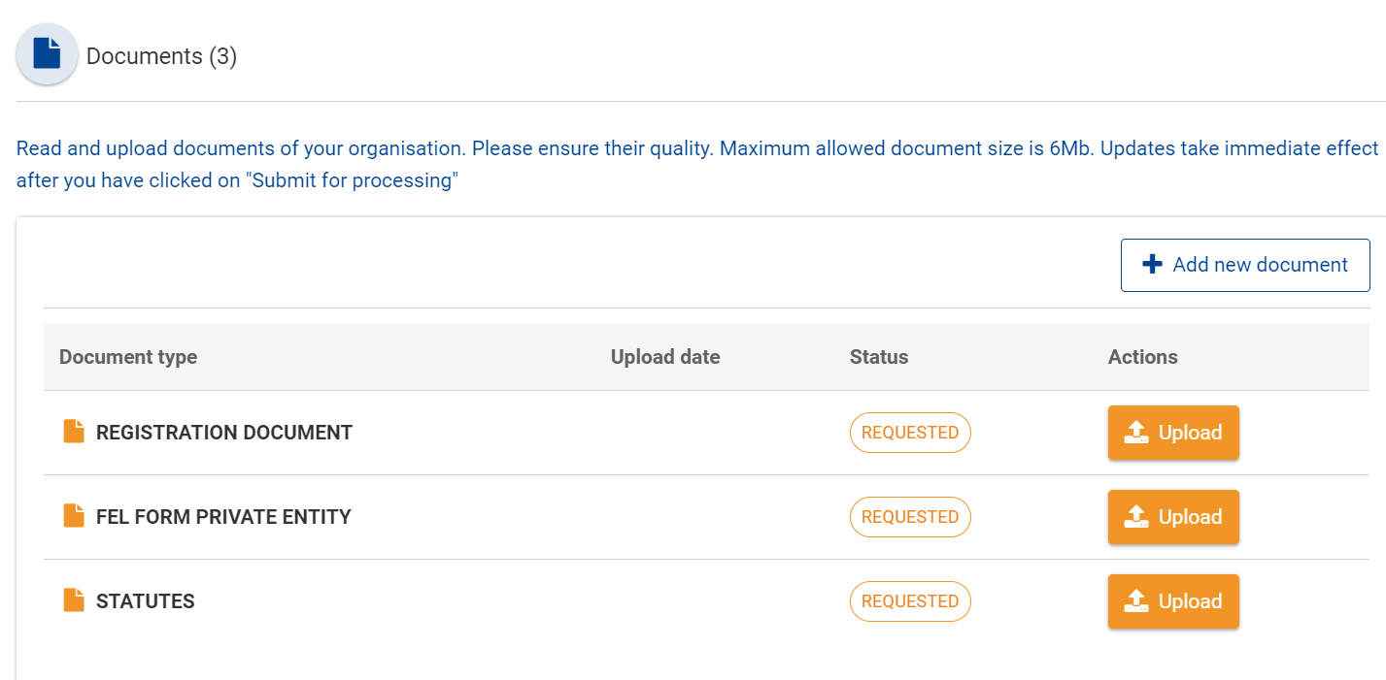
Legal validation documents Requests in Participant Register

Slide 16
Legal validation documents
Legal entity form (template to be completed, dated, stamped and signed)
VAT extract (< 6 months)
If not registered for VAT – proof of VAT exemption
Registration extract (< 6 months) – for private law bodies
Law/decree/decision – for public law bodies
Treaty – for international organisations
Statutes – for non-profit organisations

Slide 17
Legal validation documents
Official: delivered by official national authorities. They can NOT be replaced by self-declarations or by sworn or solemn statements before a judicial or administrative authorities, notaries or public officers
Uploaded by the participant (as scanned versions) via the Participant Register
In any of the official EU languages. Free translation in English is required for non EU languages

Slide 18
Validation Process Overview
Registration
Verification & validation of legal data
LEAR
FCA
Organisations have to register in the Participant Register
Based upon legal documents
Mandatory for all validated participants
Financial Capacity Assessment if needed
COMMUNICATION VIA PARTICIPANT REGISTER

Slide 19
LEAR roles and duties
In the Single Electronic Data Interchange Area, the appointment of the Legal Entity Appointed Representative (LEAR) is mandatory.
The LEAR:
keeps an overview of all the proposals/projects/contracts your organisation is involved in;
manages all the legal and financial information about your organisation;
manages the access rights at organisation level (and read-only access at project level);
appoints the persons which will be able to electronically sign grants/contracts (Legal Signatories — LSIGNs) and cost claims/invoices (Financial Signatories — FSIGNs).

Slide 20
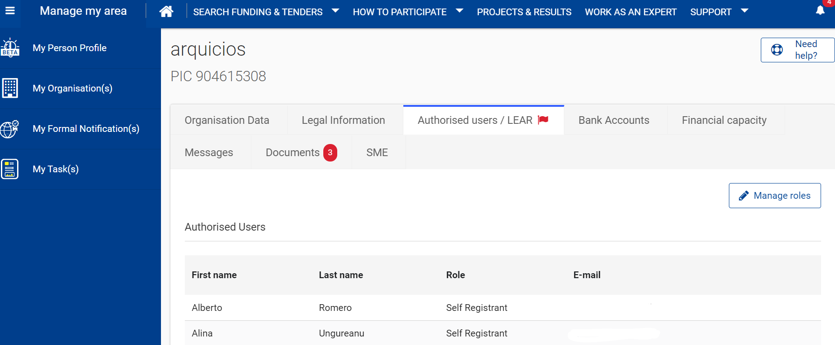
How to appoint a LEAR

Slide 21
How to appoint a LEAR

Slide 22
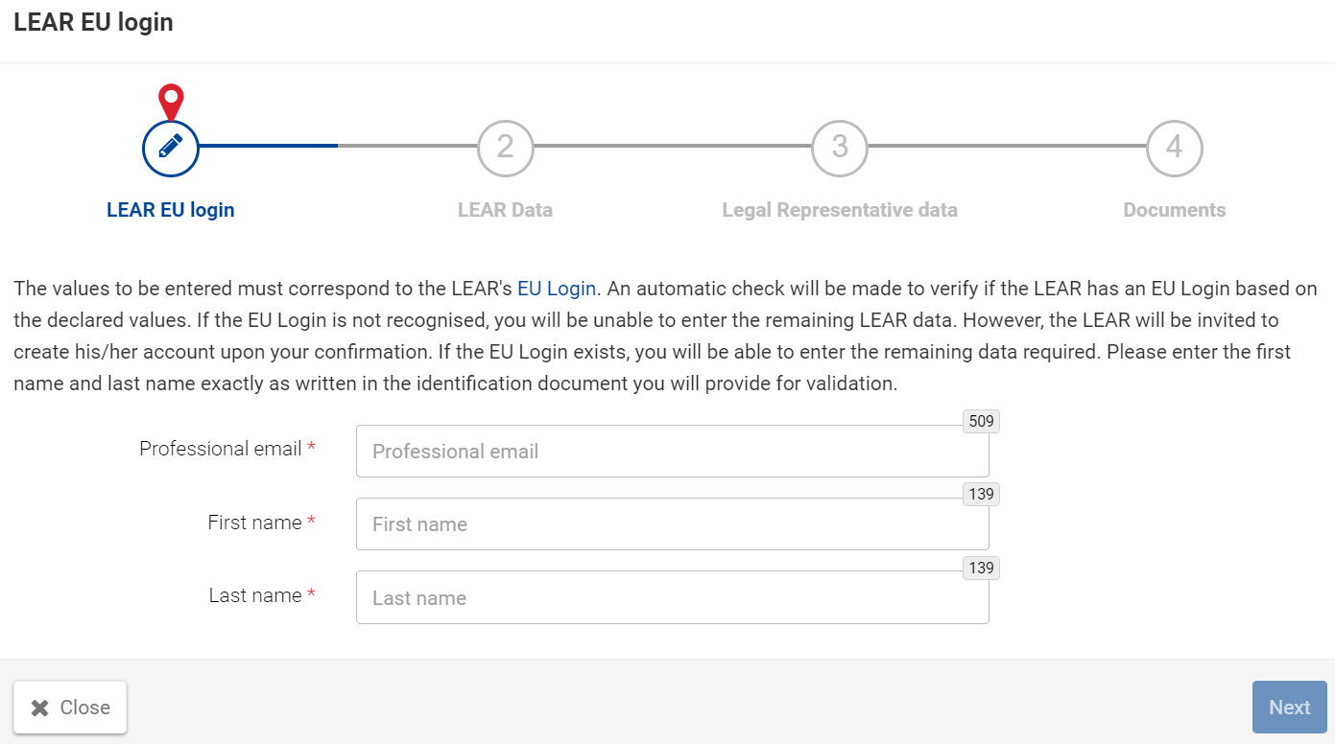
LEAR key information
Name and email shall match name and email of the linked EU Login account
New LEAR or new email = new EU Login account

Slide 23
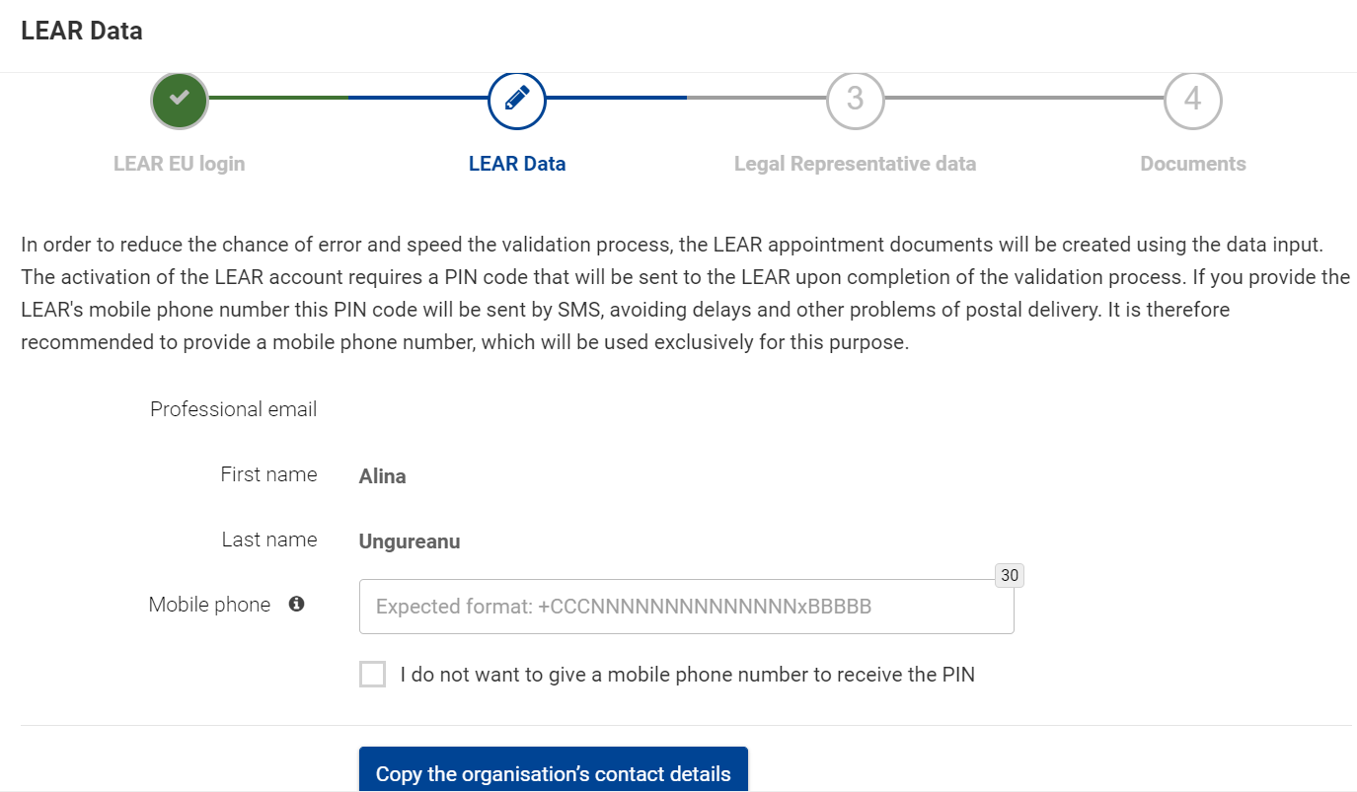
LEAR data
Mobile phone number to receive PIN code

Slide 24
LEAR data
PIN code sent by the service desk by post
Urgent request for PIN code:
send an email to EC-FUNDING-TENDER-SERVICE-DESK@ec.europa.eu
OR
provide mobile phone number (used only for PIN code)

Slide 25
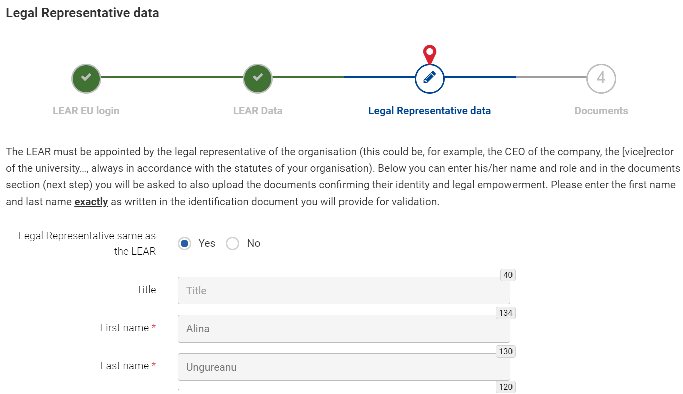
Legal representative data

Slide 26
LEAR appointment documents
LEAR appointment letter and Roles and Duties of LEARs (duly signed by both the legal representative and the LEAR)
Declaration of Consent to the EU Funding & Tenders Portal Terms and Conditions (duly signed by legal representative)
Official proof of identity (ID-card/passport with photo and signature) of the legal representative and the LEAR
Proof of empowerment of the legal representative
Scanned version of these documents shall be uploaded in the Participant Register. Originals of 1 and 2 must be kept in the entity's premises.

Slide 27
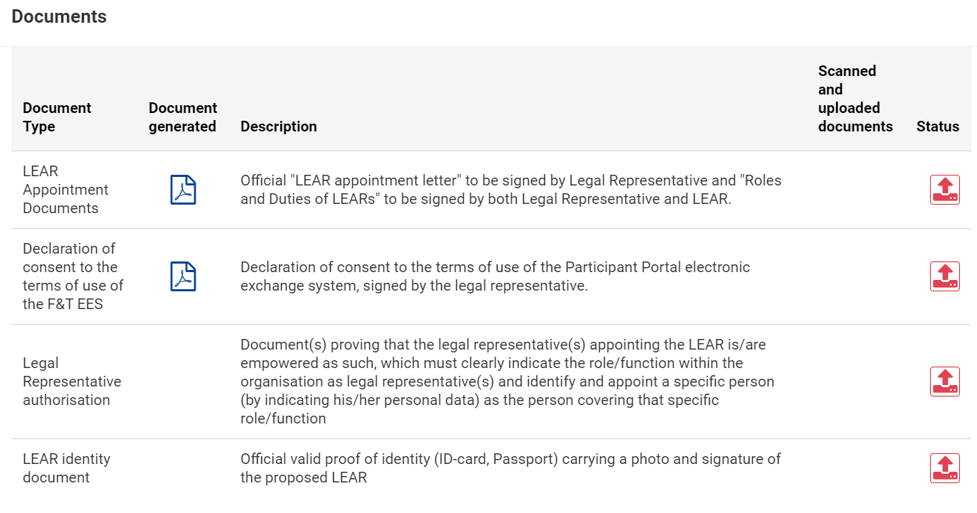
LEAR appointment documents

Slide 28
Bank accounts (BAs)
If needed, during the Grant Agreement Preparation, participants can search for available bank account(s) in the Funding & Tenders Portal's Grant Management Services System
If no account exists, the system displays an explanatory message on how to request the validation of a BA
Participants should start the BA work-flow by uploading the requested documents via the Participant Register)
REA CVS will launch BA validation and will inform the participant once validated

Slide 29
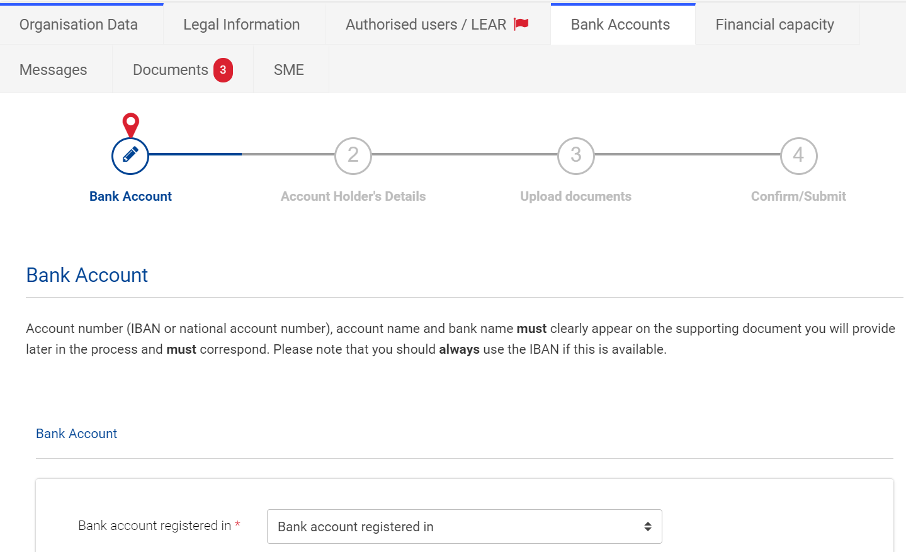
Bank accounts

Slide 30
Validation Process Overview
Registration
Verification & validation of legal data
LEAR
FCA
Organisations have to register in the Participant Register
Based upon legal documents
Mandatory for all validated participants
Financial Capacity Assessment if needed
COMMUNICATION VIA PARTICIPANT REGISTER

Slide 31
Financial Capacity Assessment (FCA)
Reference documents:
Rules on Legal Entity Validation, LEAR Appointment and Financial Capacity Assessment for EU Grants and Tenders.
EU Financial Regulation (2018/1046) arts. 196 and 198.
Regulation (EU) 2021/695 H.E. (art. 27: financial capacity of applicants).
FCA for coordinators (and mono beneficiaries) =/> 500.000€.
FCA if there are grounds to doubt the financial capacity of one applicant.
Exemptions: Public bodies, international organisations and some natural persons.
If the FCA must be checked, the entity will be contacted by the Central Validation Service via its PIC account in the Participant Register in the F&T Portal.

Slide 32
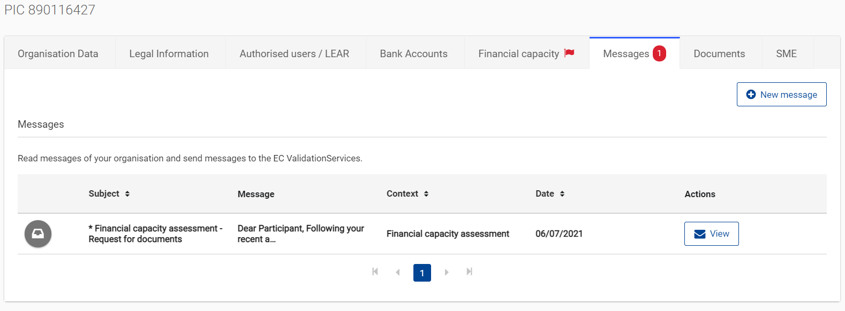
Financial Capacity Assessment: Requests in Participant Register

Slide 33
FCA supporting documents (via Participant Register)
Balance sheet
Profit and loss account
New established entities: Business Plan.
External audit report (or signed self-declaration) if requested EU-contribution exceeds € 750.000 (art. 196 EU FR).
Explanatory notes and/or annexes that form part of the above financial statements (if available).
Prudent approach if missing information.
For the 2 most recent closed and approved financial years
(in official language, dated and signed)
Once completed, the assessment is valid for 18 months from the closing date

Slide 34
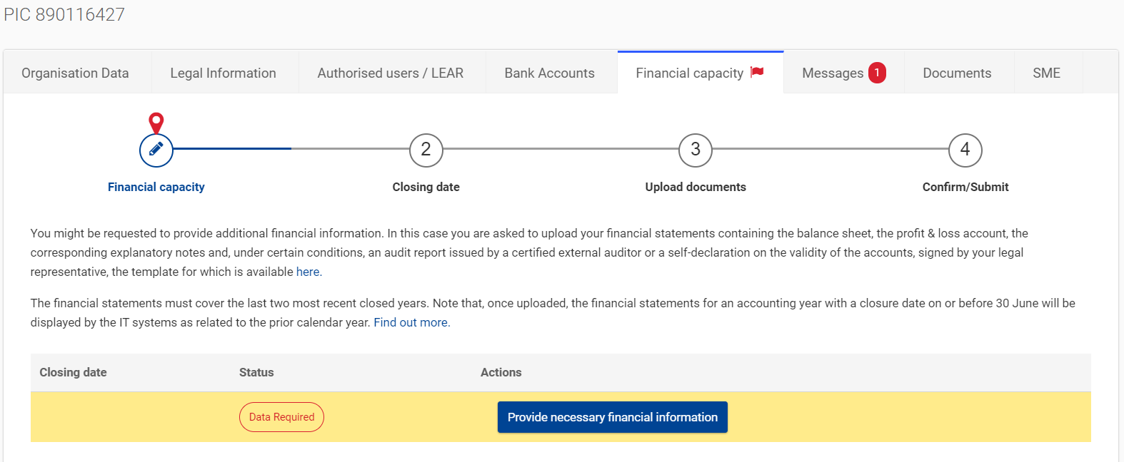
Financial Capacity Assessment: Requests in Participant Register

Slide 35
Central Validation Service workflow
Validation starts
REA CVS requests
validation documents
Participant replies?
REA CVS sends reminders to the participant
No
If the participant is non-responsive, the PIC is set to "sleeping" status in the Participant Register and REA CVS informs the Operational Unit
Yes
REA CVS requests missing supporting documents
No
Submission of documents is complete?
POs contact the participant to request documents' upload
Legal validation +
LEAR appointment +
FCA preparation
Yes

Slide 36
Validation Process Overview
Registration
Verification & validation of legal data
LEAR
FCA
Organisations have to register in the Participant Register
Based upon legal documents
Mandatory for all validated participants
Financial Capacity Assessment if needed
COMMUNICATION VIA PARTICIPANT REGISTER

Slide 37
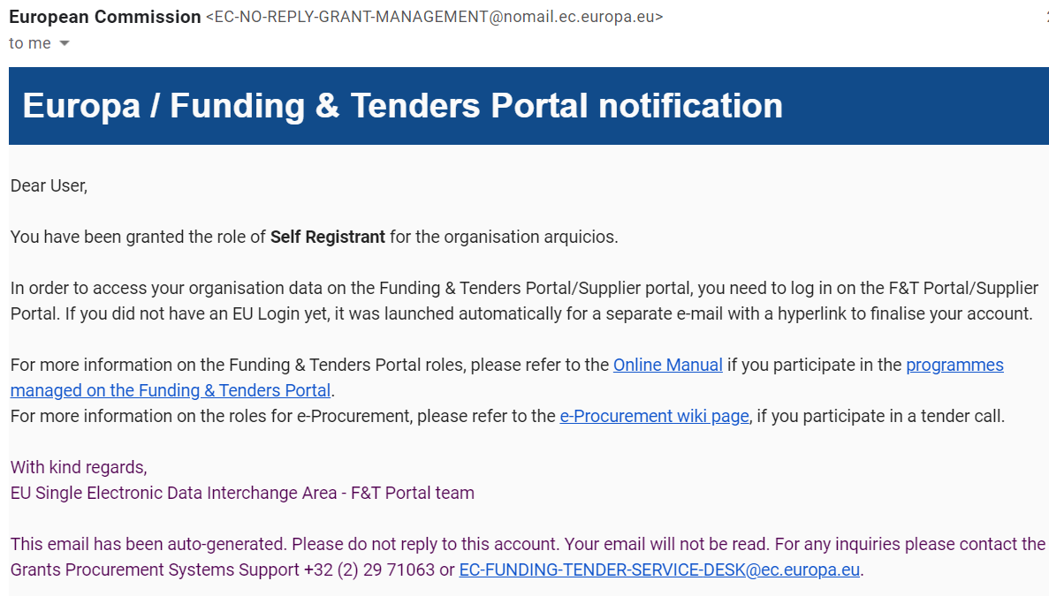
Communication (e.g. request to submit legal documents or to appoint a LEAR)
All communication to -and from- participants is exclusively managed through the Participant Register
Messages are notified via e-mail to the contact person (i.e. self-registrant or the appointed LEAR)

Slide 38
Access lost to non-valid/valid PICs
In case the self-registrant left the organisation and no one has access to a non-valid PIC – a new PIC needs to be created and REA CVS informed
If the LEAR is not available anymore and there are no Account Administrators, a new LEAR needs to be appointed – LEAR recovery procedure
https://ec.europa.eu/research/participants/urf/lear-recovery/request/

Slide 39
Guidance documents
Rules on Legal validation, LEAR appointment and financial capacity assessment: https://ec.europa.eu/info/funding-tenders/opportunities/docs/2021-2027/common/guidance/rules-lev-lear-fca_en.pdf
How to register in the Participant Register: https://webgate.ec.europa.eu/funding-tenders-opportunities/display/OM/Online+Manual
Online Manual, IT How to, IT and RES Helpdesk and specific FAQs on the Funding and Tenders Portal: https://ec.europa.eu/info/funding-tenders/opportunities/portal/screen/support/support
Legal notice on the Funding and Tenders Portal (terms and conditions, data protection): https://ec.europa.eu/info/funding-tenders/opportunities/portal/screen/support/legalnotice

Slide 40
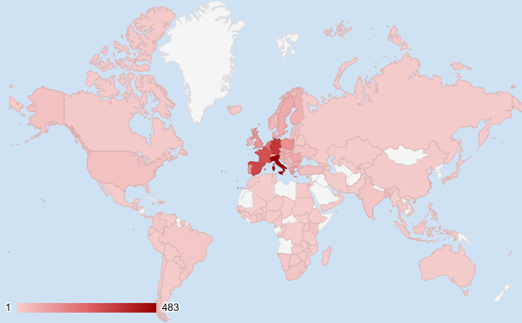
Geographical distribution of entities validated in 2021
Entities from 146 countries/territories validated in 2021

Slide 41
Thank you for your attention! Questions?

