Slide 1
Grant Agreement Preparation (GAP) – Overview
27/05/2022

Slide 2
Outline
Introduction to the Grant Agreement Preparation
Roles and access management
New elements required in Horizon Europe
Technical aspects

Slide 3
Introduction to the Grant Agreement Preparation
Horizon Europe

Slide 4
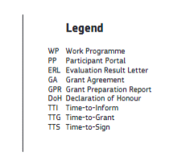
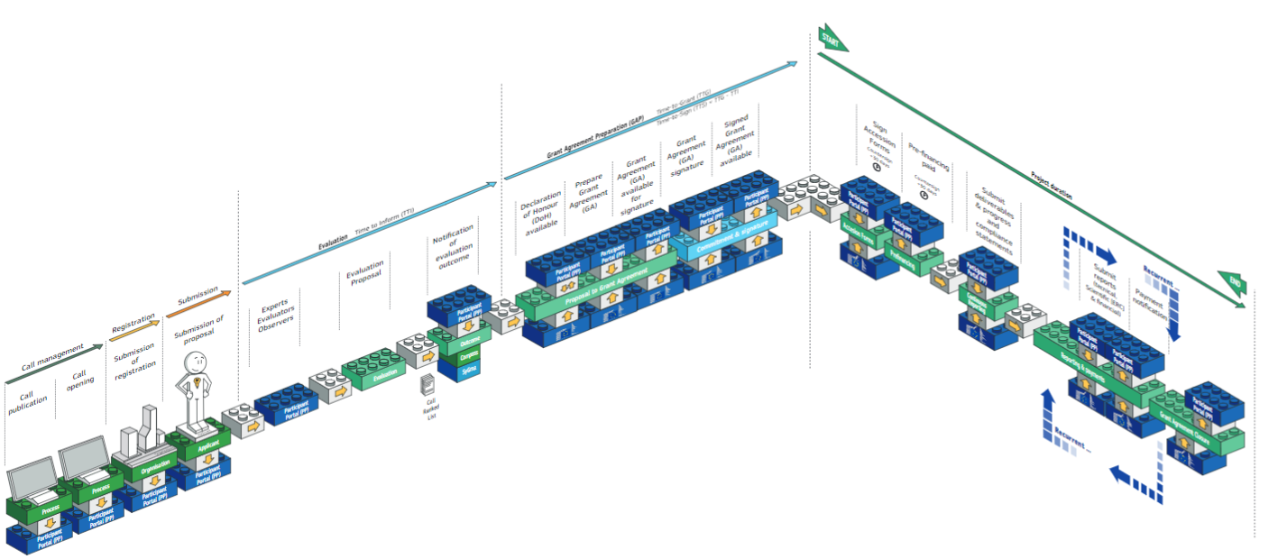
Grant Management Lifecycle (1)

Slide 5
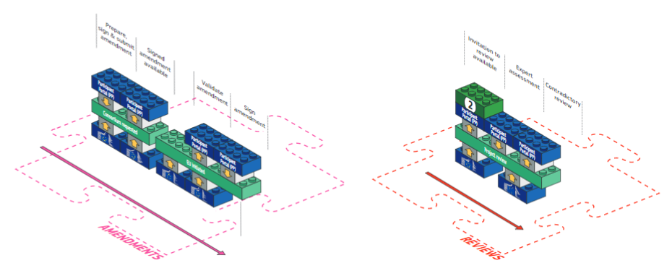
Grant Management Lifecycle (2)
amendments/reviews

Slide 6
Principles
Single gateway for all exchanges: Funding and Tenders Portal
Deep integration of IT tools and services in the portal
Uniform experience
Common business processes
Electronic-only paperless process flows
Digital sealing of documents
Digital signature on all formal documents replacing blue-ink signatures
Single, common document repository
Full traceability and audit trail ensured (who-what-when)
Predefined business rules in the IT suite ensure compliance

Slide 7
GAP: a timebound process
fully electronic process
The GA preparation – the conclusion of the grant agreement is subject to time limits – strict deadlines (this is a regulatory requirement – Fin.Reg, ΗΕ reg. –exceptions for actions managed by ERCEA)
The invitation letter specifies deadlines applicable for the GAP
Align yourself with the applicable deadlines and make diligent efforts to comply with the dates set
Notify the EU services if you encounter delays
The non-respect of the deadlines may lead to the termination of grant preparation (rejection).

Slide 8
GAP: Timing
Invitation
+ ESR
Grant agreement data (GA data)
Grant
signature
3 months max.
3 weeks
~1 week
2 weeks
consortium
PO
consortium
submit
GA data
remaining
issues
(if any)
submit
GA data
(final)

Slide 9
GAP: The main steps in the process
Invitation for grant preparation
2. Grant preparation (Coo+Ben)
3. Review
of Grant data
4. Signature of the agreement (COO)
5. Signature of the agreement (EU)
6. Signature of the accession forms (Ben)
7. Payment of pre-financing
Validation of participants
Setting identity access management (IAM) roles (each ben)
Signature of the 'Declaration of honour' (e-signature, each ben)
* further iterations possible (completion/correction of grant data)
Ex-ante checks, reservation of funds, preparation of award decision
** If and as defined in the grant agreement

Slide 10
GAP: No negotiation
Your proposal is taken ‘as is’
Proposals are evaluated based on merit and not on their potential
The Grant Agreement (GA) is prepared on the basis of the proposal selected for funding
BUT this does not mean ‘no change at all’
Changes that may be necessary:
Changes to meet legal and financial requirements
Requirements resulting from ethics review or security scrutiny
Due to removal of participant (if agreed by EU)
Correction of clerical errors and obvious inconsistencies
No negotiation does not mean no control
Eligibility and viability checks
Anti-fraud measures and risk-based controls are carried out
Non-compliance, serious breach or negligence of the applicable rules evokes the termination of grant preparation and the rejection of the proposal

Slide 11
Roles and access management
Horizon Europe

Slide 12
Identity and Access Management
Based on a "chain of trust" enabling e-signature
The role of the Legal Entity Authorised Representative (LEAR)
Identity and Access Management (IAM) + EU Login
Enacting e-signature: Legal Signatory (LSIGN) and Financial Signatory (FSIGN)

Slide 13
Electronic signature – role configuration
Declaration of honour
The coordinator and each beneficiary, enacted by the LSIGN
Grant Agreement
Coordinator signs first, represented by the LSIGN
EU / EC Agency signs next
Accession Forms
Each beneficiary – by the LSIGN

Slide 14
New elements required in HE
Horizon Europe
Tasks to be performed by your LEAR (required during the GAP)

Slide 15
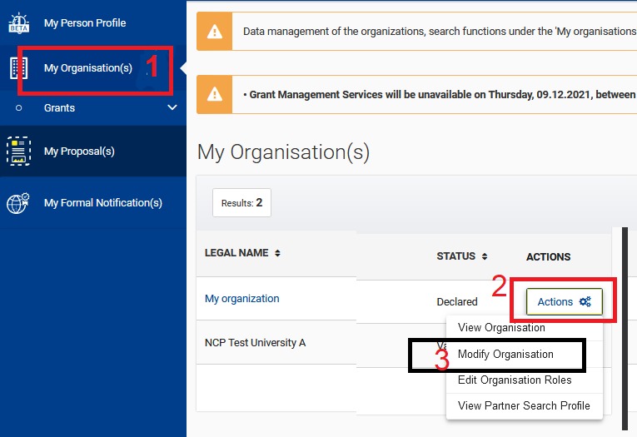
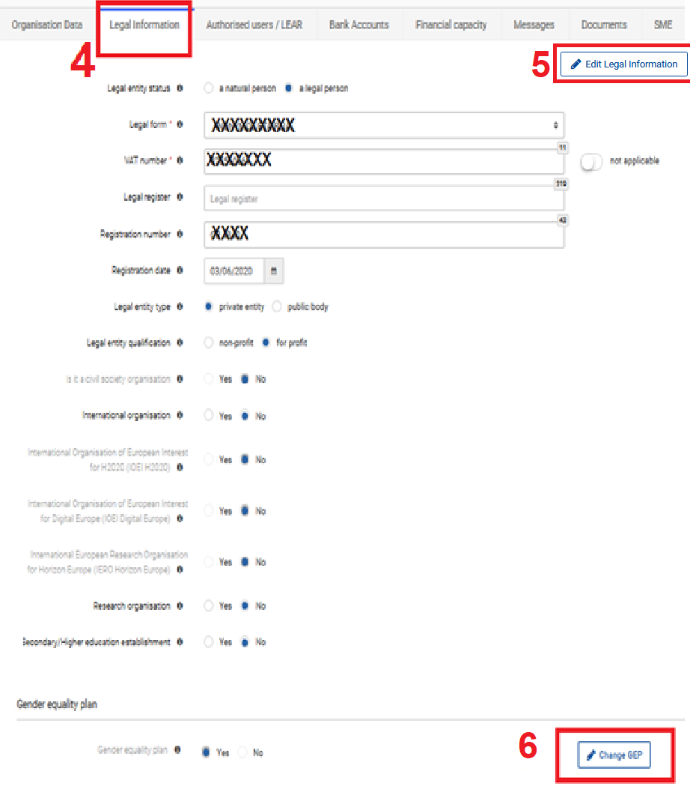
Declaring a gender equality plan
Declaring a Gender Equality Plan in participant register
If you are from a concerned organisation that requires a GEP to participate, then:
you log in the F&T portal
Select My Organisation (step 1)
Select actions (Step 2) → Modify organisation (step 3)
Select the tab → legal information (step 4)
Select edit legal information (step 5) → change GEP (Step 6)

Slide 16
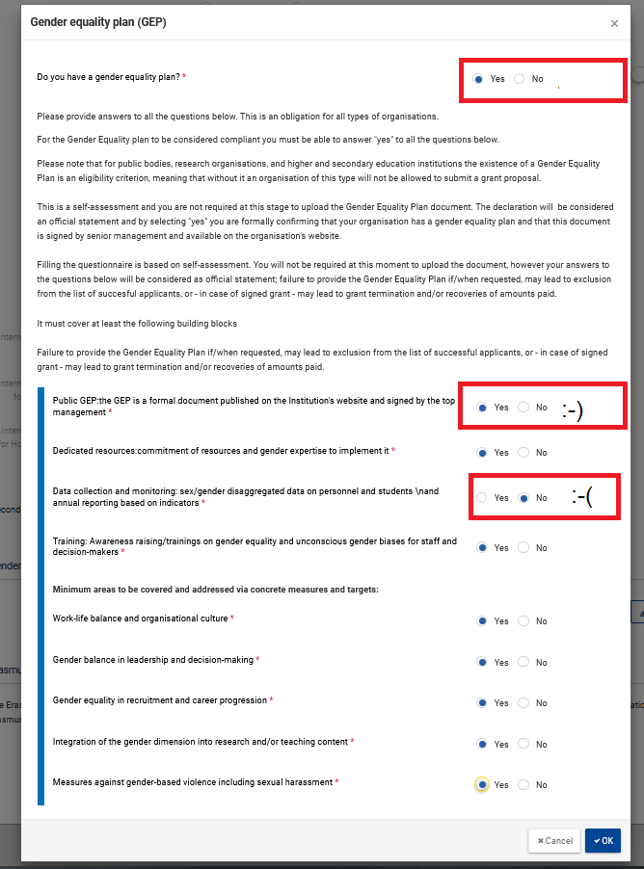
Declaring a gender equality plan
Declaring a Gender Equality Plan in participant register:
In the wizard that opens, you need to select yes to the first question: does your organisation have a gender equality plan?
Then you need to carefully read all the required criteria and answer the subsequent questions
Failure to fulfil one of the required criteria (at least the top 4 ones) is equivalent to not having a gender equality plan → the initial question (if you have a GEP) will be automatically set to ‘No’.
Please read all the relevant information and answer carefully; Failure to provide the Gender Equality Plan if/when requested, may lead to exclusion from the list of successful applicants, or – in case of signed grant – may lead to grant termination and/or recoveries of amounts paid.

Slide 17
International Organisation status
Setting correctly the International Organisation status (important for HE – action to be performed by the organisation LEAR)
If you have already declared that your organisation does not have status of ‘International Organisation’, then no action is necessary
If your organisation is already validated, and has the status of International Organisation (status subject to validation), then you need to indicate if your organisation is also ‘International European Research Organisation’ (IERO)
If your organisation will be validated as part of your participation for the first time in a project, then REA validation services will also ask you to set the IO status (if you haven’t done already)

Slide 18
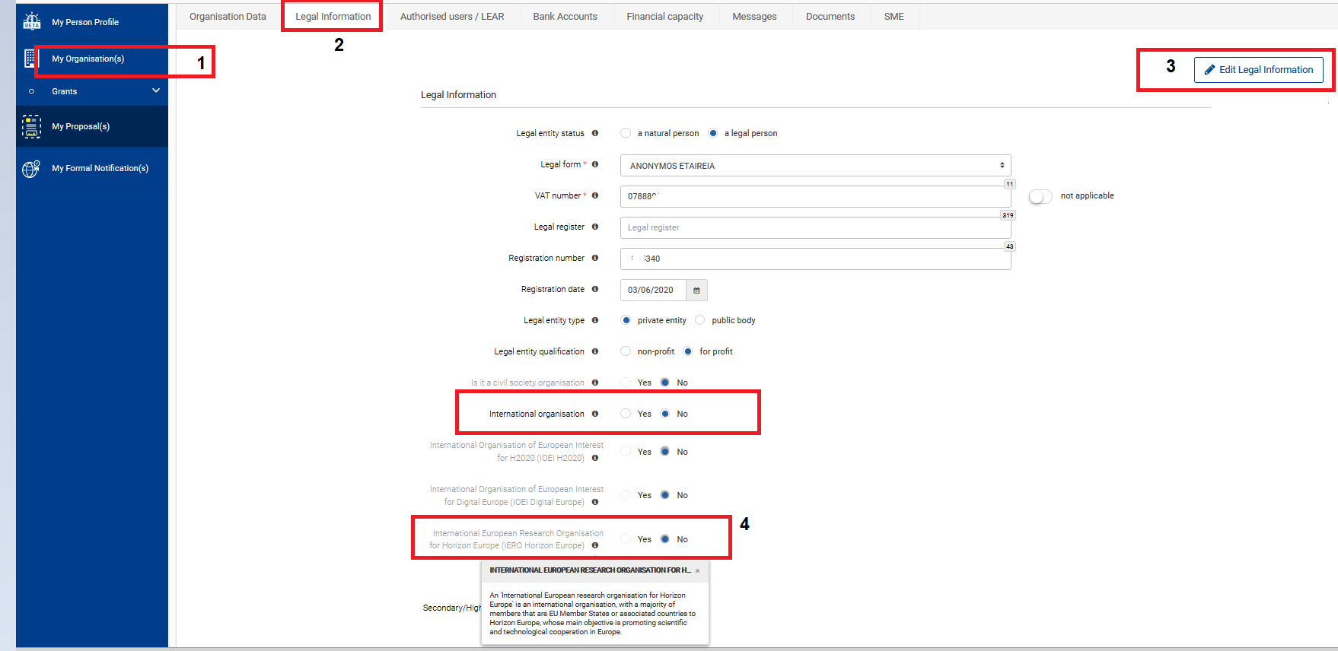
International Organisational status

Slide 19
Technical aspects

Slide 20
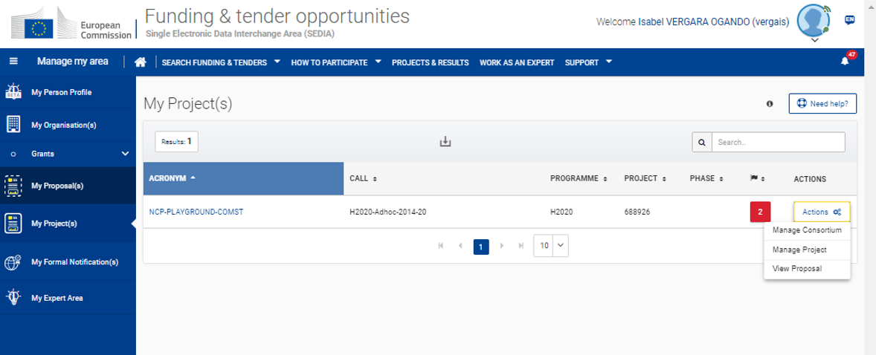
IT system for grant management

Slide 21
Grant management service

Slide 22
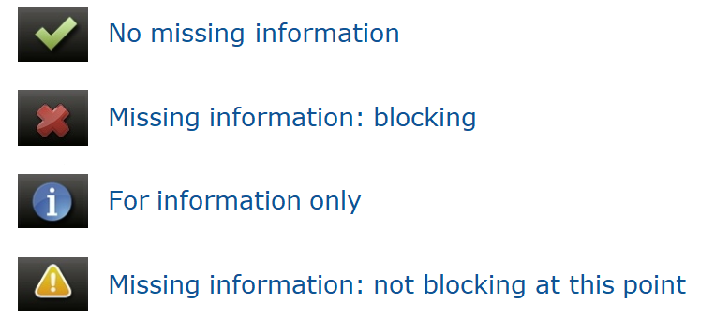
Grant management screens
Legend – icons used

Slide 23
Points for attention
‘Avoid repetitions: i.e. no duplication between work plan tables (Part A) and free text (Part B)
The results of the ethics review and security scrutiny must be implemented in the grant agreement
'Ethics requirements' (if any) are binding
'Ethics requirements' may necessitate changes in the DoA before the grant can be signed.
'Ethics requirements' may ask for local/national certificates to be submitted after grant signature.
Similarly for security scrutiny
Takeaway messages:
Pay attention to deadlines; be proactive
Be transparent in case you face difficulties; try to come up with a plan (if needed)
Collaborate with the Project Officer

Slide 24
Thank you!
# HorizonEU
http://ec.europa.eu/horizon-europe

