Slide 1
Grant Agreement Preparation (GAP) – Description of the action
26 JANUARY 2022

Slide 2
Outline
Introduction to the Grant Agreement Preparation (GAP)
The Description of the Action
IT tools walkthrough

Slide 3
Introduction to the Grant Agreement Preparation
Horizon Europe

Slide 4
GAP: the process sequence
8 months max
5 months max
Call deadline
Evaluation report ready
Info to beneficiaries: ESR (+ Invitation)
Grant signature
Award decision
Evaluation
Preparatory work
(Before or at an early stage of grant preparation)
Grant preparation:
Interaction with beneficiaries
Drafting of GAP report
Internal approval
Budgetary commitment
Pre-financing
Grant signature
Accession forms
Comitology

Slide 5
GAP: Timing
Invitation
+ ESR
Grant agreement data (GA data)
Grant
signature
3 months max.
3 weeks
~1 week
2 weeks
consortium
PO
consortium
submit
GA data
remaining
issues
(if any)
submit
GA data
(final)

Slide 6
Structure of the Grant Agreement
Consortium
Project Officer
sum of
scientific/technical, budgetary, administrative, and legal information on your project
GRANT AGREEMENT DATA
Data sheet + core
grant
agreement
Annex 1,
description of the action
(project description)
Annex 2,
estimated
budget
Other Annexes
(e.g. annex 5 –
specific rules for HE)

Slide 7
The Description of the Action
Horizon Europe

Slide 8
Description of the Action
The Description of the Action (DoA) is Annex 1 to the Grant Agreement
It contains the details of how the project will be carried out.
It consists of 2 parts, which must be generated from the submitted proposal:
Part A contains structured tables with project information. It is generated by the IT system, based on the information you enter into the Portal Grant Preparation screens. It is partially pre-filled with proposal data.
Part B is a narrative description on the work to be carried out. It must closely follow the proposal part B and must be uploaded as a PDF.
Coordinator will be able to download the DoA template (instructions) from the Portal at the time of grant preparation invitation.

Slide 9
Description of the Action – Part A
Part A of the Description of the Action (DoA) must be completed directly on the Portal Grant Preparation screens.
It will include:
COVER PAGE
TABLE OF CONTENTS
Project summary (automated – based on proposal abstract)
List of participants (automated – based on proposal information)
List of work packages (based on proposal table 3.1b)
Staff effort (based on proposal table 3.1f)
List of deliverables (based on proposal table 3.1c)
List of milestones (based on proposal table 3.1d)
List of critical risks (based on proposal table 3.1e)
All changes need to be discussed and agreed with the EU Project Officer. Substantial changes to the proposal are NOT allowed.

Slide 10
Description of the Action – Part B
Instructions:
START from Part B of your proposal. Use the version that was submitted for evaluation.
REMOVE the cover page, if any.
DELETE the header, if any.
REPLACE the footer with the following information ‘[Proposal number] [Proposal acronym] – Part B – [Page number (starting at 1 for Part B)]’.
REMOVE the list of participants. This is included in Part A.
REMOVE tables 3.1a (list of work packages), 3.1b (work packages descriptions), 3.1c (list of deliverables), 3.1d (list of milestones), 3.1e (critical risks for implementation) and 3.1f (summary of staff effort) from section 3.1 (they are encoded in the screens and included in Part A). Keep tables 3.1g, 3.1h, 3.1i and 3.1j (and any other table linked to specific types of actions).
CREATE a section 4 ‘ethics self-assessment’ and copy into this section the ethics self-assessment you included in the proposal Part A.
ADD a table with the history of changes. Specify all changes compared to your proposal. Changes should be described concisely. You do not need to include minor changes that do not modify the substance of the DoA (e.g. correction of spelling and grammar, changes in formatting).
ADD a table of contents with page numbers (or update the existing table of contents).
Use the submitted version of the proposal. All changes need to be discussed and agreed with the EU Project Officer. Substantial changes to the proposal are NOT allowed.

Slide 11
Other points to pay attention to
Ethics review and security scrutiny
The proposals are subject to an ethics review and may be subject to security scrutiny.
The results of the ethics review and/or a security scrutiny must be implemented in the grant agreement
'Ethics requirements' are binding, they must be entered by the PO in Part A (DoA)
Coordinator needs to update the ethics section in Part B (DoA) to ensure that any 'ethics requirements' are met
There may be 'ethics requirements' that need to be met before the grant can be signed
Similarly for security scrutiny
One final point…
Avoid repetition of information
E.g., no duplication between work plan tables (Part A) and free text (Part B)
All information should appear in one, findable, place only

Slide 12
IT tools walkthrough
Horizon Europe

Slide 13
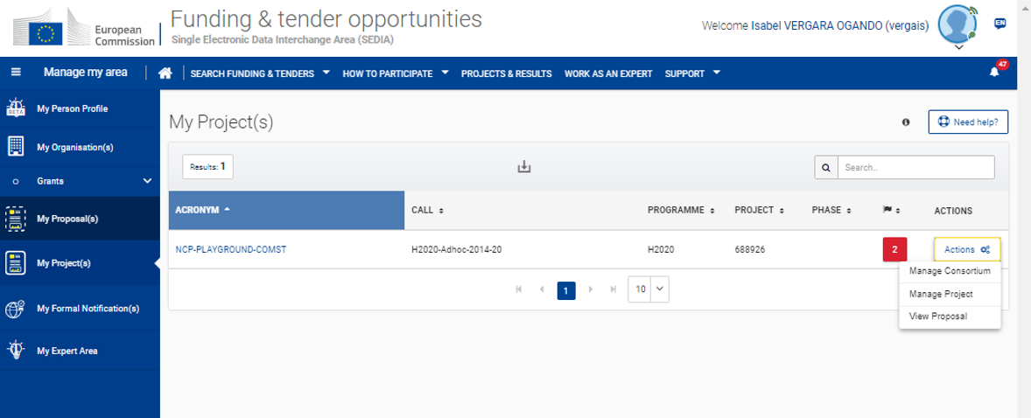
IT system for grant management

Slide 14
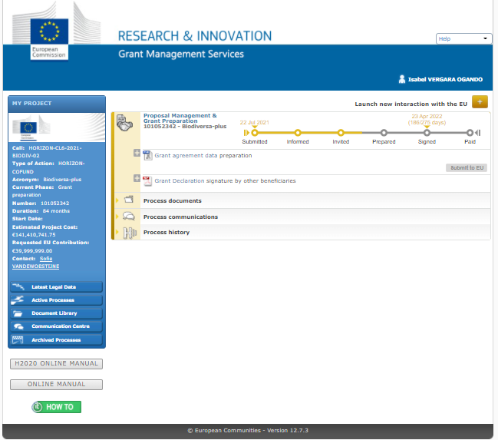
Grant management service

Slide 15
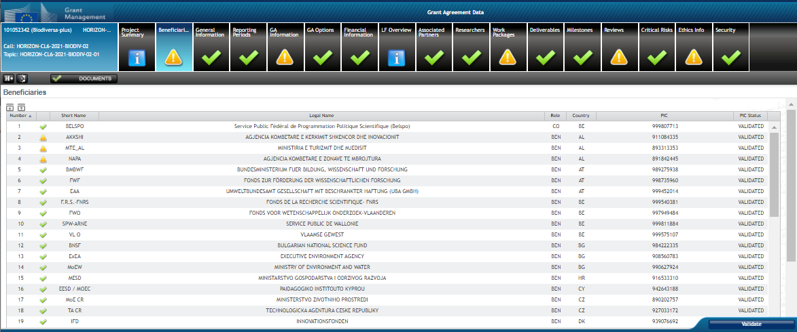
Beneficiaries

Slide 16
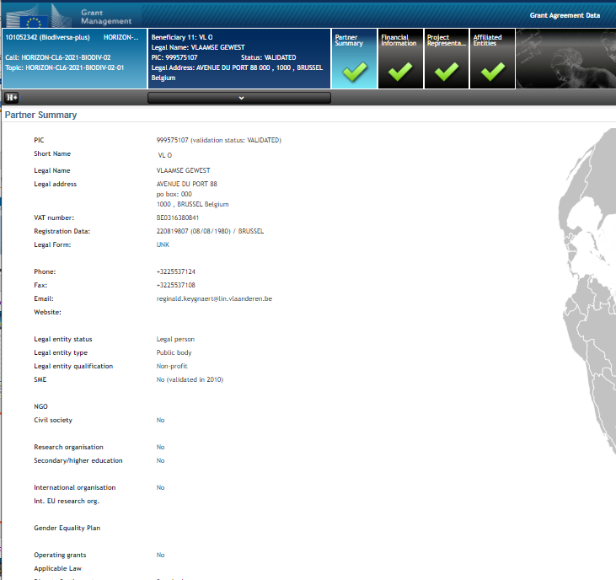
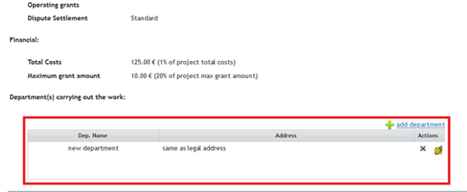
Partner summary
Coordinator/beneficiary Partner Summary is automatically listed after receiving the invitation letter.
The department needs to be added (mandatory for all beneficiaries, except for Affiliated Entities)
For HE calls (from 2022 onwards) having a Gender Equality Plan is necessary (for public bodies, research organizations and higher education institutions) before signing the GA (existence of the plan has to be declared in the portal organizational data)

Slide 17
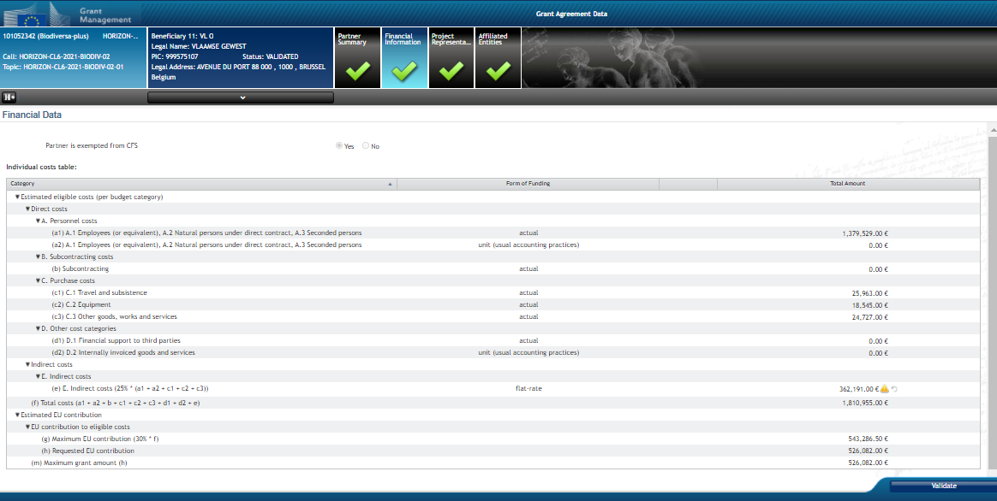
Financial information
Coordinator/beneficiary financial Information is automatically listed after receiving the invitation letter (from proposal).

Slide 18
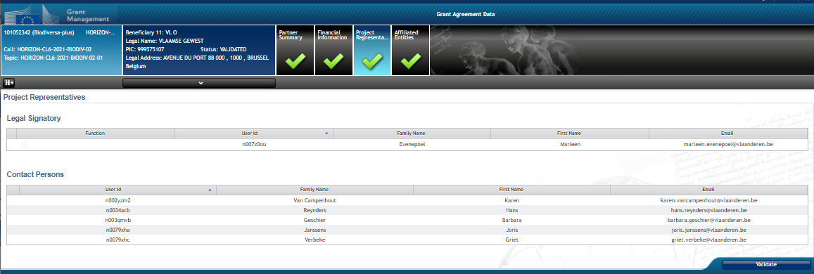
Project representatives
If no Project Representatives are listed, please complete in the roles management section of the Funding & Tenders Portal.
Check all information and update, if necessary, in the roles management section of the Funding & Tenders Portal.
Both Coordinators and beneficiaries should, as soon as they have been invited, nominate in the Funding & Tenders Portal, their Legal Entity Appointed Representative (LEAR) and Project Legal Signatory (PLSIGN). Once this has been done, the PLSIGN who will appear in the Grant Agreement has to be selected in this screen. Please note that all other PLSIGNs can sign the Grant Agreement.

Slide 19
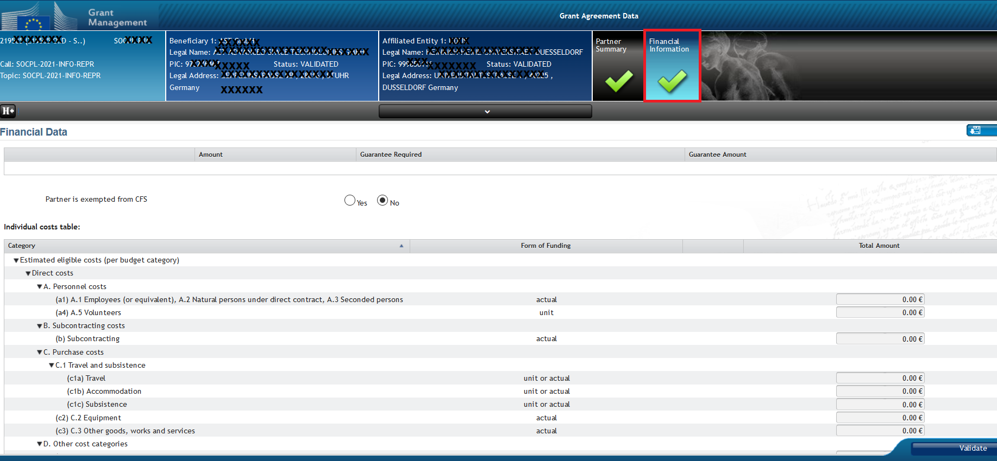
Affiliated entities

Slide 20
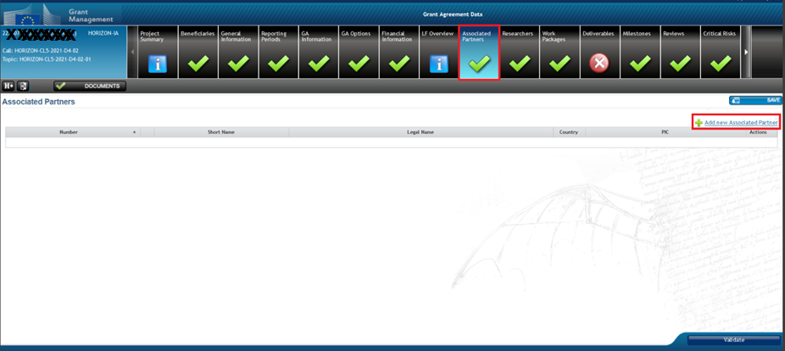
Associated partners
Data prefilled with proposal information
Associated partners do not sign the grant agreement and cannot declare costs
They will be allowed to be WP leaders (currently not possible)
Budget table in GA (Annex 2) will not include any information of the budget of AP. Information is included in the proposal and if needed, some information can also be included in DoA - part B
Coordinator will be able to enter researchers in the researcher table for AP

Slide 21
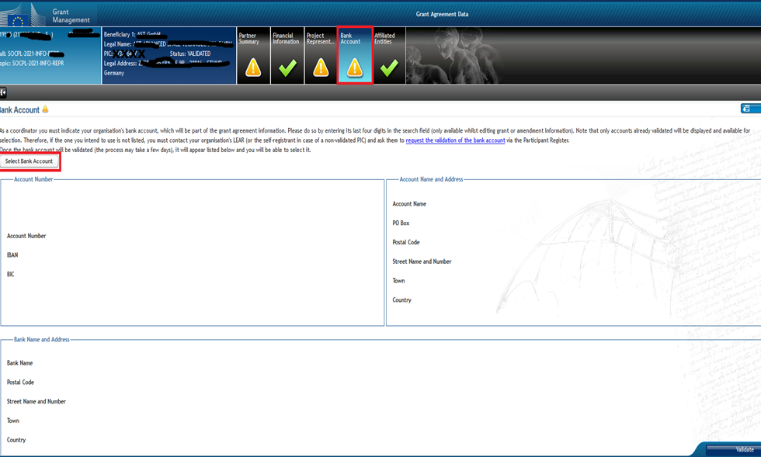
Back account (coo only)
Select your bank account from the list of accounts already registered in the Participant Register. For more information about how to register a bank account in the Participant Register, please click here.

Slide 22
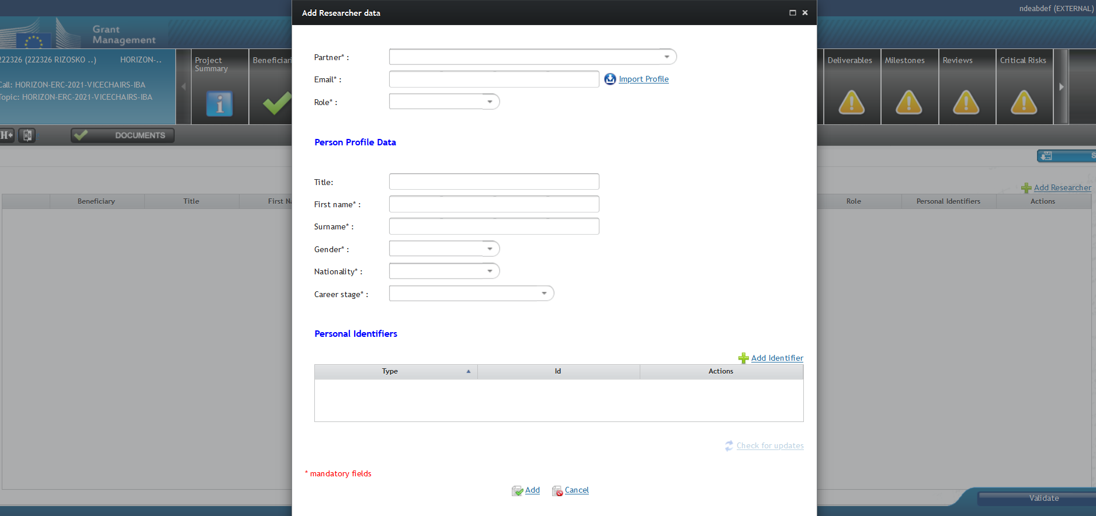
Researchers
Listing the researchers funded by the action is obligatory under HE; each beneficiary enters their own
Option A: Complete manually all the mandatory data fields
Option B: Retrieve the researcher's personal data (the ones made public, using the information provided by the researcher in the My Person Profile section of the F&T Portal)
Removal of researchers listed in proposal only conditional (subject to EU agreement)

Slide 23
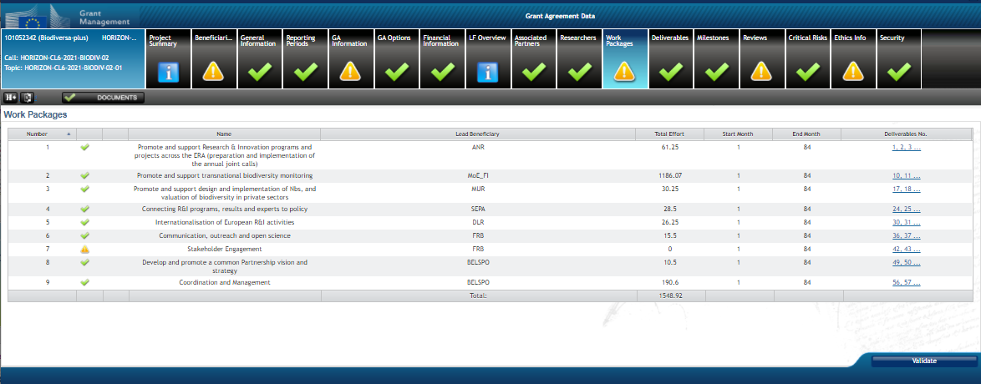
Work Packages
The Project Work Packages are not automatically listed after receiving the invitation letter.
Complete all necessary work packages
You can change the order of the work packages by dragging and dropping.

Slide 24
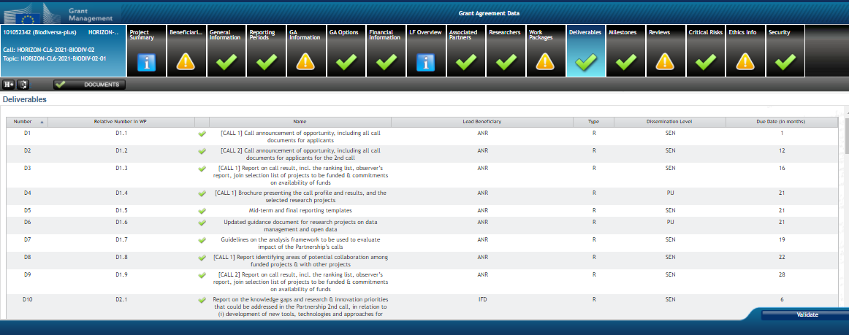
Deliverables
Deliverables are not automatically listed
All deliverables in proposal need to be included with the same details
Select appropriate Dissemination status (Public, Sensitive (limited under conditions in GA), EU classified (EU-restricted/EU-confidential/EU-secret).

Slide 25
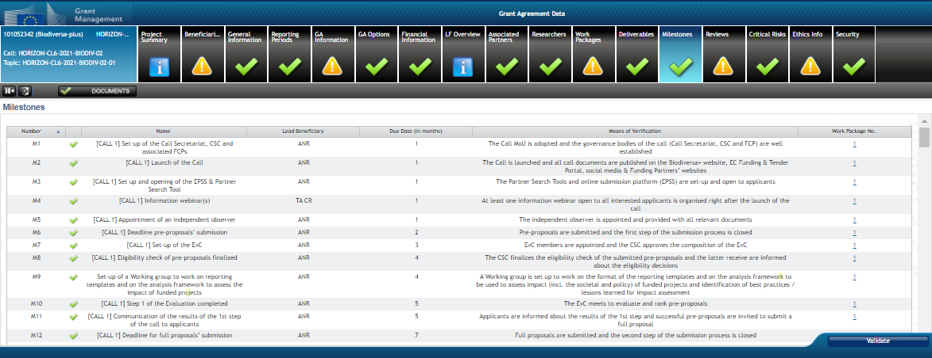
Milestones
Milestones are not automatically listed
All milestones in proposal need to be included with the same details

Slide 26
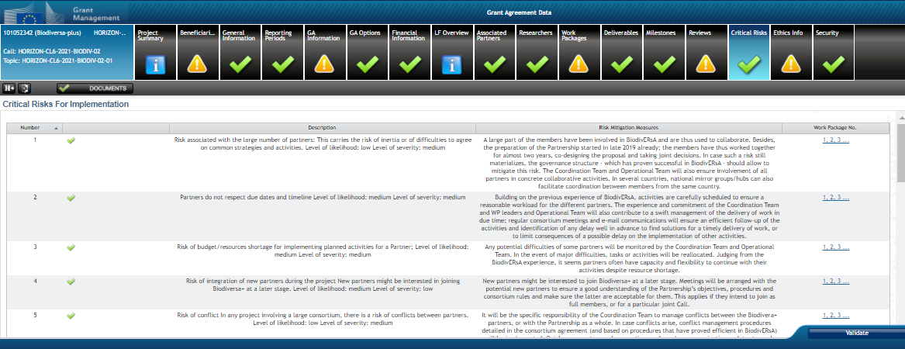
Critical risks
Critical risks are not automatically listed
All critical risks in proposal need to be included with the same details

Slide 27
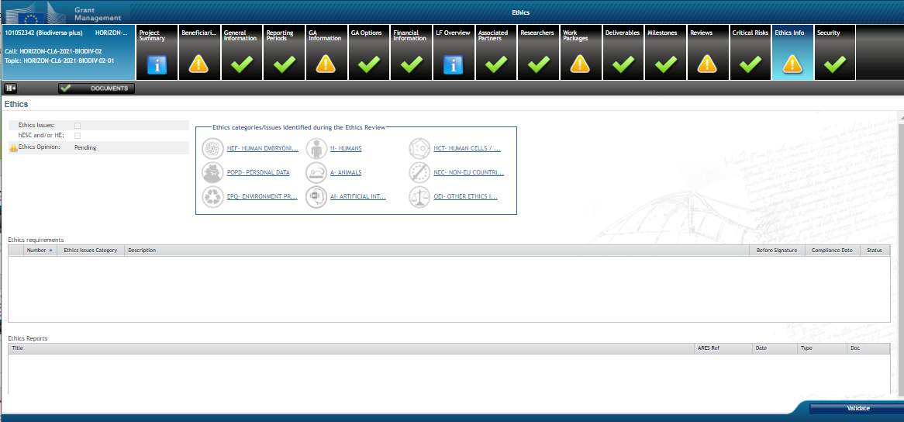
Ethics
Ethics screen is available as read only
Before a final Opinion is encoded by Ethics experts in the Ethics evaluation process, at times, additional information may be requested from the applicant.
The Consortium or its representative has to upload the requested information in Grant Management application in the Funding & Tenders Portal, under section ‘Additional Information request’

Slide 28
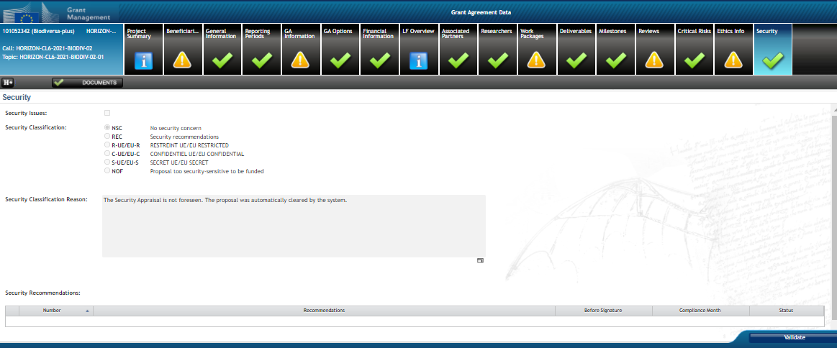
Security (NEW!)

Slide 29
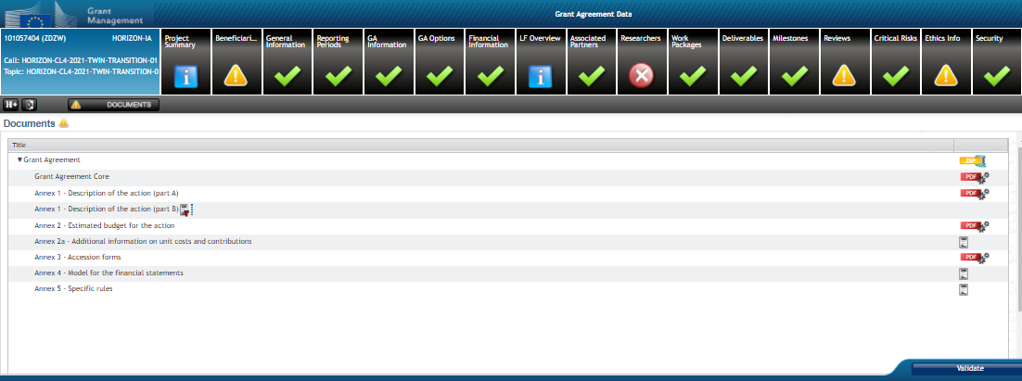
Part B of DoA
Check instructions on slide 10 of this presentation
Before uploading the part B, please remove the cover pages, the list of participants and add a history of changes. Changes need to be described concisely. Please add also a table of contents and page numbers.
Please remove also, deliverables, milestones, risks and work packages as these are included in part A
After creating the pdf, you may upload in the documents section
Avoid repetition of information

Slide 30
For more information…
… check recorded webinars:
‘How to prepare a successful proposal in Horizon Europe’ (24 March 2021). See recorded session here.
‘A successful proposal for Horizon Europe: Scientific-technical excellence is key, but don’t forget the other aspects’ (21 April 2021). Recorded session
‘The Funding & Tenders Portal for beginners’ (27 May 2021). Recorded session
‘All you need to know on D&E under Horizon Europe’ (9 June 2021). Recorded session
‘How to prepare a successful innovation procurement proposal for Horizon Europe’ (22 June 2021). Recorded session
‘Horizon Europe: key changes to the Ethics Appraisal Process’ (18 July 2021). Recorded session
R&I Days 2021: workshop on ‘Tips and tricks while writing your HE proposal’ (23 June 2021). Recorded session
Thematic info-days per cluster (June – July 2021). Event page
Check the news section of the F&T Portal regularly: https://ec.europa.eu/info/funding-tenders/opportunities/portal/screen/home

Slide 31
Thank you!
# HorizonEU
http://ec.europa.eu/horizon-europe

