Slide 1

Info Session on the Horizon Results Booster
Service 3 – Go 2 Market (G2M)
Intro and Part II
prepared by Chiara Eleonora De Marco (PNO)
date 05.10.2021

Slide 2
Service 3 - G2M, Support Type 4: Business Service

Slide 3
Support Type 4: Business Service
Service Characteristics
Providing operational support right before entering the market
Solution at high TRL levels
Mature Use Model already available
Advanced KERs developed
Provided by PNO Consultants and BDO
Activities included in the service:
Preparing commercialization plans for already developed and tested products/services with well-designed exploitation strategies
Assessing feasibility of the business plan to be work on making available a final one
Creating start-ups/spin-offs with complete business model and commercialization plans

Slide 4
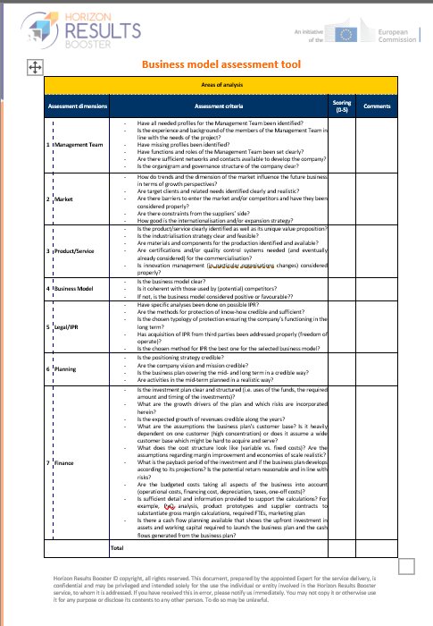
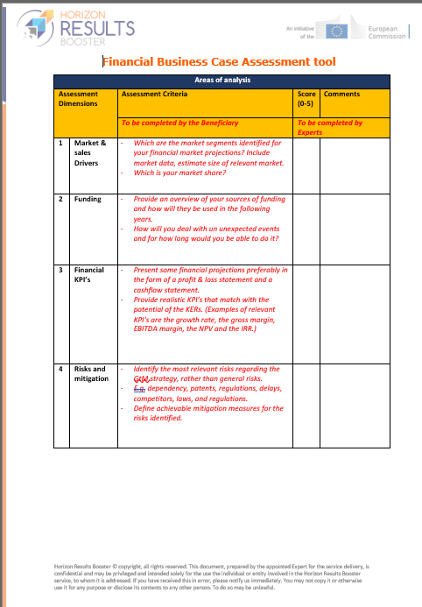
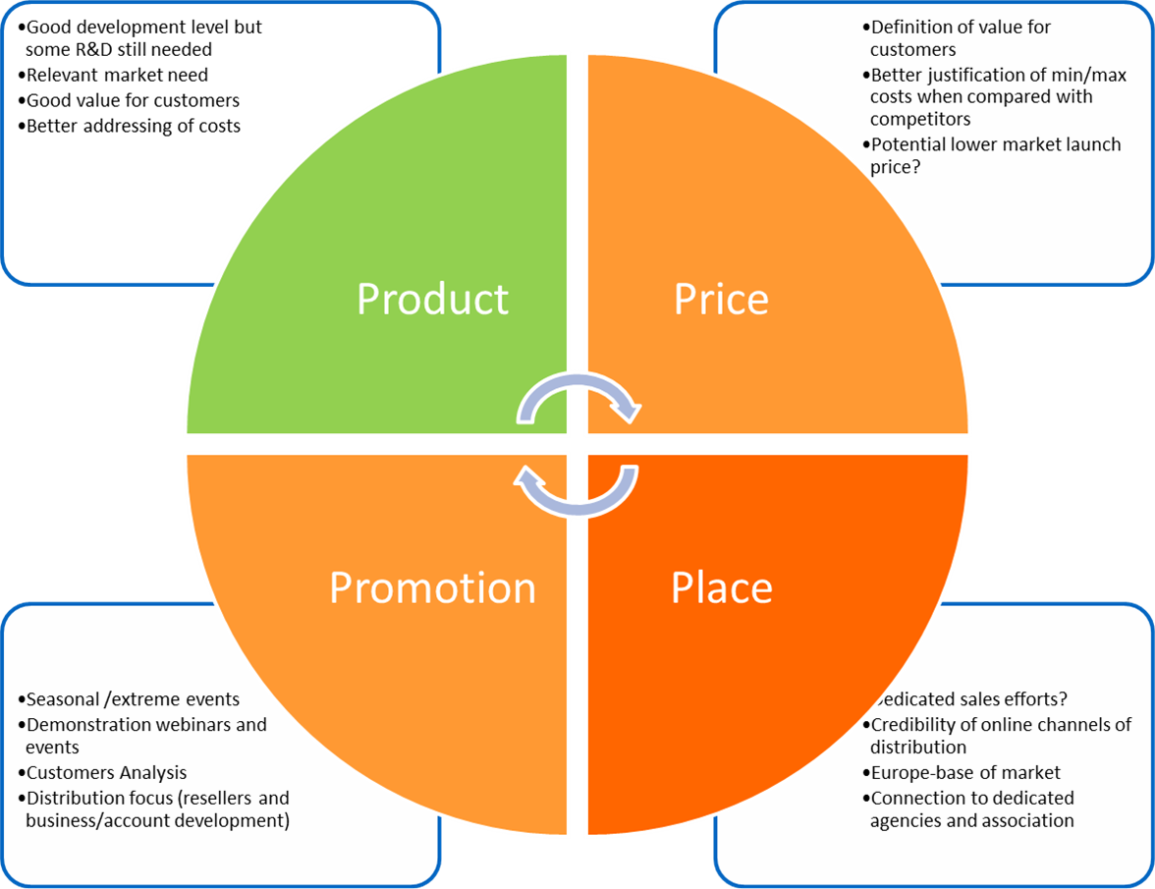
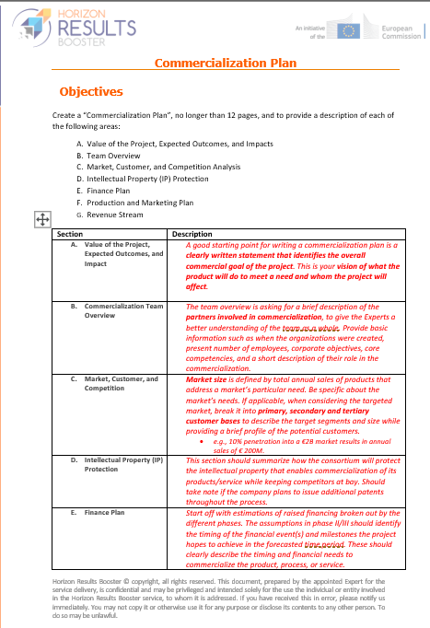
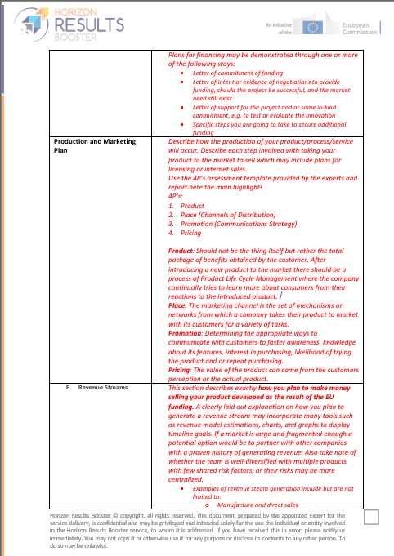
Business Service Tools
Business Model
Assessment Tool
4P’s Assessment
5C’s
Financial Business Case
Assessment Tool
Commercialization Plan

Slide 5
Types of Support under Business Service
G2M Support Type 4
Types of support 4.1 | Timing | Activities | Tools
Co-design commercial development plan | 1 Month | Assessing the desired strategic positioning of the innovation | 4P assessment tool HRB platform Feedback form
 |  | Advising/Supporting the optimization of the positioning strategy | HRB platform
Types of support 4.2 | Timing | Activities | Tools
Feasibility Study | 3 Weeks | Examining Business Plan consistency | Business Model Assessment Tool HRB platform Feedback form
 |  | Examining Feasibility and Profitability
Types of support 4.3 | Timing | Activities | Tools
Supporting start-up/spin-off creation | 4 Weeks | Assessing the business proposition plan | Self-assessment questionnaire Belbin Team Role test BOSAT self assessment tool HRB platform Feedback form
 |  | Supporting Team assessment and internal government definition | Belbin Team Role test
 |  | Assssing legal and regulatory aspects | AYR © self-assessment tool
 |  | Supporting the management intangible assets | HRB platform
 |  | Examining legal framework for company establishement | Feedback form
 |  | Evaluation of environmental, ethics, quality standards

Slide 6
Service 3 - G2M, Support Type 5: Examining Options for Exploitation

Slide 7
Support Type 5: Examining Options for Exploitation
Service Characteristics
Support the choice of the right exploitation model for higher impact on markets
Solution at high TRL levels
Mature Use Model already available
Advanced KERs developed
Activities included in the service:
Assessing Exploitation Route and Commercialization Strategy
Evaluation of pros/cons of implementation options
Types of support 5 | Timing | Activities | Tools
Examining Options for Exploitation | 4 Weeks | Assessing the Exploitation and Commercialization strategies | KERs Exploitation Form Exploitation Roadmap Form Commercialization Plan HRB platform Feedback form
 |  | Advising/Supporting the choice of exploitation options | Commercialization Plan

Slide 8
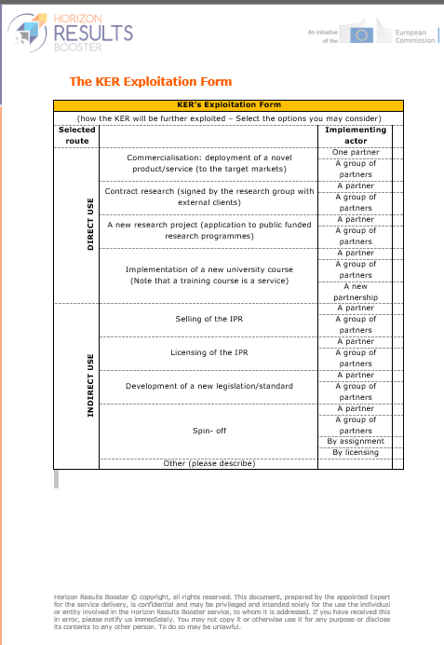
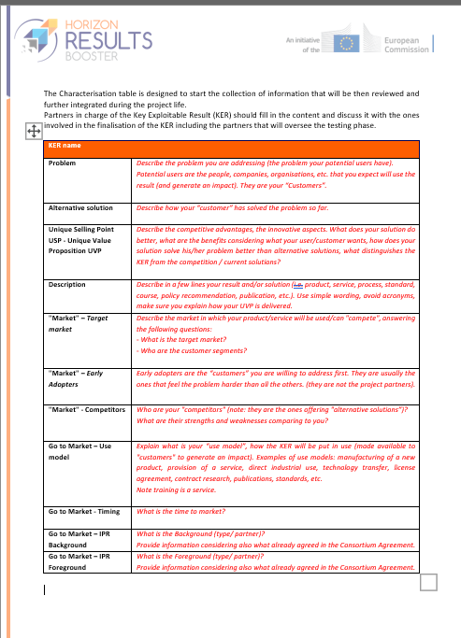
Examining Options for Exploitation Tools
Commercialization Plan
KER Characterization Form
KER Exploitation Form

Slide 9
Service 3 - G2M, Support Type 6: Access to non-EU Funding

Slide 10
Support Type 6: Access to non-EU Funding
Service Characteristics
Developing thorough public/private funding strategy
Achieve a preliminary conceptualization of an innovative project proposal
Activities included in the service:
Identifying available funding opportunities
Identifying which funding suits beneficiary’s objectives
Understanding how to prioritize different opportunities

Slide 11
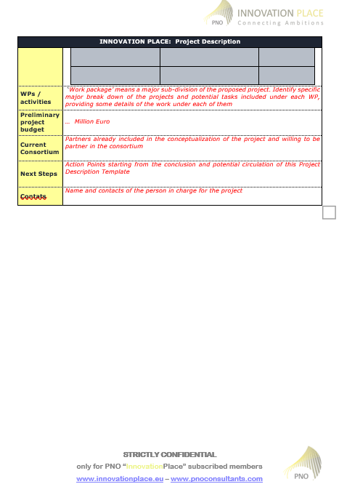
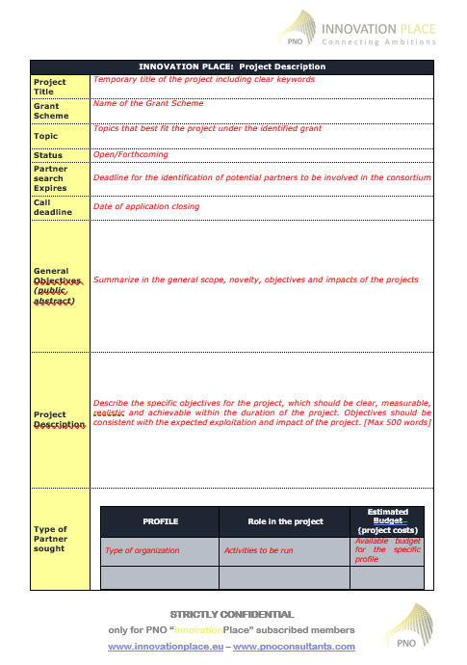
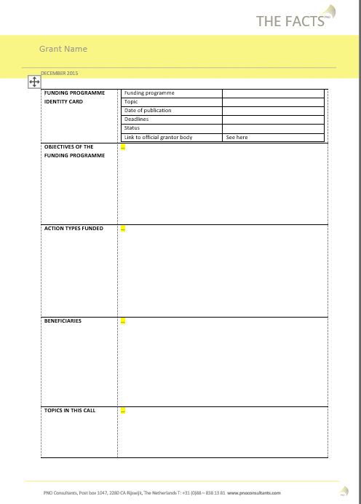
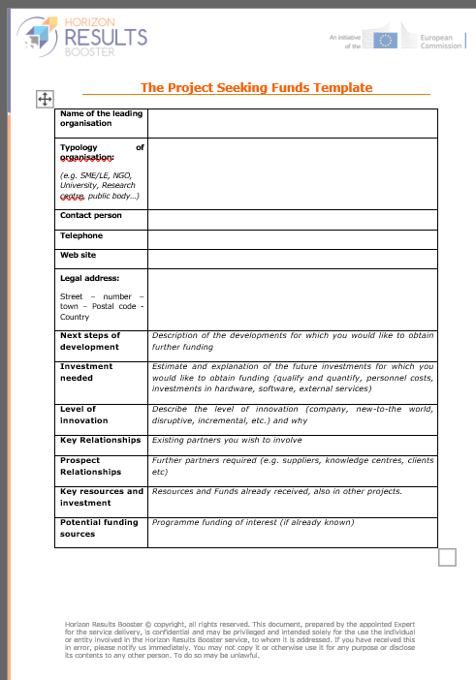
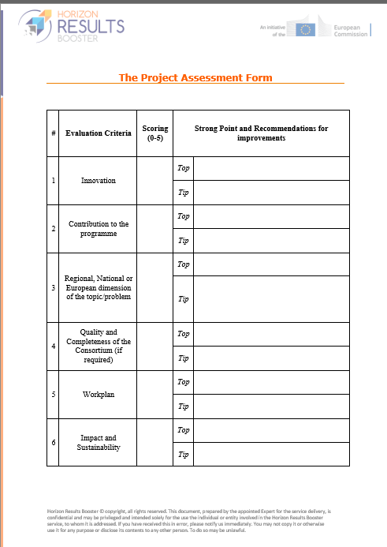
Access to non-EU Funding Tools
Project Description Template
Project Seeking Funding Template
Grant Factsheet Template
Project Assessment Form
Characterization of
Funding Opportunities Form

Slide 12
Types of Support under Access to non-EU Funding
Service 3.3 of G2M
Types of support 6.1 | Activities | Tools
Project Analysis And Funding Scan | Analysis of funding opportunities facilitating co-financing & GtM process of the specific projects | Feedback form Funding Programme Template
 | Analysis of project’s exploitation or business plan | Funding Programme Template
 | Presentation of funding landscape, opportunities, criteria & requirements
 | Outline of possible funding programmes types fitting the activities/projects to be funded
 | In-depth funding scan
 | 3-hours coaching session on setting up funding strategy
Types of support 6.2 | Activities | Tools
Funding Strategy | Support in the evaluation of identified funding possibilities "pros and cons" | Report on Funding Opportunities
 | Advice on (strategic) prioritization of different funding opportunities
Types of support 6.3 | Activities | Tools
Funding application coaching | Optimization of project application concept, structure, content and argumentation | Project Assessment Form Project Description template
 | Support to application concept development and project positioning | Project Description template
 | Feedback on the proposal and additional input
 | Project qualitative assessment

Slide 13
Chiara Eleonora De Marco
c.demarco@ciaotech.com
www. horizonresultsbooster.eu

