Slide 1
Info Session on the Horizon Results Booster
Service 1 Module C - Assisting projects to improve their existing exploitation strategy (PDES C)
Andrea Di Anselmo
05.10.2021

Slide 2
The Key Exploitable Result (KER) is the hero!
Responding to specific needs, to the demand of a well-defined group of “Customers”
Selected by the Partners for use and/or market introduction
A product or process…
A new service…
New standard…
New training courses…
Input for a new project…

Slide 3
The Exploitation Strategy Seminar (ESS) is the core of the PDES- C
The actual seminar lasts for one day/two half days
For the KER owners, the Coordinator and the Exploitation Team, but all Partners are suggested to participate and contribute
Best if organized before the midterm of a project life
Opportunity to discuss Exploitation Plan next steps and have an insight on KERs
Focus on a maximum 3 KERs
The Final Report provides inputs for making the most out of the exploitation activities in the project’s work plan:
Characterisation table, Priority map, Exploitation Roadmap, Recommendations

Slide 4
Approach
Focus not on the scientific dimension but on the key features related with its use with a problem oriented (demand driven) approach.
Concentrate on how to increase the TRL after the project is ended due to lack of resources.
Key ingredients: Unique Value proposition - UVP, Use model, Early adopters (target audiences for dissemination).

Slide 5
Objectives for the seminar
Introduce: impact, KERs, use and their relationship
Focus: on KERs and discuss:
Problems addressed - alternative solutions - unique value proposition - novel solution and use model
Risks related to the use of results (possibly) and
First actions after the project’s end

Slide 6
ESS Agenda
Day 1
(One hour) - Introducing Exploitation
Definitions of Exploitation, Key Exploitable Results, Exploitation vs Dissemination, Exploitation Plan;
Q&As.
Day 2
09.00 : 10.30 - Working session for KER1
Discuss for KER1 the Characterisation Table, the Risk Map and the Exploitation Roadmap.
10.30 : 11-00 - Break
11.00 : 12:30 - Working session for KER2
Discuss for KER2 the Characterisation Table, the Risk Map and the Exploitation Roadmap.
12.30 : 13-30 - Lunch break
13.30 : 15:00 - Working session for KER3
Discuss for KER3 the Characterisation Table, the Risk Map and the Exploitation Roadmap.
15.00 : 15:30 – Closing
*All slots are intended to be agreed in Central European Timing (CET)

Slide 7
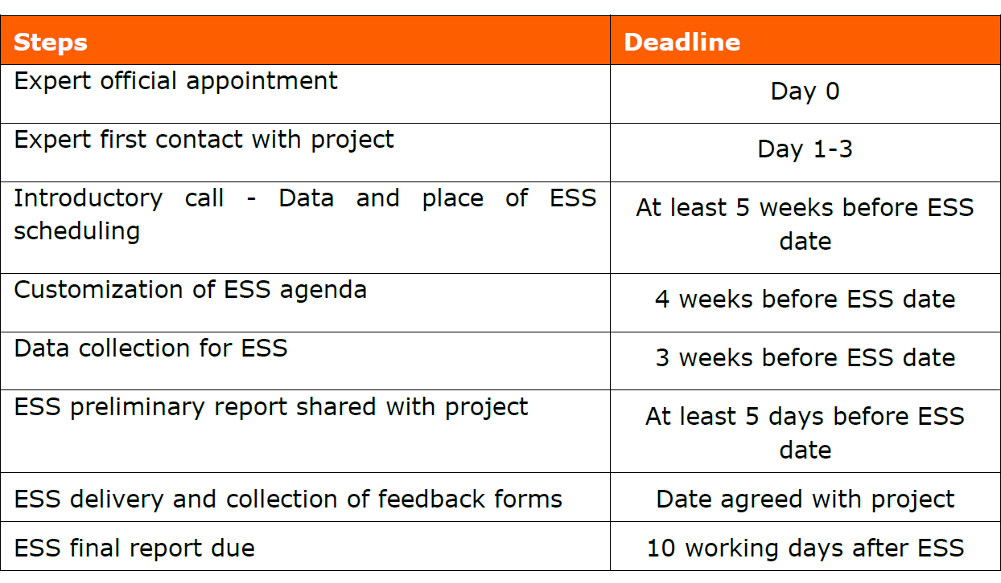
Summary table - Delivery steps

Slide 8
Info Session on the Horizon Results Booster
Service 2 - Business Plan Development
Andrea Di Anselmo
05.10.2021

Slide 9
Activities
Support to partners for having a structured business/exploitation plan (in the case the result will not be commercialized) for 1 (one) KER.
Support is customised according to the maturity of the KER selected.
If a draft business/exploitation plan is available , the Experts will help you to review it, prepare an implementation roadmap and provide recommendations for its finalisation.
If the KER is just characterised (no draft available), the Experts will support you in identifying the information to be collected and validated for drafting the plan, discussing use/business model and provide recommendations on how to prepare it.

Slide 10
Main Elements
Focus on 1 KER
The service delivery lasts for 2 months
For the KER owner/s, the Coordinator and the Exploitation Team, but all Partners are suggested to participate and contribute
Best if organized after the midterm of a project life – after a PDES C
The Final Report provides inputs for planning future use:
Characterisation table, Lean/Value Proposition Canvas, Exploitation Roadmap, Recommendations

Slide 11
Activities
Step 1 - Preparing the delivery
Maturity self-assessment (BOSAT)
Customisation (Service Delivery Plan - SDP)
Sharing guidelines and tools:
BPD First Set of Guidelines
The Business Plan Structure (KER Form + Exploitation Roadmap)
The Lean Canvas
Step 2 - Delivery
Webinar on the Lean Canvas
BPD - workshop:
Intro on business planning
The review of the Lean Canvas.
Revenue streams and costs structure
Exploitation Roadmap
Unique Value Proposition Canvas/Javelin Board
Step 3 – Finalising the service
Session to address less developed aspects:
How to reach out early adopters
Use/Business model & revenues and costs
Financial needs
Next steps - Implementation roadmap.
Reporting
Comments on the materials produced (Characterisation table, Lean/UVP Canvas and Exploitation Roadmap); Recommendations on how to prepare-finalise the plan, including:
access to services/incubators
accessing funding
contacts with risk investors or business angels’ networks
use of crowdfunding platforms or debt instruments.

Slide 12
BPD- workshop - Agenda
9:30 – 10:00, Ice breaking
Pre-meeting with the Coordinator, Welcome, Presenting the day
10:00 – 11:00, Towards an effective Exploitation Strategy: The business planning process
Introducing Business planning “Business plan is a journey”, Q&A session;
11:00 – 11:30, Coffee Break
11:30 – 13:00, Towards an effective exploitation plan
Working on the Lean Canvas and on the first draft of the Business Plan structure template.
13:00 – 14:00, Lunch
14:00 – 15:00, The Exploitation Roadmap
Discussing the key actions to be performed after the project’s end.
15:00 – 15:30, Sharing results open discussion – wrap-up
15:30 end of meeting.
* All time slots are in Central European Timing (CET).

Slide 13
Summary table - Delivery steps

Slide 14
You do not really understand something unless you can explain it to your grandmother
(A. Einstein)

Slide 15
Andrea Di Anselmo
a.dianselmo@meta-group.com
www.horizonresultsbooster.eu

