Slide 1

HRB for CLEANKER project - CLEAN clinKER production by Calcium Looping process
Info Session on the Horizon Results Booster
prepared by Martina Fantini – CLEANKER project
for Horizon Results Booster
date 05.10.2021

Slide 2
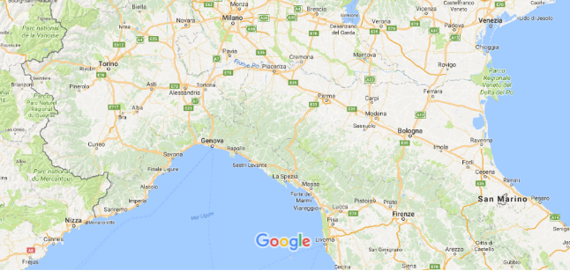
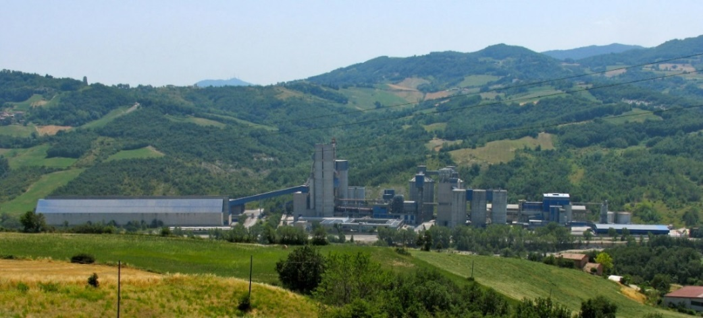
CLEANKER Primary project objectives
The ultimate objective of CLEANKER is advancing the integrated Calcium-looping process for CO2 capture in cement plants.
This fundamental objective will be achieved by pursuing the following primary targets:
Demonstrate the integrated CaL process at TRL 7, in a new demo system connected to the operating cement burning line of the Vernasca 1.300.000 ton/y cement plant, operated by BUZZI in Italy.
Demonstrate the technical-economic feasibility of the integrated CaL process in retrofitted large scale cement plants through process modelling and scale-up study.
Demonstrate the storage of the CO2 captured from the CaL demo system, through mineralization of inorganic material in a pilot reactor of 100 litres to be built in Vernasca, next to the CaL demo system.
VERNASCA PLANT

Slide 3
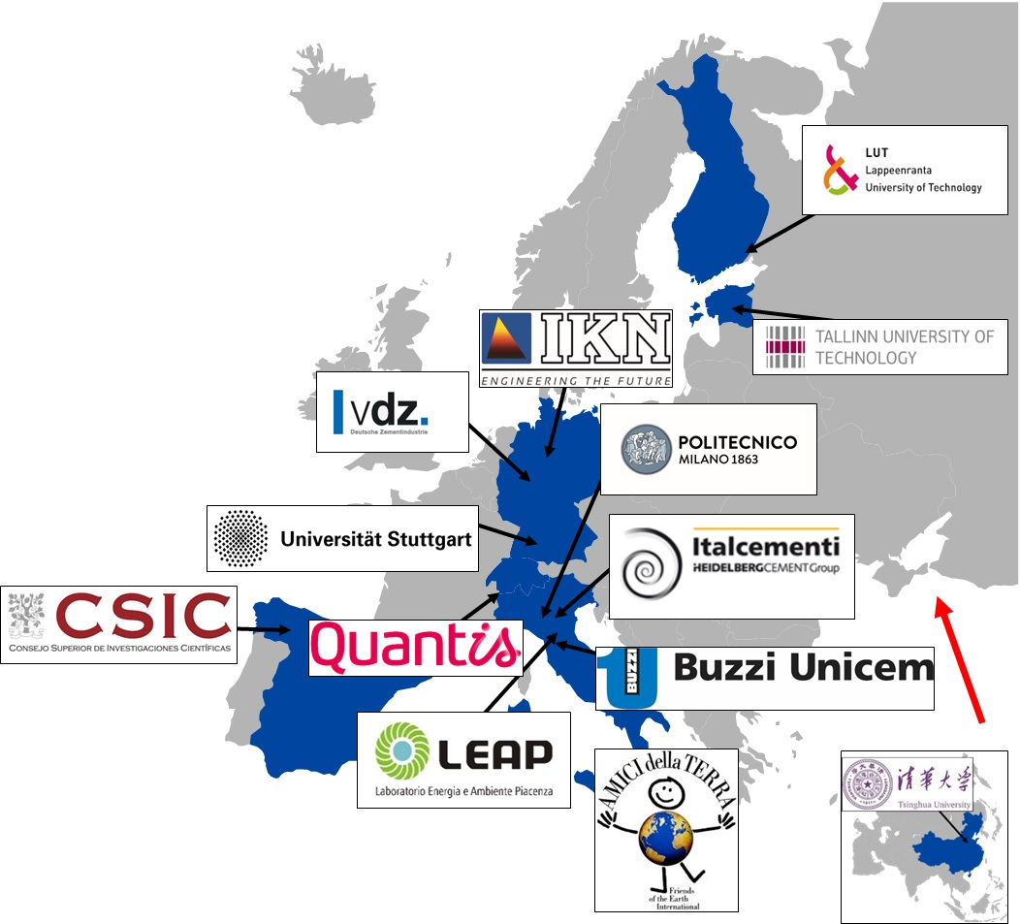
CLEANKER Consortium and WP’ structure
Starting date: October 1st 2017
Duration: 4 years + 6 months
Total budget: € 9.237.851,25
UE co-financing: € 8.972.201,25
Chinese Government founding: 265.650 €
Partner: 13 from 5 EU member states + Switzerland and China

Slide 4
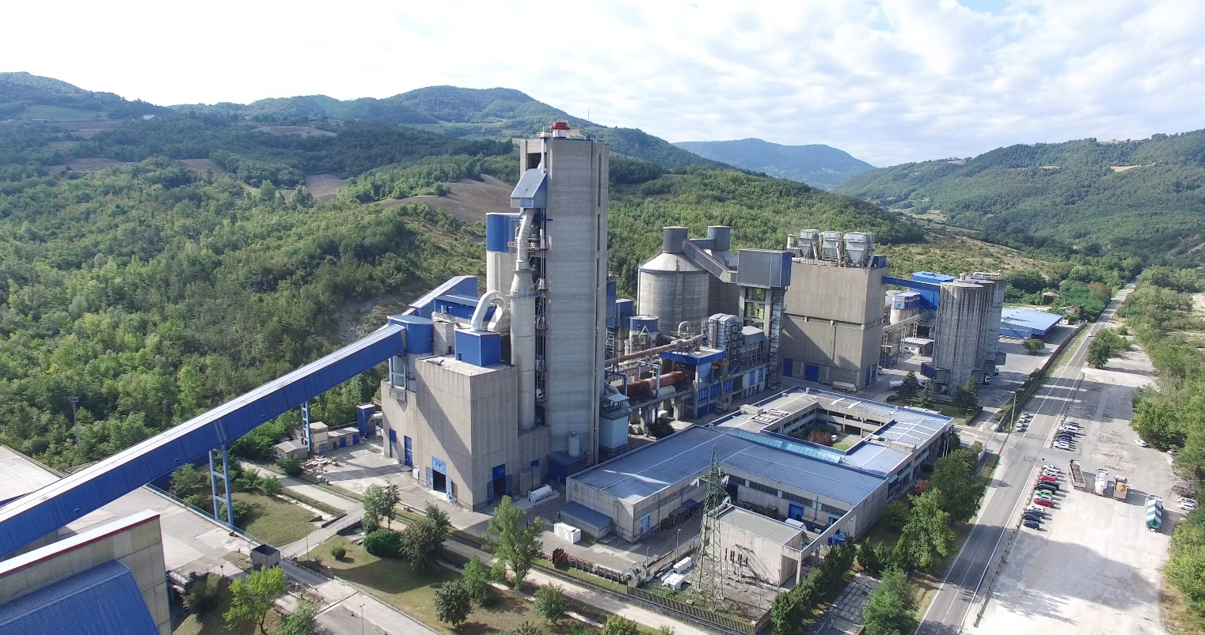
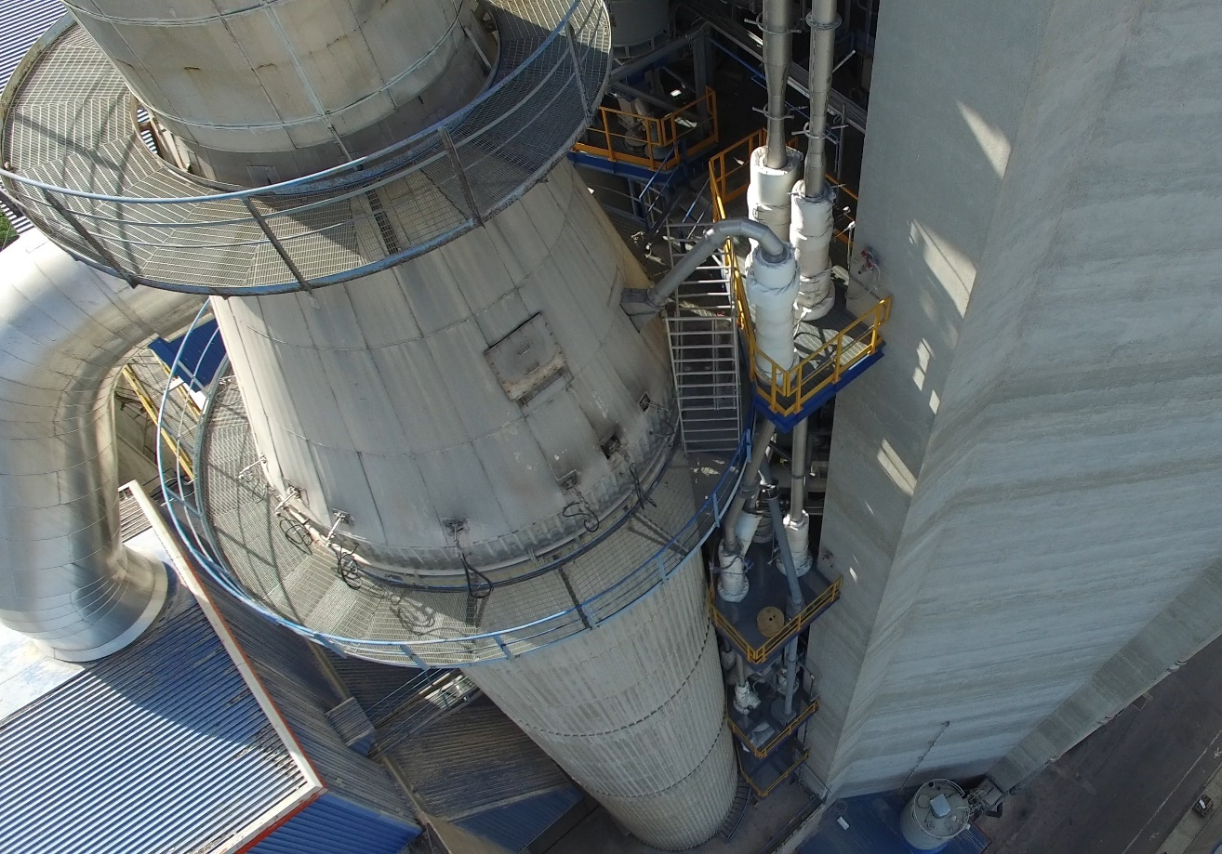
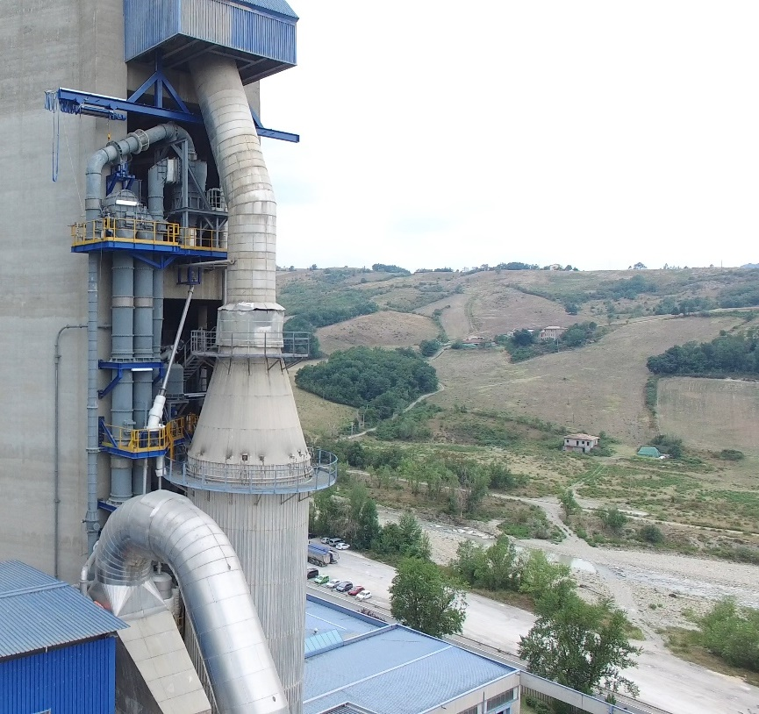
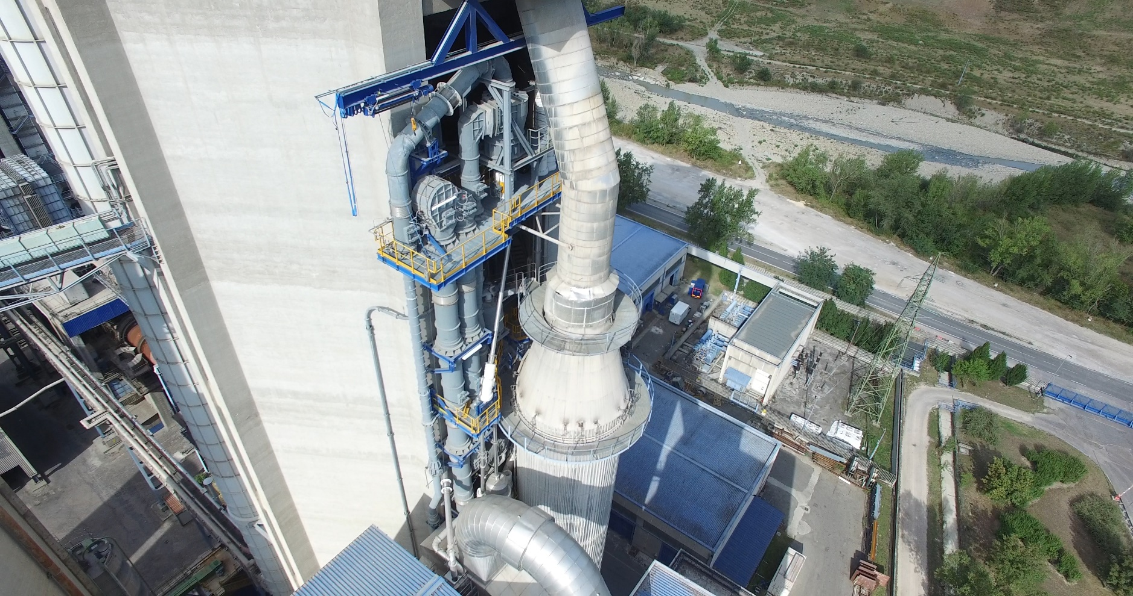
CLEANKER - pictures

Slide 5
Horizon Results Booster - HRB
Services available:
Portfolio Dissemination & Exploitation Strategy
  Module A: Identifying and creating the portfolio of R&I project results;
  Module B: Helping projects from the portfolio to design and execute a portfolio dissemination plan;
  Module C: Assisting projects to improve their existing exploitation strategy
Business Plan Development
Go to Market
10th of August 2020: CLEANKER application was accepted for the delivery of:
  Module C - Assisting the project to improve the existing exploitation strategy (PDES-C);
  Business Plan Development (BPD);
  Module A - Identifying and creating the portfolio of R&I project results for CLEANKER project.

Slide 6
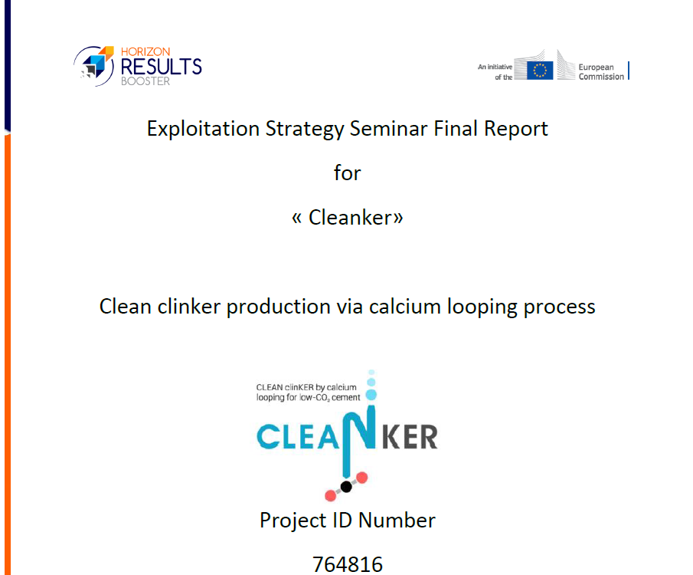
Horizon Results Booster - HRB
3rd September 2020: Call with the expert to plan both PDES-C and BDP in continuity with the SSERR service already delivered.
29th September 2020: CLEANKER members of WP8 (exploitation) decided internally the most important KER to be discussed during the seminar. We started from the three KERs identified in Neustadt within SSERR service. We merged two of them and we identified a new one. In particular:
  “How to implement CLEANKER technology in retrofitted cement plants”
  “How to explain the CLEANKER process to potential customers”.
On 27th and 28th of October 2020: Module C - Assisting the project to improve the existing exploitation strategy (PDES-C).
  Day 1: Exploitation Strategy Seminar - Introducing Exploitation;
  Day 2: Exploitation Strategy Seminar: working group for KER1 - Online session to introduce the KER1, further develop, fine-tune the Characterisation Table, the risk map and sketch the Exploitation Roadmap.
KER2 was not a KER…
At the end of the Module, we planned the Business Plan Development service for the beginning of 2021.

Slide 7
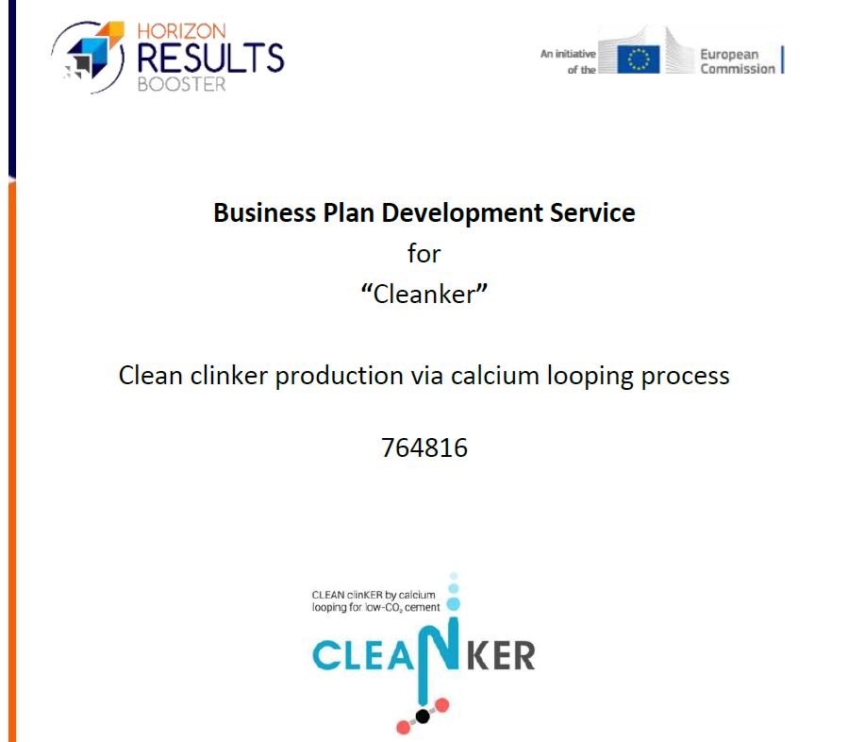
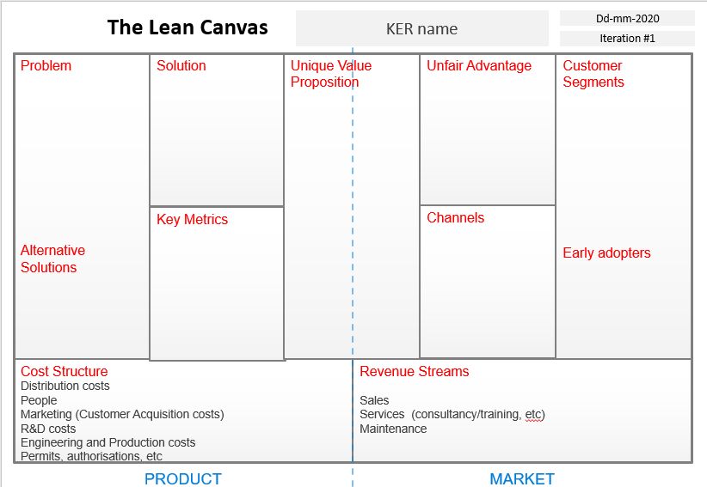
Horizon Results Booster - HRB
Business Plan Development.
  18 January 2021: Call to plan the work;
  11 February 2021: Seminar on working on the business plan structure template and Lean Canvas;
  February – March: work on the Maturity map, Business Plan Structure, Exploitation Roadmap and on the Lean Canvas.
  20 April 2021: Call with CLEANKER consortium for the BDP.

Slide 8
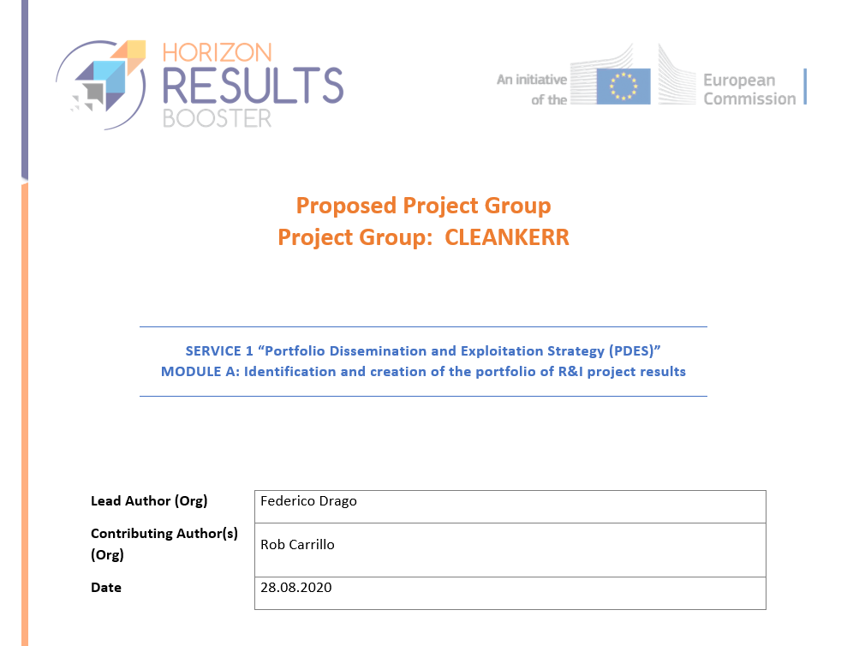
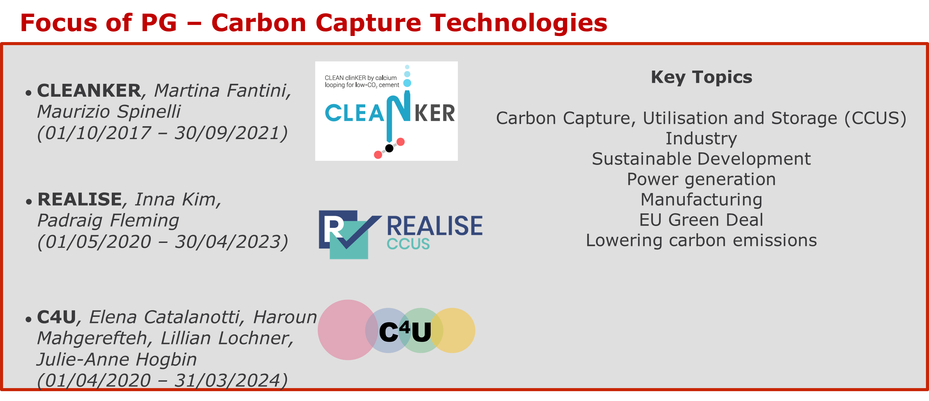
Horizon Results Booster - HRB
16th September 2020: contacted by the expert for Module A. Call scheduled for the 17th of September.
      The service is for 35 days;
      We agreed on starting the service on the 9th of November;
      Goal: define a Project Group (PG) for CCUS cluster interested to apply to Module B that aims at a concrete action (e.g. workshop). Projects proposed: LEILAC, LEAILC2, C4U, REVISE.

Slide 9
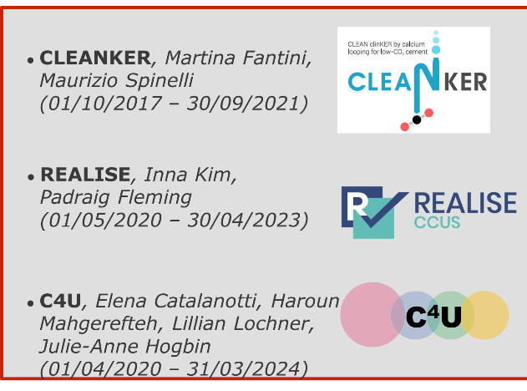
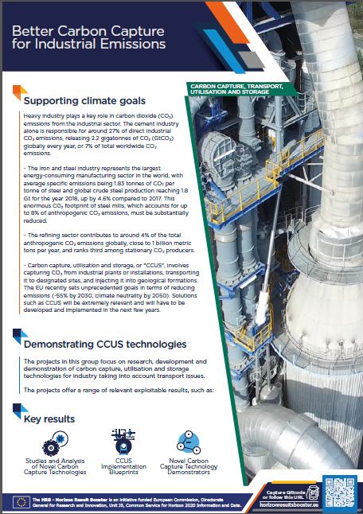
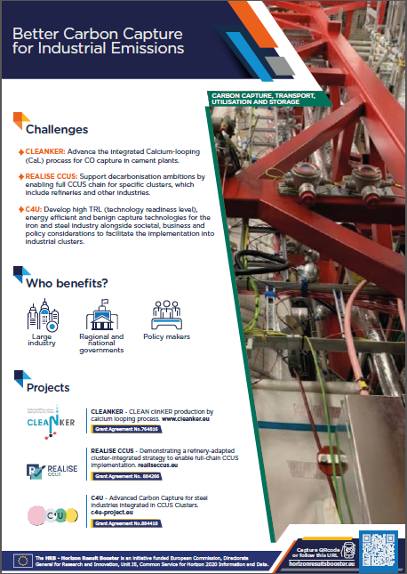
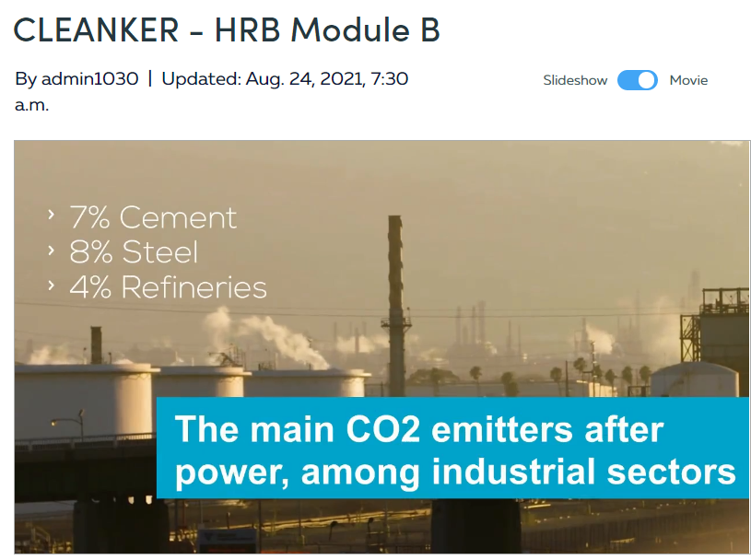
Horizon Results Booster - HRB
The experts evaluated the Project Group formed within Module A (Identifying and creating the portfolio of R&I project results) suitable for Module B (Helping projects from the portfolio to design and execute a portfolio dissemination plan).
Module B officially started on 26th of July 2021 and it is ongoing (120 days).
      First call on 30th of July 2021;
      Goal: select two Dissemination Experts Packages (DEPs) to implement as Project Group.
      August – September 2021:
        Video
        Flyer (print and web versions)
        2 DEPs between:
              On-tap strategic guidance
              Copywriting and content creation
              Communicating to Policy & Decision Makers
              Event Support
              Social Media Presence
      Next steps: the PG is working on the Policy Brief Document.
https://www.powtoon.com/online-presentation/dlBuJdT9WuK/?utm_medium=SocialShare&utm_campaign=copy%2Bshare%2Bby%2Bnon%2Blogged&utm_source=player-page-social-share&utm_content=dlBuJdT9WuK&utm_po=8502785&mode=movie

Slide 10
Challenging (it’s time consuming).. But definitely an opportunity to: learn valorize your project find synergies with others and realize something in concrete.

Slide 11
Martina Fantini
Martina.fantini@polimi.it
www. horizonresultsbooster.eu

