Slide 1
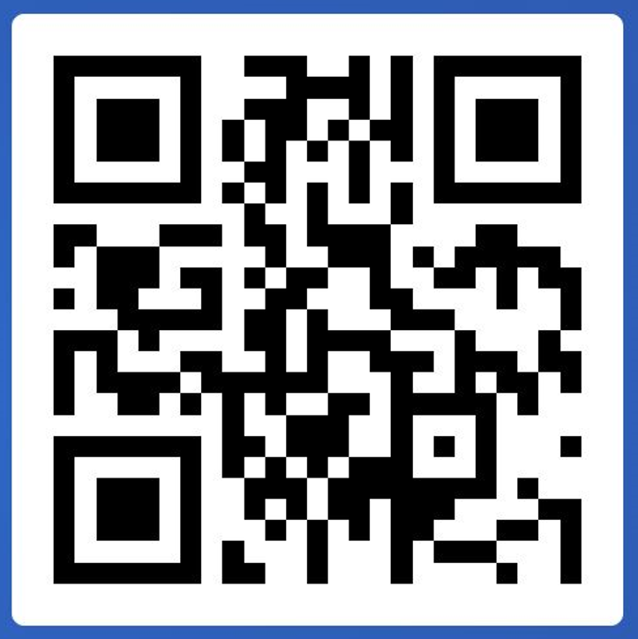
RTD.G.6
Common Knowledge and Data Management Service

Slide 2
Why the Horizon Results Booster?
Why the Horizon Results Booster?
Service offered by the European Commission to beneficiaries
To better disseminate and valorise your project’s results
To increase your exploitation potential
To improve your access to the market
Help you implement your dissemination and exploitation strategy
=> To ensure effective transfer of Research & Innovation project results to policy makers, industry and society and maximize impact
Boost your impact!

Slide 3
Why the Horizon Results Booster?
What is the Horizon Results Booster?
A set of 3 tailor-made support services for beneficiaries
Clustering R&I projects, in a portfolio of similar/complementary project results
Increasing their exploitation potential
Improve access to market
Free of charge
Portfolio Dissemination & Exploitation Strategy
Go To Market
Business Plan Development

Slide 4
Now the Horizon Results Booster
The Horizon Results Booster is run under a framework contract managed by the Commission
The Booster services are implemented by external consultants under confidentiality agreement and are available for FP7 and H2020 and future Horizon Europe beneficiaries

