Slide 1
LIEVE BOS
SUBMISSION AND EVALUATION
How to prepare a successful innovation procurement proposal in Horizon Europe
22 June 2021

Slide 2
Proposal preparation
Getting ready

Slide 3
Finding the pilot and the crew
Finding Partners
Partner search on each topic page (e.g. CARE-08-02) of the Funding & Tenders Portal
EU procurement forum (post a message there)
Linkedin (e.g. innovation procurement Linkedin group)
Ongoing & completed EU funded PCP-PPI projects
Partners in all Horizon Europe funded projects
National / regional PCP / PPI initiatives in countries around Europe
European Network of national innovation procurement competence centers
Ideal-Ist partner search (for ICT related calls)
Your own network of colleague procurers/public services in your field, etc
Support in preparing a proposal
National / regional competence centers / support programs for PCP/PPI
European Network of national innovation procurement competence centers
National Contact Points for Horizon Europe
Ideal-Ist (network National Contact Points for ICT for Horizon programme)
Notes:
Health
Inclusion
Government
Security
eInfrastructure

Slide 4
Useful Contacts
Contacts - Competence Centres - Support Programs for PCP/PPI
Info about all the national competence centers and/or financial support programs for procurers in the country profiles of each individual country here
Some contacts here
Finland: KEINO - comp center (contacts)
Sweden: VINNOVA, UHMYND – comp center (contact VINNOVA, contact UHMYND)
Germany / North Rhine-Westphalia: BME / ZENIT comp center (contact BME 1, contact BME2, contact1 ZENIT, contact 2 ZENIT)
Spain: CDTI - comp center (contact CDTI)
Austria: OIB - comp center PPI / AIT - comp center PCP (contact OIB, contact AIT)
Italy / Lombardia: CONSIP-comp center / Appaltoprecommerciale.it (CONSIP, contact AppaltoPCP)
Estonia: EAS – comp center / Ministry of Economy (contact1 EAS, contact2 EAS, contact MKM)
Netherlands: PIANOo – comp center (contact1, contact2)
Ireland: Dept of Jobs, Enterprise and Innovation / Procureti / Enterprise Ireland (contact dept, contact procureti, contact Enterprise Ireland)
Greece : DG for public procurement – comp center (contact 1, 2)
Portugal: ANI - comp center (contact)
Flanders, Belgium: PIO - comp center / VLAIO (contact PIO, contact VLAIO)
Norway: Difi – comp center (contact Difi, contact NHO)
Lithuania: MITA – comp center / Ministry of Economy (contact MITA, contact min eco)
Denmark: Market Development Fund (contact)
Notes:
Health
Inclusion
Government
Security
eInfrastructure

Slide 5
Finding budget
To cover the non-EU funded part of the costs (for PPI actions)
Own procurement budgets
Regional / National ministries (responsible for the area) concerned
Ministry of Health supporting city procurer Eindhoven (SILVER)
Ministry of Interior procuring for Belgian fire brigades (SMART@FIRE)
National / regional competence centers / support programs for PCP/PPI
Some offer co-financing for procurers in their countries/regions to undertake PCPs/PPIs (this can be combined with the EU co-financing)
Creative ways
Crowdfunding-like fundraising (Magdeburg university, IMAILE)
To covers costs that are not covered by Horizon Europe
Managing authorities of Structural Funds (ESIF) programs (e.g. some procurers can choose to have their coordination or procurement costs covered by ESIF iso HE)
Entities that already coordinate joint procurements / cross border cooperation can also participate: e.g.
Central Purchasing bodies, EGTCs (European Groupings of Territorial Cooperation), ERICs (European
Research Infrastructure Consortia), AISBLs or European International Organisations (e.g. CERN)
Notes:
Health
Inclusion
Government
Security
eInfrastructure

Slide 6
The submission process
Horizon Europe

Slide 7
Application form (proposal template)
Same structure
Proposals are submitted electronically via the Funding & Tenders Portal.
Don’t wait until the submission deadline, you can save drafts.
The proposal contains two parts:
Part A (web-based forms) is generated by the IT system. It is based on the information entered by the participants through the submission system in the Funding & Tenders Portal.
Part B is the narrative part that includes three sections that each correspond to an evaluation criterion. Part B needs to be uploaded as a PDF document following the templates downloaded by the applicants in the submission system for the specific call or topic.
There is a specific Application form for PCP actions & Application form for PPI actions

Slide 8
Admissibility
Eligibility
Proposal page limit
Substantial reduction in maximum length:
CSA actions: limit is 30 pages
PCP and PPI actions: 45 pages
RIA and IA actions: 45 pages
Exceptions, if any, specified in the call
Consortium composition
Min requirement buyers group:
Min 2 public buyers from 2 # Member States or Associated Countries, min 1 public buyer from a Member State
A self-declaration will be requested at proposal stage (tick box)
NEW
Gender Equality Plan (applicable only from 2022 on)
Participants that are public bodies, research organisations or higher education establishments from Members States and Associated countries must have a gender equality plan, covering minimum process-related requirements.
A self-declaration will be requested at proposal stage (for all types of participants).
Included in the entity validation process (based on self-declaration)
NEW

Slide 9
The evaluation process
Horizon Europe

Slide 10
Evaluation (award) criteria
Same criteria as in H2020
‘Excellence’, ‘Impact’ and ‘Quality and efficiency of the implementation’.
But adapted following lessons learnt
The number of ‘aspects to be taken into account’ have been reduced
NEW
Handling of cross-cutting objectives in PCP and PPI actions
Integration of the Gender dimension and Interdisciplinary approaches in the R&I content of the proposal, full use of Open Science practices: are typically not required
Data management plan is required
Do no significant harm principle applies
NEW
NEW
Ethics review
Security scrutiny
Your self-assessment in application form triggers whether in-depth reviews are needed.

Slide 11
Previous Horizon Europe webinars
PCP / PPI
actions
How to prepare a successful proposal in Horizon Europe
More info about RIA, IA, CSA actions, types of costs, MGA, evaluation procedure etc.
A successful proposal for Horizon Europe: Scientific-technical excellence is key, but don’t forget the other aspects
Info about Gender dimension, Open Science, Interdisciplinarity, DNSH principle etc.
Dissemination & Communication in Horizon Europe
The Funding & Tenders Portal for beginners

Slide 12
Evaluation criteria (PCP and PPI actions)
Excellence
Clarity and pertinence of the objectives and the extent to which they are ambitious, and go beyond the state of the art in terms of the degree of innovation that is needed to satisfy the procurement need.
Soundness of the proposed methodology, taking into account the underlying concepts and assumptions.
IMPACT
Credibility of the pathways to achieve the expected outcomes and impacts specified in the work programme.
Suitability and quality of the measures to maximize expected outcomes and impacts, as set out in the dissemination and exploitation* plan, including communication activities.
* For PCP actions and PPI actions, the exploitation of results by the beneficiaries means primarily the use that is made of the innovative solutions by the procurers / end-users. The manufacturing and sale of the innovative solutions are performed by the suppliers of the solutions, which are not beneficiaries but subcontractors
Quality and efficiency of the implementation
Quality and effectiveness of the work plan, assessment of risks, and appropriateness of the effort assigned to work packages, and the resources overall.
Capacity and role of each participant, and extent to which the consortium as a whole brings together the necessary expertise.
NEW
Proposals aspects are assessed to the extent that the proposed work is within the scope of the work programme topic

Slide 13
Standard evaluation process
Individual evaluation
Consensus group
Panel review
Finalisation
Experts assess proposals individually. Minimum of three experts per proposal (but often more than three).
All individual experts discuss together to agree on a common position, including comments and scores for each proposal.
The panel of experts reach an agreement on the scores and comments for all proposals within a call, checking consistency across the evaluations.
if necessary, resolve cases where evaluators were unable to agree.
Rank the proposals with the same score
The Commission/Agency reviews the results of the experts’ evaluation and puts together the final ranking list.

Slide 14
Evaluation mechanics
1 stage evaluation
- More info in online manual and general annexes to the work programme
Evaluation by independent experts
Proposals ranked according to evaluation scores
Unless otherwise specified in the call conditions: Evaluation scores will be awarded for the 3 evaluation criteria, and not for the different aspects listed under each evaluation criterion.
For full proposals, each criterion will be scored out of 5. The threshold for individual criteria will be 3. The overall threshold, applying to the sum of the three individual scores, will be 10.
Indicative Timetable
- Deadline for proposal submission, different in every WP (check this!)
- Info on outcome evaluation: 5 months after submission deadline
- Signing grant agreement: 3 months after info on outcome evaluation
Notes:
Health
Inclusion
Government
Security
eInfrastructure

Slide 15
Key principles
Your proposed work must be within the scope of a work programme topic
You need to demonstrate that your idea is ambitious and goes beyond the state of the art
Your project methodology must comply with the specific requirements for PCP/PPIs (General Annex H work programme). It must not significantly harm the environment
You should show how your project could contribute to the outcomes and impacts described in the work programme (the pathway to impact)
You should describe the planned measures to maximise the impact of your project (‘plan for the dissemination and exploitation including communication activities’)
You should demonstrate the quality of your work plan, resources and participants

Slide 16
Application form follows evaluation criteria
Part B
1. Excellence
Objectives and ambition
Methodology
2. Impact
Pathways towards impact (check also expected outcomes of the ‘topic’ calling for PCP/PPI)
Measures to maximise impact – dissemination, exploitation and communication (D&E&C)
Summary (procurement need, expected result, D&E&C measures, target groups, outcomes, impacts)
3. Quality and efficiency of the implementation
Project Plan and resources
Capacity of participants and consortium as a whole
SIMPLIFIED
NEW
Notes:
Health
Inclusion
Government
Security
eInfrastructure

Slide 17
1. Excellence
Objectives and ambition
Procurement need: What is the common challenge that the buyers want to address?
Objectives: Improve quality/efficiency of public services, address a wider societal challenge, regulatory requirement, need for standardisation, interoperability, certification?
Progress beyond state of the art: How ambitious is the procurement objective compared to what is used by procurers today? How ambitious is the degree of innovation that the supply will need to perform to address the procurement need?
Methodology
Proposed project approach and assumptions
Approach implementation phase: proposed lead procurer & buyers group, scope of the procurement, expected output, duration, budget, approach for evaluation offers (external experts or not, draft evaluation criteria), monitoring progress suppliers
PCP: nr of phases, suppliers/phase, procuring tested products included or not
PPI: joint PPI or coordinated PPIs, who buys what/how much (all exactly the same or not, FW contracts/lots or not), how long evaluation of real-life operation
Approach preparation phase: market consultation, development specs & eval criteria
Additional activities throughout the project (e.g. testing, labelling of solutions etc.)
Link with other national / international initiatives or projects
Notes:
Health
Inclusion
Government
Security
eInfrastructure

Slide 18
2. Impact
Project’s pathways towards impact
How will your project contribution to achieving:
Expected outcomes specified in WP under the ‘topic’ calling for PCP or PPI action
Wider impacts specified under the ‘destination’ in WP
Requirements and potential barriers from factors outside the project
Scale and significance of the project contribution to expected outcomes and impacts
Measures to maximise impact
Plan for dissemination, exploitation and communication
Measures to ensure wide industry interest (open market consultation, call for tender)
Communication about results achieved by the PCP/PPI
Plans of buyers group to deploy and encourage other procurers to deploy solutions
Measures to help PCP/PPI suppliers grow their business
Activities fostering wider commercialisation (e.g. standardisation, certification)
Strategy for management of IPR
Project specificities: e.g. other procurers piggy-backing on the procurement?
Ensure that your IPR approach complies with the IPR allocation requirements in general annex H of HE work programme (IPR ownership remaining with suppliers)
Notes:
Health
Inclusion
Government
Security
eInfrastructure

Slide 19
3. Implementation
Work plan and resources
Work plan: tables 3.1.a to 3.1.e (templates)
Work Packages (foresee separate work packages for)
Preparation of the procurement
Execution and follow-up of the procurement
Deliverables / milestones (foresee mandatory deliverables / milestones)
Start preparation phase: publication PIN for open market consultation in TED
End preparation stage: call for tender docs (including contract notice and request for tenders), report on outcome preparation phase, joint procurement agreement
Start execution phase: publication contract notice in TED
End of tender evaluation /evaluation per phase: info on bids received + on the result of the evaluation + publication contract award notice in TED
End of action (and at the end of each phase for PCPs): assessment and validation by the procurer of the results achieved by the suppliers + demonstration of solutions to Granting Authority (and reviewers)
Foresee sufficient time to prepare/review the tender docs + to promote the OMC/call for tender + for publication timing requirements (see application form and general Annex H to the WP) + to validate and disseminate the results after the PCP/PPI!
Critical project risks and mitigation measures
Notes:
Health
Inclusion
Government
Security
eInfrastructure

Slide 20
Resources: tables 3.1.f to 3.1.k
How will consortium mobilise resources for project (incl. own financial contribution)
Dependencies in mobilising resources (e.g. additional funding from national or other Community programs such as ESIF)
Resources (financial or in kind) from third parties associated to beneficiaries
Don't forget to complete the Tables related to resources
Total committed budget for the PCP/PPI procurement (Estimated contribution per member of the buyers group to the PCP/PPI procurement cost) -> Table 3.1.f
Estimated costs for additional activities (NOT the PCP/PPI procurement cost)
Direct personnel costs (Table 3.1.g)
Direct costs of subcontracting (Table 3.1.h)
Purchase costs (Table 3.1.i)
Other direct costs (Table 3.1.j)
In-kind contributions (Table 3.1.k)
Capacity of participants and consortium as a whole
Consortium: Complementarity and role beneficiaries (+affiliated entities)
Note: there can be no potential suppliers of solutions in the consortium
Involvement other countries and international organisations: if any (see Annex A work program), explain why their participation is essential
Notes:
Health
Inclusion
Government
Security
eInfrastructure

Slide 21
How to fill in the budget table?
Horizon Europe

Slide 22
Example PCP action
PCP
actions
Example: 10 €M PCP action
EU contribution: e.g. 9 €M for PCP (procurement of min 9 €M) + 1 €M for other additional activities
One Joint PCP call for tender +
Joint evaluation offers (common tender specs)
Example of 5-7 € Mio PCP
P1
Phase 1: Solution design
~10-15% PCP budget
~100-250K/supplier
~4-10 suppliers
Phase 2: Prototyping
~30-40% PCP budget
~500-750K/supplier
~3-6 suppliers
Phase 3: Original development –
operational testing (+ possibly ltd deployment)
~50-60% PCP budget
~800K-2,3M/supplier
~2-4 suppliers
P5
P2
Preparation
Joint PCP
Supplier A
P4
P3
Supplier B
Supplier B
Supplier B
Lead procurer and buyers group
P1->P5 (min 2)
Supplier C
Supplier C
Supplier D
Supplier D
Supplier D
Supplier E
Supplier E
Supplier E
Notes:
Group of European procurers
Pool public demand and specify needs
Manage procurement process
Share risks and benefits together and with suppliers
Cost shared, IPR shared, knowledge shared
Compatible with procurement directives and state aid
Exception to procurement directives
Legally defined as procurement of ‘R&D Services’
Possibility to restrict to ‘European wide offers’
Possibility to apply at European and Member States level
Need for incentive to support the framework

Slide 23
How to fill in budget table & table 3.1.f
PCP
actions
Suppose 3 procurers in buyers group, each contributing equally to PCP procurement budget
Scenario (1): all 3 procurers ask funding from HE for the PCP subcontracting cost
Option (I) the lead procurer pays all suppliers
Option (II) the 3 procurers pay all suppliers pro rata according to their financial contribution to the total budget for the PCP procurement
->Note that the difference in choice between Option (I) and (II) is only visible in the budget table, not in table 3.1.f Total Committed Budget for the PCP procurement
Scenario (2): Procurer 1 and 2 ask funding from HE whereas procurer 3 asks funding from ESIF for their own contribution to the total budget for the PCP procurement
Only Option (II) is possible to have clearly separate costs/invoices for H2020 and ESIF: all 3 procurers pay all suppliers pro rata according to their financial contribution to the total budget for the PCP proc.
-> Procurer 3 checks with its ESIF managing authority before submitting the proposal if the ESIF planning of the region fits the timeline of the PCP project and if the managing authority agrees to make ESIF funding available for procurer 3 to participate in the project in case the proposal gets selected for funding by Horizon Europe
Notes:
Group of European procurers
Pool public demand and specify needs
Manage procurement process
Share risks and benefits together and with suppliers
Cost shared, IPR shared, knowledge shared
Compatible with procurement directives and state aid
Exception to procurement directives
Legally defined as procurement of ‘R&D Services’
Possibility to restrict to ‘European wide offers’
Possibility to apply at European and Member States level
Need for incentive to support the framework

Slide 24
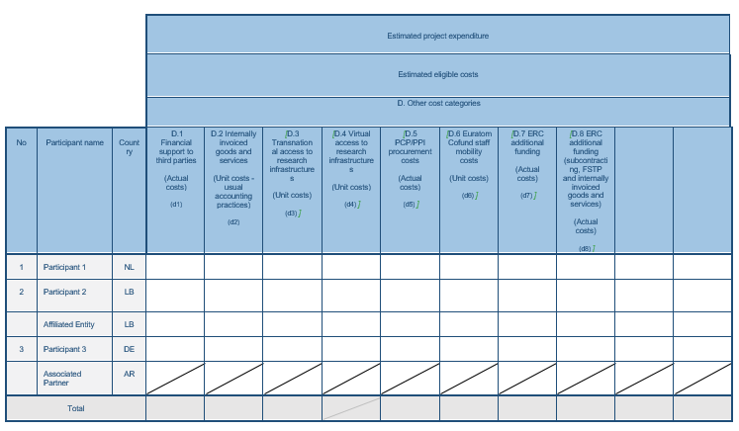
Option (I): NL lead procurer pays all suppliers
Option (II): Each of the 3 procurers pays each supplier pro rata
Budget table
PCP/PPI actions
Scenario (1)
All procurers ask
funding from HE
for PCP proc cost
PCP
actions
NEW
(I) (II)
Procurer 1
NL
9M 3M
Procurer 2
NO
0M 3M
NO
Procurer 3
DE
0M 3M
9M
Notes:
Group of European procurers
Pool public demand and specify needs
Manage procurement process
Share risks and benefits together and with suppliers
Cost shared, IPR shared, knowledge shared
Compatible with procurement directives and state aid
Exception to procurement directives
Legally defined as procurement of ‘R&D Services’
Possibility to restrict to ‘European wide offers’
Possibility to apply at European and Member States level
Need for incentive to support the framework

Slide 25
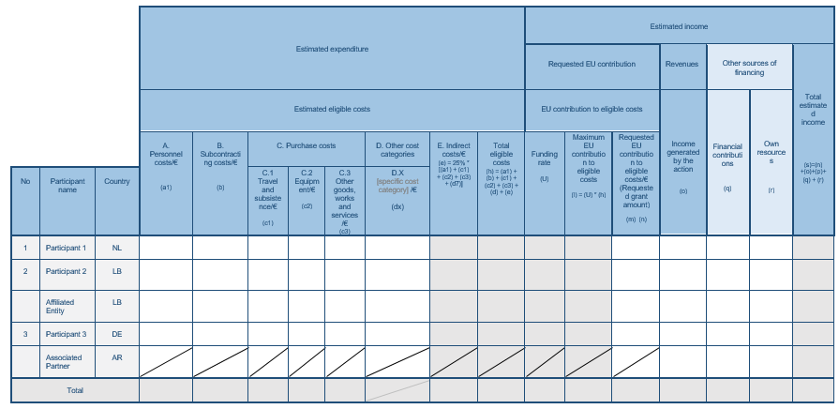
Option (I): NL lead procurer pays all suppliers
Option (II): Each of the 3 procurers pays each supplier pro rata
Budget table
PCP/PPI actions
Scenario (1)
PCP
actions
D.5 PCP
Procurement costs
Additional activities
100%
(I) (II)
(I) (II)
(I) (II)
Procurer 1
NL
0,3M
9M 3M
0,075
9,375
3,375
9,375
3,375
Procurer 2
NO
0,1M
0M 3M
0,025
0,125
3,125
0,125
3,125
NO
0,3M
0,075
0,375
0,375
Procurer 3
DE
0,1M
0M 3M
0,025
0,125
3,125
0,125
3,125
0,8M
9M
0,2M
10M
10M
Notes:
Group of European procurers
Pool public demand and specify needs
Manage procurement process
Share risks and benefits together and with suppliers
Cost shared, IPR shared, knowledge shared
Compatible with procurement directives and state aid
Exception to procurement directives
Legally defined as procurement of ‘R&D Services’
Possibility to restrict to ‘European wide offers’
Possibility to apply at European and Member States level
Need for incentive to support the framework

Slide 26
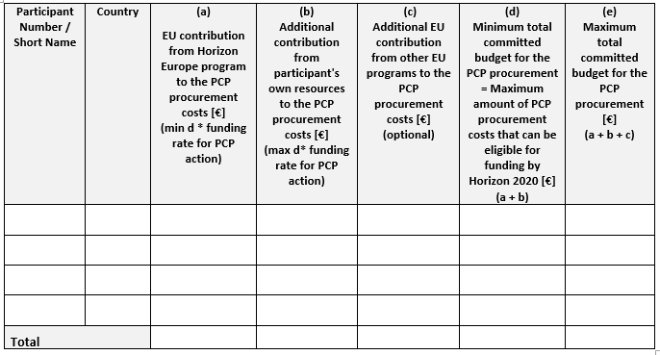
Table 3.1.f: Total committed budget for the PCP procurement
Scenario (1): All 3 procurers ask funding for PCP procurement cost from Horizon Europe
None of them from other EU programs such as ESIF
PCP
actions
PCP
actions
(I) (II)
Procurer 1
NL
3M
0M
0M
3M
3M
Procurer 1
NO
3M
0M
0M
3M
3M
Procurer 3
DE
3M
0M
0M
3M
3M
9M
0M
0M
9M
9M
It is possible to add additional budget here from own resources
Notes:
Group of European procurers
Pool public demand and specify needs
Manage procurement process
Share risks and benefits together and with suppliers
Cost shared, IPR shared, knowledge shared
Compatible with procurement directives and state aid
Exception to procurement directives
Legally defined as procurement of ‘R&D Services’
Possibility to restrict to ‘European wide offers’
Possibility to apply at European and Member States level
Need for incentive to support the framework

Slide 27
Option (I): NL lead procurer pays all suppliers
Option (II): Each of the 3 procurers pays each supplier pro rata
Budget table
PCP/PPI actions
Scenario (2)
Procurer 3 asks
funding from ESIF
for PCP proc cost
PCP
actions
(I) (II)
Procurer 1
NL
9M 4,5M
Procurer 2
NO
0M 4,5M
NO
Procurer 3
DE
0M 0M
9M
Notes:
Group of European procurers
Pool public demand and specify needs
Manage procurement process
Share risks and benefits together and with suppliers
Cost shared, IPR shared, knowledge shared
Compatible with procurement directives and state aid
Exception to procurement directives
Legally defined as procurement of ‘R&D Services’
Possibility to restrict to ‘European wide offers’
Possibility to apply at European and Member States level
Need for incentive to support the framework

Slide 28
Option (I): NL lead procurer pays all suppliers
Option (II): Each of the 3 procurers pays each supplier pro rata
Budget table
PCP/PPI actions
Scenario (2)
PCP
actions
D.5 PCP
Procurement costs
Additional activities
100%
(I) (II)
(I) (II)
(I) (II)
Procurer 1
NL
0,3M
9M 4,5M
0,075
9,375
4,875
9,375
4,875
Procurer 2
NO
0,1M
0M 4,5M
0,025
0,125
4,625
0,125
4,625
NO
0,3M
0,075
0,375
0,375
Procurer 3
DE
0,1M
0M 0M
0,025
0,125
0,125
0,125
0,125
0,8M
9M
0,2M
10M
10M
Notes:
Group of European procurers
Pool public demand and specify needs
Manage procurement process
Share risks and benefits together and with suppliers
Cost shared, IPR shared, knowledge shared
Compatible with procurement directives and state aid
Exception to procurement directives
Legally defined as procurement of ‘R&D Services’
Possibility to restrict to ‘European wide offers’
Possibility to apply at European and Member States level
Need for incentive to support the framework

Slide 29
Table 3.1.f: Total committed budget for the PCP procurement
Scenario (2): Procurer 1 & 2 ask funding for PCP procurement cost from Horizon Europe
Procurer 3 ask funding from ESIF for his contribution to the PCP procurement cost
PCP
actions
PCP
actions
(I) (II)
Procurer 1
NL
4,5M
0M
0M
4,5M
4,5M
Procurer 1
NO
4,5M
0M
0M
4,5M
4,5M
Procurer 3
DE
0M
0M
4,5M
0M
4,5M
9M
0M
4,5M
9M
13,5M
It is possible to add additional budget here from own resources
Notes:
Group of European procurers
Pool public demand and specify needs
Manage procurement process
Share risks and benefits together and with suppliers
Cost shared, IPR shared, knowledge shared
Compatible with procurement directives and state aid
Exception to procurement directives
Legally defined as procurement of ‘R&D Services’
Possibility to restrict to ‘European wide offers’
Possibility to apply at European and Member States level
Need for incentive to support the framework

Slide 30
Option (I): NL lead procurer pays all suppliers
Option (II): Each of the 3 procurers pays each supplier pro rata
Budget table
RIA/IA actions
Scenario (1)
RIA
action
Price of PCP/PPI
Procurement under
Subcontracting costs
There is no
D.5 PCP/PPI
Procurement costs
in RIA/IA actions
(I) (II)
(I) (II)
Procurer 1
NL
30M
9M 3M
7,5
46,5
40,5
Procurer 2
NO
10M
0M 3M
2,5
12,5
15,5
NO
3M
0,75
3,75
Procurer 3
DE
1M
0M 3M
0,25
1,25
4,25
44M
9M
11M
64M
Notes:
Group of European procurers
Pool public demand and specify needs
Manage procurement process
Share risks and benefits together and with suppliers
Cost shared, IPR shared, knowledge shared
Compatible with procurement directives and state aid
Exception to procurement directives
Legally defined as procurement of ‘R&D Services’
Possibility to restrict to ‘European wide offers’
Possibility to apply at European and Member States level
Need for incentive to support the framework

Slide 31
… one final point
The best way to learn is by doing
You can register in the EU experts database at any time.
Click here to register!

Slide 32
Any questions? Please enter your questions in slido https://app.sli.do/event/jwfm43x5

Slide 33
Thank you!
# HorizonEU
http://ec.europa.eu/horizon-europe

