Slide 1
LIEVE BOS
THE RULES OF THE GAME – FUNDING CONDITIONS
How to prepare a successful innovation procurement proposal in Horizon Europe
22 June 2021

Slide 2
Poll 3 – Is the topic new to you or not?
Are you familiar with the EU’s R&I programme support for innovation procurements?
Yes I already participated* in previous EU funded PCP / PPIs
Yes, but I don’t have I have heard about it before, but I have not participated* yet 1st hand experience in previous EU funded PCPs / PPIs
No This is the first time that I hear about this
(* participation can be from the demand side, supply side, or as supporting organization)
(e.g. from previous FP7, H2020 programmes)

Slide 3
The State of Play
OBJECTIVES – EXAMPLES – Lessons learnt

Slide 4
Public Procurement of Innovative solutions (PPI)
When
Solution is almost on the market or already on the market in small quantity but not meeting requirements for large scale deployment yet
If clear requirements and critical mass of demand was expressed, industry would provide solutions with required quality / price
No need to procure R&D (more scaling up of production, adaptation / integration with existing solutions etc.)
What
Public sector acts as early adopter (first 20% buyers on market) for the innovative solutions arriving on the market (not widely used yet)
How
Public sector expresses demand for a critical mass of solutions which triggers industry to bring products on the market with desired quality / price within a specific time (open market consultation, prior information notice)
After the specified time, and testing / certification / labelling (optional), the public sector buys a significant volume of solutions

Slide 5
Pre-Commercial Procurement (PCP)
When
R&D procurement needed to get new solutions developed, to de-risk tech
Pros / cons of # solution approaches not compared / validated yet
Still too risky to commit to go for large scale deployment, not possible yet to define final budget and/or final requirements
Still too risky to tie your hands to specific solutions / suppliers
Need to attract new players to tackle supplier lock-in issues
What
Public sector buys R&D to steer development to its needs, to collect info about pros / cons of alternative solutions to make specs for a possible follow-up PPI, to create a future competitive supply base
How
Public sector buys R&D from several suppliers in parallel (comparing # solution approaches) and possibly also limited volume of solutions
and evaluates progress after critical milestones (design, prototyping, test)
and shares risks & benefits of R&D (in particular the IPRs) with suppliers to maximise incentives for wide commercialisation

Slide 6
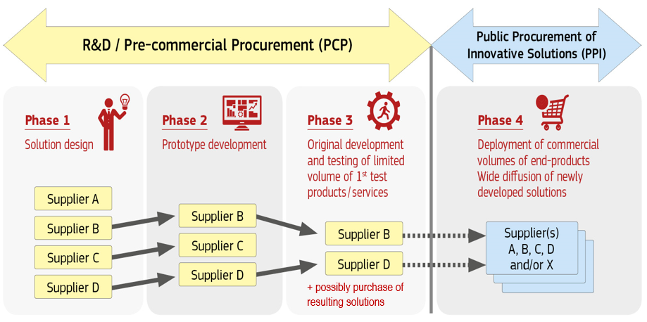
Complementarity
PCP falls outside WTO GPA and EU public procurement directives (COM(2007)799 & SEC(2007)1668)
More than 600 public buyers around Europe have already successfully implemented PCPs
PPI uses procurement procedures defined in EU public procurement directives and national law

Slide 7
Split between PCP and PPI enables to
Use PPI also if no R&D needed for procurement need
Get 20% better value for money products (US defense data)
Use a small budget PCP to de-risk a large budget PPI
PPI spec can be 'completely rephrased‘, benefiting from PCP lessons learnt
Use conditions to create strategic autonomy & growth/jobs 'in Europe'
Because PCP falls outside WTO rules
Prevent foreclosing competition & crowding out other R&D investments
Companies that are not financing their R&D via the PCP (e.g. via grants, own internal company resources, other investors, other procurements) can still bid for deployment contracts/PPIs
Facilitates access to procurement market for SMEs
Gradually increasing contract sizes, tasks, required manpower
Stringent financial guarantee/qualification requirements:'no' in PCP,'ltd' in PPI
… All the above is not the case if R&D is procured as part of/inside large deployment contract

Slide 8
Several initiatives on innovation procurement
Policy framework
Embedding Innov Proc into policies
(e.g. coordinated EU AI plan)
Benchmarking national innovation
proc. investments and policy FWs
EU IPR action plan recommends
leaving IPR with suppliers in proc.
Implementation
EU network of national competence
centers, raising capacity
European Assistance for Innov Proc
Guidance innovation procurement
Sharing experiences/good practices:
website, newsletter, events
Doing it ourselves
EU blockchain PCP
EU buys disinfection robots for
hospitals around Europe (COVID)
Joint proc with MS: EUROHPC, EU Cybersecurity Competence Center
EU funding
Recovery & Resilience Facility
MFF 2021-2027: Horizon Europe, ESIF, new Defence program, Digital Europe program, etc.
List projects, impacts achieved

Slide 9
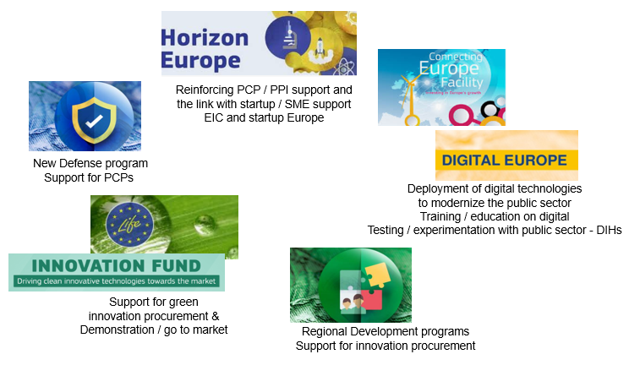
Several EU programs (2021-2027) in which innovation procurement plays a growing role

Slide 10
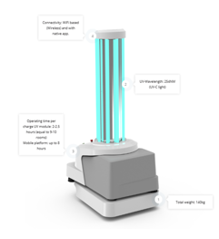
Examples: National PCPs -> EU funded PPIs
Public procurement of innovative solutions
Procurement of R&D
Pre-commercial procurement
Solution design, prototyping, development, testing and installation of first products
Wider diffusion of solutions across different customers and markets
Co-creation shortens time-to-market for innovations
First customer reference
Attract financial investors / Scale up internationally
Create jobs / technological leadership ‘in Europe’
Diffuse solutions widely
Diversify the offering to new market segments
Business expansion: Grow really big
EXAMPLE
PCP by Norwegian government resulted in deployment (EFTA funding) of
the world’s first and largest full scale carbon capture, transport and storage facility.
This will reduce by 14%
the CO2 emissions across the entire EU.
EXAMPLE
PCP by Danish hospitals
Blue Ocean Robotics
(Danish startup grew into unicorn)
Its disinfection robots kill 99% of all viruses, bacteria and are sold worldwide to fight COVID-19.
EC procured 200 robots for hospitals across Europe,
speeding up wider diffusion.
More success case examples

Slide 11
Immediate impacts of EU funded PCPs on supply side (132 procurers, 349 companies, 63 univs involved)
Opening a route-to-market for new players/SMEs
61,5% of the total value of all PCP contracts goes directly to SMEs
Compared to 29% average in public procurements across Europe
Mostly small young SMEs: 31% below 10 people, 48% below 50 people, 60% less than 10 years old
Helping also larger market players bring products to the market
16% of PCP contracts won by large companies as single bidder
19% of PCP contracts won by consortia of larger companies plus SMEs
73,5% of the PCP contracts won by SMEs (SMEs alone, or as lead bidder)
Stimulating cross-border company growth
33,1% of contracts are won by bidders that are not from a country of any of the procurers in the buyers group (e.g. DE company & ES+NL procurers)
Compared to 1,7% average in public procurements across Europe
Creating growth and jobs in Europe
99,5% of contractors do 100% of R&D activities for PCP in Europe
(2 have committed to do minimum 68% resp. 85% of R&D in Europe)

Slide 12
Longer term impacts ’so far’ of EU funded PCPs on supply side (132 procurers, 349 companies, 63 univs involved)
Commercialisation of solutions (product available on the market)
86% of Ph3 contractors, 75% of Ph2 contractors and 30% of Ph1 contractors have already commercialised (part of) their solutions
11% of contractors (across Ph1/2/3) still expect to commercialise within 2Y
17% of contractors do not plan commercialisation of solutions
Business growth
~ 50% of contractors already increased their revenues thanks to the PCP solution
24,2% of start-ups have secured equity investment since the PCP
18% of start-ups concluded partnerships with large corporates
Exit strategy (62,8% of companies in the PCPs are Start-Ups)
12,1% of start-ups have undergone a merger or acquisition
3% of start-ups have done an IPO since end of the PCP (1 on NASDAQ)

Slide 13
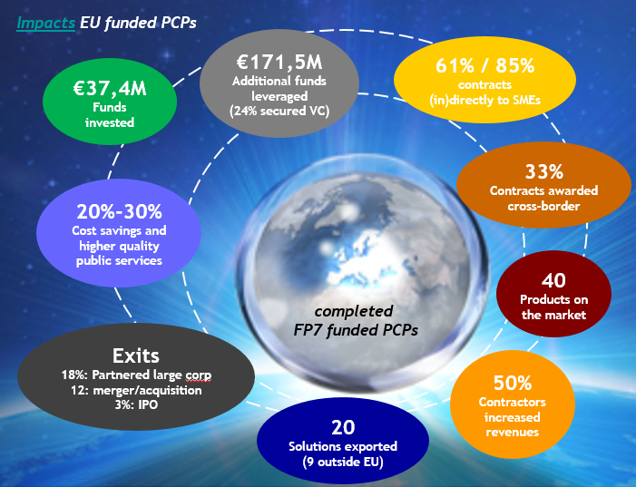

Slide 14
Examples: Impacts EU funded PCPs
Deployment: 2Y after project end 55% of projects/procurers deployed solutions
Improved interoperability: 60% of PCPs resulted in more interoperable solutions
Removing supplier lock-in: 20% cost reduction & higher quality products
Strategic autonomy, security of supply chain: Several examples for EU companies now being lead providers, not only in EU but also for Asian and US procurers
SILVER PCP -> BIOSERVO’s Exoskeleton
muscle strengthening system
Used wordwide (NASA, GM, Airbus, Eiffel…)
NASDAQ listed, 3rd VC investment round
PRACE 3IP PCP -> PPI4HPC PPI ->
EUROHPC. More energy efficient
high performance computing PCP
paved way for €Bn joint undertaking
More info: impacts of EU funded PCPs and brochure with results EU funded PCPs and PPIs in the ICT sector

Slide 15
Lessont learnt – recommendations for future
PCP / PPI
actions
Feedback from procurers
More regular, higher budget and open PCP calls, please!
Synchronise PCP calls with prior CSA calls
Allow for budget, time and task flexibility in project implementation
H2020 template tender docs: great help, add more guidance (e.g. on IPR clauses)
Feedback from companies
Don’t make big changes to the PCP instrument: it works well. More PCPs, please!
Don’t compromise on the EU wide transparent, competitive approach
Keep EU reviews on the tender docs: delivers higher quality, more open tenders
Don’t combine the purchase of R&D and wide scale deployment in one procurement (most innovative start-ups / SMEs would otherwise not have won contracts, it would crowd out R&D investments and foreclose competition also for larger companies)
Give start-ups and SMEs in PCPs priority access to EU SME support instruments
Common feedback
Simplify and accelerate without changing the core features of the PCP instrument: simplify EC IT tool for reporting/payments, fast track PCPs with combined ph2/3, make more visible that PCP can include 1st deployment (not commercial volumes)
More capacity building on PCP around Europe needed for procurers and companies
Create a European home market where solutions can scale-up fast alongside the PCPs/PPIs (remove regulatory market fragmentation, speed up certification, standardisation…)

Slide 16
Funding conditions
HorizonEU support for innovation procurement

Slide 17
Types of actions
Coordination and Support Actions (max 100% funding rate)
Can support procurers to prepare a PCP or PPI (e.g. define common needs, perform open market consultation, prepare PCP/PPI procurement)
Cannot fund R&I activities
Cannot fund the cost/price of an actual PCP or PPI procurement
Actions with as ‘primary aim’ the implementation of PCP/PPI procurement by a transnational buyers group (PCP/PPI procurement cost > 50% action budget)
PCP Actions (max 100% funding rate)
Fund actual PCP (1 joint PCP procurement/action) + related activities*
PPI Actions (max 50% funding rate)
Fund actual PPI (1 joint or # coordinated PPI(s)/action) + related activities*
* To prepare, manage and follow-up the PCP/PPI procurement + embed the PCP/PPI in a wider demand side context (e.g. to test / label / certify / standardise solutions, prepare follow-up procurement, awareness raising and training)
NEW
NEW

Slide 18
Types of actions
Other actions may ‘involve’ the implementation of PCP/PPI procurement, e.g.
RIA and IA actions can fund a PCP or PPI under the subcontracting costs
Needs to fit with the R&I / I scope of the action
Not possible if call requires industry / suppliers to be part of consortia
PCP or PPI can be implemented by 1 public procurer or by a buyers group
PCP/PPI can be proposed by participants, or called for in the call conditions
Since main aim of R&I/I action is that beneficiaries do R&D/I themselves, normally subcontracting costs can only be limited part of the action (unless the call conditions call for the PCP/PPI to be a key/large part of the action)
NEW
The EC or funding body itself may also implement PCP/PPI procurements
On its own behalf or jointly with public buyers from Member States or Associated Countries (example in H2020: EU blockchain PCP)

Slide 19
Applicable rules and guidance
General annexes of the work programme In particular Annex H: Specific conditions for actions with PCP / PPI. It applies to all actions that support the preparation and or implementation of PCP / PPI procurements (see above)!
Model Grant Agreement (MGA) and Annotated Model Grant Agreement (AGA)
Annex 5 - Specific rules for PCP and PPI procurements (recalls main points of Annex H of WP)
Article 6.2.D.5 – PCP/PPI procurement costs (specific cost category for PCP / PPI actions)
Article 6.2.B – Subcontracting costs (cost category for R&I / I actions that involve a PCP/PPI)
AGA: Guidance & examples that clarify the obligations from the articles of the MGA
Guidance PCP tender docs, Guidance PPI tender docs (update for HorizonEU coming soon)
Provides guidance on how to draft the tender documents and notices in line with HE rules
FAQs about PCP actions and FAQs about PPI actions (update for HorizonEU coming soon)
You can ask more Q&A via the topic page on the Funding & Tenders Portal
Application form PCP actions, Application form PPI actions
Reminds you of what to explain at proposal stage, mandatory deliverables etc.
HorizonEU Programme guide (section on cross-cutting priority ‘innovation procurement’)
High level strategic guidance to help you find your way in how to apply

Slide 20
Conditions for participation
PCP / PPI
actions
Min 3 independent legal entities from 3 different Member States or Associated Countries, min 2 of which are public procurers from 2 different Member States or Associated Countries. Of these 2 at least 1 is established in a Member State (minimum requirement buyers group)
Public procurers are contracting authorities or contracting entities as defined in the EU public procurement directives (see programme guide)
Buyers group can contain additional other type procurers that are providing services of public interest and share the procurement need
E.g. NGOs or private procurers
Other entities may participate in the action, on condition that they are not potential suppliers of solutions sought for by the PCP/PPI and they have no other type of conflict of interest with the PCP/PPI
E.g. Assisting buyers in preparing the PCP/PPI, dissemination activities
ELIGIBILITY
Don’t forget the box in the application form that asks you to confirm compliance with this

Slide 21
Role of different actors
PCP / PPI
actions
Buyers group
Buyers group: Procurers (beneficiaries + possibly linked 3rd parties) that provide the financial commitments to implement the PCP/PPI(s)
Needs to comply with minimum requirements buyers group! Eligibility!
Lead procurer
Beneficiary appointed by buyers group to lead & coordinate the PCP/PPI(s)
Other beneficiaries and third parties
Other entities helping the procurers in related activities
3rd parties can provide in-kind contributions to the procurers to implement the PCP/PPI(s) (e.g. resources/equipment needed for testing)
Participants can give financial support to 3rd parties (if allowed by the call)
PCP/PPI providers
Successful tenderers, selected by the buyers group & lead procurer as result of the PCP/PPI call for tenders, to provide the R&D services (PCP) or innovative solutions (PPI). They do 'NOT' enter the grant agreement
NEW

Slide 22
Eligible activities
PCP / PPI
actions
In the proposal, consortium shall already identify a specific challenge in the innovation plans of the procurers that requires innovation + KPIs (targeted quality/efficiency improvements) for the PCP/PPI. Eligible activities:
Preparation stage
Preparing 1 joint PCP / 1 joint or several coordinated PPI(s) per action
Open market consultation, verifying market readiness to meet the need
Outcome: Tender specifications + Joint procurement agreement
Execution stage
Procurement of the R&D services (PCP) or innovative solutions (PPI)
Validating performance of solutions for sufficient duration to evaluate impact
Assessment & publication of the outcomes of the procurement
Confirmation of strategy for dissemination/exploitation of results
+ If relevant to the action, other activities (e.g. preparation of follow-up PPI, testing, contribution to standardisation / regulation / certification, training)

Slide 23
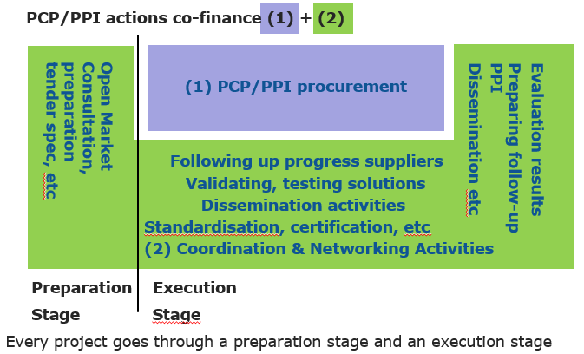
Eligible activities
PCP / PPI
actions
1st pre-fin
Review
2nd pre-fin
Possibly additional reviews
(e.g. per phase of a PCP action)
Final review
Final payment
Notes:
Firstly, the EU is strengthening the policy framework for innovation procurement
By embedding innovation procurement as a strategic priority into digital policies (e.g. in the coordinated European AI plan). EDIHs can help regional, local initiatives do the same.
The results of the (just finished) EU wide benchmarking shows you how your country compares to others in terms of national innovation procurement investments (including for the ICT sector) and in terms of setting up a mix of policy measures that encourages more innovation procurement to take place. Have a look at how your country performs (there are some references to regional innovation procurement activities in the benchmarking as well).
As one of the measures to boost economic recovery the new EU action plan on IPR encourages Member States to leave IPR ownership with suppliers in public procurements. This has proven in other parts of the world to be very effective in unlocking innovation in public procurement. It helps in particular also small companies grow,
EDIHs can help promote all these policy initiatives to public buyers in the ICT field in their area
2) Secondly, the EU is helping with the implementation aspects
The European network of national competence centers for innovation procurement is training procurers and sharing experiences. It would be interesting for EDIHs to interconnect themselves with their national competence center for innovation procurement.
Individual procurers can also apply directly for assistance from the European Assistance For Innovation Procurement for preparing and implementing a specific innovation procurement that they want to start. EDIHs that are looking to start helping local public buyers with innovation procurement case, but need help, could apply for assistance.
The EU has also published a step-by-step guidance on innovation procurement. EDIHs can reuse this guidance for local capacity building,
DG CNECT is sharing experiences and good practices on innovation procurement through its website, newsletter on innovation procurement and events.
3) We are increasing EU funding for innovation procurement
You can have a look at EU funded projects and the impacts that they have achieved
For the upcoming years, the EU has made available funding in the RRF program where innovation procurement is a key tool to boost economic recovery. Also in the new cycle of EU funding programs for the next 7 years, support for innovation procurement is foreseen in more and more programs and with increasing intensity
4) The EU itself is also doing innovation procurements
The EU blockchain pre-commercial procurement is inviting companies and researchers to come with new blockchain solutions that will enable the European Blockchain Service Infrastructure to deliver more advanced cross-border blockchain services to citizens, businesses and public administrations
The EU is also buying 200 disinfection robots that are being distributed to hospitals around Europe to fight COVID-19
The EU is also gearing up to do joint innovation procurements together with Member States: for example, in the field of supercomputing (through the EuropeHPC joint undertaking) and in the field of cybersecurity (through the European network of cybersecurity competence centers)

Slide 24
EU contribution
PCP / PPI
actions
Reimbursement rate direct costs: Max 100% of eligible costs (PCP actions) versus Max 50% of eligible costs (PPI actions)
Price of the R&D services (PCP) or innovative solutions (PPI) procured
Eligible additional activities
May include in-kind contributions (and financial support to 3rd parties, if allowed by call)
VAT is an eligible cost unless for beneficiaries that can deduct it
Flexibility: Consortium may choose to use part of the Union contribution to increase the support to additional activities or the budget for the PCP/PPI call for tender as long as the Union contribution does not exceed the max 100% (PCP) / 50% (PPI) of the total costs.
Requested funding for additional activities can be max 50% (for PCP and PPI actions) of total requested grant. PCP/PPI procurement cost must be min 50% of total eligible costs.
Plus 25% for indirect costs: But, no indirect costs on the PCP/PPI procurement cost, nor on financial support to 3rd parties
Pre-financing: Yes, 1st pre-financing at start project for costs for preparation stage, 2nd pre-financing before execution stage for costs for rest (incl. call for tender)

Slide 25
Example PCP action
PCP
actions
Example: 5 €M PCP action
EU contribution: e.g. 4,3 €M for PCP (procurement of min 4,3 €M) + 0,7 €M for other activities
EU contribution: Min 2,5 €M for PCP (procurement of min 2,5 €M) + Max 2,5 €M for other activities
Example: 3 €M PCP action
EU contribution: e.g. 2,3 €M for PCP (procurement of min 2,3 €M) + 0,7 €M for other activities
EU contribution: Min 1,5 €M for PCP (procurement of min 1,5 €M) + Max 1,5 €M for other activities
One Joint PCP call for tender +
Joint evaluation offers (common tender specs)
Example of 5-7 € Mio PCP
P1
Phase 1: Solution design
~10-15% PCP budget
~100-250K/supplier
~4-10 suppliers
Phase 2: Prototyping
~30-40% PCP budget
~500-750K/supplier
~3-6 suppliers
Phase 3: Original development –
operational testing (+ possibly ltd deployment)
~50-60% PCP budget
~800K-2,3M/supplier
~2-4 suppliers
P5
P2
Preparation
Joint PCP
Supplier A
P4
P3
Supplier B
Lead procurer and buyers group
P1->P5 (min 2)
Supplier B
Supplier B
Supplier C
Supplier C
Supplier D
Supplier D
Supplier D
Supplier E
Supplier E
Supplier E
Notes:
Group of European procurers
Pool public demand and specify needs
Manage procurement process
Share risks and benefits together and with suppliers
Cost shared, IPR shared, knowledge shared
Compatible with procurement directives and state aid
Exception to procurement directives
Legally defined as procurement of ‘R&D Services’
Possibility to restrict to ‘European wide offers’
Possibility to apply at European and Member States level
Need for incentive to support the framework

Slide 26
Example PPI action – joint procurement
PPI
actions
Example: 5 €M PPI action grant
EU contribution: e.g. 0,2 €M for coordination + 4,8 €M for PPI (procurement of 24 €M)
EU contribution: Max 2,5 €M for coordination + 2,5 €M for PPI (procurement of 12,5 €M)
Example: 2,5 €M PPI action grant
EU contribution: e.g. 0,2 €M for coordination + 2,3 €M for PPI (procurement of 11,5 €M)
EU contribution: Max 1,25 €M for coordination+ 1,25 €M for PPI (procurement of 6,25 €M)
1 Joint PPI call for tender + joint evaluation offers + joint contract award (based on common tender specs)
1 Joint Public Procurement of Innovative Solutions (PPI)
Deployment of commercial end-products
Early adoption of innovative solutions
P1
LP
P10
P2
Lot 1
For procurer 1 buying e.g. €2 Mio solutions from supplier A
…
Preparation
Joint PPI
Lot 2
For procurer 2 buying e.g. €1,5 Mio solutions from supplier B
P4
P3
Lead procurer (LP) and buyers group
e.g. P1->P10 (min 2)
Lot 3
For procurer 3 buying e.g. €5 Mio solutions from supplier D
Lot 4
For procurer 4 buying e.g. €2 Mio solutions from supplier A
…
Lot 10
For procurer 10 buying e.g. €2 Mio solutions from supplier X
Notes:
Group of European procurers
Pool public demand and specify needs
Manage procurement process
Share risks and benefits together and with suppliers
Cost shared, IPR shared, knowledge shared
Compatible with procurement directives and state aid
Exception to procurement directives
Legally defined as procurement of ‘R&D Services’
Possibility to restrict to ‘European wide offers’
Possibility to apply at European and Member States level
Need for incentive to support the framework

Slide 27
Example PPI action – coord procurement
PPI
actions
1 Joint PPI call for tender + joint evaluation offers + joint contract award for FWC, separate ones for each SC
P1
1 Joint FWC with several separate coordinated specific contracts (SC) under it
LP
P10
Preparation
PPI
P2
FWC
…
P1
SC 1
Procurer 1 buying e.g. €2 Mio solutions from supplier A
P4
P3
Lead procurer (LP) and buyers group
e.g. P1->P10 (min 2)
P2
SC 2
Procurer 2 buying e.g. €1,5 Mio solutions from supplier B
…
P10
CS 10
Procurer 10 buying e.g. €2 Mio solutions from supplier X
Separate PPI call for tenders, separate evaluation of offers, separate contract awards
Several separate coordinated Public Procurements of Innovative Solutions (PPI)
P1
P10
Preparation
PPI
P2
P1
…
Proc 1
Procurer 1 buying e.g. €2 Mio solutions from supplier A
P4
P3
P2
Proc 2
Procurer 2 buying e.g. €1,5 Mio solutions from supplier B
Lead procurer (LP) and buyers group
e.g. P1->P10 (min 2)
…
P10
proc 10
Procurer 10 buying e.g. €2 Mio solutions from supplier X
Notes:
Group of European procurers
Pool public demand and specify needs
Manage procurement process
Share risks and benefits together and with suppliers
Cost shared, IPR shared, knowledge shared
Compatible with procurement directives and state aid
Exception to procurement directives
Legally defined as procurement of ‘R&D Services’
Possibility to restrict to ‘European wide offers’
Possibility to apply at European and Member States level
Need for incentive to support the framework

Slide 28
IPR allocation
PCP / PPI
actions
PCP procurements:
Beneficiaries retain IPR they generate and give each other and other participants (including PCP/PPI providers) access to their background needed for project
PCP providers retain IPR they generate and buyers group obtains:
License free rights to use the results for their own use
Right to require the PCP providers to grant, or to grant themselves, non-exclusive licenses to exploit the results for the procurers under fair and reasonable conditions, without right to sublicense
Call back right: If PCP provider uses results to the detriment of the public interest, including security interests, or fails to commercially exploit the results within a specified period after the contract, then – after having consulted the PCP providers on why this happened – the procurers can require the PCP provider to transfer the IPR ownership to the procurers
PPI procurements:
Similar approach as in PCPs: Ownership of IPR should be allocated to the party generating it, except in duly justified cases (e.g. when party not able to exploit)
EU IPR
action plan
recommends
this for all
procurements
in Europe!

Slide 29
Main novelties in Horizon Europe
PCP / PPI
actions
Implementation novelties:
Higher funding rates: 50% (PCP actions), 100% (PPI actions)
Easier to propose (single procurer) PCPs/PPIs in other actions
Fast-track PCPs (2 iso 3 phases, deployment in PCP), starting PCP with 2 iso 3 suppliers
Third party financing possible in PCP/PPI actions
IPR allocation approach from PCPs generalized to all procurements (also PPIs)
Fair international level playing field:
Non-discrimination: no preferential treatment for companies from your country / region / city, or for bidders of specific size / types (SMEs/startups)
Access for 3rd country bidders based on reciprocity
All PINs for market consultations, contract (award) notices published on TED, except possibly for low value PPIs (< national thresholds) and security contracts
Restriction to EU-established/EU-controlled bidders possible in security PCP/PPIs
Place of performance conditions possible also for security PPIs
EU strategic autonomy clauses: e.g. restrict licensing / transfer of IPR outside EU, require sourcing strategic components from EU, min level commercialisation in EU

Slide 30
Calls in first WP
Topics calling for innovation procurement

Slide 31
2021-2022 calls in support of PCP and PPI
2021 (95,5 M€)
PCP actions
RIA actions involving PCP or PPI
CSA actions
2022 (170,7 M€)
PCP actions
RIA actions involving PCP
PPI actions
CSA actions
Programme Cofund actions
Situation awareness in civil protection: 6 M€ (SSRI-01-04)
International connectivity Research & Education: 15 M€ (NET-01-FPA)
New and existing ESFRI research infrastructure projects: 36 M€ (DEV-02-01), 7,5 M€ (DEV-02-02)
Healthcare Innovation Procurement Network: 5 M€ (CARE-05-04)
Coordination… adoption of trustworthy AI, data and robotics: 13 M€ (HUMAN-01-02)
Joint procurement of local energy related digital services: 4 M€ (D3-02-11)
Zero polluted seas and oceans: 3 M€ (ZEROPOLLUTION-01-04)
Preparing PCP on climate change adaption and mitigation: 2 M€ (GOVERNANCE-01-15)
Building capabilities in innovation procurement – startups / SMEs: 4 M€ (CONNECT-01-02)
Building resilience of healthcare systems in the context of recovery: 25 M€ (CARE-08-02)
Boosting green economic recovery and open strategic autonomy in strategic digital technologies: 9 M€ (RESILIENCE-02-01)
Public sector as Galileo or Copernicus user: 5,2 M€ (SPACE-02-52)
R&D for next generation scientific instrumentation, tools and methods: 110 M€ (TECH-01-01)
Building resilience of healthcare systems in context of recovery: 15 M€ (CARE-08-03)
Stronger grounds for PCPs on Innovative security technologies: 2 M€ (SSRI-01-03)
Stimulating innovation procurement: 4,5 M€ (CONNECT-02-02)

Slide 32
Open & Forthcoming calls for PCP and PPI actions**
Click on a topic identifier (e.g. CARE-08-02) for more detailed information
Civil Security Work program
HORIZON-CL3-2021-SSRI-01-04: Demand-led innovation for situation awareness in civil protection (PCP actions; 6 M€; 23 November 2021)
Digital, Industry and Space Work program
HORIZON-CL4-2022-RESILIENCE-02-01-PCP: Boosting green economic recovery and open strategic autonomy in Strategic Digital Technologies through pre-commercial procurement (PCP actions; € 9M; 30 March 2022)
HORIZON-EUSPA-2022-SPACE-02-52: Public sector as Galileo and/or Copernicus user (PCP actions; € 5,2M; September 2022, indicative)
Health Work Program
HORIZON-HLTH-2022-CARE-08-02: Pre-commercial research and innovation procurement (PCP) for building the resilience of health care systems in the context of recovery (PCP actions; € 25M; 21 April 2022)
HORIZON-HLTH-2022-CARE-08-03: Public procurement of innovative solutions (PPI) for building the resilience of health care systems in the context of recovery (PPI actions; € 15M; 21 April 2022)
Call deadlines in red

Slide 33
Open & Forthcoming calls for PCP/PPIs in RIA/IA actions**
Click on a topic identifier (e.g. CARE-08-02) for more detailed information
Research Infrastructure Work Program
HORIZON-INFRA-2021-NET-01-FPA: Network connectivity in Research and Education - Enabling collaboration without boundaries (€ 15M; Second quarter 2022, indicative)
HORIZON-INFRA-2022-TECH-01-01: R&D for the next generation of scientific instrumentation, tools and methods (€ 110M; 20 April 2022)
Call deadlines in red

Slide 34
Open and forthcoming calls for CSA actions
Click on a topic identifier (e.g. CARE-05-04) for more detailed information
Call deadlines in red
Extended deadlines underlined
Health Program
HORIZON-HLTH-2021-CARE-05-04: Health care innovation procurement network (€ 5M; 21 September 2021)
Research infrastructure Work Program
HORIZON-INFRA-2021-DEV-02-01: Preparatory phase of new ESFRI research infrastructure projects (€ 36M; 20 January 2022)
HORIZON-INFRA-2021-DEV-02-02: Consolidation of the research infrastructure landscape – Individual support for ESFRI projects (€ 7,5M; 20 January 2022)
Digital, Industry and Space Work program
HORIZON-CL4-2021-HUMAN-01-02: European coordination, awareness, standardisation & adoption of trustworthy European AI, Data and Robotics (AI, Data and Robotics Partnership) (€ 13M; 21 October 2021)
Civil Security Work program
HORIZON-CL3-2022-SSRI-01-03: Stronger grounds for pre-commercial procurement of innovative security technologies (€ 2M; 23 November 2022)

Slide 35
Open and forthcoming calls for CSA actions
Click on a topic identifier (e.g. CARE-05-04) for more detailed information
Call deadlines in red
Energy Program
HORIZON-CL5-2021-D3-02-11: Reinforcing digitalisation related know how of local energy ecosystems (€ 4M; 5 January 2022)
Food, bioeconomy, natural resources, agriculture and environment Work Program
HORIZON-CL6-2021-ZEROPOLLUTION-01-04: Achieving zero polluted seas and ocean (€ 3M; 6 October 2021)
HORIZON-CL6-2021-GOVERNANCE-01-15: Preparing for pre-commercial procurement (PCP) for end-user services based on environmental observation in the area of climate change adaptation and mitigation (€ 2M; 6 October 2021)

Slide 36
Topic specific workshops / Info days
PCP / PPI
actions
Specific workshops for topics that are supporting PCP or PPI
28 / 06 / 21: Online workshop / healthcare topics (CARE-05-04, CARE-08-02, CARE-08-03)
28 / 06 / 21: Online Info session / research & education network topic (@13:00) (NET-01-FPA)
02 / 07 / 21: Online workshop / security topics (SSRI-01-03, SSRI-01-04)
4-7 / 10 / 21: Big Science Business Forum / scientific instrumentation topic (TECH-01-01)
07 / 07 / 21: Info day / Climate change topic (@15:45) (GOVERNANCE-01-15)
For more info about the Horizon Europe programme
European Research and Innovation Days 2021 – 23 & 24 June 2021 (registration needed)
Horizon Europe Info Days between 28 June and 9 July 2021 (no registration needed)

Slide 37
Any questions? Please enter your questions in Slido https://app.sli.do/event/jwfm43x5

Slide 38
Thank you!
# HorizonEU
http://ec.europa.eu/horizon-europe

