Slide 1
Horizon Results Booster
Alessia Melasecche Germini, META Group

Slide 2
Generation of an Impact (on society and/or market) strictly depends on
dissemination and exploitation strategies and actions.
Wrong basics, generate wrong strategies!
Experiences from the delivery:
Wrong identification of Key Exploitable Results
Confusion between customers-end users-partners
Use model not identified
…
It is important to dedicate the right effort and time to
dissemination, exploitation and uptake of research results.

Slide 3
Transforming project results into concrete benefits for the society, maximising the scientific, social, economic, technological and policy value, is a must.
The Horizon Results Booster is the new initiative
by the European Commission
which aims
to maximise the impact of projects receiving
FP7, H2020 and HE funding.

Slide 4
Three type of services:
1 - Portfolio Dissemination and Exploitation Strategy (PDES) - develop a portfolio of results and design an effective dissemination and exploitation strategy – (PDES1 A, B and C).
2 - Business Plan Development (BPD) - finalise a BP.
3 - Go to Market (G2M) - get your research ready for market!
Services delivered to eligible projects are free-of-charge and fully supported by the EC.
Services can be requested “à la carte” from the list when completing the application form.
HRB provides beneficiaries with tools and methodologies. Experts act as facilitators. Service delivery happens remotely and virtually.

Slide 5
Objectives and outputs of the services
1_PDES-A (entry point of dissemination services): to create a Project Group (PG) for dissemination (if not already in place) and to prepare a portfolio of results for joint dissemination.
1_PDES-B: to support the PG with the preparation of a joint dissemination plan, create the PG’s visual identity and video.
1_PDES-C (entry point of exploitation services): to improve/define the exploitation strategy with actions.
2_BPD: to draft/finalize the business plan (action plan for exploitation).
3_G2M: to address one or more specific aspects for the implementation of the business/action plan:
Pitching (capacity to present in front of interested stakeholders)
IPR support (orientation in the IPR landscape)
Innovation Management (specialised training)
Exploitation options (exploration and in-depth analysis of the different options)
Business services (one among commercialisation plan, evaluation of business plan potential, creation of start-up)
Access to non-EU funding (analysis of funding options for follow-on financing)

Slide 6
Service 1 – Portfolio Dissemination and Exploitation Strategy (PDES)
Module A: Identification and creation of the portfolio of R&I project results | Application is open to both individual projects and project groups (PGs). Project Groups will be formed during the delivery of the service.
Module B: Portfolio Dissemination Plan (design and execution) | Application is open only to project groups or individual projects having requested also Module A.
Module C: Assisting projects to improve their existing exploitation strategy | Application is open only to individual projects. Focus on max 3 KERs.
Service 2 - Business Plan Development (BPD)
 | Application is open only to individual projects Recommended for projects entering the second half of their lifetime; preferably went through PDES – Module C or have prepared similar outputs. Focus on 1 KER.
Service 3 - Go-To-Market Support (G2M)
 | Application is open to both individual projects and project groups (PGs); single or multiple typologies of support (packages); high TRLs (>6) and mature projects; use of “minimum requirements” to access. Focus on 1 KER. Projects requesting PDES-C and/or BPD can request G2M only after the previous services are concluded.

Slide 9
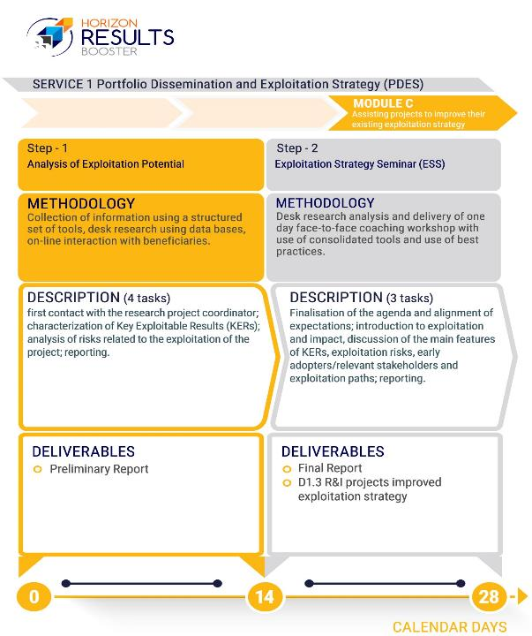

Slide 12
Go to Market - Packages
Suggested Packages
Pitching + Access to non-EU funding
Business services + Access to non-EU funding
Pitching + Business services
Support and guidance for IPR + Examining options for exploitation + Business Services
Support and guidance for IPR + Business services
Examining options for exploitation+ Business Services
Training in Innovation Management + Business services
Pitching + Training in Innovation Management + Examining options for exploitation + Support and guidance for IPR

Slide 13
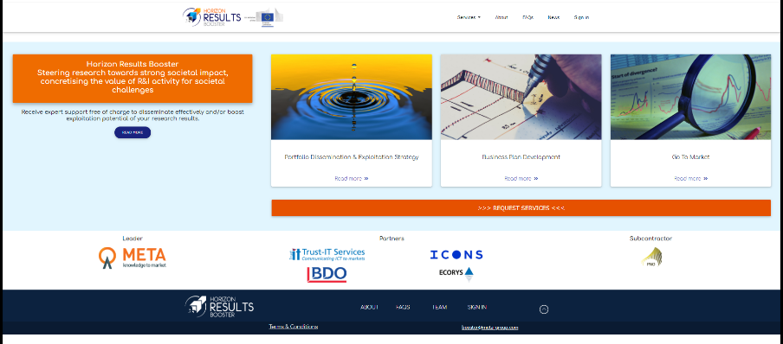
How to get in touch with the HRB…
The HRB functional mailbox is booster@meta-group.com
The HRB website/platform access is https://www.horizonresultsbooster.eu

Slide 14
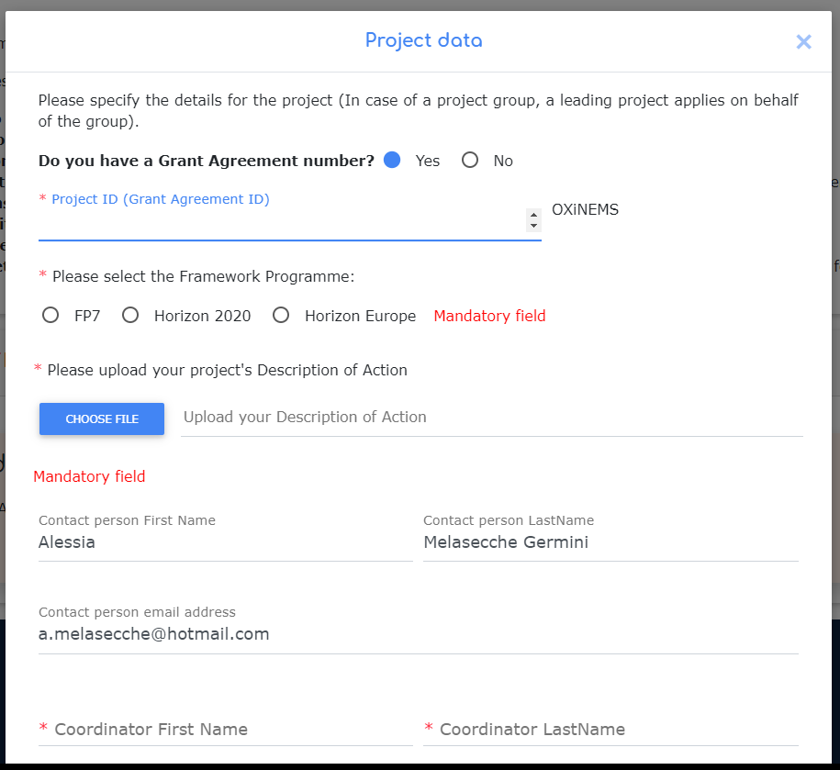
How to apply…

Slide 15
How to apply…
Applicants have to register first to the HRB platform to submit an application.
At the registration they need:
project ID (GA number)
name and e-mail of the applicant
name and e-mail of the project coordinator
name and e-mail of the PO
They can save draft applications and continue whenever they want before submitting.
During the application, specific questions are made and documents have to be uploaded, based on the service requested
Alerts keep applicants informed about their “readiness” for the requested service

Slide 16
What happens after the submission?
Eligibility of applications (minimum requirements, application to the same service, projects too far in the past, etc.) is verified by HRB Team (EC).
Experts are proposed by the Contractor and accepted/rejected by HRB Team (EC) according to background, expertise, etc. in their CV.
The expert organises a “preliminary call” to define the Service Delivery Plan.
If the expert realises the projects are not “ready” for the service, (s)he proposes another service.
Feedback questionnaires are proposed at the end of the service to verify effectiveness.
Outputs, deliverables and final reports of the services are saved in the platform.
Automatic e-mail alert (to the EC too) when the final report is uploaded onto the platform.

Slide 17
What happens during the delivery?
Average amount of efforts from beneficiaries:
Service 1 Module A: around 1 EWD (so around 8 hours spread into multiple days)
Service 1 Module B: from 2 to 4 EWDs (depending on the training package selected during the service)
Service 1 Module C, BPD, G2M: a range from 3 to 10 EWDs (depending on the level of maturity of the project)

