Slide 1
Novelties of Horizon Europe on Dissemination & Exploitation (D&E)

Slide 2
Some definitions…
Research Communities
MS, EU Policymakers
Research Roadmaps
Data
Policy Recommendations
Results:
Project Results
Results’ means any tangible or intangible effect of the action, such as data, know-how or information, whatever its form or nature, whether or not it can be protected, as well as any rights attached to it, including intellectual property rights…
Publications
Reports
Software
Platforms (Collaboration)
Key results are the outputs generated during the project which can be used and create impact, either by the project partners or by other stakeholders
Prototypes
Skills and Knowledge
Project results can be reusable and exploitable (e.g. inventions, prototypes, services) as such, or elements (knowledge, technology, processes, networks) that have potential to contribute for further work on research or innovation
Educational Materials
Pre-Standards
Codes of Conduct
Industry, Innovators
Civic Society, Citizens

Slide 3
Lessons learned from H2020 on D&E Why does it not always happen? From the side of the project/beneficiaries
D&E = Tick boxes, and not real work
Focus on implementation
vs. users’ needs
Lack of skills (or interest)
to share results with society
Lack of awareness on D&E opportunities (issues, solutions, market, etc.)
Not truly part of the project design from the start
Perceived as an “after-project” activity

Slide 4
How we tried to address this in Horizon Europe
D&E = gained importance under HE
From the proposal we ask beneficiaries to think about D&E
Horizon Results Booster provides guidance to beneficiaries
HRP TV
Increased trainings and webinars
The proposal form has been redesigned to identify the role of each partner
Increased availability of tools during and after the grant

Slide 5
Horizon Europe legal basis
Article 39 – Exploitation and Dissemination
“Each beneficiary that has received Union funding shall use its best efforts to exploit the results it owns, or to have them exploited by another legal entity. Exploitation may be direct by the beneficiaries or indirect in particular through the transfer and licensing of results in accordance with Article 40”
“Beneficiaries shall disseminate their results as soon as it is feasible, in a publicly available format, subject to any restrictions due to the protection of intellectual property, security rules or legitimate interests.”
Article 51: Information, communication, publicity and dissemination and exploitation
Para 3: The Commission shall also establish a dissemination and exploitation strategy for increasing the availability and diffusion of the Programme’s research and innovation R&I results and knowledge to accelerate exploitation towards market uptake and boost the impact of the Programme.
*rules for participation

Slide 6
What’s new in D&E under HE? Changes from H2020
D&E is part of the Key Impact Pathway to demonstrate the contribution to the impact on society
Improvements on the proposal/reporting template to introduce more specific language on D&E
Emphasis on continuous reporting on D&E (even after the end of the project)
Encouragement of third party exploitation (where appropriate)
Introduction of incentives for exploitation

Slide 7
Obligations of beneficiaries to exploit their results and the Horizon Results Platform
In Horizon Europe, as in H2020, the obligation to exploit remains and is a responsibility of the beneficiaries on a “best efforts” approach
When specified in the WP additional exploitation obligations could be applied
Horizon Europe encourages the use of the R&I results through third party exploitation (where appropriate)
If despite the best effort for exploitation no uptake happens within a specific period after the end of the project (1 year), then the project must use a platform (Horizon Results Platform) to make exploitable results visible (unless obligation is waived)
The Horizon Results Platform is free, is part of the F&T portal, available to all beneficiaries and is based on results, not on projects.
https://ec.europa.eu/info/funding-tenders/opportunities/portal/screen/opportunities/horizon-results-platform

Slide 8
D&E at proposal stage Under the Key Impact Pathway
Applicants have to submit (unless Work Programme says otherwise) a short description of the D,E &C activities together with the impact pathways in their proposal
In Horizon Europe not a full fledged D&E plan is required at proposal stage, but a complete exploitation, dissemination and communication plan has to be submitted as a deliverable after the first 6 months of the project.
This plan will need to be updated at the end of the grant.

Slide 9
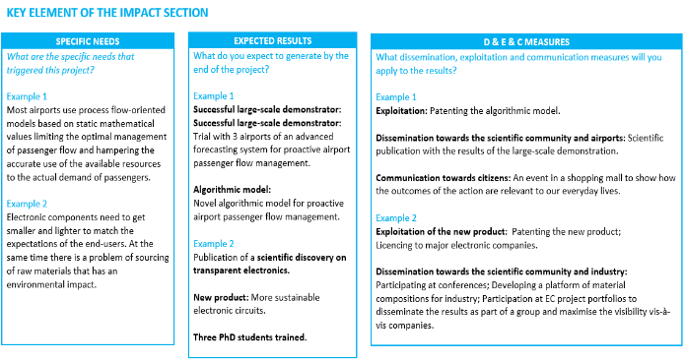
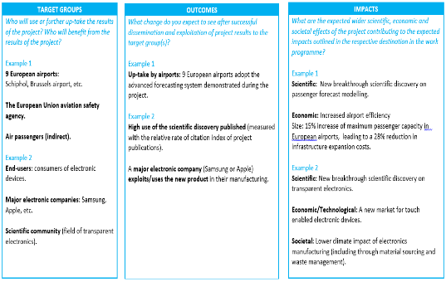
Proposal: The impact canvas new

Slide 10
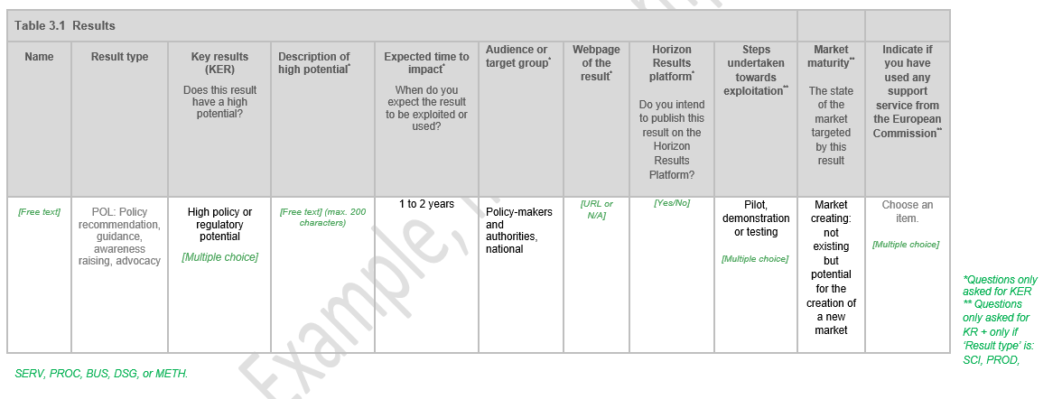
Reporting : results table new Project pathway to impact: Results table with drop down menu
Identification of KER, the type of potential, link with other results (publications, datasets, IPR and standards)

Slide 11
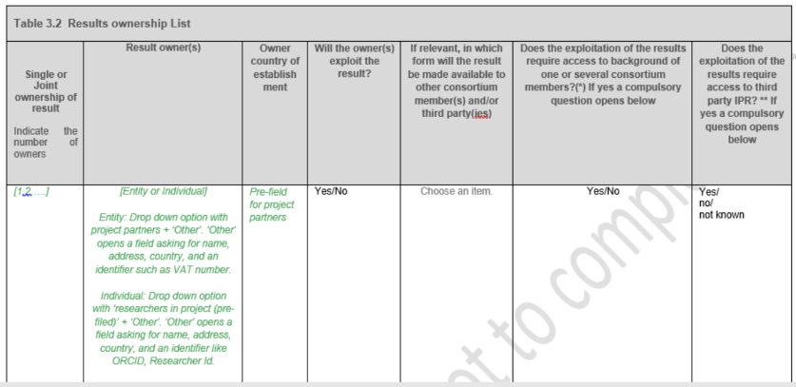
Reporting: Results Ownership List new
New obligation under HE, it was identified as being an obstacle for the uptake of research results

Slide 12
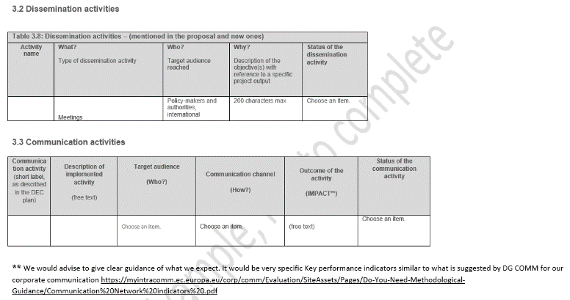
Reporting: Dissemination and Communication activities new
Instead of a text in part B, the Dissemination and Communication are now in a table.
In a semi-structured format for dissemination in order to extract data

Slide 13
Follow up of results after the end of the project Through the reporting tools
In Horizon Europe, the follow up of the exploitation activities will continue after the end of the project
The first year after the end of the project, and if no exploitation takes place, beneficiaries must use a platform, (e.g. Horizon Results Platform) for making their exploitable results visible
For the following period there will probably be a structured questionnaire available to beneficiaries to report on the progress, their needs and obstacles on their path for exploitation
This questionnaire could be part of the EC grant management system and will remain open until the conclusion of the follow up period after the end of the project where a final report will be created

Slide 14
Concrete tips for drafting the proposal

Slide 15
The proposal template
Allows easier comparison between proposals (use of tables, charts, etc.)
Ensures links with EC and external data sources, and encourages the use of external single identification such as ORCID
Facilitates the clustering of projects from different parts of the programme by topic and policy area
Collects as much as possible structured data that can then be used for reporting purposes

Slide 16
Measures to maximise: Dissemination & Exploitation
The proposal takes into account the capacity and role of each consortium member, and the extent to which the consortium as a whole brings together the necessary expertise
Planned D&E measures to maximise the impact of projects
that are proportionate to the scale of the project
that contain concrete actions (i.e. stakeholders management, business and market actions, standardisation, spin-off, etc.) to be implemented both during and after the end of the project
planned according to draft timeline of when they will reach their own outcomes/impact both during and after the project
Target group (e.g. scientific community, end users, financial actors, local community)
What is the proposed channel to interact with the target group?
What is the function of the proposed target group? How do they contribute to the maximisation of impact?
Follow-up plan to foster exploitation/uptake of the results
Policy feedback measures to contribute to policy shaping and supporting the implementation of new policy initiatives and decisions

Slide 17
Measures to maximise: Communication
Communication measures
Adequate to promote the project and its findings throughout the full lifespan of the project
Strategically planned with clear objectives
That clearly define the main message, tool(s) and channel(s) that will be used to reach out to target groups
To promote the project and its results beyond the projects own community
To communicate the research in a way that is understood by non-specialist, e.g. the media and the public
To inform EC in advance of communication activities expected to have a major media impact

