Slide 1
Anne Pépin
How to prepare a successful proposal in Horizon Europe: Horizontal Aspects
21 April 2021

Slide 2
Gender Equality
Horizon Europe

Slide 3



Eligibility: Gender Equality Plan
Award Criteria: Integration of the gender dimension
Ranking Criteria: Gender balance

Slide 4
Policy and legal context
Horizon Europe

Slide 5
Policy and legal context
Despite progress achieved under Horizon 2020 and in the ERA framework, gender inequalities in R&I persist (She Figures 2018 and ERA Progress Report 2018)
Strengthened crosscutting priority in Horizon Europe: Article 7(6) and Recital 53 of Framework Regulation & Articles 2(2)(e) and 6(3)(e) of the Specific Programme
Political Priority for the European Commission: Communication on ‘A Union of Equality: Gender Equality Strategy 2020-2025’ (March 2020)
Support to the implementation of Gender Equality Plans (GEPs) in research organisations, higher education establishments and public bodies for over a decade: through FP7 and Horizon 2020, over 200 organisations supported through 30 GEP-implementing projects, plus additional initiatives including guidance, trainings and communities of practice on GEPs
Renewed ERA policy priority: Council Conclusions on the New ERA (1 Dec. 2020), and Commission’s Communication on A new ERA for Research and Innovation (30 Sept. 2020)

Slide 6
Gender Equality Plans
Horizon Europe eligibility Criterion

Slide 7
Eligibility Criterion
  Gender Equality Plan (applicable from 2022 onwards)
Participants that are public bodies, research organisations or higher education institutions* established in a Member State or Associated Country must have a gender equality plan in place, fulfilling mandatory process-related requirements
  A self-declaration will be requested at proposal stage (for all categories of participants)
  Included in the entity validation process (based on self-declaration)
* Private-for-profit entities (incl. SMEs), NGOs, CSOs, as well any type of organisations from
non-associated third countries, are exempted for the criterion
See legal categories definitions in the Funding & Tenders Portal here

Slide 8



Mandatory GEP process requirements
Public document
Dedicated resources
Data collection and monitoring
Training and capacity building
Formal document
Signed by top management
Published on the institution’s website
Disseminated through institution
Funding for gender equality positions or teams
Reserved time for others to work on gender equality
Data on sex or gender of staff across roles and leadership
Annual reports and evaluation of progress and outcomes
Whole organisation engagement
Joint action on specific topics
Tackle gender biases of people and decisions

Slide 9
Recommended GEP content areas
Work-life balance and organisational culture
Gender balance in leadership and decision-making
Gender equality in recruitment and career progression
Integrating the gender dimension into research and teaching content
Measures against gender-based violence, including sexual harassment
Essential factors for gender equality in R&I

Slide 10
The eligibility criterion steps
Self-declaration by Horizon Europe applicants through GEP eligibility criterion questionnaire*
The GEP must be in place for the signature of the Grant Agreement (for calls with deadlines from 2022 onwards)
Equivalent strategic documents may meet the GEP eligibility criterion
Grant Agreement commits beneficiaries to taking measures to promote gender equality in implementation of action and, where applicable, in line with their GEP
Random eligibility compliance checks on beneficiaries during Horizon Europe

Slide 11

Supporting GEP practice
Extensive knowledge and support on GEPs already available
The GEAR tool (‘Gender Equality in Academia and Research’): a step-by-step online guidance co-developed by DG RTD and EIGE for implementing GEPs, including e.g.:
  Action toolbox: key themes to consider in a GEP
  Concrete examples of good practices, building on GEP projects funded under FP7 and Horizon 2020
  Who is involved in GEPs
  Legislative and policy backgrounds in each Member State
Additional guidance and support on GEPs upcoming, including through a Pilot knowledge and support facility on institutional change through GEPs

Slide 12
Integration of the gender dimension in R&I content
Horizon Europe Award CRITERIA

Slide 13
Award Criteria: Integration of the gender dimension
Excellence criterion for RIAs/IAs
Clarity and pertinence of the project’s objectives, and the extent to which the proposed work is ambitious, and goes beyond the state-of-the-art.
Soundness of the proposed methodology, including the underlying concepts, models, assumptions, inter-disciplinary approaches, appropriate consideration of the gender dimension in research and innovation content, and the quality of open science practices including sharing and management of research outputs and engagement of citizens, civil society and end users where appropriate.
Proposals aspects are assessed to the extent that the proposed work is within the scope of the work programme topic

Slide 14

Integration of the gender dimension in R&I content
Addressing the gender dimension in research and innovation content entails taking into account sex and gender in the whole research & innovation process
Gender Dimension
The integration of the gender dimension into R&I content is mandatory, unless it is explicitly mentioned in the topic description
Why is the gender dimension important?
Why do we observe differences between women and men in infection levels and mortality rates in the COVID-19 pandemic?
Does it make sense to study cardiovascular diseases only on male animals and on men, or osteoporosis only on women?
Does it make sense to design car safety equipment only on the basis of male body standards?
Is it ethical to develop AI products that spread gender and racial biases due to a lack of diversity in the data used in training AI applications?
Is it normal that household travel surveys, and thus mobility analysis and transport planning, underrate trips performed as part of caring work, which are predominantly undertaken by women?
Did you know that pheromones given off by men experimenters, but not women, induce a stress response in laboratory mice sufficient to trigger pain relief?
And did you know that climate change is affecting sex determination in a number of marine species and that certain populations are now at risk of extinction?

Slide 15
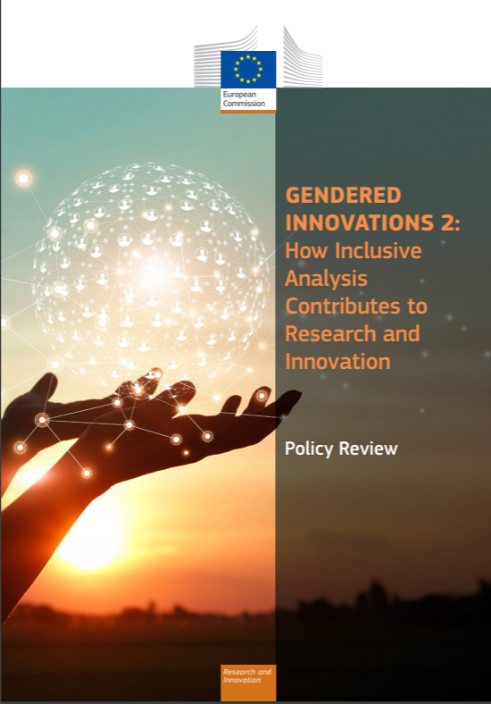
Gendered Innovations : How inclusive analysis contributes to research and innovation
15 new case studies in health, AI & robotics, climate change, energy, transport, urban planning, waste management, agriculture, taxation, venture funding) building on Horizon 2020 funded projects
Refined methodologies on the integration of sex/gender based analysis, and intersectional analysis, in R&I content
Evidence-based policy recommendations for Horizon Europe
Awareness raising material including factsheets
Case study on the impact of sex & gender in the COVID-19 pandemic
Factsheet on gender and intersectional bias in AI
Full Policy Review Report and Factsheet released on 25 November 2020
Interview of Commissioner Gabriel in KILDEN News (25/11/2020)
Nature editorial (09/12/2020)

Slide 16
Why do we need to integrate the gender dimension into R&I content?
  Every cell is sexed and every person is gendered
  Brings added value of research in terms of excellence, rigor, reproducibility, creativity and business opportunities
  Brings an in-depth understanding of all people’s needs, behaviours and attitudes
  Goods and services better suited to the needs of all citizens
  Enhanced societal relevance of research and innovation

Slide 17
Gender balance in research teams
Horizon Europe PROPOSAL RANKING CRITERIA

Slide 18
Ranking Criteria for ex aequo proposals
By order of priority
Aspects of the call that have not otherwise been covered by more highly ranked proposals
Scores on ‘Excellence’ then on ‘Impact’ (for IAs, scores on ‘Impact’ then ‘Excellence’)
Gender balance among personnel named in the proposal who will be primarily responsible for carrying out the research and/or innovation activities, and who are included in the researchers table in the proposal
Geographical diversity
…

Slide 19
Useful Resources
Horizon Europe

Slide 20
Factsheet on key Gender Equality provisions under Horizon Europe
https://op.europa.eu/en/web/eu-law-and-publications/publication-detail/-/publication/c0b30b4b-6ce2-11eb-aeb5-01aa75ed71a1

Slide 21
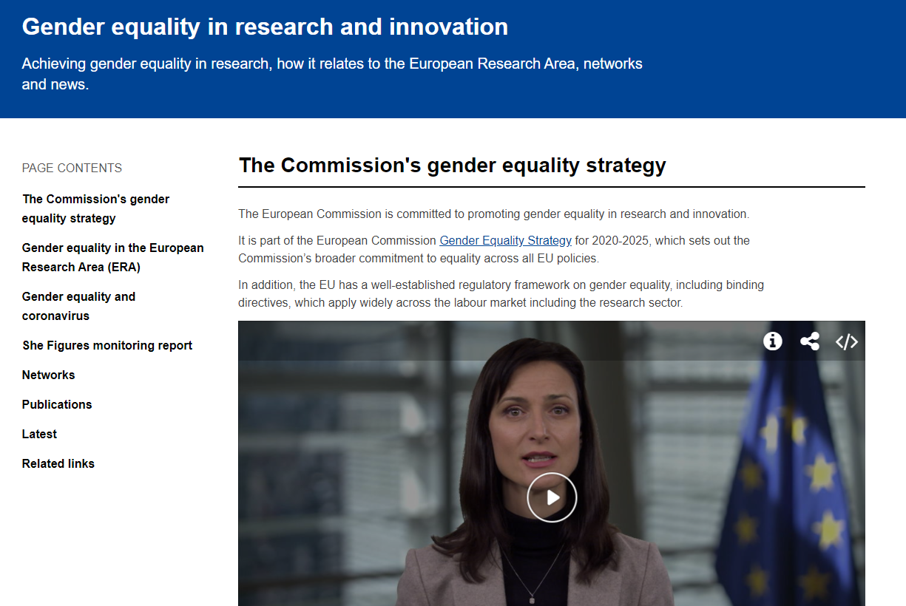

Gender Equality in R&I policy page
SCAN ME!
https://ec.europa.eu/info/research-and-innovation/strategy/gender-equality-research-and-innovation_en

Slide 22
Thank you!
For questions specific to the GEP eligibility criterion, please contact:
RTD-HORIZON-EU-GENDER-EQUALITY-PLAN@ec.europa.eu
For other questions and further information on gender equality provisions, please contact:
RTD-GENDERINRESEARCH@ec.europa.eu
#HorizonEU
http://ec.europa.eu/horizon-europe

