Slide 2
Communication, Dissemination, Exploitation and IP management in Horizon Europe

Slide 3
Starting point 1: Definitions…
Research Communities
MS, EU Policymakers
Research Roadmaps
Data
Policy Recommendations
Results:
Publications
Reports
Results’ means any tangible or intangible effect of the action, such as data, know-how or information, whatever its form or nature, whether or not it can be protected, as well as any rights attached to it, including intellectual property rights…
Project Results
Software
Platforms (Collaboration)
Key results are the outputs generated during the project which can be used and create impact, either by the project partners or by other stakeholders
Prototypes
Skills and Knowledge
Pre-Standards
Educational Materials
Project results can be reusable and exploitable (e.g. inventions, prototypes, services) as such, or elements (knowledge, technology, processes, networks) that have potential to contribute for further work on research or innovation
Codes of Conduct
Industry, Innovators
Civic Society, Citizens

Slide 4
…more definitions
Communication:
Taking strategic and targeted measures for promoting the action itself and its results to a multitude of audiences, including the media and the public, and possibly engaging in a two-way exchange
Reach out to society as a whole
Demonstrate how EU funding contributes to tackling societal challenges
Strategically planned with pertinent messages, right medium and means
Dissemination:
The public disclosure of the results by appropriate means, other than resulting from protecting or exploiting the results, including by scientific publications in any medium
Circulation of knowledge and results to the ones that can best make use of them
Enabling the value of results to be potentially wider than the original focus
Essential element of all good research practice and vital part of the project plan
Exploitation:
The use of results in further research and innovation activities, including among other things, commercial exploitation such as developing, creating, manufacturing and marketing a product or process, creating and providing a service, or in standardisation and policy making activities
Recognise exploitable results and their stakeholders, identify the value added from their use
Partners can exploit their results or let them being exploited by interested third parties

Slide 5
Starting point 2: Lessons learned from H2020 on D&E Why does it not always happen? From the side of the project/beneficiaries
Lack of skills (or interest)
to share results with society
D&E = Tick boxes, and not real work
Focus on implementation
vs. users’ needs
Lack of awareness on D&E opportunities (issues, solutions, market, etc.)
Not truly part of the project design from the start
Perceived as an “after-project” activity

Slide 6
Novelties of Horizon Europe on Dissemination & Exploitation (D&E)

Slide 7
Horizon Europe legal basis
Article 35 – Exploitation and Dissemination
“Each beneficiary that has received Union funding shall use its best efforts to exploit the results it owns, or to have them exploited by another legal entity. Exploitation may be direct by the beneficiaries or indirect in particular through the transfer and licensing of results in accordance with Article 40”
“Beneficiaries shall disseminate their results as soon as it is feasible, in a publicly available format, subject to any restrictions due to the protection of intellectual property, security rules or legitimate interests.”
Article 46 : Information, communication, publicity and dissemination and exploitation
Para 3: The Commission shall also establish a dissemination and exploitation strategy for increasing the availability and diffusion of the Programme’s research and innovation R&I results and knowledge to accelerate exploitation towards market uptake and boost the impact of the Programme.

Slide 8
What’s new in D&E under HE? Changes from H2020
D&E is part of the Key Impact Pathway to demonstrate the contribution to the impact on society
Improvements on the proposal/reporting template to introduce more specific language on D&E
Emphasis on continuous reporting on D&E (even after the end of the project)
Encouragement of third party exploitation (where appropriate)
Introduction of incentives for exploitation

Slide 9
D&E at proposal stage Under the Key Impact Pathway
D&E cuts across the overall project life cycle, from the proposal until after the end of the project
Applicants have to submit (unless Work Programme says otherwise) a short description of the D,E &C activities together with the impact pathways in their proposal
In Horizon Europe not a full fledged D&E plan is required at proposal stage, but a complete exploitation, dissemination and communication plan has to be submitted during the first 6 months of the project

Slide 10
Obligations of beneficiaries to exploit their results and the Horizon Results Platform
In Horizon Europe, as in H2020, the obligation to exploit remains and is a responsibility of the beneficiaries on a “best efforts” approach
When specified in the WP additional exploitation obligations could be applied
Horizon Europe encourages the use of the R&I results through third party exploitation (where appropriate)
If despite the best effort for exploitation no uptake happens within a specific period after the end of the project (1 year), then the project must use the Horizon Results Platform to make exploitable results visible (unless obligation is waived)
The Horizon Results Platform is free, is part of the F&T portal, available to all beneficiaries and is based on results, not on projects.
https://ec.europa.eu/info/funding-tenders/opportunities/portal/screen/opportunities/horizon-results-platform

Slide 11
Follow up of results after the end of the project Through the reporting tools
In Horizon Europe, the follow up of the exploitation activities will continue after the end of the project
The first year after the end of the project, and if no exploitation takes place, beneficiaries must use the Horizon Results Platform for making their exploitable results visible
For the following period there will probably be a structured questionnaire available to beneficiaries to report on the progress, their needs and obstacles on their path for exploitation
This questionnaire could be part of the EC grant management system and will remain open until the conclusion of the follow up period after the end of the project where a final report will be created

Slide 12
Elements to consider when drafting your Dissemination, Exploitation, Communication and IP management parts of your proposal

Slide 13
Measures to maximize: Dissemination & Exploitation
The proposal takes in to account the capacity and role of each consortium member, and the extent to which the consortium as a whole brings together the necessary expertise
Planned D&E measures to maximise the impact of projects
that are proportionate to the scale of the project
that contain concrete actions (i.e. stakeholders management, business and market actions, standardisation, spin-off, etc.) to be implemented both during and after the end of the project
planed according to draft timeline of when they will reach their own outcomes/impact both during and after the project
Target group (e.g. scientific community, end users, financial actors, public at large)
What is the proposed channel to interact with the target group?
What is the function of the proposed target group? How do they contribute to the maximisation of impact?
Follow-up plan to foster exploitation/uptake of the results
Policy feedback measures to contribute to policy shaping and supporting the implementation of new policy initiatives and decisions

Slide 14
Measures to maximize: Communication
Communication measures
Adequate to promote the project and its findings throughout the full lifespan of the project
Strategically planned with clear objectives
That clearly define the main message, tool(s) and channel(s) that will be used to reach out to target groups
To promote your project and its results beyond the projects own community
To communicate your research in a way that is understood by non-specialist, e.g. the media and the public
To inform EC in advance of communication activities expected to have a major media impact

Slide 15
Communication VS Dissemination
About the project and results
Multiple audiences Beyond the project's own community (include the media and the public)
Inform and reach out to society, show the benefits of research
About results only
Audiences that may use the results in their own work
e.g. peers (scientific or the project's own community), industry and other commercial actors, professional organisations, policymakers
Enable use and uptake of results

Slide 16
Dissemination VS Exploitation
Describe and make results visible
To audiences that may use the results
That may enable their use and uptake
Actual use of the results for scientific, societal, economic purposes or for policy making
All results generated during the project lifetime but also after its end

Slide 17
Management of intellectual property
Each Horizon Europe beneficiary shall use its best efforts to exploit the results it owns, or to have them exploited by another legal entity, in particular through the transfer and licensing of results. In this respect beneficiaries are required to adequately protect their results – if possible and justified – taking account of possible prospects for commercial exploitation and any other legitimate interest.
IP management in a proposal:
Does the proposal present a comprehensive and feasible strategy for the management of the intellectual property generated in the project, including protection measures (if relevant)?
Is the IP strategy commensurate with the described impact pathways to outcomes and impacts and therefore underpins the ‘credibility’ of these pathways?
Does it consider ‘freedom to operate’ regarding background owned by consortium members or third parties (if relevant)?
Does the IP approach give due thought to balancing between publication of results and plans to protect IP, e.g. in terms of timing the respective activities, involvement of IP experts?
If relevant (work programme), have additional exploitation obligations in relation to IP been considered?
The provision of a results ownership list (ROL) is mandatory at the end of the project.

Slide 18
The proposal template
Collects as much as possible structured data that can then be used for reporting purposes
Allows easier comparison between proposals (use of tables, charts, etc.)
Ensures links with EC and external data sources, and encourages the use of external single identification such as ORCID
Facilitates the clustering of projects from different parts of the programme by topic and policy area

Slide 19
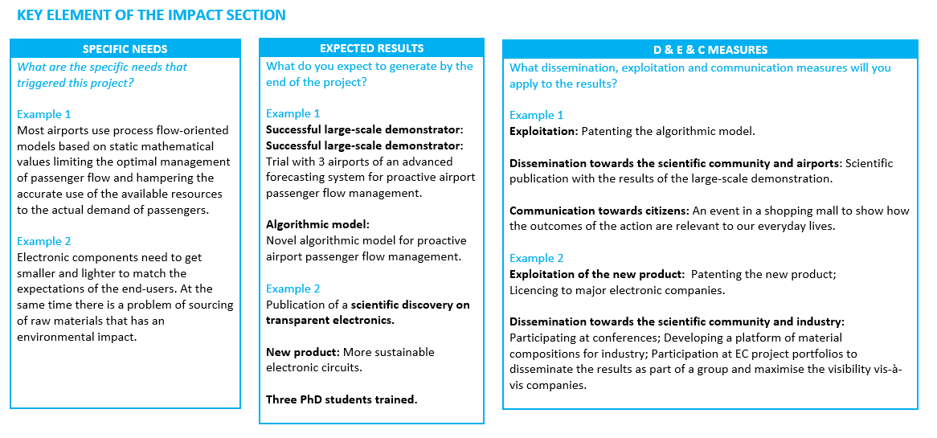
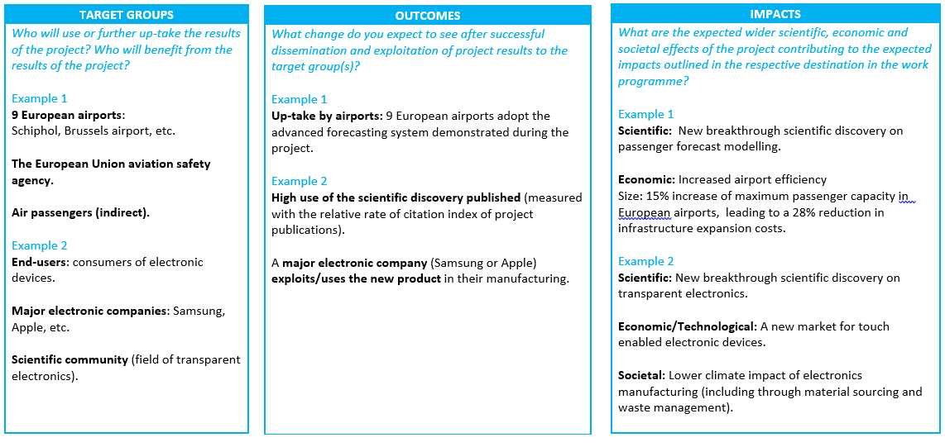
Proposal: The impact canvas new

Slide 20
Thank you!
# HorizonEU
http://ec.europa.eu/horizon-europe

