Slide 1
Liability, safety and new technologies
Felicia Stoica and Nike Bönnen
European Commission
DG Internal Market, Industry, Entrepreneurship and SMEs

Slide 2
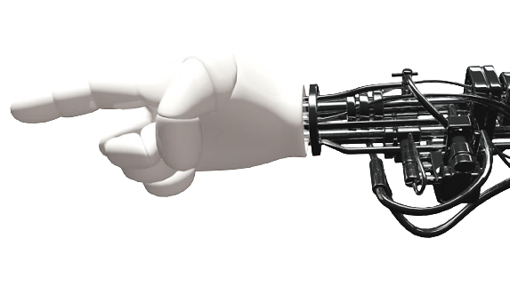
WHERE WE COME FROM (I)
Communication on Artificial Intelligence for Europe (COM(2018)237)
SWD Liabilities for emerging digital technologies (SWD(2018) 137)

Slide 3
WHERE WE COME FROM (II)
Staff Working Document on the evaluation of the Machinery Directive
(SWD(2018) 160 final)
Fifth report on the application of the Liability Directive for the period 2011-2016
(COM(2018) 246 final)
Staff Working Document on the evaluation of the Liability Directive
(SWD(2018) 157 final)

Slide 4
EU SAFETY FRAMEWORK FOR AI ROBOTS
Machinery Directive
Radio Equipment Directive
Medical Devices Directive
Key legislation for safety of robots (which are not medical devices).
Machinery in broad sense which includes:
Industrial collaborative robots;
Commercial and consumer service robots.
(i) the safety, (ii) the interoperability, (iii) the interconnectivity and (iv) the efficient use of the spectrum of radio equipment between 0 and 3000 GHz.
all robots to diagnose, prevent, monitor, treat, alleviate, compensate for and/or control a disease, injury, handicap, physiological process or conception.
EVALUATED IN 2018:
Check performance: relevance, coherence, efficiency, effectiveness, EU added value
Check suitability to emerging digital technologies
CAN BE ADAPTED TO:
ensure network compatibility
protect user privacy and the security of data
prevent fraud
provide access for the emergency services

Slide 5
PRINCIPLES OF THE EU SAFETY FRAMEWORK
Mandatory safety objectives
(essential health and safety requirements)
Voluntary use for harmonized standards published in OJEU
CE marking via choices of conformity assessment procedures:
Self-assessment by the manufacturer
Involvement of a notified body
Market Surveillance for enforcement

Slide 6
MACHINERY DIRECTIVE (2006/42/EC)
1989
1993
1998
2006
2009
2018
2021
Evaluation on performance
New revised legislation on machinery
Machinery Directive 89/392/EEC
Directive 93/68/EEC (amendment to MD)
Machinery Directive 98/37/EEC
Machinery Directive 2006/42/EC
Directive 2009/127/EC
(amendment to MD)
Conclusions of the evaluation
relevant to future developments in digitisation (EU new approach principles)
further analysis for new emerging digital technologies such as AI (e.g. transparency of algorithms, human-robot coexistance) and cybersecurity.
Next step - revision
launch an impact assessment study in January 2019
Commission's proposal for new legislation on safety of machinery/robots, possible in Q2 2021

Slide 7
LIABILITY FOR DEFECTIVE PRODUCTS (85/374/EEC)
The Directive
guarantees the liability without fault of the producer for damage caused by a defective product.
Defectiveness is assessed on legitimate safety expectations
facilitates the free movement of products and protects the consumers.

Slide 8
WHY AN EVALUATION OF THE LIABILITY DIRECTIVE?
The Directive dates from 1985 and has never been evaluated.
We assessed its functioning and performance also vis-à-vis new technological developments.
Stakeholders have been widely consulted during the process (open public consultation, surveys and a conference on 20 October 2017).

Slide 9
FINDINGS (I)
Product Liability and safety are complentary tools for the functioning of the Single Market for Goods.
Until now, there are limited to no empirical cases related to damages caused by smart products
Despite a lack of evidence, open questions on the complexity and autonomy of emerging digital technologies are raised

Slide 10
FINDINGS (II)
Do some concepts and rules need clarification?
product
producer
defectiveness
burden of proof
Consensus on the need to pursue the reflection

Slide 11
Expert Group on Liability and New Technologies
Product Liability formation: Member States, stakeholders and independent experts
Assist the Commission in drawing up guidance on the Product Liability Directive
New technologies formation: independent experts
Assess national frameworks for liability

Slide 12
NEXT STEPS
Mid 2019:
Guidance on Product Liability Directive
Report on broader implications for, and potential gaps in and orientations for, the liability and safety frameworks for AI, Internet of Things and robotics

Slide 13
Thank you!

