Slide 1
Training course Air Quality and Health Methods, Tools and Practices for Better Air Quality Action Planning
Contents:
The challenge vs the opportunity
The experience of the Urban Agenda (UA) Partnership on Air Quality
The results ready for uptake and further development
The approach to knowledge exchange
The structure of this training

Slide 2
The air we breath: 400.000 premature deaths
1. The challenge vs. The opportunity

Slide 3
Air Quality is a multi-level issue
1. The challenge vs. The opportunity
Source: Own elaboration on the basis of Urban PM2.5 Atlas. Air Quality in European cities, P. Thunis et al (JRC), 2017, ISBN 9789279738753

Slide 4
A lot has been achieved with EU and national legislation...
1. The challenge vs. The opportunity
Air Quality has improved substantially over the last decades.
A fundamental pillar of the EU Clean Air policy framework is Directive 2008/50/EC and Directive 2004/107/EC, the so-called Ambient Air Quality Directives.
Such framework is completed by the new Directive 2016/2284 (NEC Directive), which will help deliver cleaner air throughout the EU by 2030. It introduces ‘NERCs’ – National Emission Reduction Commitments – which are set for both 2020 and 2030.
For most Member States, PM_{2.5} and ammonia are the pollutants which will require most additional efforts by 2030. New measures addressing agriculture and domestic heating will be particularly important to drive PM_{2.5} and ammonia reductions. Other pollutants (NO_{x}, SO₂, VOCs,) will also have to be reduced, but these reductions are expected to be largely driven by already existing legislation.
Overall, the health impact of air pollution is expected to be halved by 2030, compared to 2005 levels.

Slide 5
...however, more needs to be done...
1. The challenge vs. The opportunity
Even after full implementation of the NEC Directive, close to 250,000 Europeans are still expected to die prematurely because of air pollution in 2030.
Due to the very weak 2020 limits and the absence of mandatory limits for 2025, the new NEC Directive is expected to deliver very little additional progress by 2020 and 2025.
To effectively protect their population and environment against the harmful effects of air pollution, Member States must look beyond the NEC Directive’s 2030 National Emission Reduction Commitments (NERCs) and aim at meeting the health standards recommended by the WHO.
The European Commission will also have to reassess its policies with the aim of improving air quality further.

Slide 6
The opportunity offered by a threefold approach
1. The challenge vs. The opportunity
Air quality is one of the twelve priority themes of the ‘Urban Agenda for the EU’.
The Partnership (with active participation of Member States, cities and other stakeholders) recognised that more needs to be done, as the mere compliance to EU limit values – although fundamental – will not by itself ensure reaching the WHO recommended health targets.
Therefore, the Partners decided to focus on ‘The Healthy City’ as a shared vision to address that emerging challenge through:
Alignment between EU limit values and WHO recommended health standards,
Better integration of air quality measures with measures from other relevant policy sectors (mobility, energy, climate, agriculture, rural, regional and urban development, etc),
Multi-governance level approach, based on close cooperation between different governance levels (local, regional, national, European) on air quality issues.

Slide 7
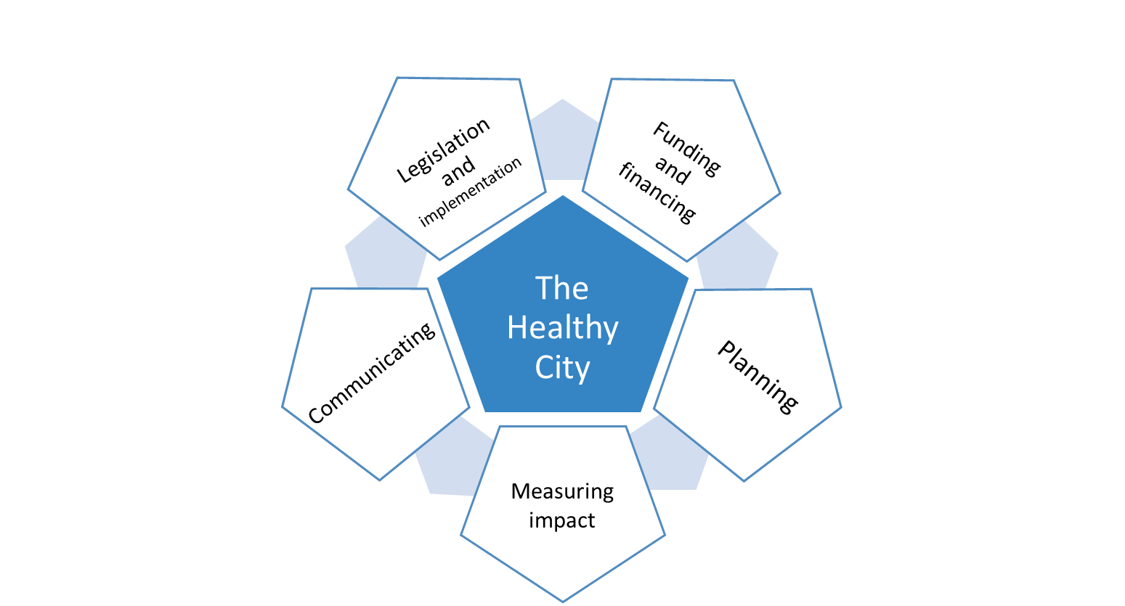
The shared vision of the Partnership on Air Quality
1. The challenge vs. The opportunity

Slide 8
Who are we?
2. The experience of the UA Partnership on Air Quality
4 Member States: The Netherlands (coordinator), Croatia, Czech Republic, Poland
6 cities: Helsinki/HSY (Helsinki Region Environmental Services Authority) (FI), Greater London Authority (UK), Utrecht (NL), Milano (IT), Constanta (RO), and Duisburg (DE, representing the Consortium Clean Air Ruhr Area)
2 stakeholders: EUROCITIES, HEAL (Health and Environment Alliance)
2 observers: The European Commission (DG REGIO, DG ENV, DG RTD, DG JRC, DG AGRI, DG GROW) and URBACT

Slide 9
Main milestones:
2. The experience of the UA Partnership on Air Quality
2015.12
UA Partnership on Air Quality setup
2016.05
1st Action Plan launched
2017.11
2nd Action Plan launched
2019.02
2nd Action Plan fully delivered
NOW!
Dissemination of results and facilitation of uptake
2017.07
1st Action Plan fully delivered

Slide 10
What specific issues have we addressed?
2. The experience of the UA Partnership on Air Quality
What are the gaps in regulation and implementation on air pollutant emission sources and what possible solutions are available?
How can we combine focus on EU limit values and health improvement?
How can we improve planning of cities air quality measures?
How can we develop an appropriate business model to fund air quality measures?
How can we better measure the impact of urban planning on citizens’ health and living environments?
How can we improve communication and citizens’ awareness-raising campaigns on air quality?

Slide 11
What outputs has the Partnership delivered?
3. The results ready for uptake and further development
An integrated suite of tools to make the vision of The Healthy City a reality:
A Political statement (position paper) embedding the vision of The Healthy City into the ongoing Fitness Check of EU Ambient Air Quality Directives
A Code of Good Practice for Cities’ Air Quality Plans
A Guidance document on Financing Air Quality Plans for cities and local authorities
A Health Impact Assessment tool
A Communication toolkit to better inform and engage citizens and stakeholders on air quality

Slide 12
Position Paper (1/2)
3. The results ready for uptake and further development
Currently, EU ambient air quality legislation directs Member states and cities towards a focus on meeting air quality limit values. The Partnership would like to see this approach complemented by a focus on health improvement.
There is a need for co-operation at all levels of authority, including for exchange of knowledge and experience.
The current EU legislation is lacking in certain areas, including regulation of increasingly relevant emission sources, such as automotive brake and tyre wear and consideration of pollutants such as PAHs, ultrafine particles and black carbon.
A consideration of emissions under realistic future use scenarios is essential in designing effective measures from both cost and health perspectives.
The impact on air quality and health should be evaluated at the early stages of any activity that may have a negative impact on either one.
Measures to reduce the negative impact on air quality are often more effective and less burdensome when introduced early in the process and the Partnership recommends a precautionary approach where necessary.

Slide 13
Position Paper (2/2)
3. The results ready for uptake and further development
Signed by:
The Netherlands
Croatia
Czech Republic
Poland
Constanta (RO)
Duisburg (DE)/Consortium Clean Air Ruhr Area
Greater London Authority (UK)
Helsinki/HSY (FI)
Milan (IT)
Utrecht (NL)
EUROCITIES
HEAL

Slide 14
Code of Good Practice for Cities’ Air Quality Plans
3. The results ready for uptake and further development
Based on the analysis of more than 30 Cities Air Quality Plans and Strategies, including the Partners’
Clear 360° explanation of processes to better develop, manage and implement Cities Air Quality Plans
Useful guidance for a consistent interpretation of the content listed under Annex XV, Section A of Directive 2008/50/EU on ambient air quality and cleaner air for Europe
Rich collection of best practices of Air Quality Plans
Description of success factors for Air Quality measures design, selection and implementation
Tailored recommendations for overall improved Air Quality planning

Slide 15
Financing Air Quality Plans – guidance for cities and local authorities
3. The results ready for uptake and further development
Developed in cooperation with the European Investment Bank, leveraging the Partners’ experiences
For the main actors at EU, national, regional, metropolitan and urban level
Supporting tool to identify, integrate and improve traditional and innovative financing schemes dedicated to the implementation of air quality measures
Recommendations for improving the targeting of existing funding instruments on air quality and promoting better accessibility to funds
Opportunities to leverage the involvement of both private and public financial resources highlighted
Examples of how a multi-city financial instrument providing standardised solutions and delivery models could be a viable solution to support the achievement of urban air quality objectives.

Slide 16
The health impact assessment tool (PAQ2018)
3. The results ready for uptake and further development
Developed in cooperation with the Netherlands National Institute for Public Health and the Environment (RIVM), Utrecht University, and the World Health Organization (WHO)
Science-based
User-friendly
Calculations based on information/data which are/or can be easily available for cities
Produces objective results to support decision-making by calculating the health benefit of a certain measure
Assesses health benefit/loss of a change in air quality.
It also calculates the health impact of one or several pollutants at one moment in time.
Already applied in Utrecht (NL)

Slide 17
The toolkit - Communicating on air quality and health.
3. The results ready for uptake and further development
Leveraged on experience from 66 local authorities from 13 EU countries
Helps cities and clean air stakeholders strengthen communication and awareness raising efforts
Analysis of stumbling blocks and challenges limiting effective communication on air quality
Rich collection of hands-on practices, tools and approaches to
increase public awareness about health benefits of clean air
improving social acceptance of and support for air quality management measures
Inspiring snapshot on how communication on air quality, the health links and (policy and behavioural) changes takes places
Methodological guidelines, practical tips and lessons learnt to improve communication on clear air.

Slide 18
What results has the Partnership produced?
3. The results ready for uptake and further development
The Partnership’s holistic vision on ‘The Healthy City’ taken into account in future policy-making on air quality at EU, National, Regional and Local level
Cities Air Quality Action-planning made easier and improved across the EU
Access for financial resources made easier for cities to invest in air quality measures
Assessment of impacts on human health and environment embedded in urban planning
Citizens’ understanding and support for air quality measures increased
Air Quality & Health top priority in political agenda at EU, National, regional and local levels.

Slide 19
4. The approach to knowledge exchange
Partners’ collective knowledge refined and codified
Hands-on, problem-solving approach embedded into the Partnership’s work
Tools designed, tailored and tested directly by Partners during 3-years
Solutions ready to be shared with, customized and taken up by other stakeholders (cities, regions, member states)
Highly interactive training modules, based on co-design and facilitation for accelerated learning and engagement.

Slide 20
4. The approach to knowledge exchange

Slide 21
5. The structure of this training
Introduction
Module 1 – Legislation and implementation
Module 2 – Public funding and financing
Module 3 – Planning
Module 4 – Measuring impact
Module 5 – Communicating and raising awareness
Integration of modules’ outcomes
Conclusion
Post-training feedback

Slide 22
Thank you for your attention!
…….@.......
https://ec.europa.eu/futurium/en/air-quality
@......

