Slide 1
Women in science, technology and research
Eurostat Webinar
March 6, 2023

Slide 2
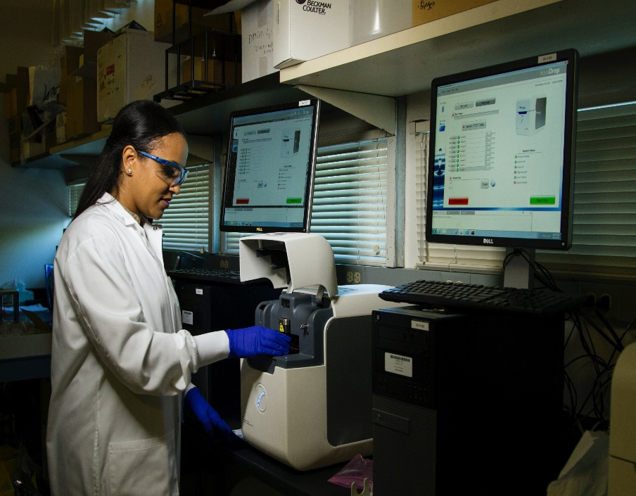

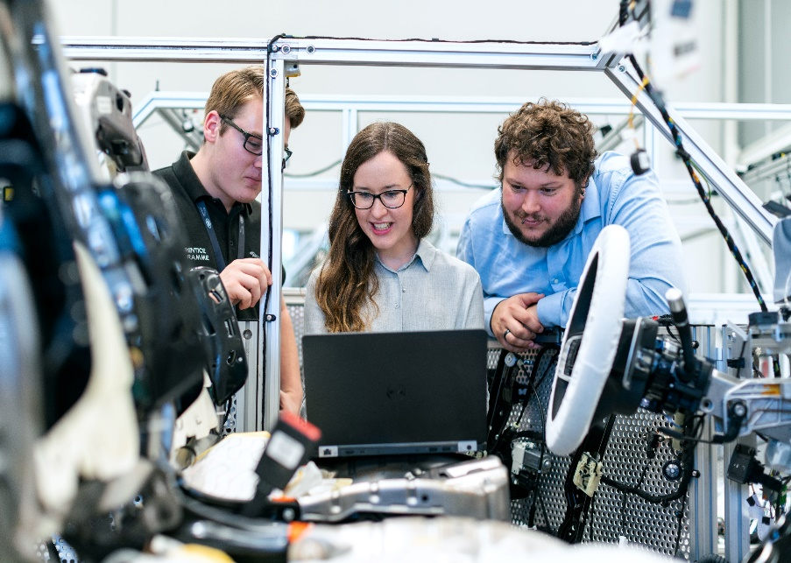
Are women and men represented equally in S&T and research in the EU?
HR in the science and technology
High technology and knowledge-intensive sectors
Research and Development (R&D)

Slide 3
Human resources in science and technology

Slide 4

Human resources in S&T - Definition
Persons having tertiary education
People having tertiary education and working in S&T
Education
Persons having tertiary education and/or working in S&T
People working in S&T
Scientists and Engineers
Occupation

Slide 5
Human resources in S&T in EU - Overview
YEAR: 2021
47% 53%
99 M
50%
50%
239 M
46%
54%
79 M
68M
47M
48%
52%M
46%
54%M
EU POPULATION 25-64 Years
16M
60%
40%
Men
Women

Slide 6
Human resources in S&T in EU- Evolution over time

Slide 7
Human resources in S&T in EU- Evolution over time

Slide 8
Human resources in S&T in EU - Scientists and engineers

Slide 9
Human resources in S&T in EU – Unemployment rate
Notes:
One final relevant graph from the data we can found in Eurostat website about Human resources in science and technology is looking at the unemployment rate relative to the studies of the population.
In this graph we look at the unemployment of men and women having a tertiary education, in comparison with unemployment of men and women not having a tertiary education.
We can see that in the last 20 years, the unemployment of men has remained lower than the one for women when we are talking about people holding a tertiary education degree. We can also see that during this whole period, the unemployment for both men and women holding a tertiary education degree has been substantially lower than the one for people not holding a tertiary education degree.
We can see that in the last 10 years (between 2011 to 2021), the unemployment rate of women holding a tertiary education degree went down by 0.9 percent while in the same period the unemployment for men holding the same level of education went down by 0.7 percent.

Slide 10
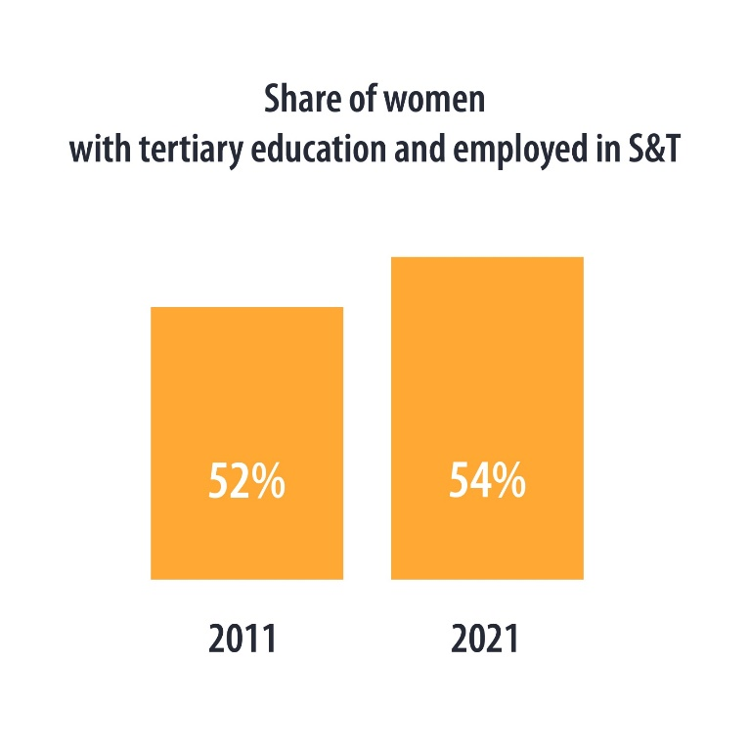
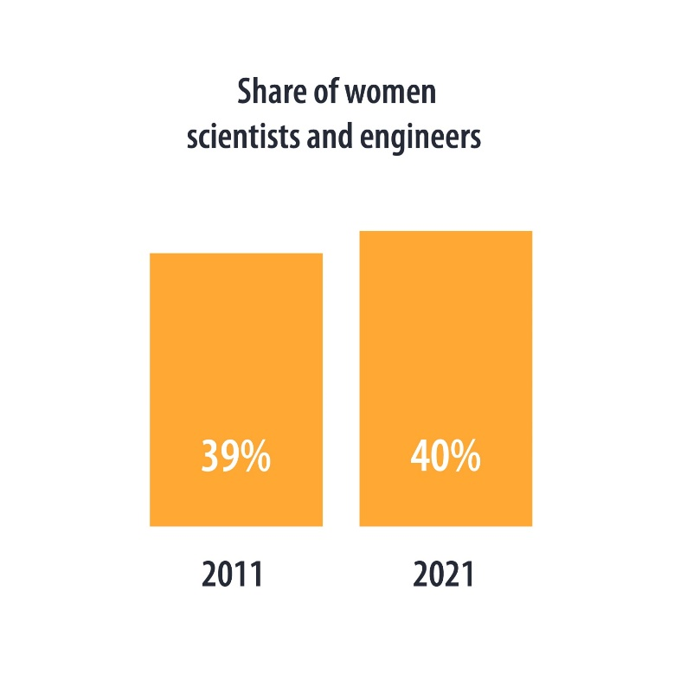
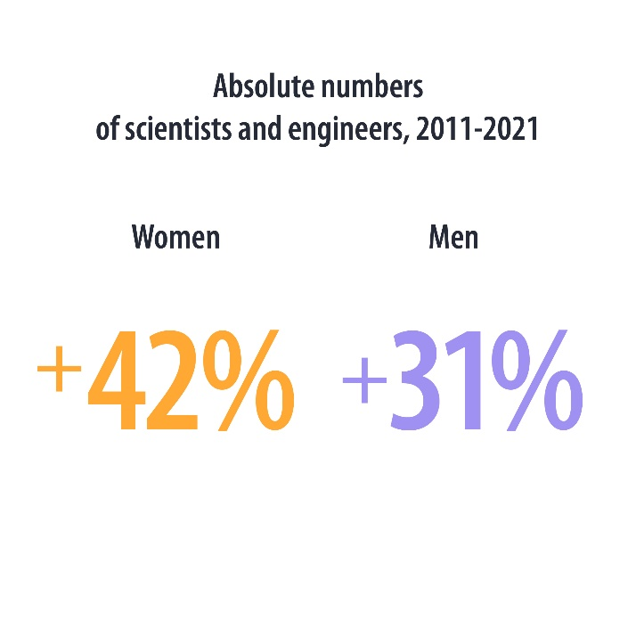
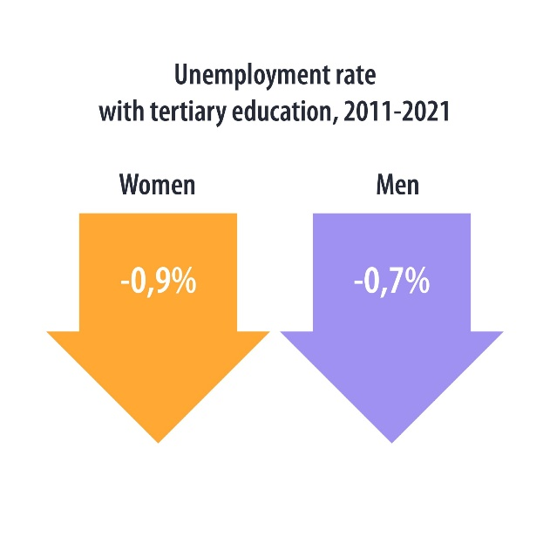
HR in S&T in EU - Women in S&T 2011 vs 2021

Slide 11

Thank you
© European Union 2020
Unless otherwise noted the reuse of this presentation is authorised under the CC BY 4.0 license. For any use or reproduction of elements that are not owned by the EU, permission may need to be sought directly from the respective right holders.
Slide xx: element concerned, source: e.g. Fotolia.com; Slide xx: element concerned, source: e.g. iStock.com

