Slide 1
Energy mix and energy dependency of the European Union
March 11, 2022
Eurostat Webinar

Slide 2
Contents
Energy mix of the EU
EU energy production and consumption
Import dependency of the EU
EU's energy dependency on Russia
Natural gas
Oil
Coal

Slide 3
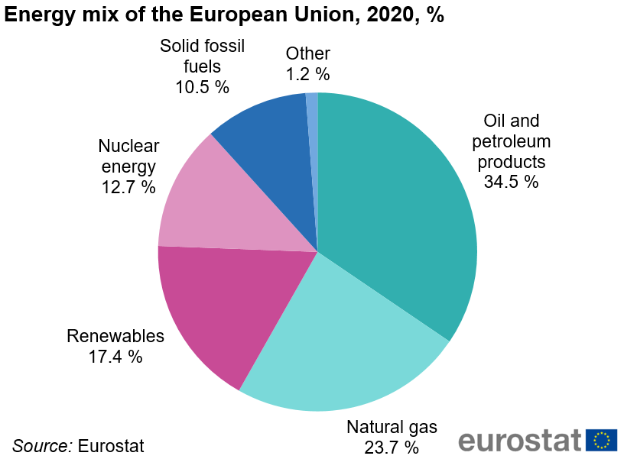
Energy mix of the EU
3

Slide 4
Energy production and consumption in the EU

Slide 5
Import dependency of the EU
EU has become increasingly dependent on energy imports
In 2020, the EU imported 57.5% of the energy it consumed
Policy concerns relating to the security of energy supply

Slide 6
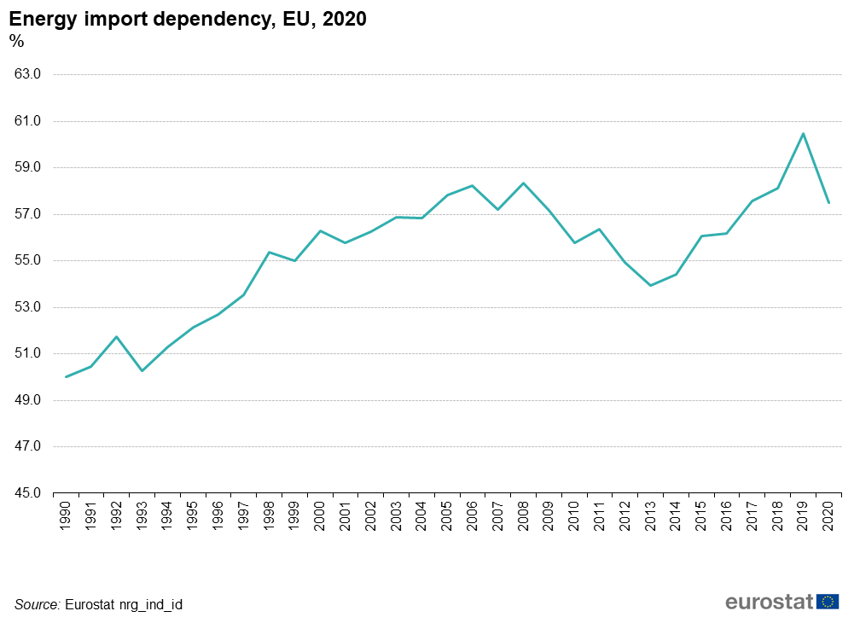
Import dependency of the EU

Slide 7
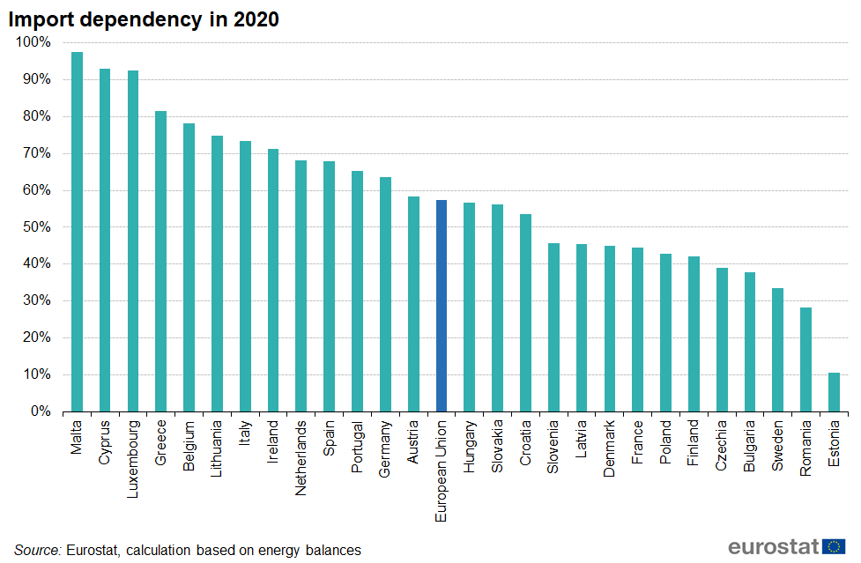
Import dependency of the EU
Since 2013 all 27 Member States of the EU have been net importers of energy

Slide 8
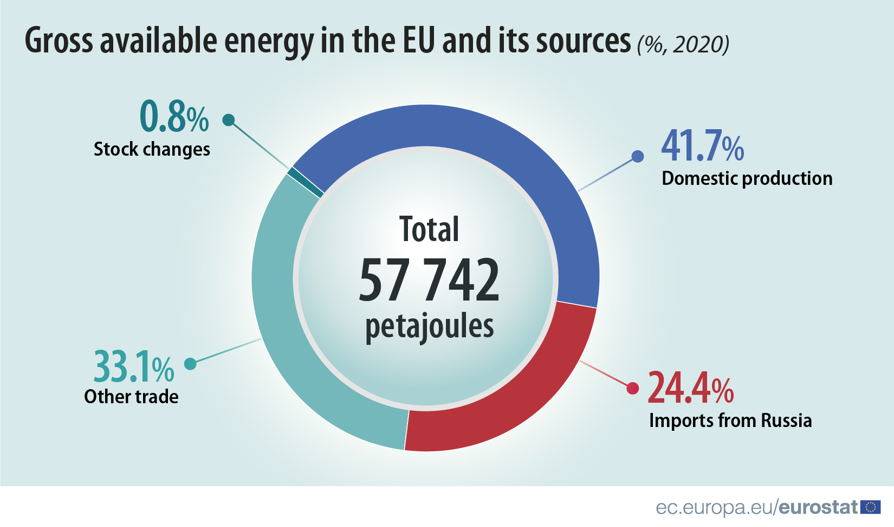
EU's energy dependency on Russia
The EU depends on Russia for 24.4% of all its energy needs.

Slide 9
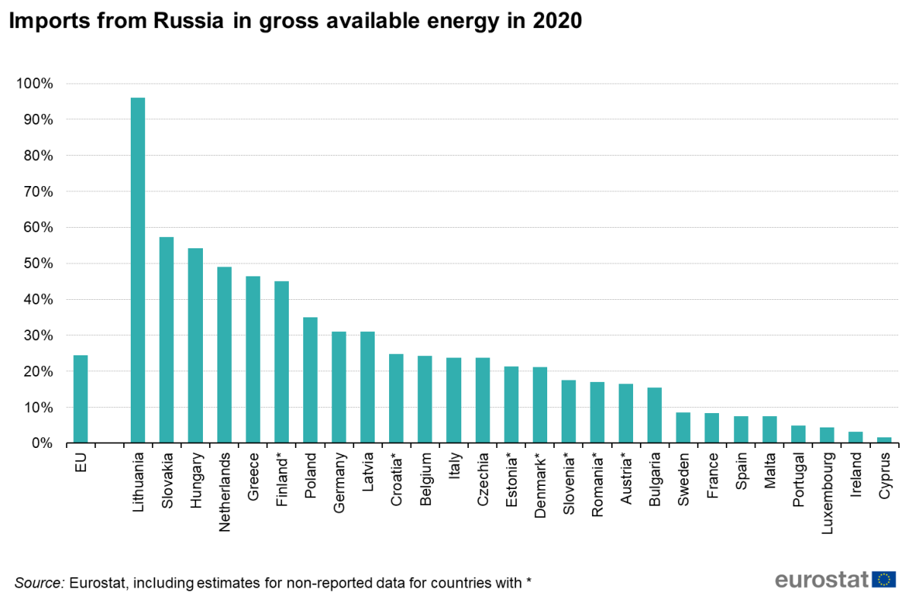
EU's energy dependency on Russia
Vastly different country-specific energy dependencies on Russia

Slide 10
Natural gas
A major fuel for electricity production and heating in the EU
Covers 23.7% of the EU's energy needs
Import dependency rate of 83.6% in 2020
Consumption broadly flat over last decade (bcm: billion cubic meters):
399.6 bcm in 2020 vs. 409.3 bcm in 2011
Production fell 60% in same period:
55.7 bcm in 2020 vs. 139.0 bcm in 2011

Slide 11
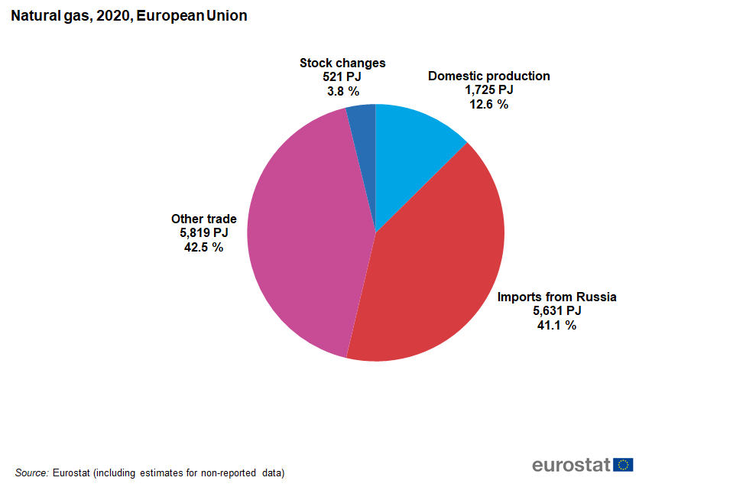

Slide 12
Natural gas
Gap growing during the last decade between consumption and production largely filled by increased imports
Imports concentrated among relatively few providers in 2020:
Roughly two thirds of natural gas imports from top 3 suppliers:
Russia, Norway, Algeria
About 90% from top 8 suppliers:
Russia, Norway, Algeria, Qatar, USA, UK, Nigeria, Libya

Slide 13
Natural gas
Russia is the single largest natural gas provider (including liquified natural gas or LNG) to the EU representing in 2020:
46.1% of total net natural gas imports¹
41.1% of EU natural gas needs
9.8% of EU’s total energy needs²
Natural gas has the highest exposure to Russia of all fuels
1 Imports from Russia in all imports of natural gas into EU27 (excluding intra-EU imports)
2 Expressed as share of Russian natural gas imports to total gross available energy

Slide 14
Oil
Decrease in consumption from the peak of two decades ago
Crude oil and petroleum products still hold the largest share in the EU energy mix: 34.5% in 2020
Production of crude oil: reached the lowest point at 18.7 Mt
Crude oil import dependency increased to 96.2%
Production of petroleum products: 504.8 Mtoe
Final consumption: 384.0 Mtoe, the lowest level ever recorded
Import dependency for crude oil and petroleum products, record high: 97.0%

Slide 15
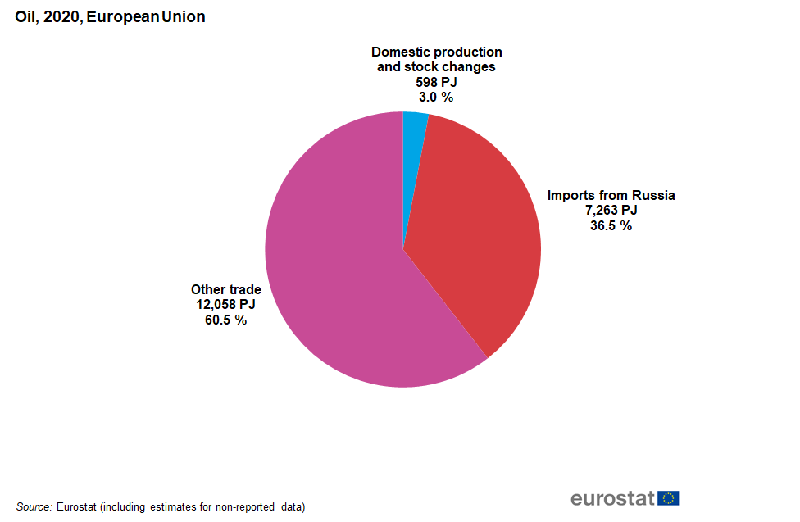

Slide 16
Oil
Russia: the world’s third largest oil producer and among the main exporters
In 2020, the EU relied on Russia for 25.7% of its crude oil imports (440.3 Mt)
Imports from Russia declined but remain the highest
Other main suppliers: Norway (8.7%), Kazakhstan (8.5%), USA (8.1%) and Saudi Arabia (7.9%)
Imports of oil from Russia satisfied 36.5% of the EU energy needs of oil and 12.6% of all total EU energy needs.
Dependency on Russian oil decreasing over the last five years
Oil fuel family has the second highest exposure to Russia after gas

Slide 17
Coal
Solid fossil fuels in 2020
Small share of the EU energy mix: 10.5%; import dependency rate: 34.8%
This number accounts for all solid fossil fuels
The most import-dependent solid fossil fuel is hard coal (import dependency rate in 2020: 57.4%)
From 1990 to 2020 hard coal production decreased faster than consumption, gap filled by imports
Notes:
Hard coal import dependency rate: 57.4%
Be careful – there is also intra-EU trade (Poland exports hard coal to other EU countries) and hard coal coming from stocks (Germany, Spain)

Slide 18
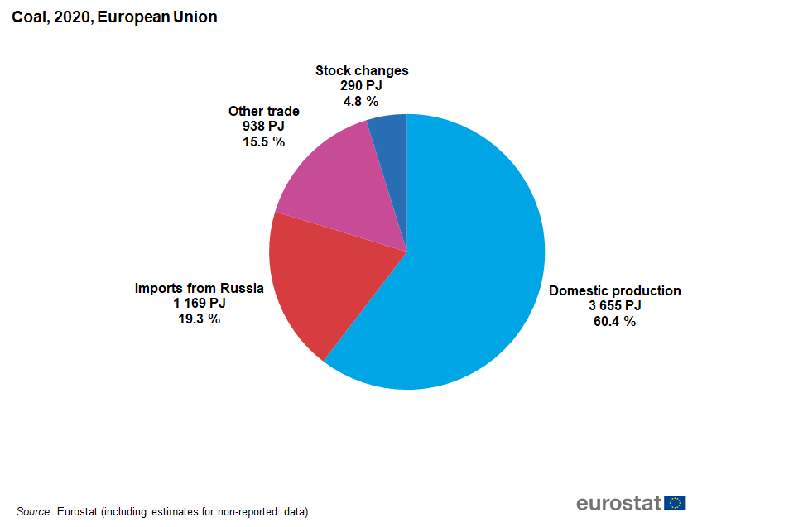
Notes:
Unlike lignite which is produced and used in a few EU countries, hard coal is used in every EU country except Malta.

Slide 19
Coal
In 2020, 52.7% of EU's hard coal imports from Russia
Share of Russia in imports of hard coal increased in the 2010s
Other main suppliers: the United States (17.5% of hard coal imports in 2020) and Australia (15.8%)
30.3% of EU's hard coal consumption covered by imports from Russia
2.0% of EU's total energy needs

Slide 20
Thank you
© European Union 2020
Unless otherwise noted the reuse of this presentation is authorised under the CC BY 4.0 license. For any use or reproduction of elements that are not owned by the EU, permission may need to be sought directly from the respective right holders.
Notes:
Update/add/delete parts of the copy right notice where appropriate.
More information: https://myintracomm.ec.europa.eu/corp/intellectual-property/Documents/2019_Reuse-guidelines%28CC-BY%29.pdf

