Slide 1
Common Monitoring and Evaluation System for Rural Development 2014-2020
EvaluationWORKS! 2015

Slide 2
Key messages
In this programming period there are common provisions on monitoring and evaluation.
A proactive approach to monitoring and evaluation is required.
There is a Common Monitoring and Evaluation System (CMES) that is part of the Common Monitoring and Evaluation Framework (CMEF)

Slide 3
Common provisions on M&E
Regulation (EU) No 1303/2013 – Common Provisions Regulation for all ESI Funds
General provisions on Monitoring Committees, progress reports for programmes and partnership agreements (Art. 47-53)
General provisions on evaluation (evaluation plan, ex ante , ex post– Art. 54-57) :
Provision of resources
Procedures for data collection
Independence of evaluation
Evaluations on the basis of the evaluation plan
§§§

Slide 4
What is the CMEF?
Who does what:
CAP and Pillar I evaluations responsibility of EC
Pillar II evaluations responsibility of MS
EU level synthesis responsibility of the EC
Regulation (EU) No 1306/2013 – CAP Horizontal Regulation
The CMEF covers both CAP Pillars (art. 110):
Pillar I (direct payments, market measures, horizontal instruments)
Pillar II (rural development measures)
The CMEF aims to assess impacts in relation to all 3 CAP objectives:
viable food production
sustainable management of natural resources and climate action
balanced territorial development

Slide 5
What is the CMES?
What is new:
Planning,
Flexibility
New ways of reporting
focus on results and impacts
Better in capturing policy effects
Regulation (EU) No 1305/2013, Art. 67
Single framework and ground for M&E in rural development within the CAP
Continuity and adaptation of the CMEF of RD 2007 – 2013 to:
Ensure:
common understanding on M&E among rural development stakeholders and
comparabilty of evaluation results in assessing RD interventions accross the EU
Help various audiences, such as CAP stakeholders in the MS, MA, PA, MC, evaluators and EC Desk Officers to:
organise, design and implement the evaluation of RD interventions
report, communicate and disseminate evaluation results and feed them back into policy cycle

Slide 6
CMES as part of CMEF
CAP Common Monitoring and Evaluation Framework (1306/2013, Art. 110)
Common Monitoring and Evaluation System
(1305/2013, Art. 67 and 808/2014. Art.14)
Pillar I specific elements
Common elements
Pillar II specific elements
Common context indicators
Common evaluation
questions
RD priorities/specific
Objectives Pillar II measures
Pillar I specific objectives
Pillar I instruments
Intervention logic:
Overall CAP policy objectives
Common impacts
Pillar II result /target indicators
Pillar II output indicators
Performance framework
Pillar I result indicators
Pillar I output indicators
Common impact indicators
Data sources
Operations database
Responsibility
for evaluation: DG AGRI
Responsibility
for evaluation: MAs

Slide 7
Why is the CMES useful in the evaluation of RDPs Regulation (EU) 1305/2013
The CMES helps you to understand better...
Purpose of evaluation
Evaluation content
Evaluation process
Enables judgment
on RD interventions
according to their results
and impacts
Provides evidence
for decision making,
improves effectiveness,
efficiency and relevance
of RD interventions
Contributes to transparency,
learning and accountability
of RD policy
Provides the framework and
guidance for assessment of:
→ RDP results and impacts
→ contributions to achievement
of RD and CAP objectives
→ effectiveness, efficiency and
relevance of RD interventions
→ synergies among priorities
and focus areas towards
effectiveness of RDP
Facilitates:
→ Planning and implementing
the evaluation, including data
collection and processing
→ Reporting and
communicating evaluation
results
Defines actors/responsibilities
and procedures in evaluation

Slide 8
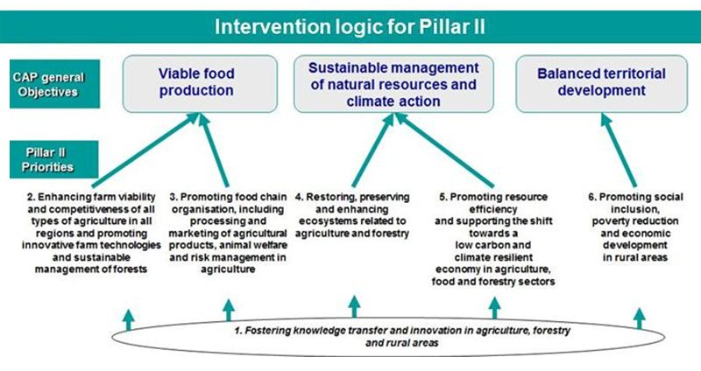
Elements of the CMES (1) (Reg.808/2014, Art. 14.1)
Intervention logic showing interactions between priorities, focus areas and measures;
Common context (including RD related impact indicators), result/target, output indicators and performance review indicators;
Common evaluation questions.
Fiches for common context, impact, result/target and
output indicator
Guidance on use and establishment of proxy indicators
Guidance on the Indicator Plan
Guidance on performance review and reserve
CEQ related to:
→focus areas of RD priorities (18 CEQs)
→other aspect of RDP (RDP synergies and TA) (3 CEQs)
→Union level objectives (9 CEQs)

Slide 9
Elements of the CMES (2) (Reg.808/2014, Art. 14.1)
Common data sources: FADN, Eurostat, others
(updated tables for CCI), II, RI.
Operations database and electronic transmission of
monitoring data (OI)
Data collection, storage and transmission
Reporting on monitoring and evaluation activities
Evaluation plan
Ex ante, AIR 2017 and 2019 and ex post evaluation
Support to actors in M&E to fulfil their obligations
Guidance on monitoring covering elements included
in the AIR
Guidance on the Evaluation Plan preparation
and implementation
Guidance on the ex ante evaluation of RDP 2014-2020
Other guidance documents 2014-2020

Slide 10
More detail on
The intervention logic

Slide 11
More detail on
The Evaluation Plan
New element of the CMES in this programming period
Mandatory component of RDPs
Prepared at RDP design stage and progress reported in AIRs
A tool for MAs to plan evaluation activities
MA responsible for drafting the EP
Standard content of EP: objectives, governance, evaluation topics and activities, data and information, timeline, communication, resources

Slide 12
More detail on
Can be complemented with programme specific indicators
Indicators for RD
Common output indicators: activities directly realised by interventions
Target indicators for rural development: they set targets at FA level, they measure general contextual trends
Common RD result indicators and complementary result indicators: direct and immediate effect of interventions
Common context indicators, including RD related impact indicators: outcome of intervention beyond immediate effects
Performance framework indicators: for setting performance milestones and targets

Slide 13
More detail on
Common evaluation questions
Focus area related (18 EQs)
Related to other aspects of the RDP (synergies, technical assistance, NRN – 3 EQs)
Related to Union level priorities (e.g. employment, climate change, biodiversity - 9 EQs)
Can be complemented with programme specific evaluation questions

Slide 14
More detail on
Data collection, storage and transmission
Established sources of data, e.g. Farm Accountancy Data Network, Eurostat.
There are information sheets/fiches for each indicator.
For rural development, the main source is the operations database (stores data items at project level)
For CRI, source of information is the evaluation activity
Electronic transmission of data via standard templates
Standardised and electronic process should lead to time savings for data validation and correction

Slide 15
More detail on
Reporting on M&E activities
Regular reporting via Annual Implementation Reports (as from 2016)
Enhanced AIRs to be submitted in 2017 and 2019
Quantification of programme achievements (2017, 2019)
Progress towards objectives of RDP (2017, 2019)
Contribution to Union objectives (2019)
Contribution to changes in CAP impact indicator values (2019)

Slide 16
More detail on
Evaluations
Ex ante evaluation (in parallel to RDP design)
AIR 2017
AIR 2019
Ex post evaluation (by end of 2024)

Slide 17
More detail on
European support to actors in M&E to fulfil their obligations
Guidance documents
Training/information workshops/seminars
Evaluation Helpdesk
Expert Groups
Interaction with DG AGRI

Slide 18
CMES and LEADER
The MA…
LAGs…
NRNs…
Shall include in the EP the evaluation activities to assess the contribution of LDS and the planned support for evaluation at LAG level
Shall provide LAGs with guidance on their monitoring and evaluation tasks and support in implementing them
May also cover aspects not mentioned in the CMES such as the added value of LEADER
Shall include in their LDS a description of M&E arrangements
Shall carry out specific evaluation activities of their strategy
Shall provide MA and evaluators all necessary information for M&E of the RDP
May also develop specific evaluation questions and specific indicators for their LDS
Shall organize training/capacity building for LAGs
Shall share and disseminate LAG M&E findings
May also take a more proactive role in developing and supporting a harmonized approach to the M&E of LDS

Slide 19
Thank you for your attention!
European Evaluation Helpdesk for Rural Development
Boulevard Saint Michel 77-79
B-1040 Brussels
Tel. +32 2 7375130
E-mail info@ruralevaluation.eu
http://enrd.ec.europa.eu/evaluation

