Slide 1
This project has received funding from the European Union’s Horizon 2020 research and innovation programme under
grant agreement No 652601

Slide 2
ISIB-02-2014
Closing the research and innovation divide: the
crucial role of innovation support services and knowledge exchange
What are the main objectives
of ISIB-02-2014 ?

Slide 3
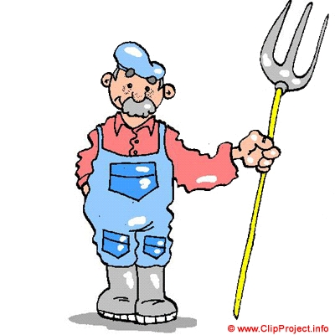
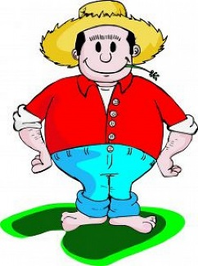
ISIB-02-2014
Two Mean Ideas
1
End-users are ill-informed or too slowly informed about research results
Academic Research
“Improved flow of information and knowledge between academia and practitioners”
Introduction
2
Some innovations coming from the field could be better shared
“Increased exchanges between European regions on innovative matters”

Slide 4
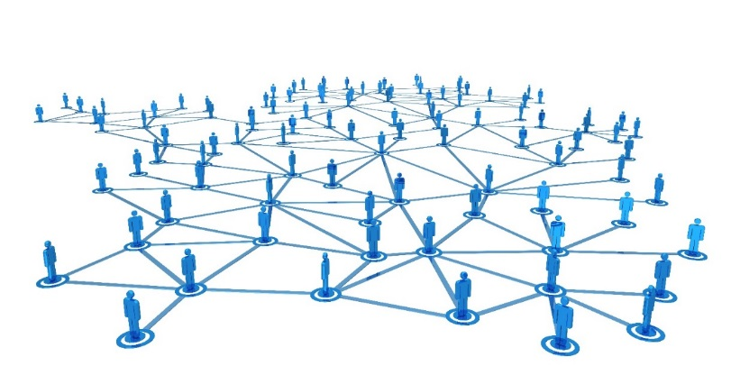
Main Objectives
ISIB-02-2014
1
Develop European Network
Introduction
2
Create and develop New Tools for long term information sharing by end-users (dissemination)

Slide 5
The construction of a European network for the transfer of innovative knowledge to increase the sustainability of European vineyards
From
Introduction
to

Slide 6
Objectives
WINETWORK project has the ambition to stimulate collaborative innovation in the wine sector.
The project will implement a methodology that has been successful in promoting demand-driven innovations during previous regional and European projects.
The main topic of the network is the control of diseases that jeopardise the future grape production.
Project overview

Slide 7
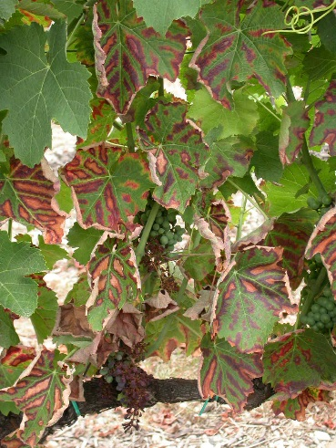
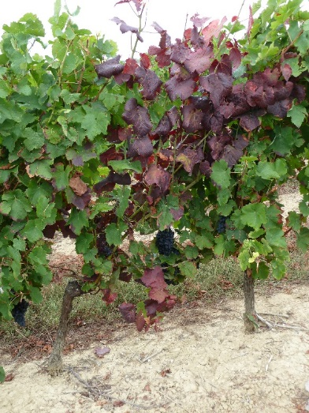
A Network to deal with two main issues
Grape Trunk Diseases
Flavescence Dorée
2 diseases that endanger vines and jeopardise the grape production
Fast spreading
across Europe!
Severe financial implications/losses
and
Source of anxiety and questions among wine growers
Project overview

Slide 8
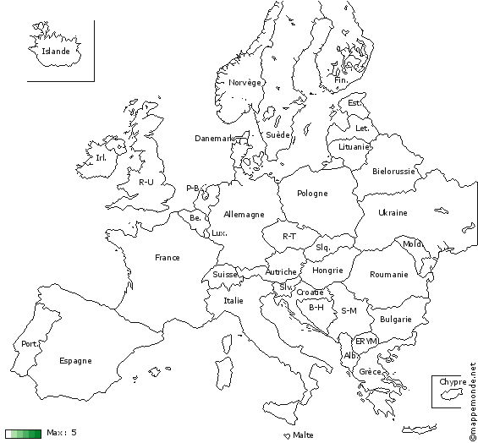
Impact of GTDs in Europe
% non productive vineyard
Widely spread
Present
U-K
U-K
Poland
The diseases
Germany
5%
Switzerland
Hungary
Roumania
Austria
13%
Italy
3-30%
Bulgaria
Portugal
3-20%
Spain
Greece
Gréce
(Grosman & Doublet, 2013, Bruez et al., 2013)

Slide 9
Impact of Flavescence Dorée
Widespread
Recently detected
Present
The diseases
Greece

Slide 10
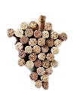
A relevant consortium
10 wine-producing areas – 7 countries
11 Partners
10 involved in dissemination ,
1 in methodology,
1 in tools development
1 in scientific knowledge
PALATINATE
RHINELAND
Project overview
ALSACE
SUD-OUEST
EGER
Innovation Support Services
SMEs
Wine producers clusters
Scientific research centre
ISTRIE
PIEMONTE
VENETO-FRIULI
DOURO
GALICE
RIOJA

Slide 11
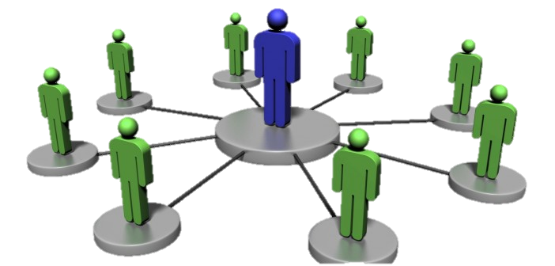
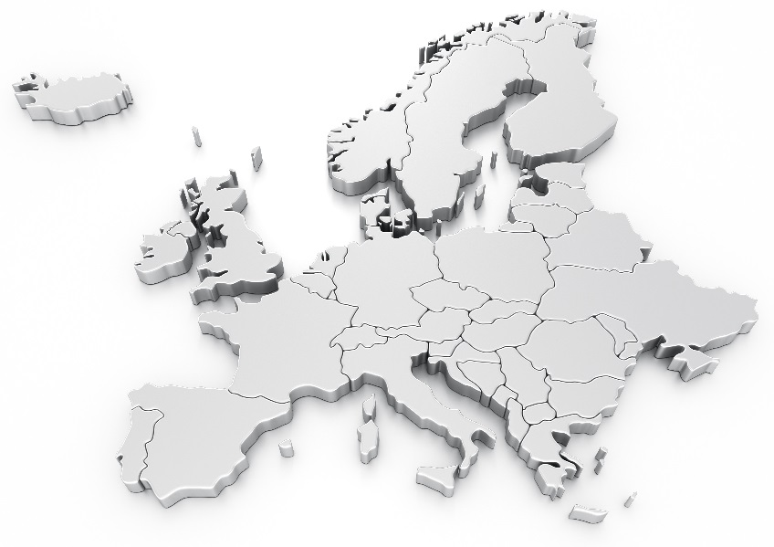
The Network
Installation of Operation Groups in each area
Managed by a Facilitator-Agent (FA)
10 interconnected
Operation Groups spread all over the european vineyards
A precise methodology
Operation Groups are composed of wine growers and technicians

Slide 12
Collect of Technical and Scientific knowledge
One of the most important phase of the project !
A precise methodology
The central role of the Facilitator Agent

Slide 13
Collect of knowledge
Detection of innovation in situ
Training Session
And Guidelines
A precise methodology
Survey on innovative pratices in each wine area
20 to 30 interviews of practitioners and winegrowers per area

Slide 14
Collect of knowledge
The scientific Groups
Analysis of literature
2. Workshop
Link with
the european COST
Scientific Group
GTDs
Scientific Group
FD
A precise methodology
Training Session on diseases
Scientific knowledge
To put scientific results into practices

Slide 15
Transfer of knowledge
Communication and Dissemination
Two distinct tasks

Slide 16
Tools : General Information, activities and results
Stakeholders : scientists, authorities and wine growers
8 languages
A Website
6 sections
Region-Specific information to give a local feedback
Hosting plan for 5 years for the sustainability of the platform
Communication
Brochures, leaflets and Posters
4 WiNetwork Newsletters
A list of more than 50 000 contacts of european wine industry
3 Press releases
Presentation of the project to the community
Midterm : focused on the knowledge reservoir
End : Promote the research agenda and the results

Slide 17
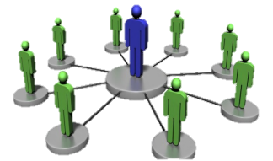
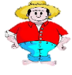
Transfert of knowledge
FD
GTD’s
Synthesis of the knowledge will be transfered to wine growers and Innovation Support Services thanks to several tools
Dissemination
The Knowledge Reservoir
Material available will be updated and adapted to the different end-users

Slide 18
Updating material
Tools for ISS : Technical advisory to winegrowers
5 Videoseminars made by scientists
4 information papers
4 PPT presentations
Dissemination
Training material for wine growers :
Farmers and vineyard workers without a strong technical background
End-user flyers
Video clips
Training modules

Slide 19
Conclusion
Innovative practices will be synthesized, tailored and translated to become fully accessible to innovation support services and to winegrowers.
The project will then deliver a vast reservoir of existing scientific and practical knowledge related to sustainable vineyard management.
It will also provide a methodology that will support all agriculture sectors to enhance innovation-driven research.
Proposition for the research agenda

Slide 20
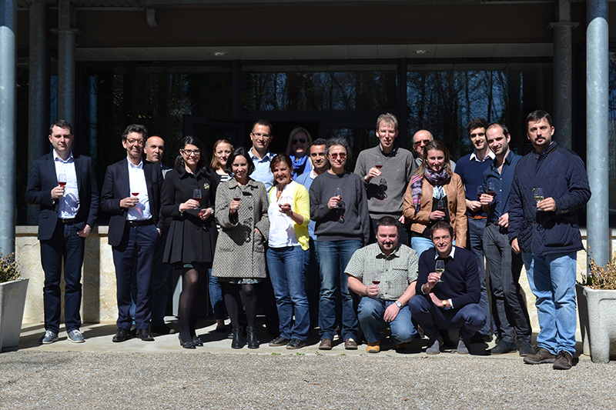
Conclusion
BUDGET : 2 million €
From April 2015 for 30 months
Thanks for your attention

