Slide 1
TATRA Tastes of Trappists: a slow tourism experience
Project co-financed by the European Union

Slide 2
Summary:
TITLE | Tastes of Trappists: a slow tourism experience
ACRONYM | TATRA
DURATION | 15 months (starting 1st April 2014)
BUDGET | 322.367,63 euro
EC CO-FUNDING | 241.500,00 euro (74,91%)
PARTNERS | 7 from Belgium, Germany, Italy and the Netherlands

Slide 3
TATRA project objectives:
To develop a sustainable tourism strategy within the Trappists’ sites area
To contribute to the creation of an environment favorable to transnational co-operation among tourism-related stakeholders with particular emphasis on the SMEs
To increase the visibility of the thematic cycling/hiking routes with links to the slow tourism standards
To create integrated and personalized vacation packages
To connect partners from Belgium, the Netherlands, Germany and Italy

Slide 4
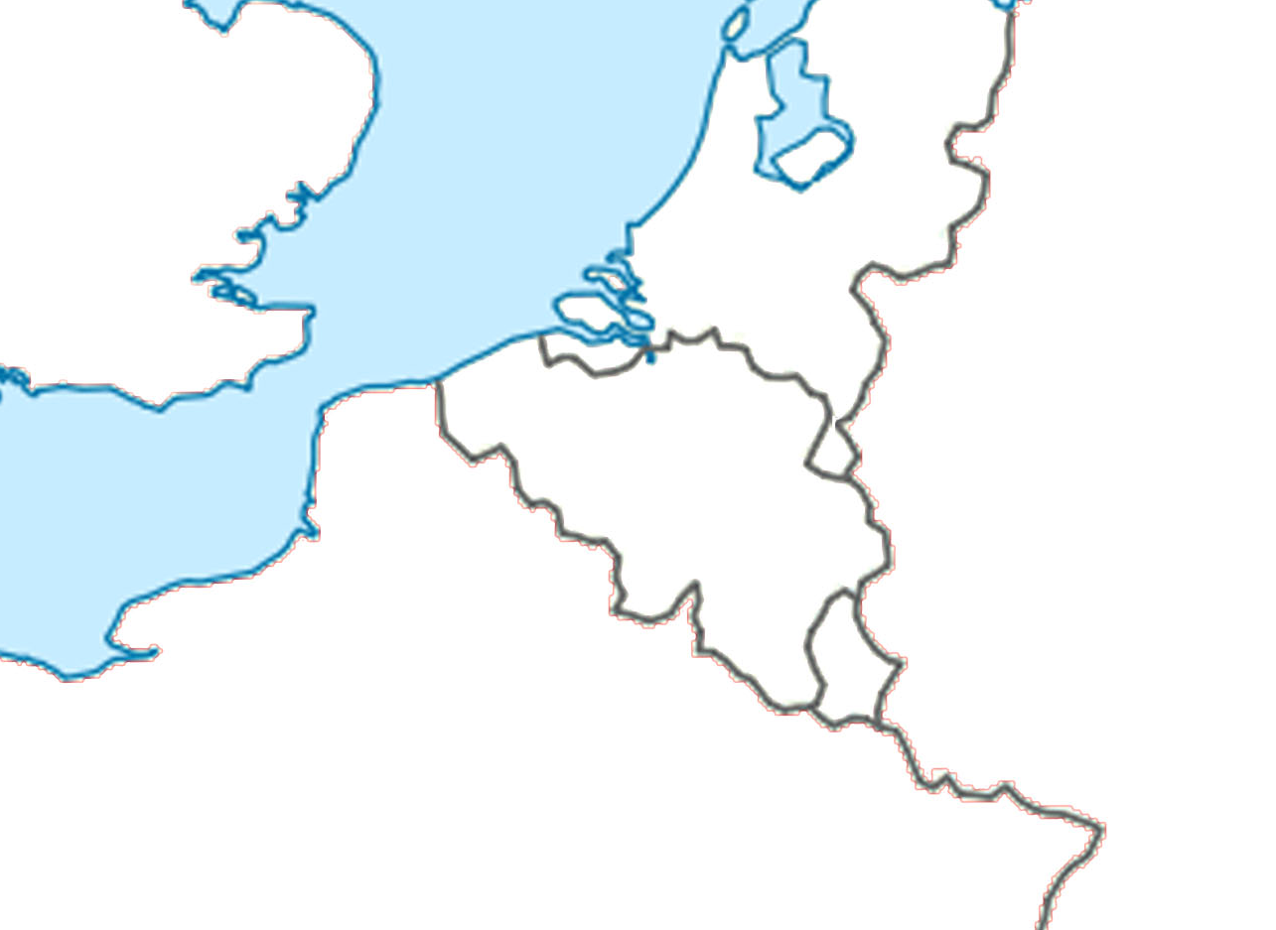
Trappist sites
Konigshoeven
Westmalle
Westvleteren
Achel
Mariawald
Rochefort
Chimay
Orval
+ ITALY: Abbazia Tre Fontane in Rome

Slide 5
TATRA partner associations:
Belgian-Italian Chamber of Commerce (BEL)
Toerisme Vlaanderen (BEL)
Toerisme Provincie Antwerpen (BEL)
Regio Hart van Brabant (NED)
Bierevents (NED)
Italienische Handelskammer für Deutschland (GER)
Fondazione per le Scienze religiose Giovanni XXIII (ITA)

Slide 6
Stakeholders
Public authorities
Beneficiaries
Operators of the horeca sector
Tourism local, regional and national boards
Abbeys and dioceses
Municipalities
Local tour operators
Tourism agencies
Holiday-makers
TARGET GROUP
Holiday-makers (excursionists, individual travelers, families with children, etc.)

Slide 7
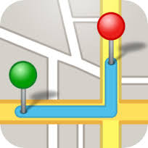
Activities
Research and analysis:
International web-platform
Capacity building workshops for SMEs:
mapping process
historical background
definition of vacation packages
environmental sustainability
communication and marketing strategies
product/service development
Dissemination of results:
open public events in Brussels and Rome
newsletter and leaflet distribution
virtual galleries with photos and videos of the abbeys
promotion of vacation packages

Slide 8
Lucia Sinigaglia
European Desk, Master and Training
Belgian-Italian Chamber of Commerce
Avenue Henri Jaspar 113 - 1060 Bruxelles
Tel: +32 26 09 00 81
E-mail: lucia@ccitabel.com
Website: www.ccitabel.com

