Slide 1
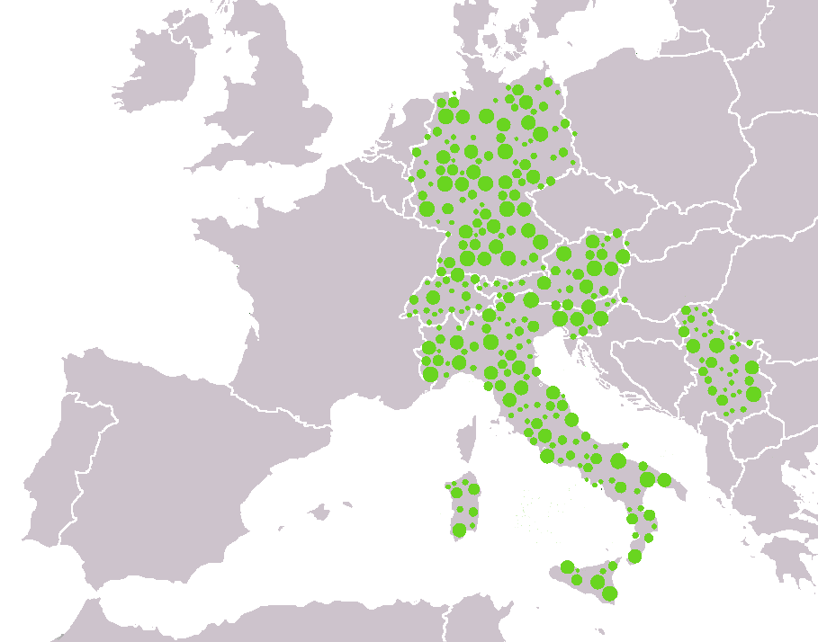
EcoDots
A European network of ecofriendly touristic destinations, hosting facilities and itineraries
Connecting the green (eco) dots network
Notes:
EcoDots Project intends to create a European network of touristic destinations, hosting facilities and itineraries characterized by the fact that they contribute to the local, natural and cultural environment, to the local economy and community.
Most of this destinations already exist and operate, but are difficult to find, contact and book.

Slide 2
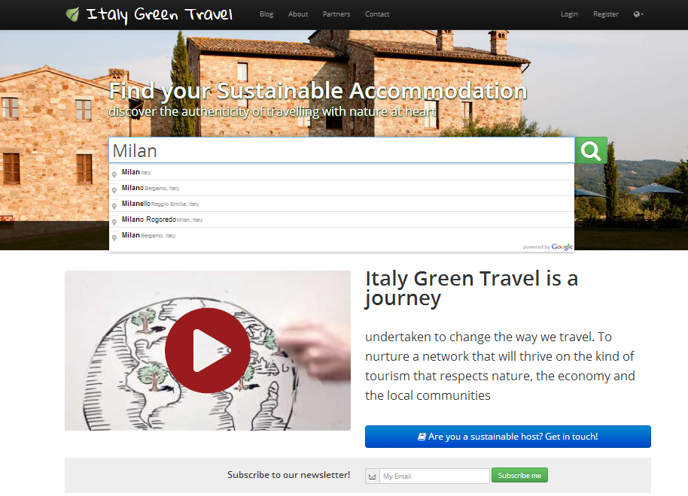
Notes:
EcoDots is a natural extension of the project ItalyGreenTravel, a network of ecofriendly accommodations in Italy, and a website conceived to promote ecotourism.

Slide 3
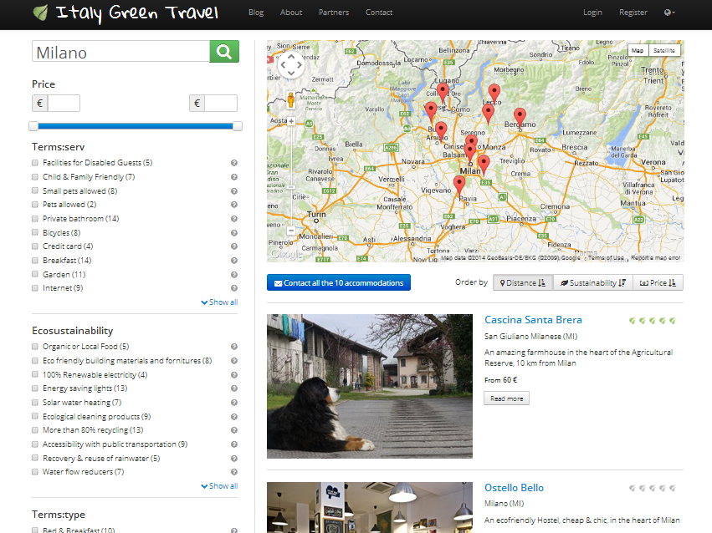
Notes:
ItalyGreenTravel has a database of about 1.000 ecofriendly accommodations in Italy, selected, profiled and ranked using 10 parameters of sustainability, identified on the basis of scientific publications on the subject.

Slide 4
Notes:
This 10 main eco-parameters are: Organic or local food, Eco-friendly building materials, 100% renewable energy, solar water heating, ecological cleaning products, more than 80% waste recycling, accessibility with public transportation, recovery & reuse of rainwater, water flow reducers.

Slide 5
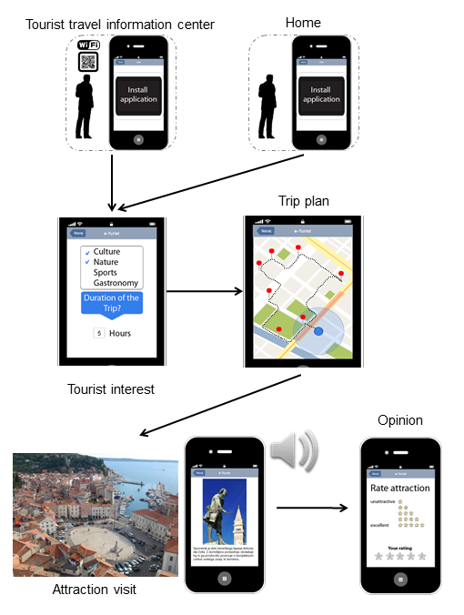
TourCert
E-Turist
Notes:
Ecodots will benefit from ItalyGreenTravel project and database, but also:
fromTourCert, the certification methodology developed by the partner Kate,
and from E-Turist, the artificial intelligence technology available to the partner Jozef Stephan Institute for the development and visualisation of personalised itineraries.

Slide 6
Project Partners:
KATE (Germany)
Institut Josef Stefan (Slovenia)
Orme nel Parco(Italy)
EcoDev Centre for Research and Development (Republic of Serbia)
Municipality of Parma (Italy)
Ministry of Finance & Economy (Republic of Serbia)
Istituto di Studi per l’Integrazione dei Sistemi scrl ISIS (Italy)
Notes:
The other project partners of:
▪ Orme nel Parco, a small enterprise known for operating a successful case of ecotourism in the South of Italy
▪ EcoDev, a Serbian NGO specialising on the development of ecotourism.
▪ Municipality of Parma in Italy, which supports ecotourism at municipal and regional level, and provides leverage at the national level.
▪ Serbian Ministry of Finance and Economy, which in Serbia is responsible for tourism and keep the links with the world of accommodations and tour operators.
. Isis, an Italian Research Center

Slide 7
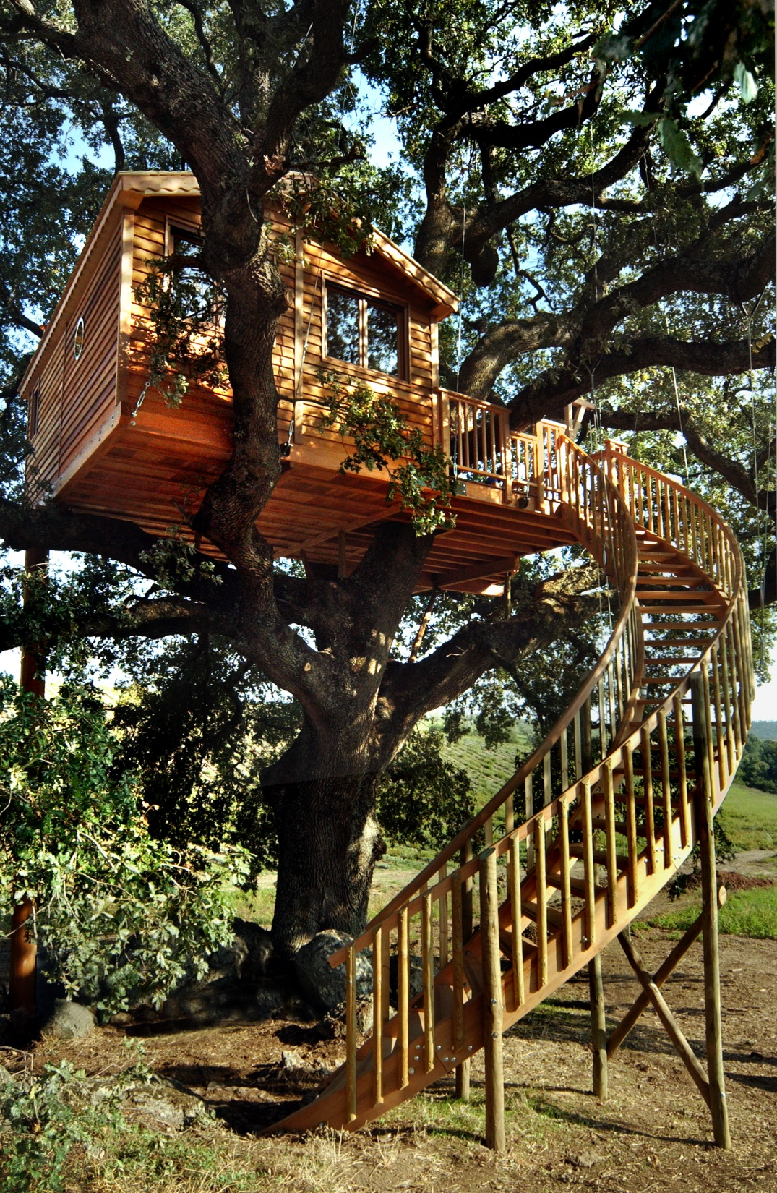
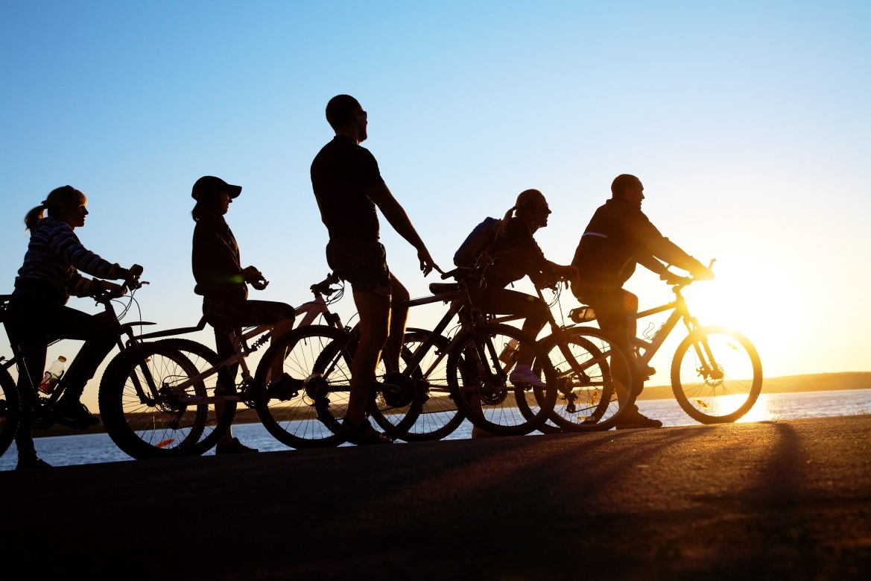
Notes:
EcoDots aims to connect travellers, small and micro-enterprises in hospitality sector, tour operators, local communities and itineraries, sharing a close link to the concept of eco-tourism.

Slide 8
Main objectives
Build an innovative network of sustainable accommodations and “green” itineraries in Italy, Austria, Switzerland, Germany, Slovenia and Serbia
Promote the demand of sustainable tourism in Europe
Involve green accommodations sharing an eco-tourism vision, in order to enhance their visibility on the market and transfer good practices
Notes:
Specifically, the 3 main objective of the project are:
1) build an innovative network of sustainable accommodations and “green” itineraries in the countries of Italy, Austria, Switzerland, Germany, Slovenia and Serbia.
2) promote the demand of sustainable tourism in Europe, leveraging an intelligent interactive system, committed people, natural resources, quality accommodations, local and transnational itineraries.
3) involve small green hotels, eco B&Bs, bio farmhouses and tours operators sharing an eco-tourism vision, in order to enhance their visibility on the market and transfer good practices.

Slide 9
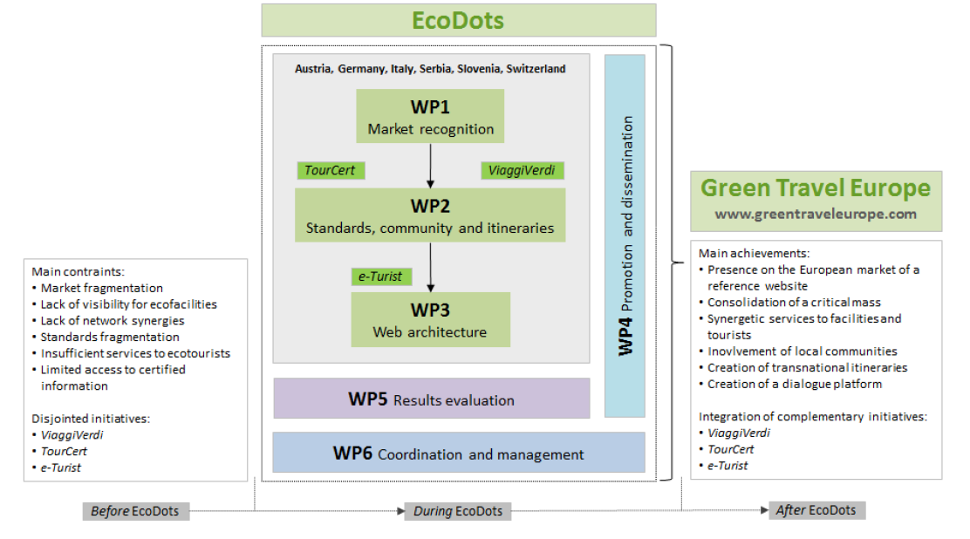
The flow chart of the EcoDots work plan
Notes:
The work plan of the project:
WP1, Market recognition: which survey and analyses the existing and expected ecotourism market in Italy, Germany, Austria, Switzerland, Serbia, Slovenia, reviews user needs, behaviours and preferences, agrees on the vision and the brand of Europe Green Travel
WP2, Standards, community and itineraries: which converges on a set of harmonised EcoDots standards for inclusion in the Europe Green Travel community, estabilishes a transnational database of ecofriendly accommodations, tours-operators and itineraries in Italy, Austria, Germany, Slovenia, Serbia and Switzerland
WP3, Web architecture: which enhances the ItalyGreenTravel website with the European database, the E-Turist itineraries and search functionalities (an artificial intelligence developed by Serbian partner), the mobile application and other valuable ideas suggested by the local communities.
WP4, Promotion, dissemination and outreach, which provides EcoDots with visibility, ability to involve and interact with the target group
WP5, Result evaluation, which identifies, monitors and reflects the impact of EcoDots project
WP6, Coordination and management, which ensures strategic direction of the project activities

Slide 10
Duration: 18 months
Total cost: 330.689 Euro (248.016 EC contribution)
Deliverables:
Notes:
The duration of the project is 18 months
The total budget of the project is around 3 hundreds thousand euros
The deliverable are: Report on market recognition, Report on European Green Travel standards harmonisation, Report on members mapping, Report on itineraries mapping, Report on the enhancement of the Europe Green Travel website and mobile application, Report on the enhancement of the Europe Green Travel website and mobile application, Report on evaluation methodology, Report on results and conclusions, First Interim technical implementation report and financial statement, Second Interim technical implementation report and financial statement, Final technical implementation report

Slide 11
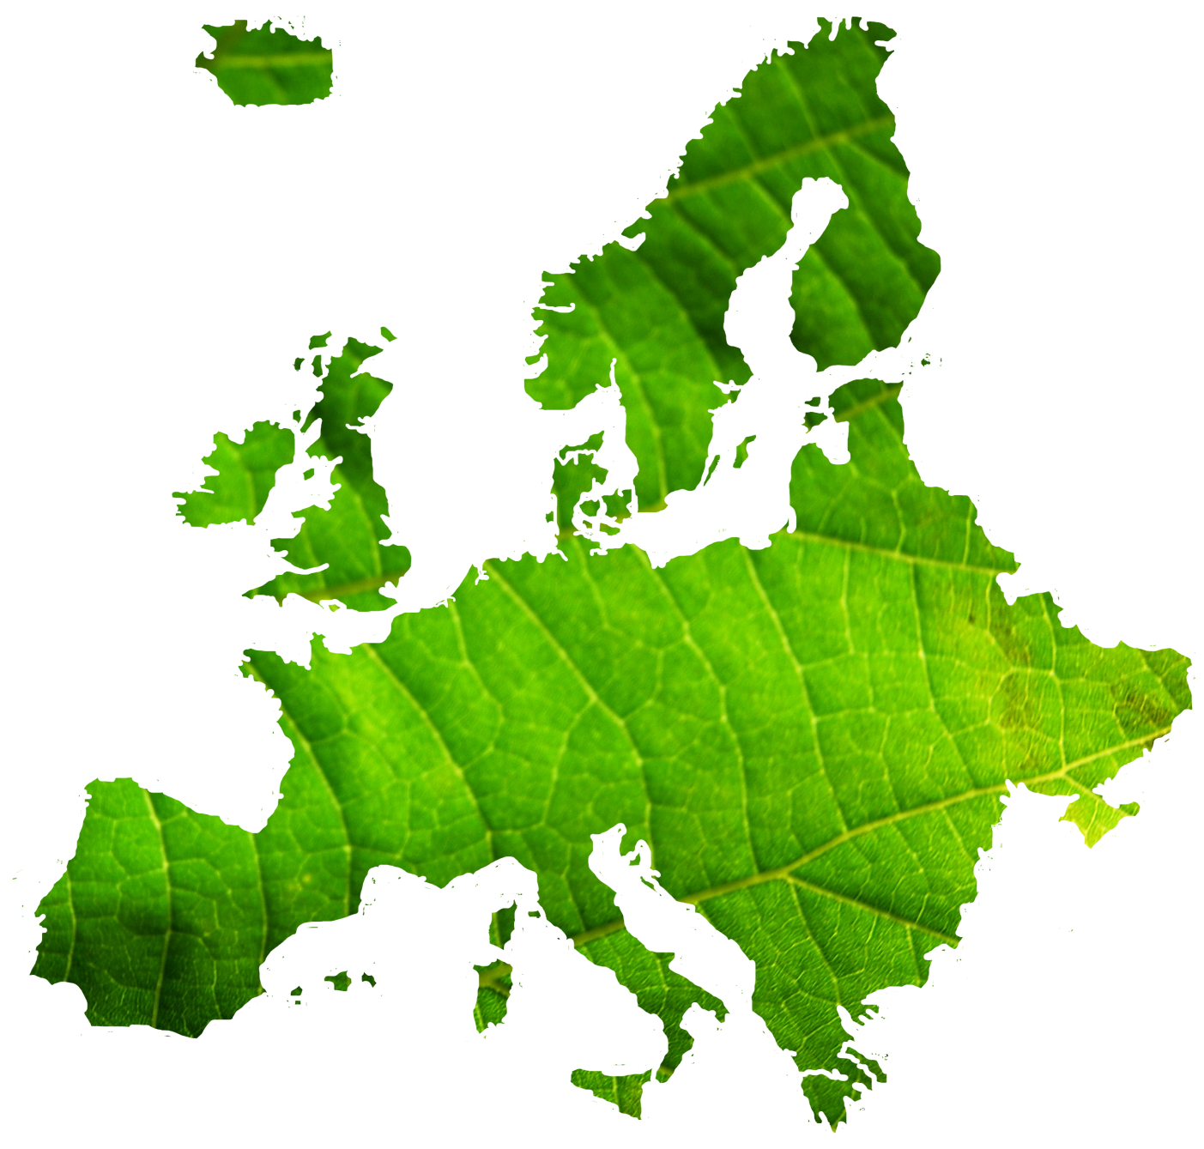
www.europegreentravel.com
European web platform for Sustainable Tourism
Notes:
The resulting tourism product, Europe Green Travel, which will be ready for the market by the end of EcoDots, is a European web platform (http://www.europegreentravel ) capable of acting as a catalyst for a community of eco accommodations, tours operators, itineraries and local communities sharing similar visions and values, and meeting harmonised sustainability standards.

Slide 12
Main Outcomes:
Create the Europe Green Travel Community, formed primarily by eco-accommodations and tours operators in Italy, Austria, Switzerland, Serbia, Slovenia.
Create an interactive platform expected to become a reference point for the community supporting sustainable tourism in Europe.
Provide travelers with practical information on eco-accommodations, itineraries and topics.
Positive impact on the environment
Notes:
Main Outcomes:
Create the Europe Green Travel Community, formed primarily by eco-accommodations and tours operators in Italy, Austria, Switzerland, Serbia, Slovenia.
Create an interactive platform expected to become a reference point for the community supporting sustainable tourism in Europe. The website Europe Green Travel will promote ecofriendly accommodations, car-free vacations, green itineraries (walking, cycling, horseback, hiking, etc.)
Provide travellers with pratictical informations on eco-accommodations, itineraries and topics.
By promoting eco-friendly accommodations and tourist itineraries, EcoDots will have a positive impact on the environment and on local communities.

Slide 13
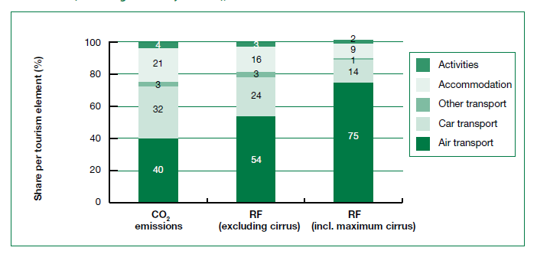
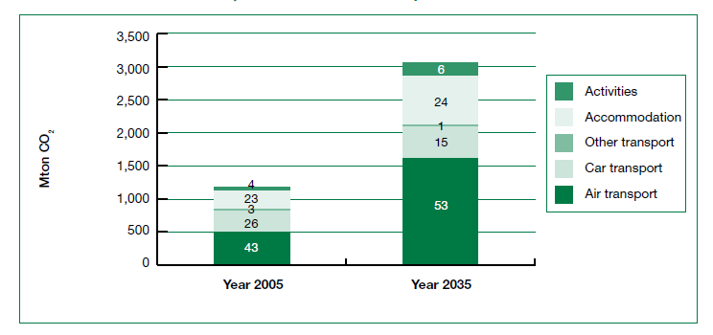
Reduce CO2 emissions
CO2 Emissions in Tourism. Source: Consumption and Environment 2012
Notes:
Accommodation facilities are responsible for 21% of CO2 emissions related to the entire tourism system. Stimulating accommodations to meet Europe Green Travel’s requirements (reducing their ecological footprints), and stimulating travelers to confidently turn to that network when planning a journey, the project could contribute to reduce up to 80% the CO2 emissions, energy and water consumption.
Green Itineraries will contribute to reduce the biggest impact of tourism on the environment, that is linked with transport (particularly with car and airplane which account for 75% of total tourism-related CO2 emissions)

Slide 14
Thank you!
To know more about the Project:
Short Video: https://www.youtube.com/watch?v=PlrVBAxeGXY#t=150
Web site: www.italygreentravel.it
Contacts: simone@viaggiverdi.it silvia@viaggiverdi.it

