Slide 1

The role of the EU in global manufacturing value chains
Deliverable #1

Slide 2
Motivation

Slide 3
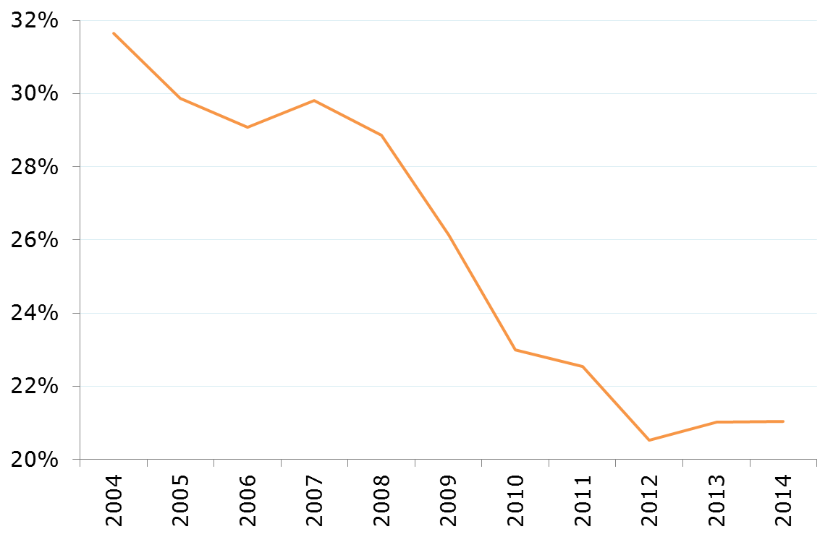
EU contributing less
Share of value added in global manufacturing production chains
-10.6pp
2004-2014
Notes:
Ratio = 1 / 2
1 = Value added in EU embodied in global final demand of manufacturing products
2 = Value added in the world embodied in global final demand of manufacturing products

Slide 4
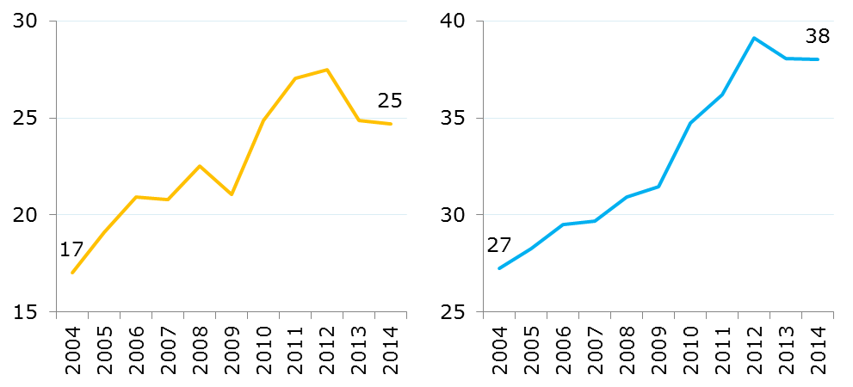
Reassessing EU external dependencies
Global manufacturing production chains
Higher non-EU value added in EU production
Higher EU value added linked to non-EU final demand
% of indirect value added in EU production
% of EU value added
Notes:
Left-hand chart
Ratio = 1 / 2
1 =(indirect) value added in RoW embodied in global final demand of manufacturing products produced in the EU
2 = indirect value added embodied in global final demand of manufacturing products produced in the EU
Right-hand chart
Ratio = 1 / 2
1 = Value added in EU embodied in RoW final demand of manufacturing products
2 = Value added in EU embodied in global final demand of manufacturing products

Slide 5
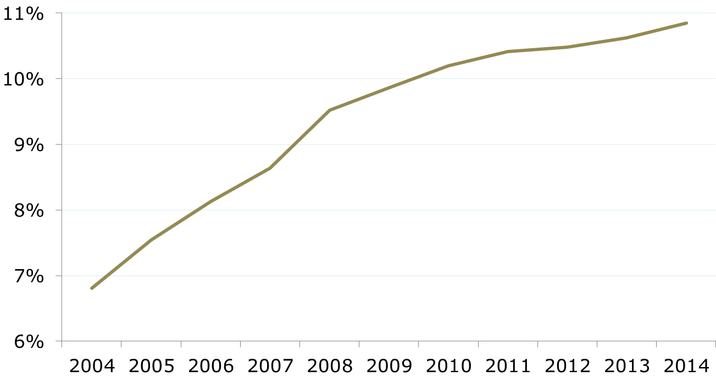
Structural changes within the EU
Share of new members states in EU value added linked to manufacturing VCs
+4.0pp
2004-2014
Notes:
Ratio = 1 / 2
1 = Value added in EU13 embodied in global final demand of manufacturing products
2 = Value added in EU embodied in global final demand of manufacturing products

Slide 6
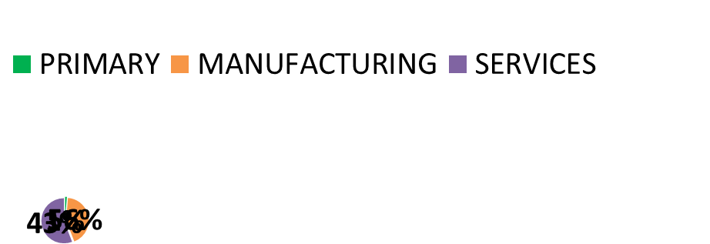
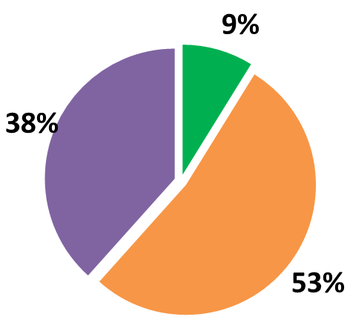

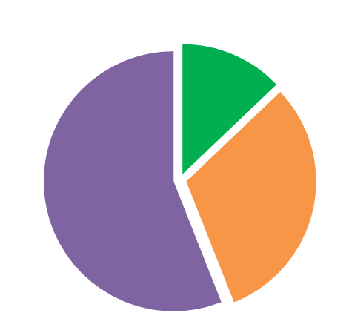
DIRECT 31%
How do we define manufacturing competitiveness?
Value added in EU manufacturing production (2014)
INDIRECT 69%
Notes:
Direct and indirect value added in EU embodied in global final demand of manufacturing products produced in EU
Indirect value added in EU […], by sector

Slide 7
Contents
1
Reading the declining EU share
Shift-share analysis identifying demand, supply and production factors under a EU-RoW scheme
2
The EU production network
Value added decomposition and specialization patterns by manufacturing industries, the role of the most recent members
3
The EU in external production networks

Slide 8
1
reading THE declining eu share: main drivers
2
3

Slide 9
EU value added in global manufacturing production chains…
…linked to final demand by…
EU
RoW
Share in global final demand
Relative share of manufacturing in global final demand
Value added in EU per unit of manufacturing final demand
Notes:
Decomposition of ratio = 1 / 2
1 = Value added in EU embodied in global final demand of manufacturing products
2 = Global final demand of manufacturing products
Decomposition of ratio = (3 + 4) / 2
3 = Value added in EU embodied in EU final demand of manufacturing products
4 = Value added in EU embodied in RoW final demand of manufacturing products
Ratios '3/2' and '4/2' are the result of the product of the three variables on the slide

Slide 10
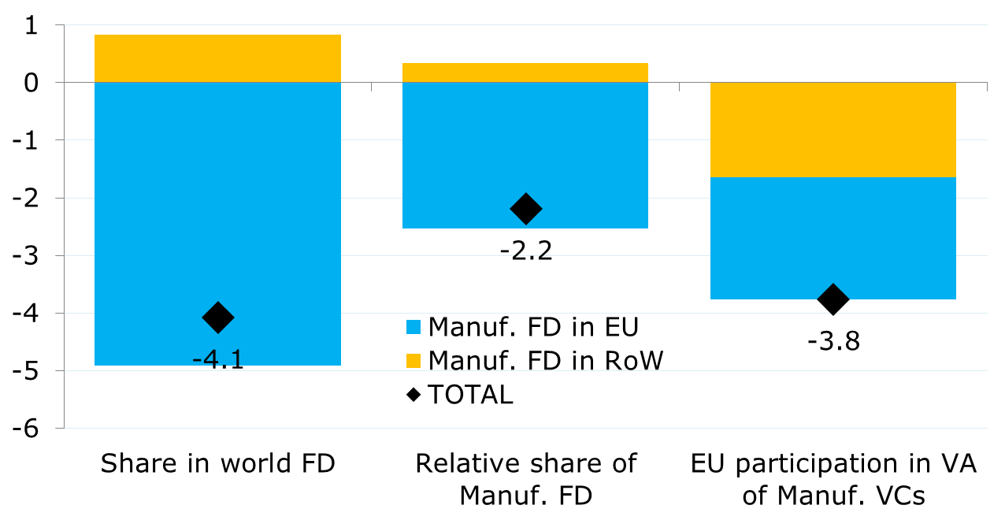
Both demand and competitiveness factors behind lower EU contribution
-10.6pp
2004-2014
Notes:
Contribution of each factor to the change of the ratio = 1 / 2 between 2004 and 2014
1 = Value added in EU embodied in global final demand of manufacturing products
2 = Global final demand of manufacturing products

Slide 11
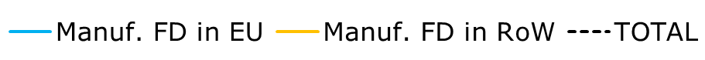
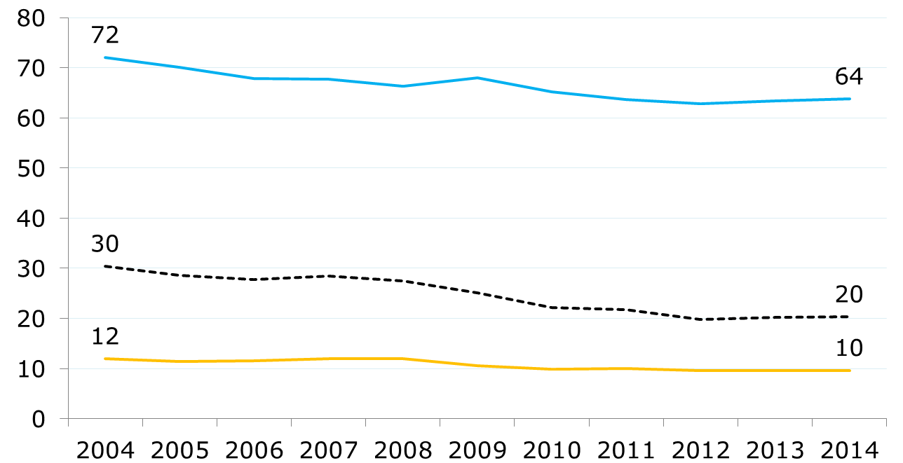
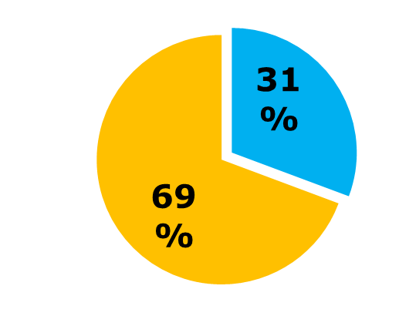
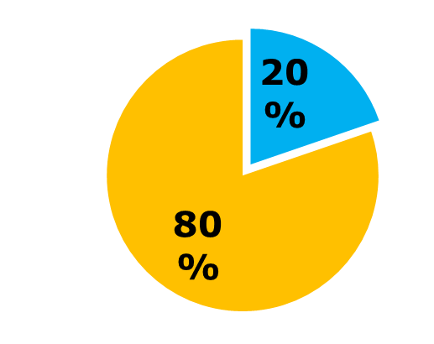
Less EU value added per unit of final demand
¢ EU VA / $ FD
FD
EU
-10¢ per $ of manufacturing final demand
2004-2014
FD
RoW
Notes:
TOTAL = USD cents of EU value added embodied in 1 USD of global final demand of manufacturing products
Manuf. FD in EU = USD cents of EU value added embodied in 1 USD of EU final demand of manufacturing products
Manuf. FD in RoW = USD cents of EU value added embodied in 1 USD of RoW final demand of manufacturing products
TOTAL is the result of changes in the two other ratios and in the EU/RoW composition of final demand of manufacturing products

Slide 12
"The EU lost share in manufacturing production chains not only because demand grew faster abroad (explaining 60%) but also because its participation in value generation decreased regardless of where final production takes place (40%)"

Slide 13
1
reading THE declining eu share: manufacturing industries
2
3

Slide 14
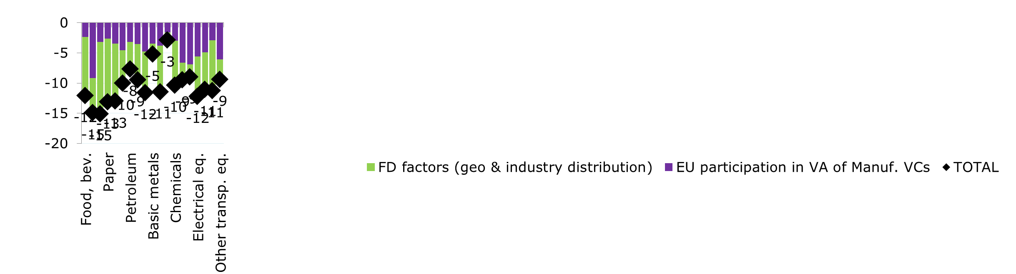
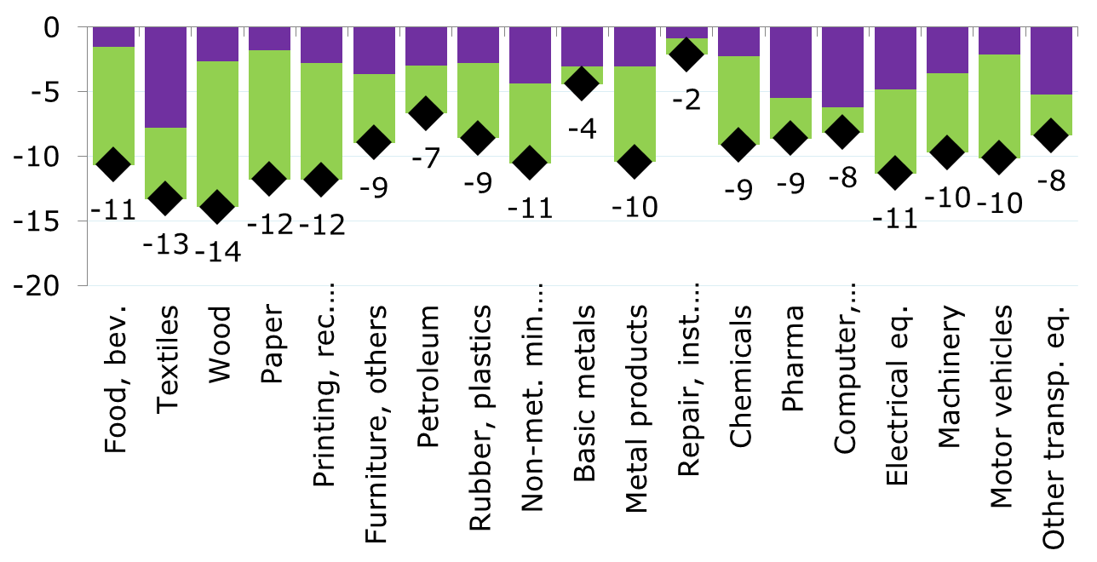
Relative demand behind larger decline for low-tech and competitiveness more relevant for medium&high-tech
¢ EU VA
/
$ FD
2004-2014
Simple average by sub-sector
L
-12pp (71/29%)
M
-7pp (57/43%)
H
-9pp (53/47%)
Notes:
USD cents of EU value added embodied in 1 USD of global final demand of manufacturing products of industry 'i‘
Ratio for each manufacturing industry 'i' value chain = 1 / 2
1 = Value added in EU embodied in global final demand of manufacturing products of industry 'i'
2 = Value added in the world embodied in global final demand of manufacturing products of industry 'i'
Change of ratio between 2004 and 2014 decomposed into two aggregate factors (A+B):
A/FD factors = 3&4&5
3 = Ratio of total final demand in EU/RoW over total final demand in the world [changes in the distribution of total final demand by region]
4 = Relative share of total final demand in EU/RoW of manufacturing products over total final demand in EU/RoW [changes in the distribution of total final demand by sector]
5 = Relative share of total final demand in EU/RoW of manufacturing products of industry 'i'
over total final demand in EU/RoW of manufacturing products [changes in the distribution of total final demand by industry]
B/EU participation in VA of Manuf. VCs = USD of EU value added embodied in 1 USD of EU/RoW final demand of manufacturing products of industry 'i' [changes in the participation in value chains]
L (low), M (medium) and H (high) correspond to classification according to technological intensity

Slide 15
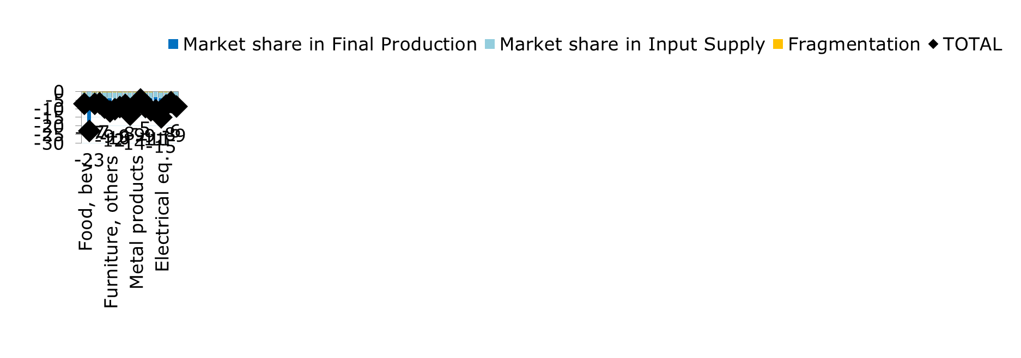
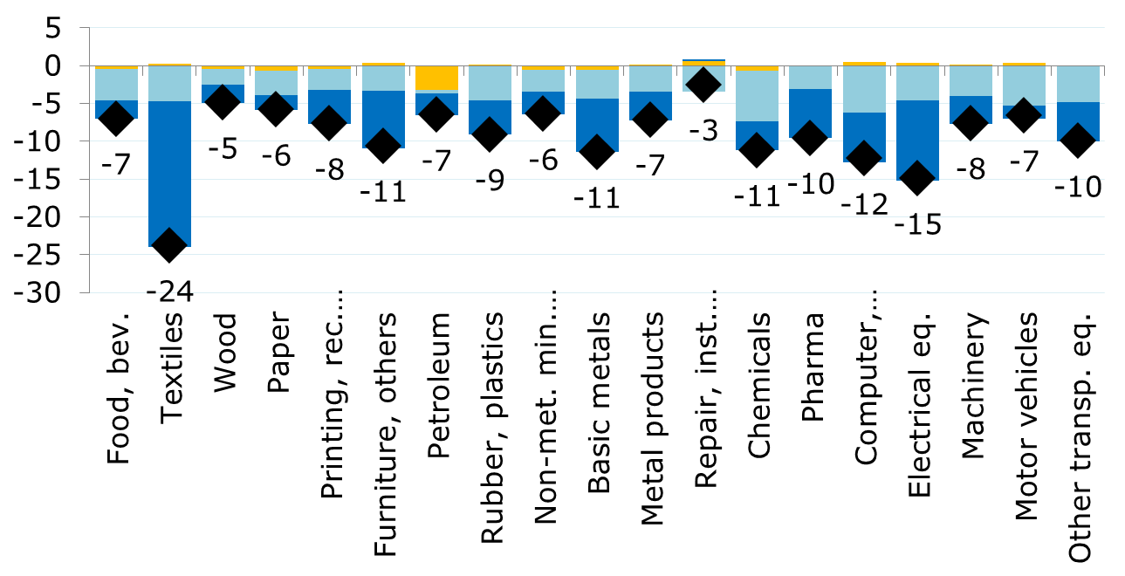
Decline of market share in value chains serving EU final demand: larger for textiles and most high-tech industries
¢ EU VA
/
$ EU FD
2004-2014
Simple average by sub-sector
L
-10pp (55/41%)
M
M
-7pp (41/53%)
H
H
-10pp (50/50%)
Notes:
USD cents of EU value added embodied in 1 USD of EU final demand of manufacturing products of industry 'i'
Change of ratio between 2004 and 2014 decomposed into three factors (A+B+C):
A/Market share in Final Production = Share of EU/RoW production serving EU final demand of manufacturing products of industry 'i' [changes in who provides the final product]
B/Market share in Input Supply = Share of EU in indirect value added embodied in global final demand of manufacturing products of industry 'i' produced by EU/RoW [changes in who provides inputs; geographical fragmentation]
C/Fragmentation = Share of direct and indirect value added embodied in global final demand of manufacturing products of industry 'i' produced by EU/RoW [changes in the distribution of direct-indirect value added; vertical fragmentation]

Slide 16
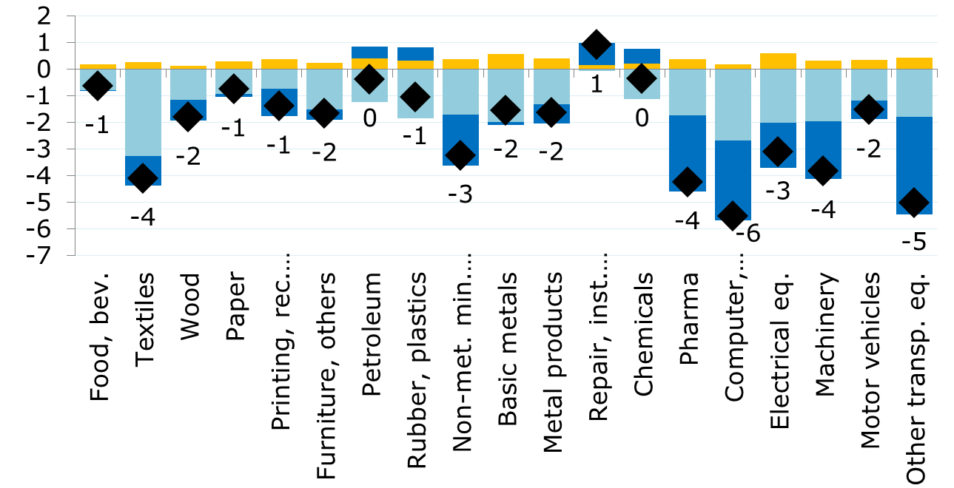
Decline of market share in value chains serving RoW final demand: larger among high-tech final producers
¢ EU VA
/
$ RoW FD
2004-2014
Simple average by sub-sector
L
-1.7pp (-0.6pp)
M
M
M
-1.2pp (-0.2pp)
H
H
H
-3.4pp (-1.9pp)
Notes:
USD cents of EU value added embodied in 1 USD of RoW final demand of manufacturing products of industry 'i'
Change of ratio between 2004 and 2014 decomposed into three factors (A+B+C):
A/Market share in Final Production = Share of EU/RoW production serving RoW final demand of manufacturing products of industry 'i' [changes in who provides the final product]
B/Market share in Input Supply = Share of EU in indirect value added embodied in global final demand of manufacturing products of industry 'i' produced by EU/RoW [changes in who provides inputs; geographical fragmentation]
C/Fragmentation = Share of direct and indirect value added embodied in global final demand of manufacturing products of industry 'i' produced by EU/RoW [changes in the distribution of direct-indirect value added; vertical fragmentation]

Slide 17
"The EU participation in production chains decreased across all manufacturing industries, being demand-driven for low tech and with competitiveness playing a more significant role in medium-high tech activities"

Slide 18
1
The eu production network: specialization overview
2
3

Slide 19
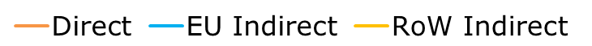
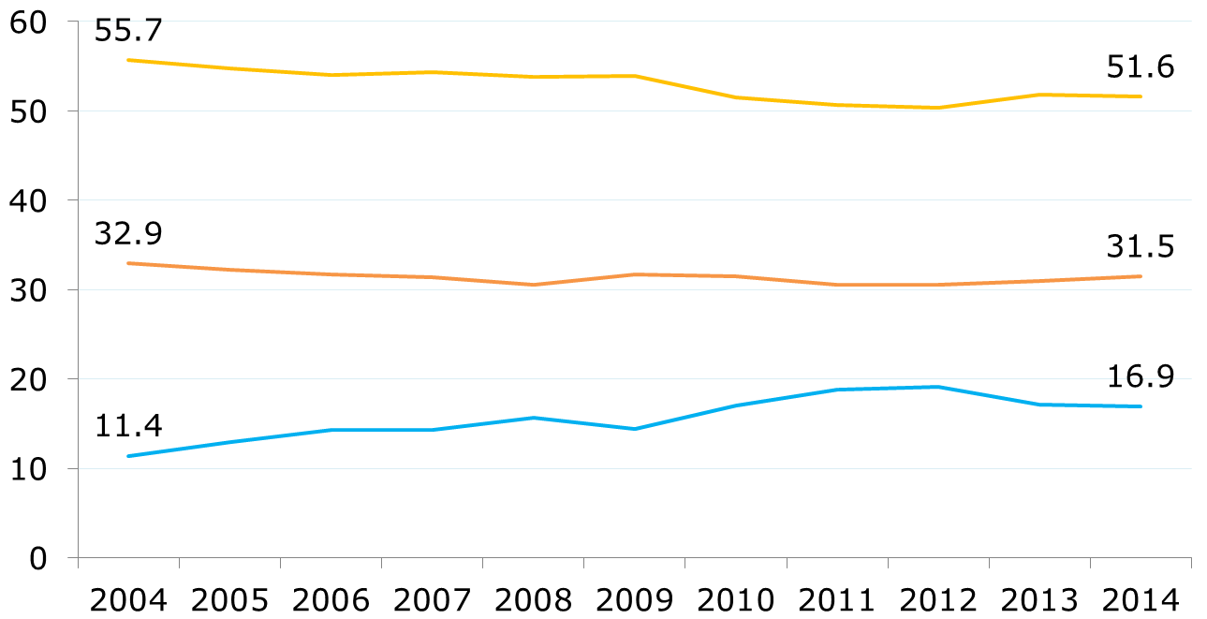
Non-EU value added on the rise
Share of value added linked to EU manufacturing production chains
%
Notes:
The three ratios correspond to the share in total value added embodied in global final demand of manufacturing products produced by the EU
Direct = value added ratio * value of final demand
Indirect is split into:
EU Indirect = both domestic (final producer country) and from other EU countries
RoW Indirect = foreign value added when considering a EU/RoW scheme

Slide 20
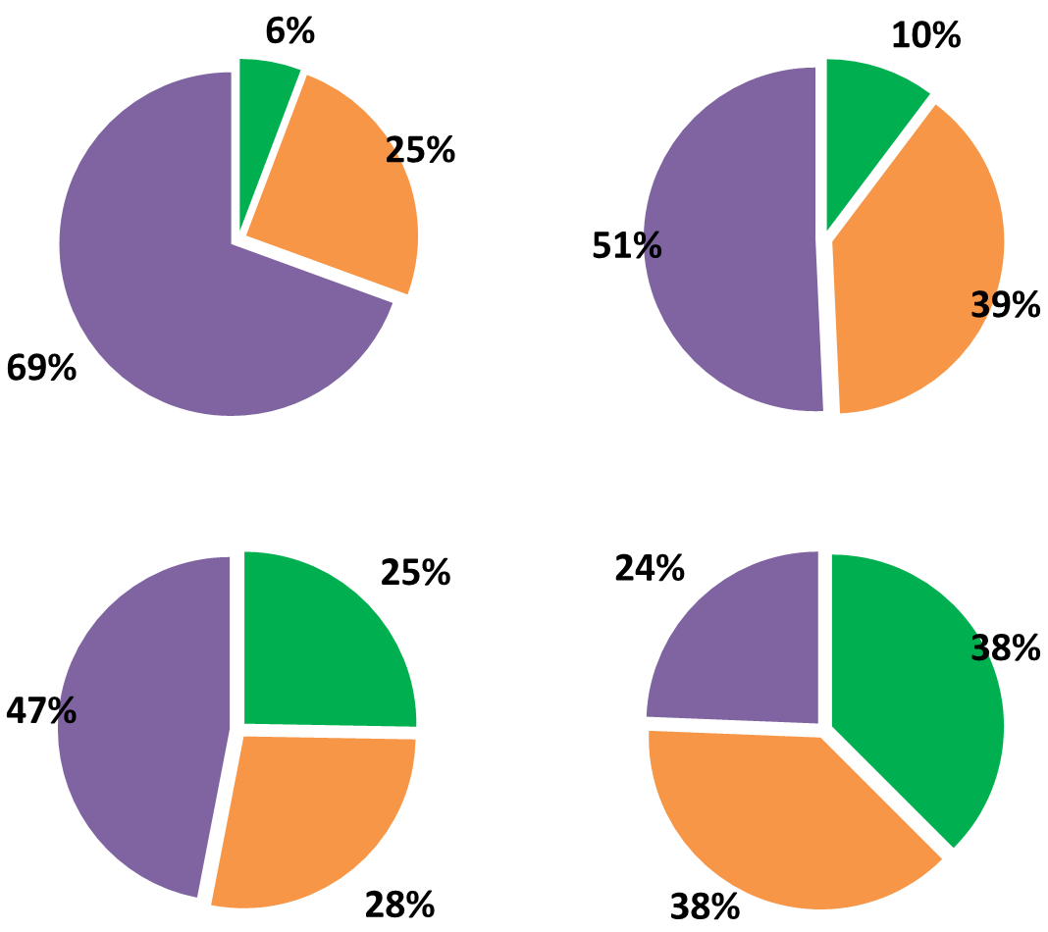
Service-oriented indirect EU value added, RoW specialized in primary inputs
2014
Upstream inputs
Downstream inputs
¢/$ EU Y
26¢
23¢
Indirect value added in EU
12¢
4¢
Indirect value added in RoW
Notes:
2014
Indirect value added embodied in global final demand of manufacturing products produced by the EU
Distribution of sectoral indirect value added for four categories according to the following two criteria (A&B):
A = stage of the value chain
A1/ Upstream inputs = value added generated when providing inputs except to the final producer (inputs for inputs)
A2/ Downstream inputs = value added generated when providing inputs to the final producer (inputs for output)
B = region of generation of value added (EU or RoW)
Values on the centre of each circle correspond to USD cents of indirect value added embodied in 1 USD of global final demand of manufacturing products produced by the EU

Slide 21
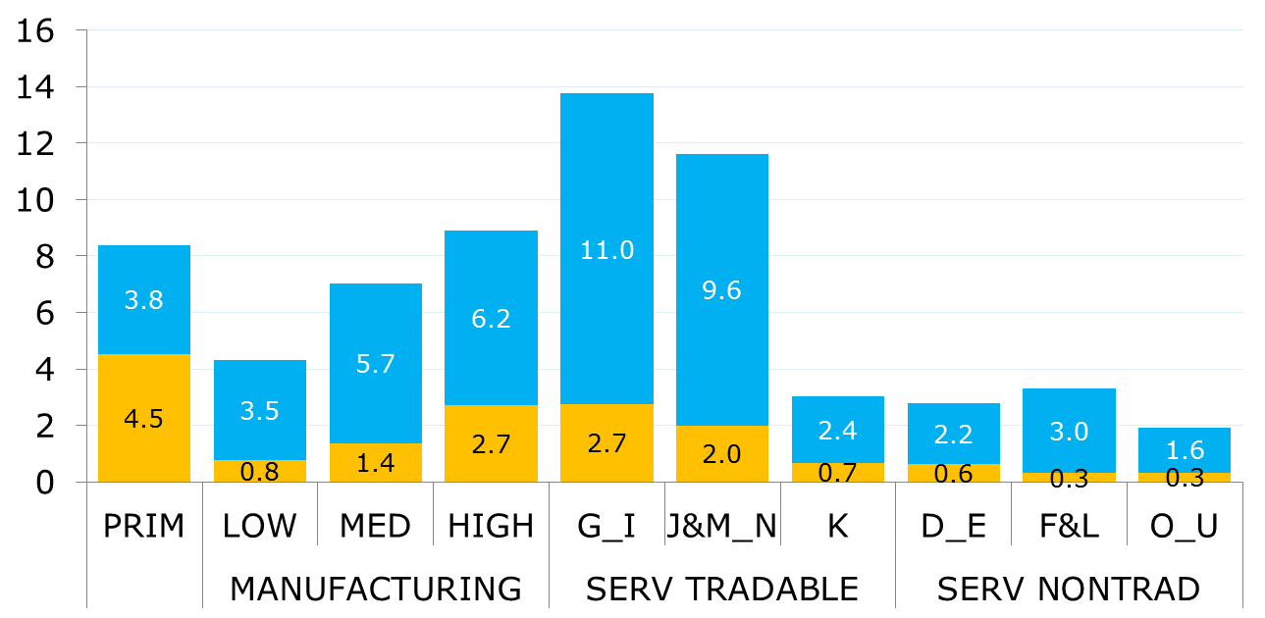
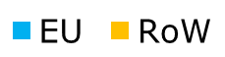
Logistics and business services as main manufacturing inputs
¢ VA / $ EU Y (2014)
49¢
16¢
RoW share
Notes:
2014
USD cents of indirect value added embodied in 1 USD of global final demand of manufacturing products produced by the EU, by sub-sector and region (EU/RoW) of value added generation
'RoW share' at the bottom is the ratio between the yellow bar and the blue bar
Sub-sectors:
PRIM = Primary (A&B NACE codes) (Agriculture, farming, mining)
MANUFACTURING (C) according to technological intensity:
LOW = C10_12 Food, C13_15 Textile, C16 Wood, C17 Paper, C18 Printing, C31_32 Furniture
MEDIUM = C19 Petroleum, C22 Plastic, C23 Non-metallic minerals, C24 Basic metals, C25 Fabricated metals, C33 Repair&installation
HIGH = C20 Chemicals, C21 Pharma, C26 Electronics, C27 Electrical, C28 Machinery, C29 Motor vehicles, C30 Other transport equipment
Services are split into two categories according to their tradability:
SERV TRADABLE = tradable services
G_I [logistics] = Trade (G, 3 industries), Transport (H, 5 industries) and Accommodation (I)
J&M_N [business services] = Communication (J, 4 industries), Professional and technical (M, 5 industries), Administrative and Support (N)
K [finance, 3 industries]
SERV NONTRAD = non-tradable services
D_E [utilities] = Electricity&gas (D), Water collection and sewerage (E, 2 industries)
F&L [construction] = Construction (F) and Real estate (L)
O_U [other services] = Public administration (O), Education (P), Health (Q), Personal (R_S), Households (T) and Extraterritorial bodies (U)

Slide 22
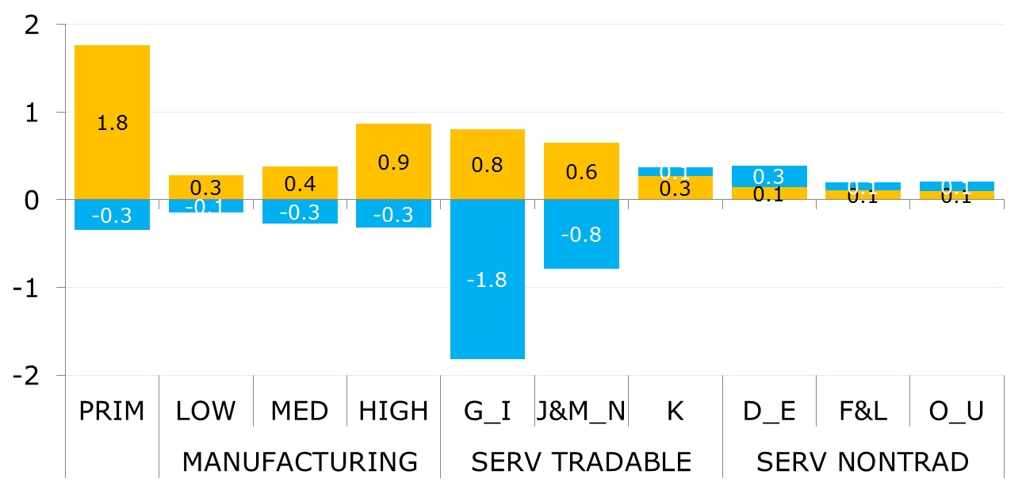
RoW value added increases across the board, particularly in primary and high-tech
¢ VA / $ EU Y
2004-2014 change
-4¢
+6¢
ΔRoW share
Notes:
Change between 2004 and 2014 of corresponding ratios in previous slide

Slide 23
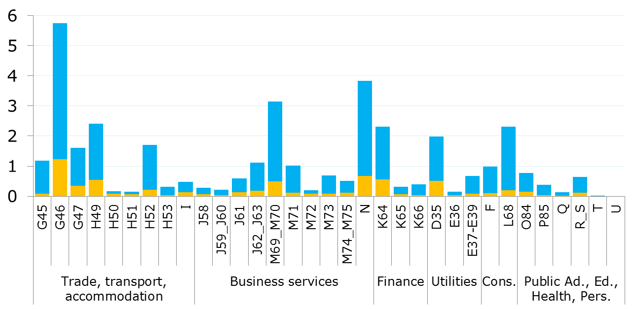
Wholesale trade, legal and administrative as the main service inputs
Wholesale trade
¢ VA / $ EU Y (2014)
Admin. & support
Legal, acc., head offices, consultancy
Land transp.
General finance
Real estate
Retail trade
Wareh.
& transp. support
Elect. & gas
Motor trade
Comput. prog. & info
Arch. & engineer.
Constr.
RoW share
Notes:
2014
USD cents of indirect value added embodied in 1 USD of global final demand of manufacturing products produced by the EU, by service industry and region (EU/RoW) of value added generation
'Row share' at the bottom is the ratio between the yellow bar and the blue bar

Slide 24
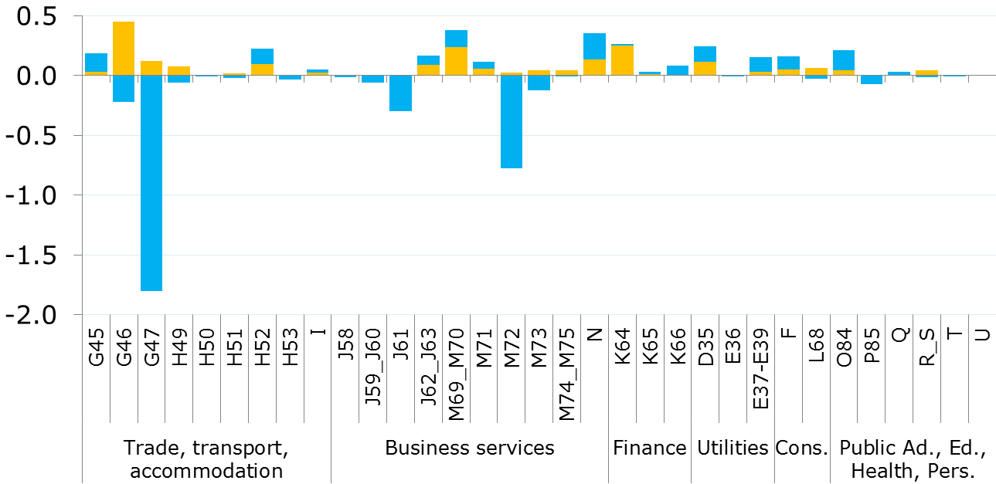
Non-EU wholesale traders gaining market share serving EU manufacturing production
Wholesale trade
R&D
¢ VA / $ EU Y
2004-2014 change
See caveats at the end
Retail trade
ΔRoW share
Notes:
Change between 2004 and 2014 of corresponding ratios in previous slide
Caveat at the end of the PPTX referred to 'G47 - Retail trade, except of motor vehicles and motorcycles' and 'M72 - Scientific research and development':
"Accounting methodological changes, particularly affecting retail trade and R&D between 2008 and 2010"
National accounts in some countries now compute the bulk of R&D as final demand (gross fixed capital formation to be specific) rather than an intermediate product
Care needed particularly for time comparisons between pre-crisis and post-crisis periods

Slide 25
"Non-EU value added in EU manufacturing production increased sharply during the last decade, including significant gains in industries in which the EU shows a certain degree of specialization, such as logistics and business services"

Slide 26
1
The eu production network: manufacturing industries
2
3

Slide 27
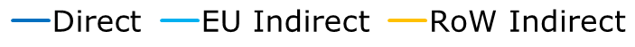
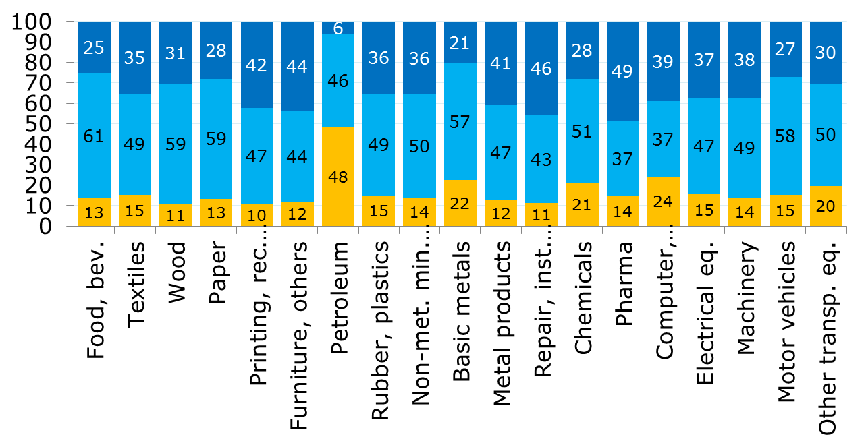
Higher RoW value added in petroleum, metals and a few high-tech manufactures
% (2014)
Simple average by sub-sector
L
34-53-13%
M
31-49-20%
H
35-47-18%
Notes:
2014
Distribution of total value added embodied in global final demand of manufacturing products of industry 'i' produced by the EU
Direct = value added ratio * value of final demand
Indirect is split into:
EU Indirect = both domestic (final producer country) and from other EU countries
RoW Indirect = foreign value added when considering a EU/RoW scheme

Slide 28
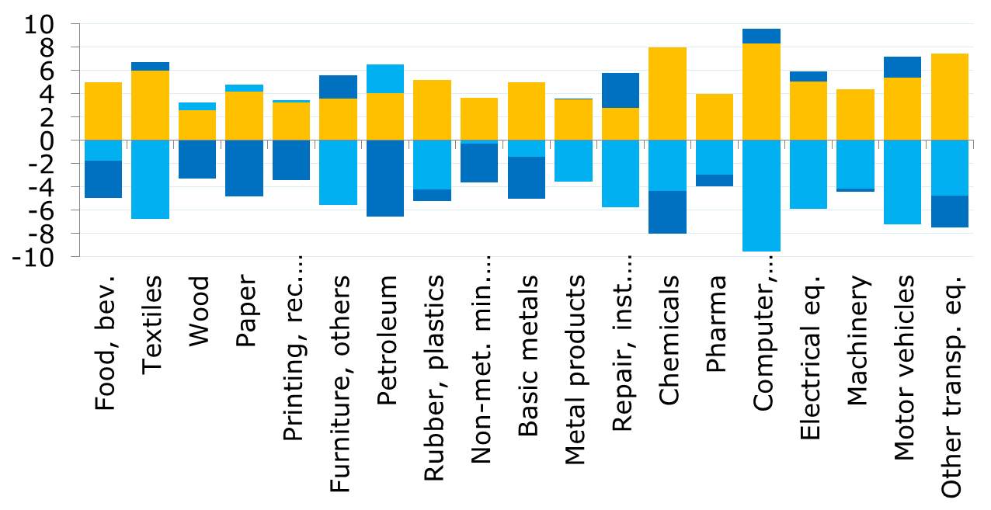
Lower direct value added for low-medium tech and higher RoW inputs for high-tech
pp change
(2004-2014)
Simple average by sub-sector
L
-2/-2/+4
M
-2/-2/+4
H
-1/-6/+6
Notes:
Change between 2004 and 2014 of corresponding shares in previous slide

Slide 29
EU services as the main source of indirect value added for all industries but petroleum
Contribution of indirect value added (¢ / $ EU Y) 2014
EU
RoW
L
M
H
Notes:
By sub-sector of value added generation
USD cents of indirect value added embodied in 1 USD of global final demand of manufacturing products of industry 'i' produced by the EU, by region (EU/RoW) and sub-sector of value added generation
Min-Max colour scales work for each final manufacturing industry (i.e. horizontal reading)

Slide 30
Increasing RoW participation, particularly along the full value chain of electronics
RoW share in indirect value added
2014 (%)
Change 2004-2014 (pp)
L
M
H
Notes:
By sub-sector of value added generation
Left-hand side of the table
Ratio = 1 / 2
1 = (indirect) value added in RoW embodied in global final demand of manufacturing products of industry 'i' produced by the EU
2 = indirect value added in EU embodied in global final demand of manufacturing products of industry 'i' produced by the EU
Right-hand side of the table
Change of the ratio between 2004 and 2014
Colour scales work for all final manufacturing industries (i.e. across all industries and sub-sectors of value added generation):
Min-Max on the left
Negative (blue; i.e. higher EU share) – Positive (red; i.e. higher RoW share)

Slide 31
Service structure relatively homogenous except for utilities-intensive industries
Contribution of EU&RoW indirect value added (¢ / $ EU Y) (2014)
L
M
H
Notes:
By service industry of value added generation
USD cents of indirect value added embodied in 1 USD of global final demand of manufacturing products of industry 'i' produced by the EU, by region (EU/RoW) and service industry of value added generation
Min-Max colour scales work for each final manufacturing industry (i.e. horizontal reading)

Slide 32
Petroleum and electronics using a high share of RoW service inputs
RoW share in indirect value added
2014 (%)
Change 2004-2014 (pp)
L
M
H
Notes:
By selected service industries of value added generation
Left-hand side of the table
Ratio = 1 / 2
1 = (indirect) value added in RoW embodied in global final demand of manufacturing products of industry 'i' produced by the EU
2 = indirect value added in EU embodied in global final demand of manufacturing products of industry 'i' produced by the EU
Right-hand side of the table
Change of the ratio between 2004 and 2014
Colour scales work for all final manufacturing industries (i.e. across all industries and sub-sectors of value added generation):
Min-Max on the left
Negative (blue; i.e. higher EU share) – Positive (red; i.e. higher RoW share)

Slide 33
"The share of non-EU value added increased across all EU manufacturing industries, but particularly in some high-tech industries, such as electronics, in which the loss of EU participation was along the full value chain"

Slide 34
1
The eu production network: the role of new members
2
3

Slide 35
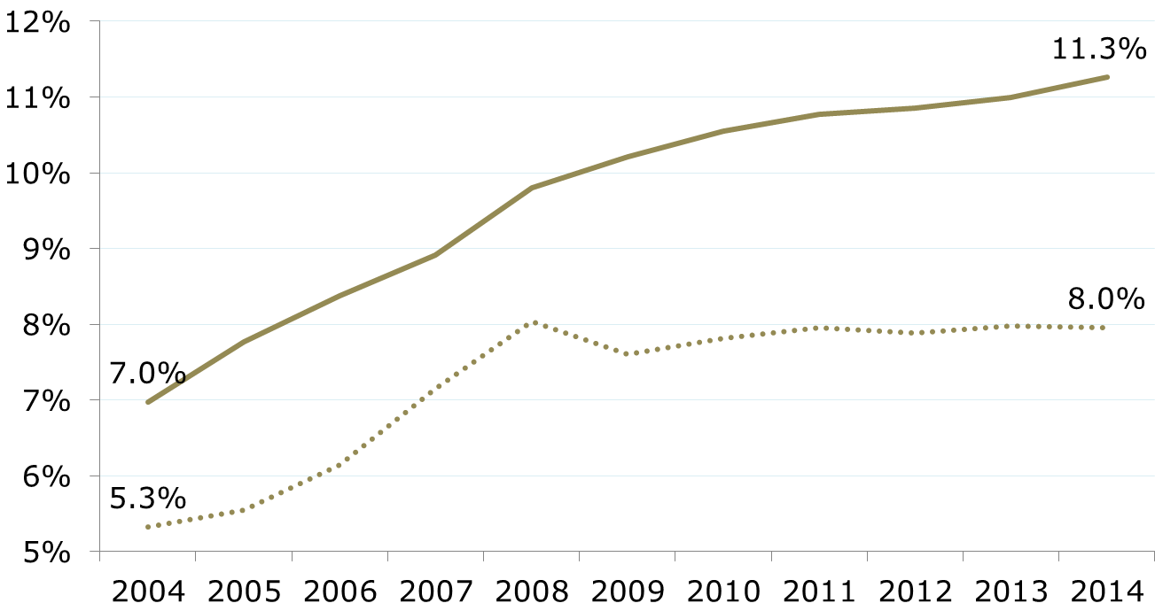
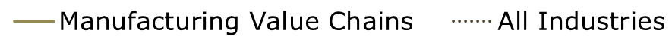
EU13 becomes generally more specialized in manufacturing value chains
% participation in EU value added
Notes:
General definition of ratio = 1 / 2
1 = Value added in EU13 embodied in global final demand of products produced by EU
2 = Value added in EU embodied in global final demand of products produced by EU
Final demand of ALL products
EU13 = Bulgaria, Croatia, Cyprus, Czech Republic, Estonia, Hungary, Latvia, Lithuania, Malta, Poland, Romania, Slovenia and Slovakia

Slide 36
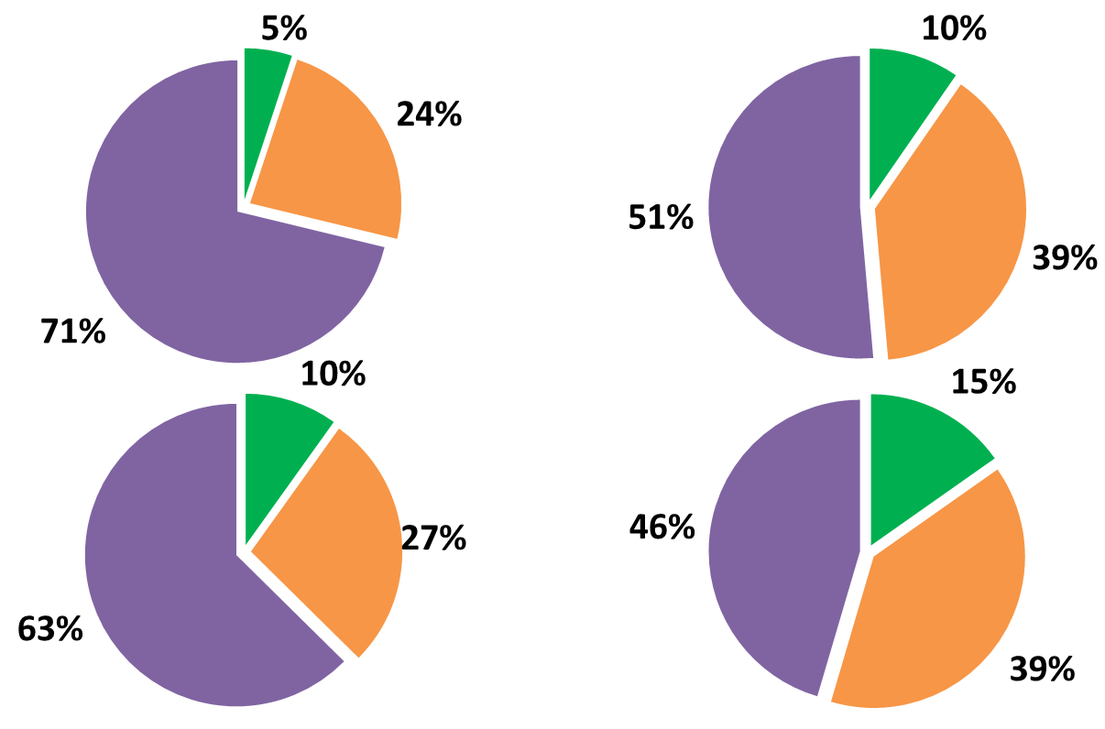
EU13 relatively more upstream and less service-oriented
Upstream inputs
Downstream inputs
¢/$ EU Y
Indirect value added in EU15
23.9¢
20.1¢
3.0¢
2.6¢
Indirect value added in EU13
Notes:
2014
Indirect value added in the EU embodied in global final demand of manufacturing products produced by the EU
Distribution of the corresponding figures in Slide 18 for indirect value added in the EU
Distribution of sectoral indirect value added for four categories according to the following two criteria (A&B):
A = stage of the value chain
A1/ Upstream inputs = value added generated when providing inputs except to the final producer
A2/ Downstream inputs = value added generated when providing inputs to the final producer
B = region of generation of value added (EU13 or EU15)
Values on the centre of each circle correspond to USD cents of indirect value added embodied in 1 USD of global final demand of manufacturing products produced by the EU

Slide 37
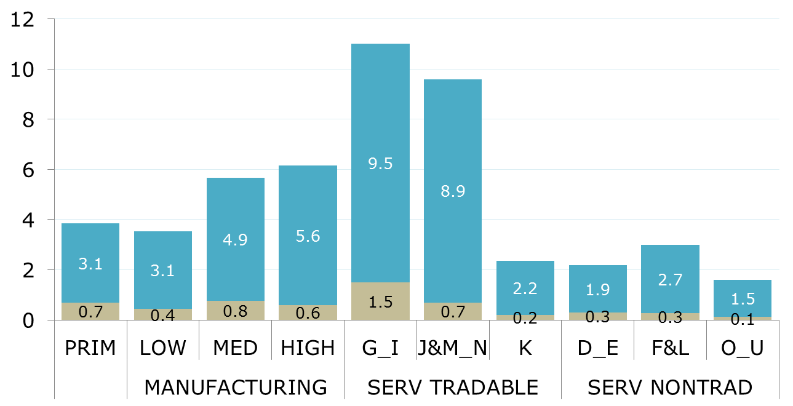
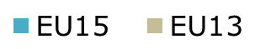
EU13 specialized in providing primary inputs and logistics for manufacturing chains
¢ EU VA / $ EU Y (2014)
44¢
6¢
11%
EU13
share
Notes:
2014
USD cents of indirect value added embodied in 1 USD of global final demand of manufacturing products produced by the EU, by sub-sector and region (EU13/EU15) of value added generation
'EU13 share' at the bottom is the ratio between the brown bar and the blue bar

Slide 38
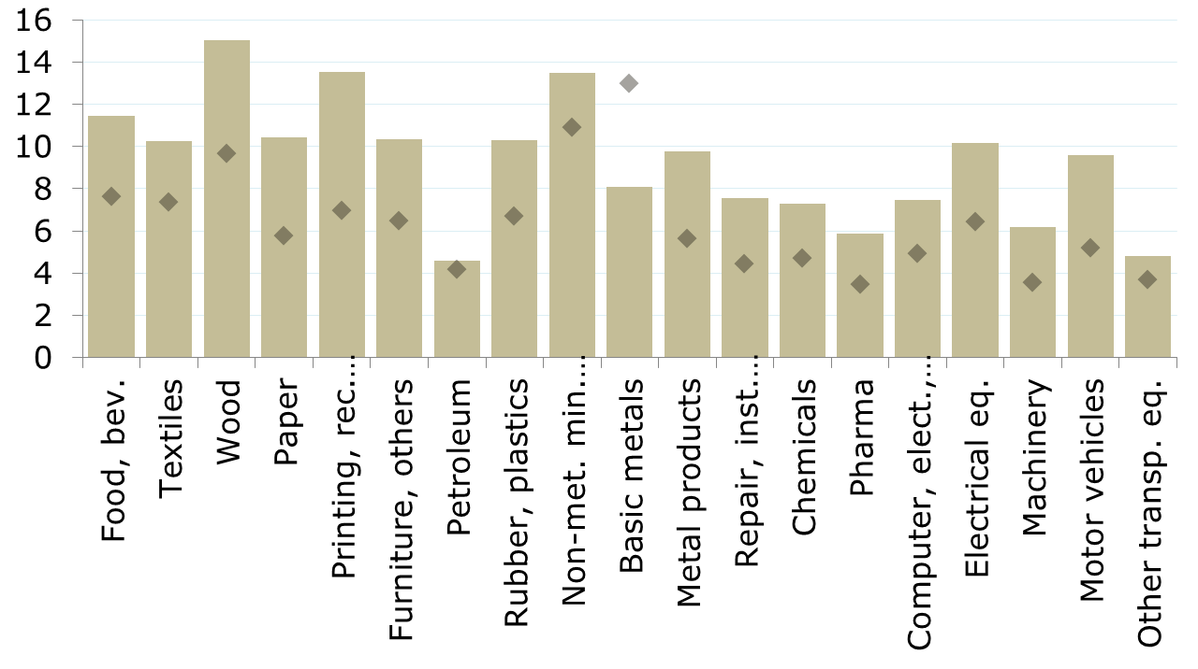
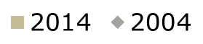
EU13 specialized in low-medium tech chains but gaining share across the board
¢ EU13 VA / $ EU Y
Total
MAN
(2014)
L
M
H
EU13 share
11%
Notes:
USD cents of value added in the EU13 embodied in 1 USD of global final demand of manufacturing products produced by the EU, by final manufacturing industry
'EU13 share' at the bottom is the ratio = 1 / 2
1 = Value added in the EU13 embodied in 1 USD of global final demand of manufacturing products of industry 'i' produced by the EU
2 = Value added in the EU13 embodied in 1 USD of global final demand of manufacturing products of industry 'i' produced by the EU
The dotted line (Total MAN) corresponds to the 2014 value for the aggregate of final manufacturing industries

Slide 39
EU13 providing more logistics vs. business services for all manufacturing
Contribution of indirect value added (¢ / $ EU Y) 2014
EU15
EU13
L
M
H
Notes:
By sub-sector of value added generation
USD cents of indirect value added in the EU embodied in 1 USD of global final demand of manufacturing products of industry 'i' produced by the EU, by region (EU13/EU15) and sub-sector of value added generation
Min-Max colour scales work within each regional section (EU13/EU15) of the table and for each final manufacturing industry (i.e. horizontal reading)

Slide 40
Increasing EU13 participation in electronics, electrical and autos value chains
EU13 share in EU indirect value added
2014 (%)
Change 2004-2014 (pp)
L
M
H
Notes:
By sub-sector of value added generation
Left-hand side of the table
Ratio = 1 / 2
1 = (indirect) value added in RoW embodied in global final demand of manufacturing products of industry 'i' produced by the EU
2 = indirect value added in EU embodied in global final demand of manufacturing products of industry 'i' produced by the EU
Right-hand side of the table
Change of the ratio between 2004 and 2014
Colour scales work for all final manufacturing industries (i.e. across all industries and sub-sectors of value added generation):
Min-Max on the left
Negative number (blue i.e. higher EU15 share) – Positive number (brown; i.e. higher EU13 share)

Slide 41
"The new EU members increased their role in manufacturing chains faster than in the rest of the economy: across all industries, specialized in primary inputs and logistics, and with particular gains in high-tech manufactures"

Slide 42
1
The eu in external production networks: PARTICIPATION OVERVIEW
2
3

Slide 43
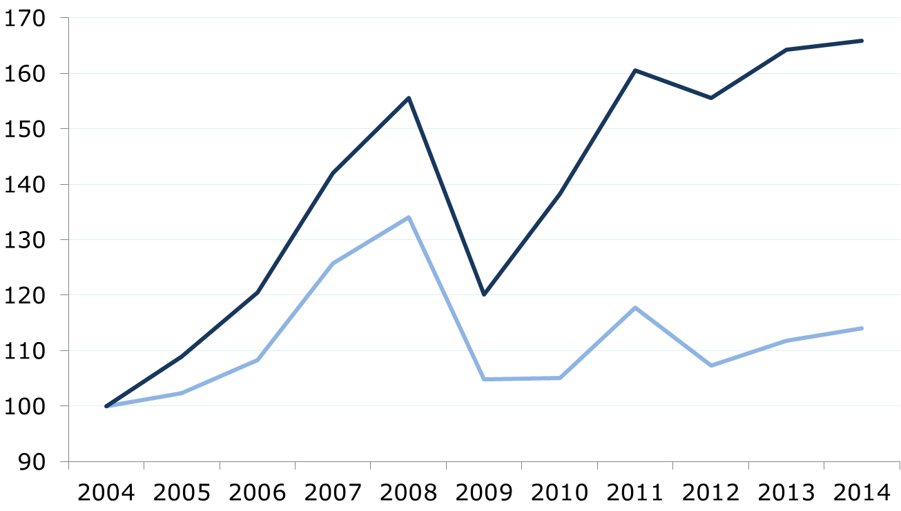
EU value added increasingly driven by non-EU manufacturing chains
Index 100 = 2004
EU value added in RoW final production
EU value added in EU final production
Notes:
USD values drawn as indices based on 2004
(Indirect) value added in the EU embodied in global final demand of manufacturing products produced by RoW
Value added in the EU embodied in global final demand of manufacturing products produced by EU

Slide 44
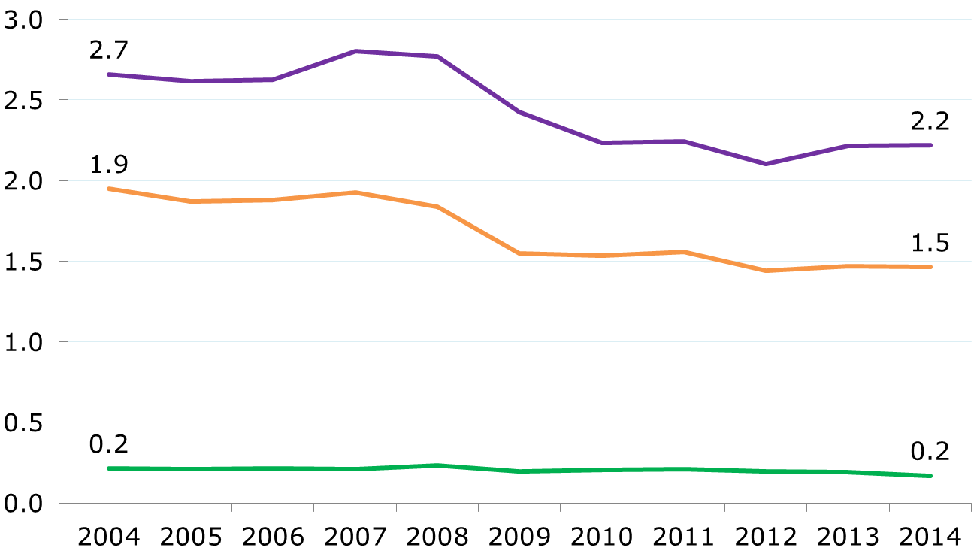
However, EU losing share per unit of non-EU production
¢ EU VA / $ RoW Y
Notes:
USD cents of (indirect) value added in the EU embodied in 1 USD of global final demand of manufacturing products produced by RoW, by sector of value added generation

Slide 45
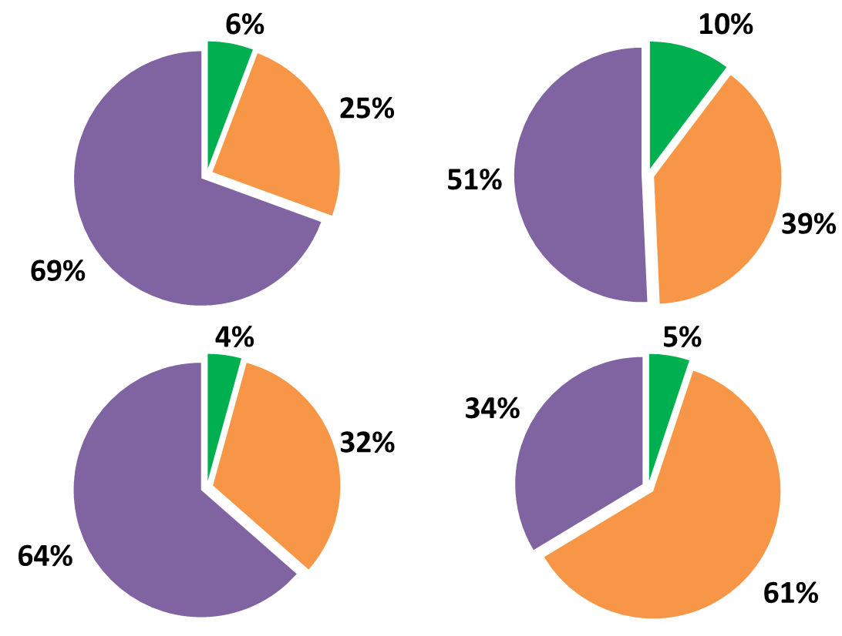
EU participation abroad: larger role for inputs for manufacturing inputs
Upstream inputs
Downstream inputs
EU VA
EU final production
$884B
$764B
RoW final production
$369B
$92B
Notes:
2014
Indirect value added in the EU embodied in global final demand of manufacturing products produced by the EU/RoW
Distribution of sectoral indirect value added for four categories according to the following two criteria (A&B):
A = stage of the value chain
A1/ Upstream inputs = value added generated when providing inputs except to the final producer
A2/ Downstream inputs = value added generated when providing inputs to the final producer
B = region of final production (EU or RoW)
Values on the centre of each circle correspond to indirect value added in the EU embodied in global final demand of manufacturing products in each of the four categories explained above

Slide 46
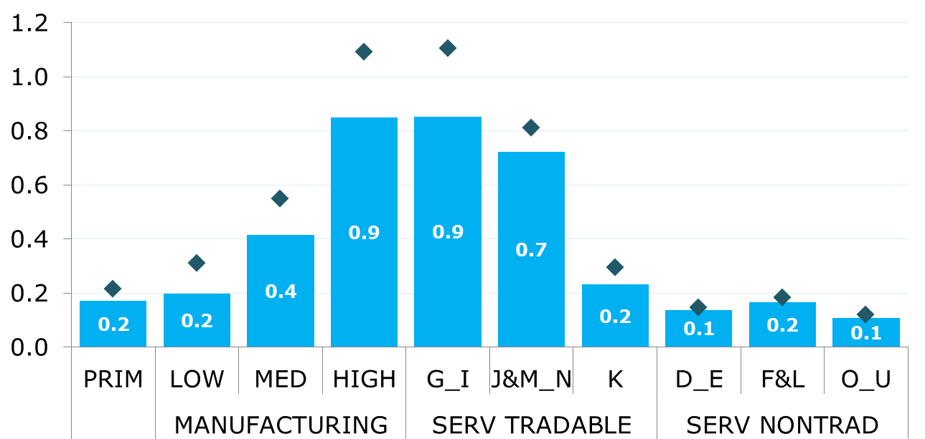
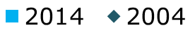
High-tech inputs and logistic services as the main source of indirect value added
¢ EU VA / $ RoW Y
Notes:
USD cents of (indirect) value added in the EU embodied in 1 USD of global final demand of manufacturing products produced by RoW, by sub-sector of value added generation

Slide 47
1
The eu in external production networks: MANUFACTURING INDUSTRIES
2
3

Slide 48
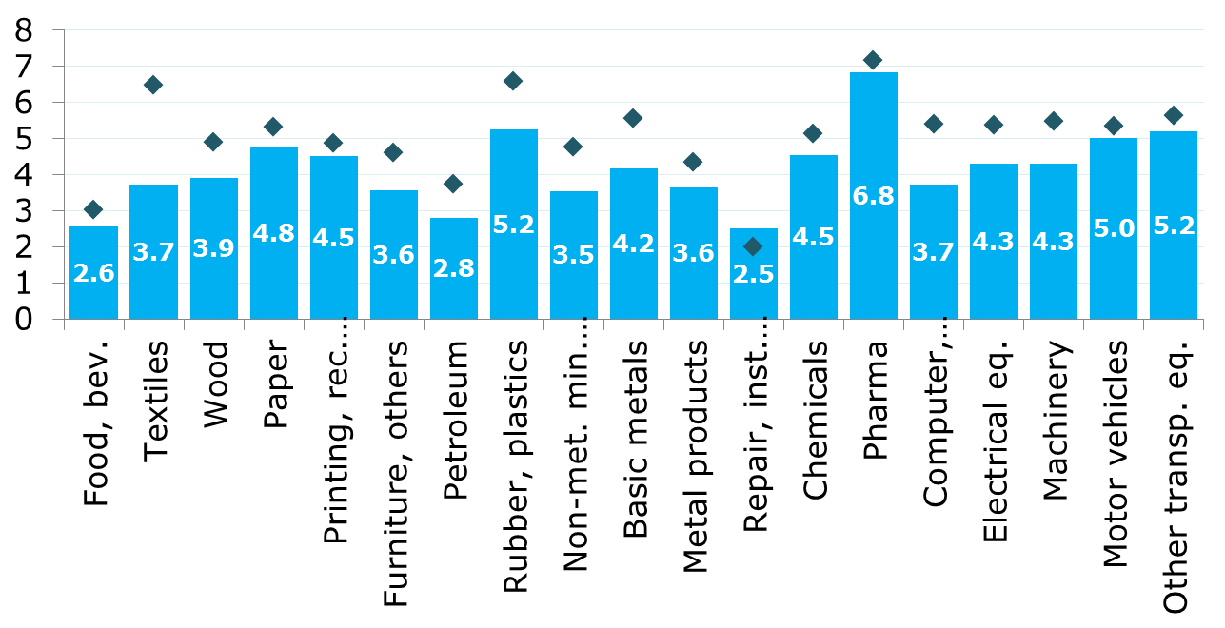
EU share higher in (broad) chemicals, autos and aircraft, big loss in textile & electronics
¢ EU VA / $ RoW Y
Total
MAN
(2014)
L
M
H
Notes:
USD cents of value added in the EU embodied in 1 USD of global final demand of manufacturing products produced by RoW, by final manufacturing industry
The dotted line (Total MAN) corresponds to the 2014 value for the aggregate of final manufacturing industries

Slide 49
High-tech for high-tech, logistics for the rest, homogenous business services
EU value added in RoW production (¢ / $ RoW Y)
2014
Change 2004-2014
L
M
H
Notes:
By sub-sector of value added generation
Left-hand side of the table
Ratio = 1 / 2
1 = (indirect) value added in RoW embodied in global final demand of manufacturing products of industry 'i' produced by RoW
2 = indirect value added in EU embodied in global final demand of manufacturing products of industry 'i' produced by RoW
Min-Max colour scale work for each final manufacturing industry (i.e. horizontal reading)
Right-hand side of the table
Change of the ratio between 2004 and 2014
Colour scale work for all final manufacturing industries (i.e. across all industries and sub-sectors of value added generation): Negative (blue; i.e. higher EU share) – Positive (red; i.e. higher RoW share)

Slide 50
"EU value added abroad grew faster on foreign demand dynamics, with some specialization differences with EU manufacturing chains: input upstreamness, value added in high-tech and logistics, serving chemical-related, autos and aircraft final industries"

Slide 51
"However, participation in non-EU manufacturing production chains generally decreased, particularly in electronics and textiles"

Slide 52
1
The eu in external production networks: the role of new members
2
3

Slide 53
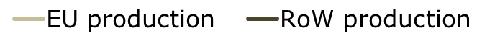
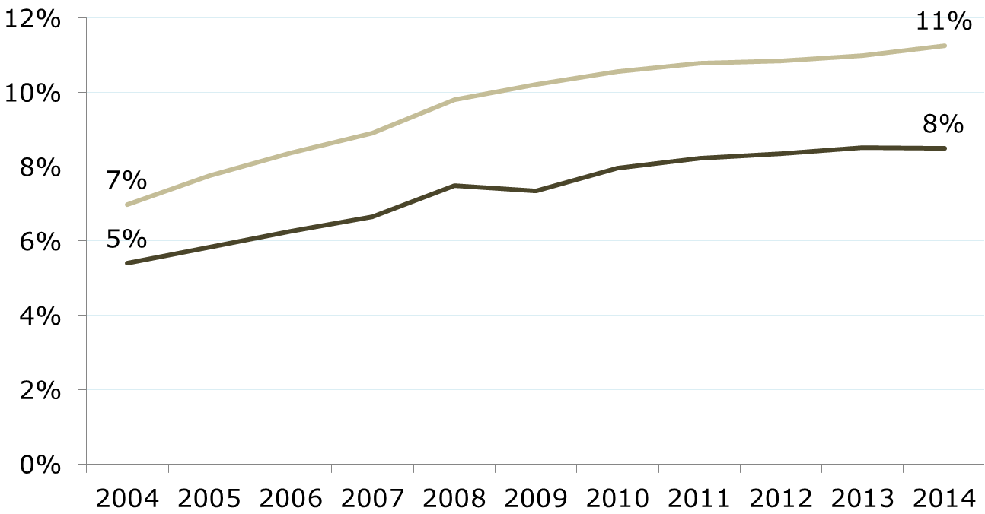
EU13 participation in RoW vs. EU production chains: lower and growing less
Notes:
EU production ratio = 1 / 2
1 = Value added in EU13 embodied in global final demand of products produced by the EU
2 = Value added in EU embodied in global final demand of products by the EU
RoW production ratio = 3 / 4
3 = Value added in EU13 embodied in global final demand of products produced by RoW
4 = Value added in EU embodied in global final demand of products by RoW

Slide 54
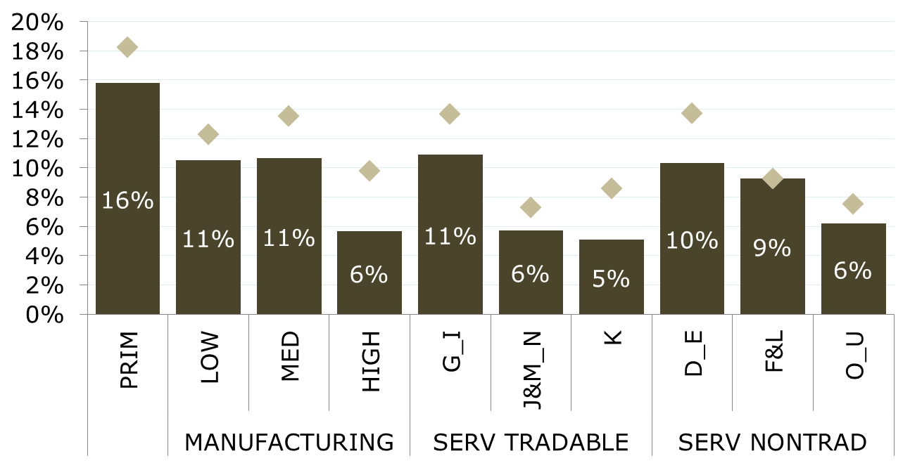
EU13 participation particularly lower providing high-tech inputs
Notes:
2014
By sub-sector of value added generation
EU production ratio = 1 / 2
1 = Value added in EU13 embodied in global final demand of products produced by the EU
2 = Value added in EU embodied in global final demand of products by the EU
RoW production ratio = 3 / 4
3 = Value added in EU13 embodied in global final demand of products produced by RoW
4 = Value added in EU embodied in global final demand of products by RoW

Slide 55
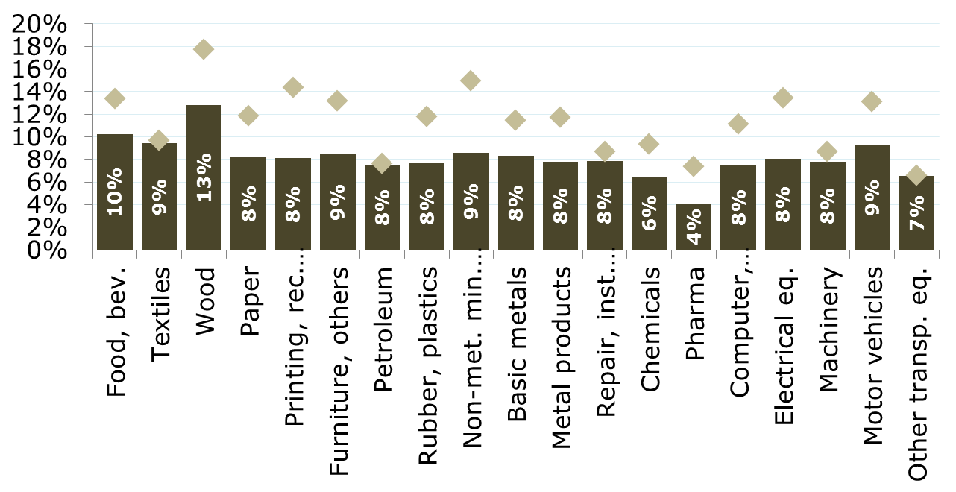
Share in RoW production lower across most production chains, no tech correlation
Total
MAN
L
M
H
Notes:
2014
By final manufacturing industry
EU production ratio = 1 / 2
1 = Value added in EU13 embodied in global final demand of products produced by the EU
2 = Value added in EU embodied in global final demand of products by the EU
RoW production ratio = 3 / 4
3 = Value added in EU13 embodied in global final demand of products produced by RoW
4 = Value added in EU embodied in global final demand of products by RoW
The dotted line (Total MAN) corresponds to the 'RoW production' value for the aggregate of final manufacturing industries

Slide 56
"The new members increased their participation abroad at a slower pace than in EU production chains, being particularly limited providing high-tech manufacturing inputs and services other than logistics"

Slide 57
MAIN CAVEATS

Slide 58
Main caveats
  No exchange rate adjustment: partially solved when using net changes for 2004-2014
  No price adjustment: industry-country differences could be substantial (e.g. commodities vs. capital goods)
  Accounting methodological changes, particularly affecting retail trade and R&D between 2008 and 2010

Slide 59
Further Deliverables
(deadline to be defined)
  Taking the analysis and results of Sections 1 to 3 and moving to the country perspective: How different do EU member states fare relative to manufacturing value chains?
  Additional analysis on non-EU competitors: Where does value added lost in the EU go? Is that homogenous across manufacturing industries?

Slide 60
THANK YOU!

