Slide 1
The EU share in global value added: contributing factors between 2000 and 2014

Slide 2
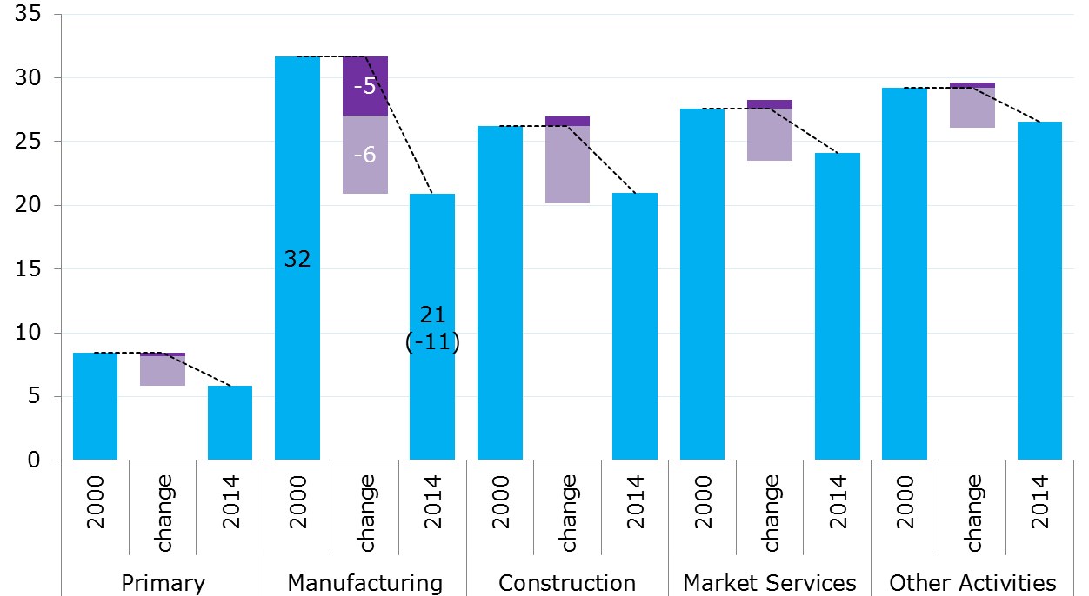
By sector of value added EU share as % of global value added* and change by contributing factor
Participation effects
Demand effects
*Chain-linked volumes (2014)
Notes:
-Value added in the EU as a % of total value added in the world for each broad sector: primary (A&B), Manufacturing (C), Construction (F), Market Services (G to N, R&S), Other Activities (D&E, O to Q, T&U)
-Participation effects refer to changes in the distribution of value added generated by one unit of final demand for a given product in a given country
-Demand effects refer to changes in the volume and composition of final demand
-According to this figure, the participation of the EU in global value added has fallen across all sectors between 2000 and 2014: -3pp for primary, market services and other activities, -5pp for construction and -11pp for manufacturing, compared with an overall decline of -4pp
-The general fall has been largely driven by demand effects, being particularly negative for value added in construction and manufacturing
-Participation effects have been significantly negative only for value added in manufacturing, accounting for 40% of the decline in that sector (-4.6 vs. -6.2 by demand effects for an aggregate fall of 10.8pp)

Slide 3
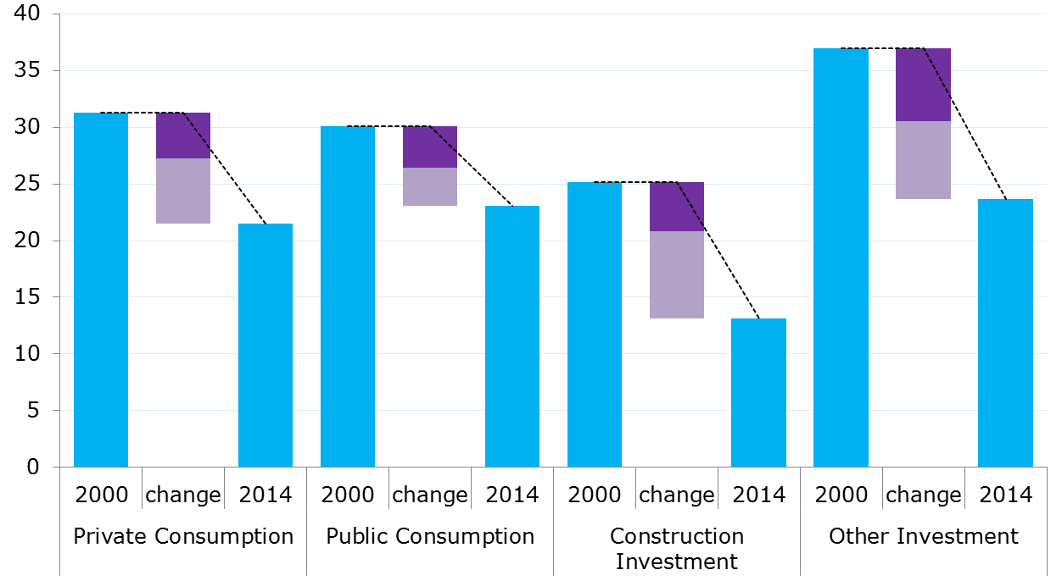
Value added in manufacturing, by component of final demand EU share as % of global value added* and change by contributing factor
Participation effects
Demand effects
% EU manufacturing VA (2014)
54%
8%
10%
28%
*Chain-linked volumes (2014)
Notes:
Now we turn to the specific case of value added in the manufacturing sector
-Value added in the manufacturing sector in the EU as a % of total value added in the manufacturing sector in the world by component of final demand: Private Consumption, Public Consumption, Construction Investment (investment in products from F sector) and Other Investment (all other investment products: machinery, equipment,…)
[both investment components include private and public investment]
-According to this figure, the participation of the EU in global value added in manufacturing has fallen significantly across all components of final demand between 2000 and 2014: -7pp for public consumption, -10pp private consumption, -12pp construction investment and -13pp other investment, compared with the overall decline of -11pp shown in the previous slide
[manufacturing value added in the EU was distributed as follows in 2014: 8% associated with public consumption, 10% with construction investment, 28% with other investment and 54% with private consumption]
-The fall was driven across the board by negative both demand and participation effects, being demand effects more adverse for the two investment components

