Slide 1
Peppol ViDA Pilot
eDelivery Interoperability Forum meeting
Wednesday, 27th February 2025
Lefteris Leontaridis
OpenPeppol Operations Manager

Slide 2
Contents
The Peppol Ecosystem
Peppol Interoperability Framework
The ViDA Pilot Project

Slide 3
1. The Peppol Ecosystem

Slide 4
About Peppol and OpenPeppol
Peppol
is what we do
A global ecosystem for the
exchange of electronic invoices
and other business documents
OpenPeppol
is who we are
An international non-profit Association,
based in Brussels, with members
from 41 countries all over the world

Slide 5
Peppol stakeholders
End
Users
Service
Providers
Peppol
Authorities
Buyers and sellers that
send and receive
business documents
____________________________
End Users are not required
to be OpenPeppol members
to send and receive
Peppol messages
They provide business process interoperability between End Users
____________________________
All provide Peppol Access Point services and some also provide Addressing and Capability Lookup Services
They are policy enablers
that drive Peppol
adoption in a jurisdiction
____________________________
Currently, all Peppol Authorities are
Government
departments or agencies
Notes:
Role of the PA
- authoritative source for requirement in a jurisdiction
- signing SP agreements in the governance framework
- promotion of Peppol
- participation in Peppol Authority Community

Slide 6
The original challenge
Supplier 1
Buyer 1
Supplier 2
Buyer 2
No interoperable mechanism for businesses to connect with each other on a bilateral basis
Supplier 3
Buyer 3
Supplier 4
Buyer 4
Supplier 5
Buyer 5
Supplier 6
Buyer 6
Supplier 7
Buyer 7
Supplier 8
Buyer 8

Slide 7
Four-corner model and key features
Each sender and receiver:
utilises their own system/software
need only one service provider
can choose any service provider
is not locked in to a service provider
Service providers convert documents to standard specifications
Dynamic discovery locates other service providers and end users
Messages sent over secure internet
No fees between service providers
Service provider charges their client
Potential to exchange any document type
Options
Options
Options
Dynamic
Discovery
Options
Options

Slide 8
Peppol CTC – a model for businesses and tax administrations
(Peppol specifications as common denominator. Domestic scenario)
Options
Options
Options
Options
Options
Dynamic
Discovery
Options
Options
Options

Slide 9
Peppol CTC – a model for businesses and tax administrations
(Peppol specifications as common denominator. Cross-border scenario)
Options
Options
Options
Country X
Options
SML
SMP
Options
Options
Country Y
Options

Slide 10
2. Peppol Interoperability Framework

Slide 11
What is needed for interoperability?
Governance
Network
Specifications
Legal agreements, policies, and procedures between stakeholders
________________________
Defines the rules under which Peppol activity is undertaken
Network architecture
with a four-corner
model
________________________
Enables Peppol-certified Service Providers to
send and receive
Peppol documents
Peppol Business Interoperability Specifications ________________________
Process flow, document content and format exchanged between Service Providers

Slide 12
High level view
Agreements
Peppol Governance Framework
Policies and Procedures
Peppol Interoperability Framework
Technical Specifications
Peppol Architectural Framework

Slide 13
Peppol Interoperability Framework vs. EIF
Refined EIF
Peppol Interoperability Framework
Peppol Governance Framework
Legal Interoperability
  Authority Agreement
  Service Provider Agreement
  General Provisions
  Domain Specific
  Requirements
  PA Specific
  Requirements
  Policies for the Use of the Peppol Network (Internal Regulations Part II)
Organisational interoperability
  Specifications and Capabilities
  Operational Procedures for the Use of the Peppol Network
  Certification and Accreditation
  Specific policies and procedures
Business Process Interoperability
Peppol Architectural Framework
  Peppol message specifications
  Peppol Network specifications
Semantic Interoperability
  Peppol Business Interoperability Specifications – Peppol BIS
  Packaging and Security
  Messaging
Technical Interoperability
  PA governed specifications
  Capability lookup and addressing

Slide 14
Accommodating national requirements
Peppol Interoperability Framework
Peppol Governance Framework
  Authority Agreement
  Service Provider Agreement
National and
Domain Specific
Requirements
For Tax Reporting
  General Provisions
  Domain Specific
  Requirements
  PA Specific
  Requirements
  Policies for the Use of the Peppol Network (Internal Regulations Part II)
  Specifications and Capabilities
  Operational Procedures for the Use of the Peppol Network
  Certification and Accreditation
  Specific policies and procedures
Peppol Architectural Framework
  Peppol message specifications
  Peppol Network specifications
  Peppol Business Interoperability Specifications – Peppol BIS
  Packaging and Security
  Messaging
  PA governed specifications
  Capability lookup and addressing

Slide 15
3. The ViDA Pilot Project

Slide 16
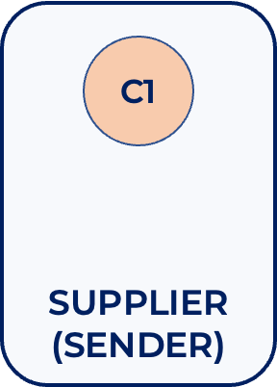



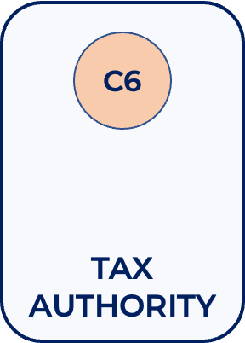
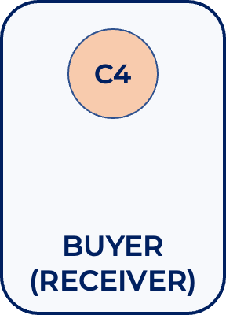

Peppol Network – six corner model = three x four
Matching
Reconciliation
Document UUID
Transmission UUID
Message
Level
Status
SML
SMP
Tax
Data
Status
Notes:
3x Reuse of four corner model

Slide 17
Peppol Network – CTC cross-border model
COUNTRY A
COUNTRY A
SML
Tax
Data
Status
COUNTRY B
SMP
COUNTRY A

Slide 18
Workplan structure
WS3: Implementation
WS1: Consult Tax Administrations
WS2: Architecture and Specifications
WS4: Communication and Reference Group
WS5: Project management and coordination

Slide 19
Project time plan (high-level)

Slide 20
Get involved
If you want to participate, contact us
  Active participants – those who will implement the flows and test
  Reference Group – receiving information and providing feedback
OpenPeppol members only (can be Observers)
Tax Administrations and other public Authorities do not need to be members

