Slide 1
OOTS
Guidance
For teams across the EU working on the implementation of the Once-Only Technical System

Slide 2
About this guidance
This guidance was created through a collaborative process between the Commission and the Member States.
It is intended to provide a high-level overview and introduction to the way the Once-Only Technical System (OOTS) will work, and we hope it is useful to a broad range of stakeholders.
There are, of course, variations and choices Member States will need to make for their specific implementations that will depend on their preferences and existing IT landscape that are not represented here.
The scenario used to illustrate the guidance is where the user is retrieving evidence from 1 provider. There may be cases where users are retrieving evidence from more than 1 provider in more than 1 Member State.

Slide 3
7 key steps in the once only journey
Scope of the OOTS
0 | 1 | 2 | 3 | 4 | 5 | 6 | 7
Discover the OOTS | Authenticate | Locate evidence | Evidence Request | Redirect | Preview | Evidence response | Submit
Understand you can retrieve evidence from the issuer | Authenticate with an eIDAS notified eID scheme | Locate the evidence type and evidence provider | Request evidence exchange | Redirect to preview (if applicable) | Preview the evidence | Confirm use of evidence | Submit procedure for processing

Slide 4









Architectural design of the once only system
Evidence Requester MS A
Evidence Provider MS B
Authentication Service
eIDAS Node
eIDAS Node
Identity provider
Procedure Portal
eDelivery AP
eDelivery AP
Preview Space
Evidence Provider
Evidence Broker
Data Services Directory
Semantic Repo
EC Common Services

Slide 5
Mapping of architecture to user journey
Evidence Requester MS A
Evidence Provider MS B
1. Authentication
eIDAS Node
eIDAS Node
Identity provider
Procedure Portal
eDelivery AP
eDelivery AP
Preview Space
Evidence Provider
4. Redirect
7. Submit
3. Evidence Request
6. Evidence response
5. User preview
Evidence Broker
Data Services Directory
Semantic Repo
2. Locate evidence
EC Common Services
Once-Only Domain

Slide 6
Mapping of architecture to Implementing Regulation
Evidence Requester MS A
Evidence Provider MS B
Authentication Service
eIDAS Node
eIDAS Node
Identity provider
Art. 11
Art. 3
Procedure Portal
eDelivery AP
eDelivery AP
Preview Space
Evidence Provider
Art. 3
Art. 15
Art. 9
Art. 8
Art. 10
Evidence Broker
Data Services Directory
Semantic Repo
Art. 16
Art. 12
Art. 13
Art. 14
Art. 4
Art. 17
Art. 6
Art. 5
Art. 7

Slide 7
Once only steps
1. Authenticate | 2. Locate evidence | 3. Evidence Request | 4. Redirect | 5. Preview | 6. Evidence Response | 7. Submit

Slide 8
1 Authenticate
Users must have an eIDAS enabled eID to request the exchange evidence through the Once-Only Technical System

Slide 9
User must authenticate to use the OOTS
Users begin their once only journey on a portal that offers access to one of the online procedures in scope of the Single Digital Gateway Regulation. Cross-border users will start the procedure by authenticating with their eID.
Only users who authenticate with an eIDAS means from a notified eID scheme will be able to request evidence through the Once-Only Technical System.
Procedure Portal
Login with your eID

Slide 10
User must select the MS that issued their eID
Once users have chosen to sign-in with their eID on the procedure website, they will typically be re-directed to the website of the national authentication provider on the evidence requester side.
Users must then select from a list, the Member State that issued their eID. If their eID was issued by another Member State, the user will then be redirected to the website of the selected national authentication service.
An authentication request is sent from the eIDAS node in the evidence requester Member State to the eIDAS node in the Member State that issued the users’ eID.
Authentication Service | Evidence Reuqester side
Select the MS that issued your eID
Member State
Member State
Member State
Member State

Slide 11

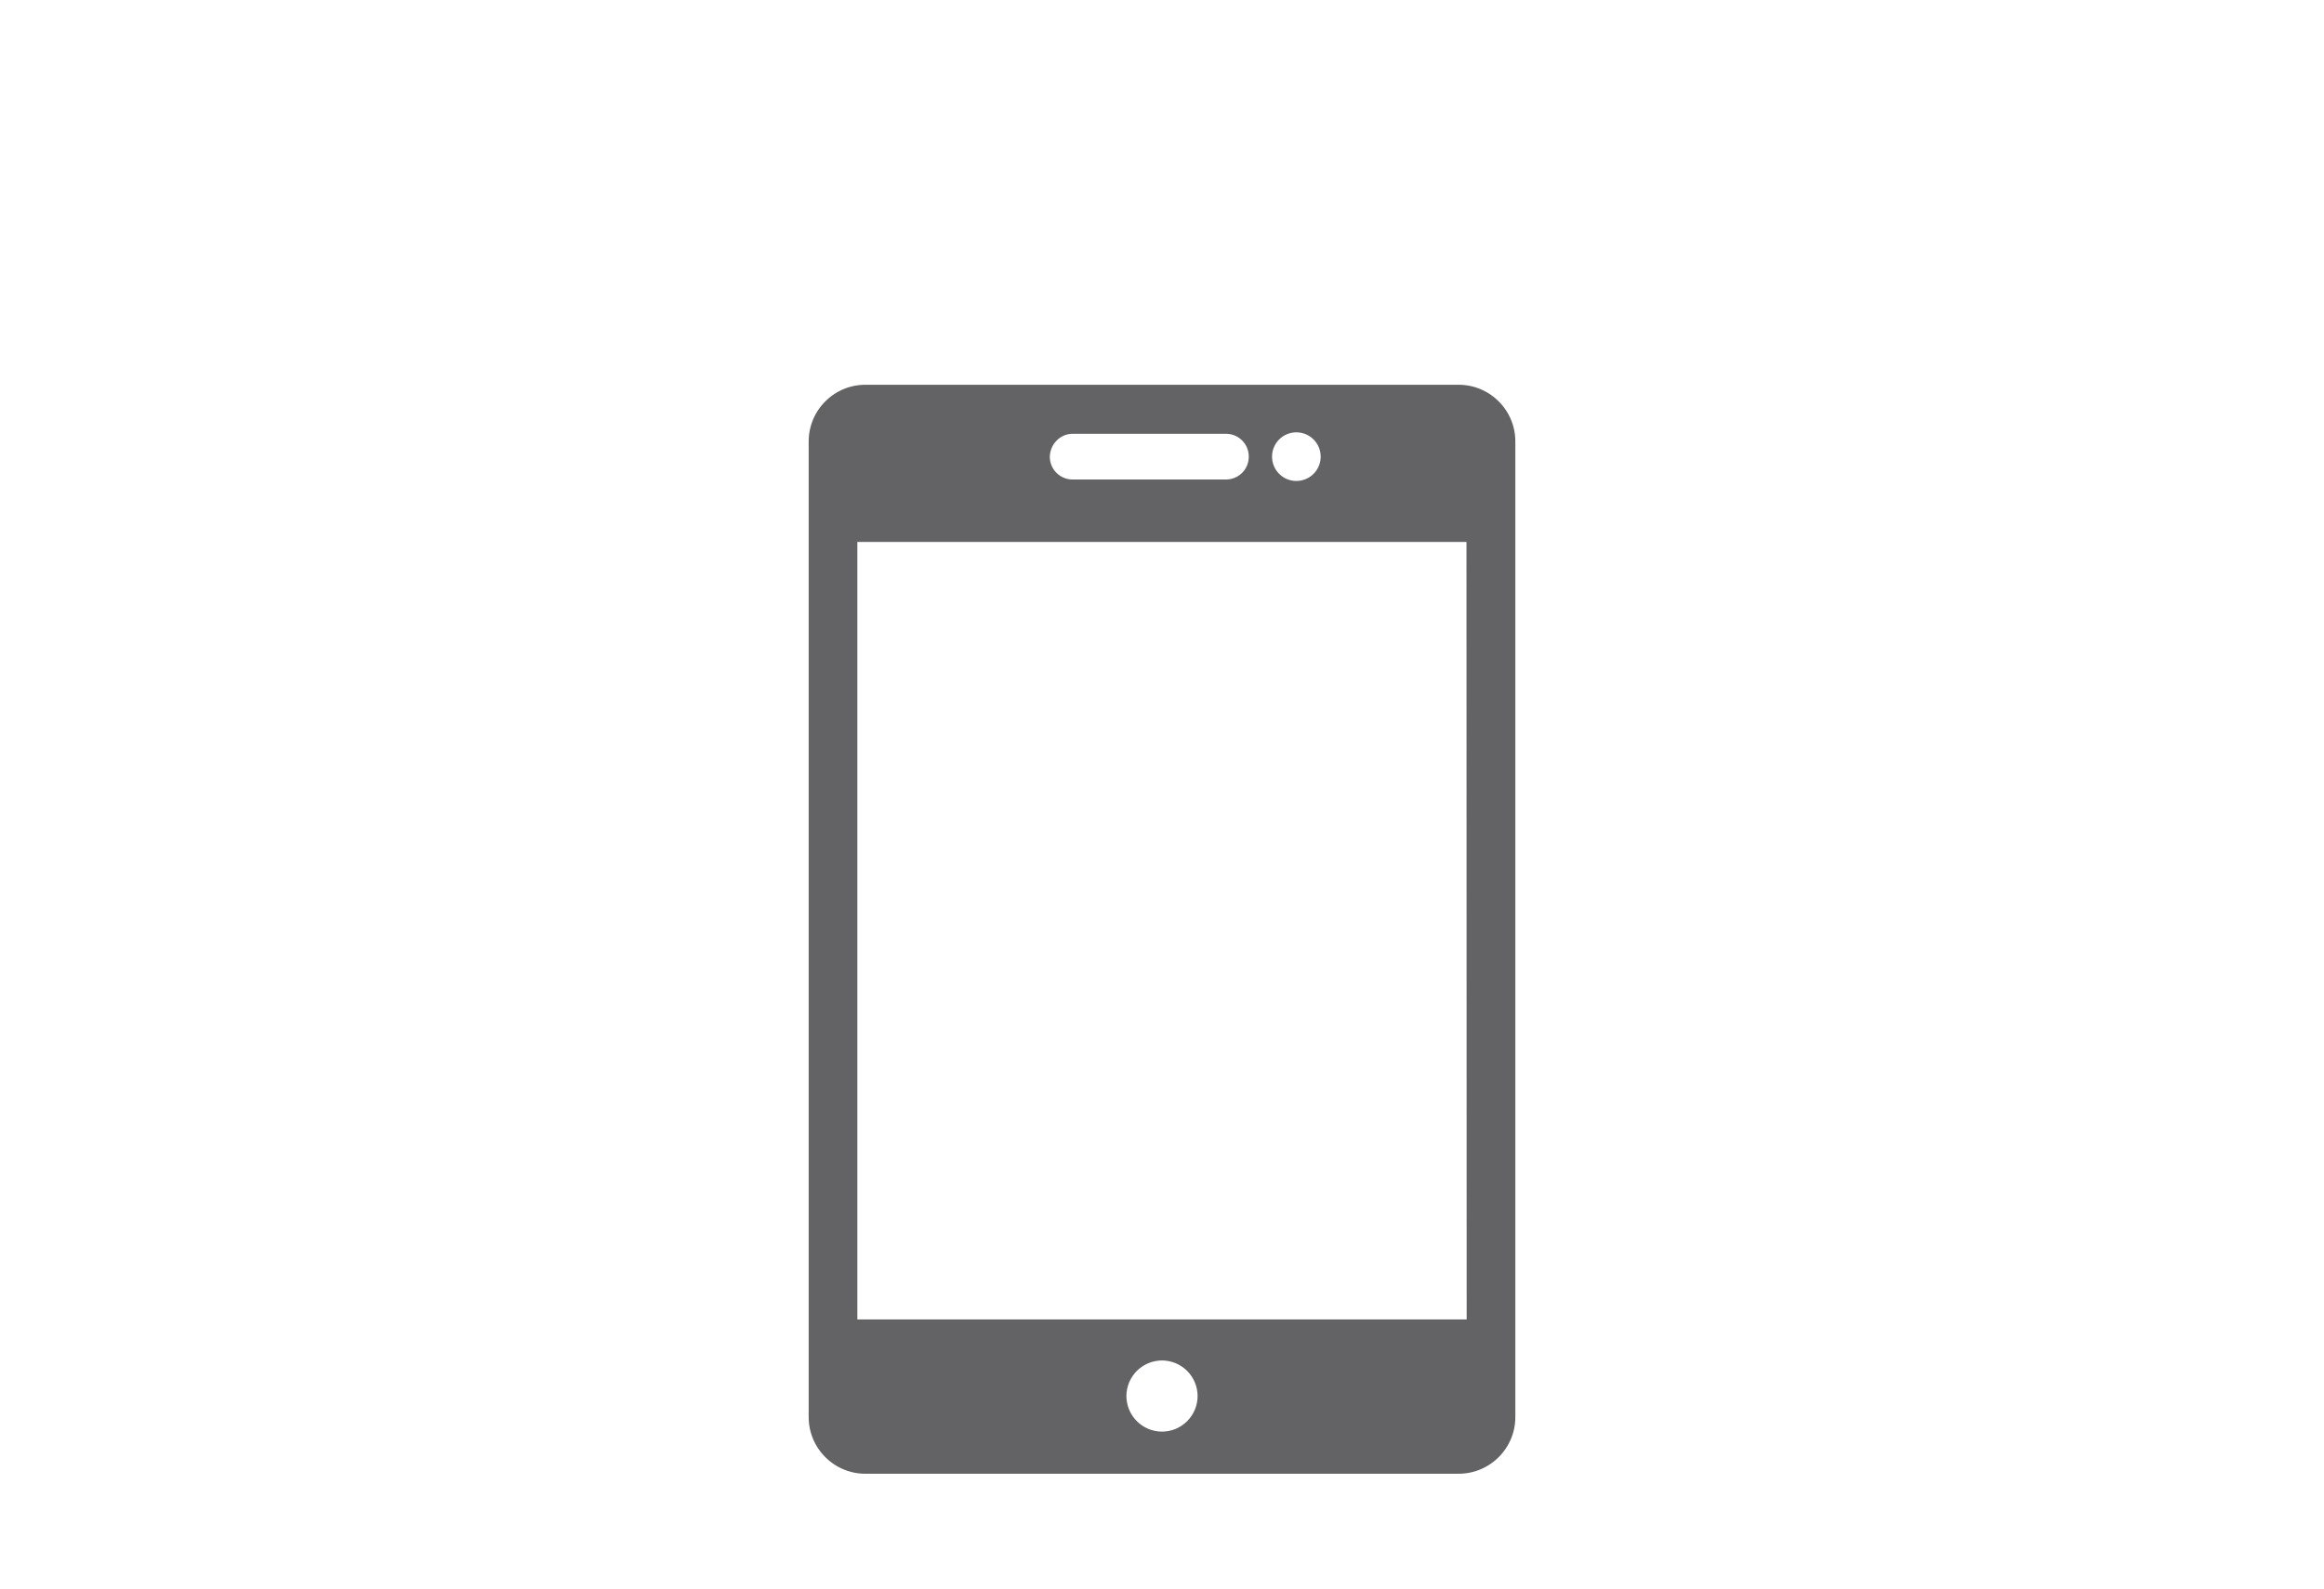
User must select their eID means
National authentication portals may provide users with multiple eID means to authenticate. Typically, these include a mobile app or an eID card reader. Users must authenticate with an eIDAS notified scheme or they won’t be able to exchange evidence via the Once-Only Technical System.
National Authentication Service in the MS that issued the users’ eID
How do you want to authenticate?
eID + Card Reader
Mobile App

Slide 12
User will be asked for consent
Users will be asked to consent to share their eIDAS attributes with the requesting service in the Member State where they are completing the procedure, this request for consent is performed by either by the national authentication service on the provider side and/or by the users’ identity provider. Once the user has successfully authenticated, they are re-directed back to the procedure portal.
Identity Provider
Service is requesting the following data:
Confirm

Slide 13
2 Locate evidence
The procedure portal must identify what to ask for (Evidence Type), and who to ask it from (Evidence Provider).

Slide 14
Users can choose to use once only
Using the Once-Only Technical System is not obligatory – users can still choose to use the Once-Only Technical System or upload the required documents manually.
Procedure Portal
Evidence required:
Upload
Get with OOTS

Slide 15

User must input where their evidence is located
The user needs to select the MS where their evidence is issued. If there are multiple evidences required, the user needs to be able to select the provider MS for each evidence.
Proceudure Portal
What country issued the evidence?
Select Country
Confirm

Slide 16
Determining the evidence type
If the portal does not already know what evidence type to request, the procedure portal sends a query to the Evidence Broker. The Evidence Broker allows the Evidence Requester to look up the right evidence type(s) to request from the Evidence Provider.
Evidence Requester
Evidence Broker
Evidence type query
Evidence type response

Slide 17
Determining the Evidence Provider
To determine who to send the request for evidence to, the portal sends a query to the Data Service Directory (DSD) with the evidence type (provided by the Evidence Broker) and Member State. The DSD returns the name of the Evidence Provider, the ID of the eDelivery Access point and if defined, any additional attributes required to locate the evidence provider.
Evidence Requester
Data Service Directory
Data service provider query
Data Service provider response

Slide 18
Selecting the Evidence Provider
In some cases, Member States may need information from the user to determine the right evidence provider. For example, users may be required to input a region or other data to help locate the evidence. These additional attributes will be registered in the DSD. When the portal makes the query to the DSD and the response includes a request for these additional attributes, the procedure portal will request them from the user and use the user’s input to query the DSD again and define the right evidence provider.
Proceudure Portal
Where is your evidence located?
Select a region
Confirm

Slide 19
Selecting the Evidence Provider
If the Data Service Directory returns multiple Evidence Providers for an evidence type the user will be asked to select the relevant Evidence Provider from a list. For example, if university diplomas are stored in each university rather than in a central database, the user will be asked to select the right university to request the evidence from.
Proceudure Portal
Select your evidence provider:
Select provider
Confirm

Slide 20
3 Evidence request
The request for evidence is sent to the Evidence Provider

Slide 21
User’s explicit request
Processing of requests for evidence is only permitted at the explicit request of the user, unless the exemption from article 14.4 of the SDGR applies. To enable users to provide an informed explicit request they should be provided with:
The name(s) of the Evidence Provider(s);
The name of the evidence type(s) that will be requested.
Optionally a description of the evidence type
Only Space
Confirm the evidence you want to request:
Evidence: Diploma di Laurea
Issued by: Ministero dell'Istruzione
Request

Slide 22
Evidence request is sent
Once the user explicitly requests to retrieve an evidence, the first (1 of 2) request-response dialogue is triggered:
The Requester sends an evidence request message through an eDelivery access point to each one of the selected Providers for each requested type of evidence.
The data service of each Provider returns an evidence response message through an eDelivery access point for each of the evidence request messages containing a redirect URL and optionally additional information describing the evidence in one or multiple languages.
The user can then click on the URLs to be re-directed to the provider side.
Note: If no preview is required, the evidence provider can respond directly to the first evidence request message, with the evidence itself.
Procedure portal
To retrieve the evidence below you will need to sign-in on the providers website.
Evidence: Diploma di Laurea
Issued by: Ministero dell'Istruzione
Continue
Evidence Requester
Evidence Provider
First request msg
Response with URL

Slide 23
4 Redirect
The user is redirected to the provider side

Slide 24
User is redirected to the provider side
When a user chooses to proceed with evidence exchange by clicking on the link in the procedure portal, they are redirected to the URL at the provider side for each evidence or a group of evidences. The requester will then send a second message to the provider; it will include ‘return information’ as an appended return URL parameter.
Later, after the user has been directed to the provider side and confirms they want to proceed with evidence exchange, the evidence provider will respond to this message with the evidence itself.
Procedure portal
To retrieve the evidence below you will need to sign-in on the providers website.
Evidence: Diploma di Laurea
Issued by: Ministero dell'Istruzione
Continue
Evidence Requester
Evidence Provider
Second request msg

Slide 25
User may need to authenticate again
The user will potentially have to re-authenticate; this is up the evidence provider to decide. If the user is required to re-authenticate, the provider must check that the mandatory attributes of the minimum eIDAS data set retrieved in the re-authentication process match the ones received in the request for evidence sent by the evidence requester.
Authentication on provider side
How do you want to authenticate?
eID + Card Reader
Mobile App
Other

Slide 26
5 Preview
The user previews their evidence

Slide 27

User previews the evidence
Except where Preview is not required by national law, users must be offered the possibility to preview the evidence before they decided to proceed with evidence exchange.
If the user decides to proceed, the evidence provider will respond to the second evidence request message(s) from the requester with the evidence(s).
Whether the user choose to confirm or cancel the evidence exchange, the user is then redirected back to the requester side.
Preview space
Preview your evidence and confirm if you want to share it.
Evidence: Diploma di Laurea
Requester: Procedure portal
Confirm
Cancel

Slide 28
6 Evidence response
The Evidence Provider responds to the evidence request

Slide 29
Evidence Provider sends the evidence
In response to the second request message from the evidence requester the evidence provider returns a response containing the evidence (if the user decided to use the evidence) or an error (in case the user decides not to use the evidence, if the evidence cannot be located or if the provider cannot match the user’s identity).
Evidence Requester
Evidence Provider
Second request msg
Response with evidence

Slide 30
The structure of the evidence response
To be automatically exchanged via the Once-Only Technical System an evidence must be supplemented by the metadata elements of the Once-Only Technical System generic metadata model which uniquely identifies the evidence and the evidence provider along with other additional and optional fields such as the language in which the evidence is issued. The evidence itself must be in one of three formats:
AS4 To & From ID + ConversationId
AS4 To & From ID + ConversationId
AS4 To & From ID + ConversationId
Reg Rep Envelope + Generic Metadata Model
Reg Rep Envelope + Generic Metadata Model
Reg Rep Envelope + Generic Metadata Model
1) Evidence that is in a human readable format (e.g., a PDF).
2) Structured evidence that complies with an OOTS data model relevant for the evidence type.
3) Structured evidence that does not comply with an OOTS data model must be accompanied by a human-readable version of the evidence (e.g., a PDF).

Slide 31
User retrieves other evidences
If the user wants to retrieve evidences from different Member States or if Member States have multiple preview areas, the user must repeat the steps ‘redirect’ and ‘preview’ for each evidence. Once the user has collected and confirmed all the evidences they want to use in their procedure they will be redirected back to the procedure portal.
Procedure Portal
Confirm the evidence you want to request:
Evidence: Diploma di Laurea
Issued by: Ministero dell'Istruzione
Request

Slide 32
7 Submit
User completes submits their procedural form

Slide 33
User submits their form
The user has completed the once only part of the procedure and can now provide additional information if required and submit their procedure for processing.
Procedure Portal
Submit

Slide 34
End.

Slide 35
Once-Only Technical System
Once-Only Wiki

