Slide 1
A guide for teams across the EU working on implementing the Once-Only Principle

Slide 2
Who is this guidance for?
Teams responsible for the online public procedures in scope of the SDGR* (see next slide) that need to make updates to those procedures to enable the once-only steps of the user journey.
This guidance is also for teams responsible for the systems that will provide the evidence citizens and businesses need to complete these online procedures (via automated exchange thanks to the Once-Only Principle).

Slide 3
Table of contents
What does this guidance cover?
A basic introduction to once-only
A clickable prototype of the baseline to-be user experience
High-level once-only requirements
The high-level architectural design of the system
A step by step walk through of once-only, with:

Slide 4
Introduction to the Once-Only Principle

Slide 5
The Once-Only Principle, reducing administrative burden for citizens and businesses.
From 2023, the Once-Only Principle will allow public administrations in Europe to reuse, or share, citizens’ and businesses’ data/documents upon request, in a transparent and secure way.
This means citizens (whether representing themselves or a business) won’t have to find and upload data/documents themselves every time they do an online procedure.

Slide 6

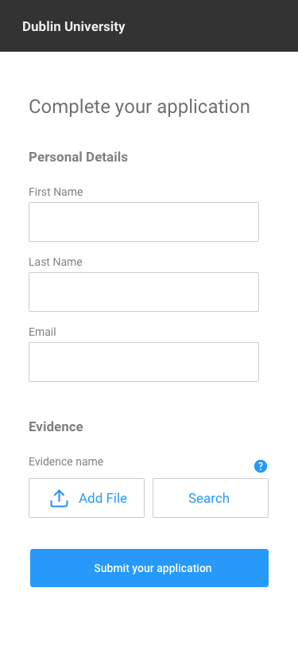
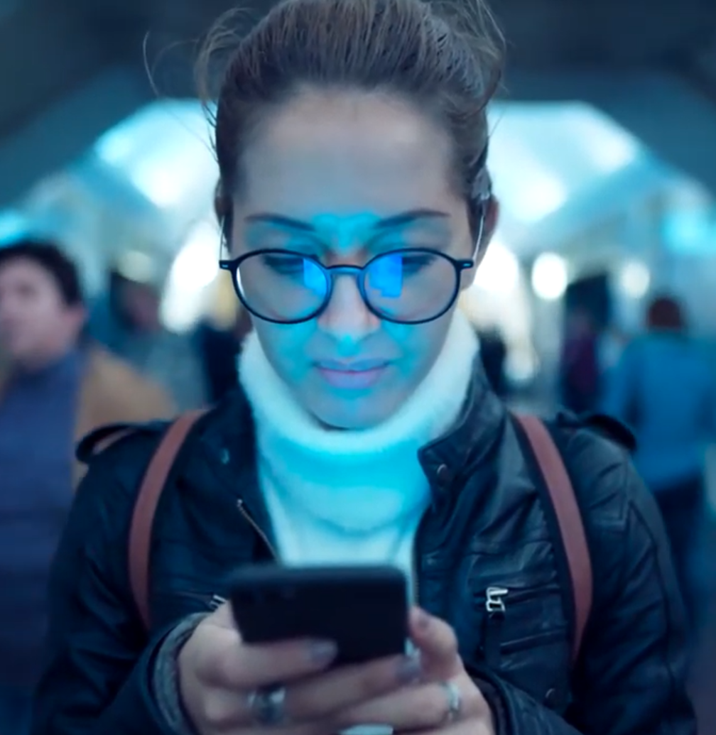


Once-Only means users can request for docs/data to be retrieved from other Member States (MS) to complete online procedures in other MS
Evidence provider
Requests & responses for docs & data
Spain
User: Bianca
Evidence Requester: Germany

Slide 7

Click through the User Experience

Slide 8
8 key requirements of the once-only system
1 Authenticate
5 ID Matching
User can authenticate with an eIDAS eID
Evidence provider can locate the user’s evidence
2 Locate evidence
6 Evidence response
Portal can locate the evidence provider
Evidence provider return the evidence
3 User Request
7 Preview
User can request their document(s)/data
User can preview the evidence in separate space
4 Evidence Request
8 Confirm
Request for evidence is sent to the evidence provider
User can confirm if they want to use the evidence

Slide 9






Architectural design of the once-only system
Germany
Evidence requester
Spain
Evidence Provider
eIDAS Node
eIDAS Node
Identity provider
1. Authentication
Evidence requester
preview space
eDelivery AP
eDelivery AP
Evidence provider
4. Evidence Request
6. Evidence response
3. User Request
7 & 8 Preview and confirm
5. Identity Matching
Evidence Broker
Data Services Directory
2. Locate evidence
EC Common Services

Slide 10
A screen-by-screen walkthrough of OOP

Slide 11
Key Once-Only steps
Authenticate Locate evidence User request Evidence request ID Matching Evidence response Preview Confirm

Slide 12
1 Authenticate
Users must have an eIDAS enabled eID to exchange data or documents automatically through the OOP system

Slide 13
Authenticate Locate evidence User request Evidence request ID Matching Evidence response Preview Confirm
Add a page to filter users' pre-authentication
If designers are concerned that adding content for foreign nationals might diminish the experience for national users, consider adding a filter page so that you can tailor the following steps specifically to different user segments.

Slide 14
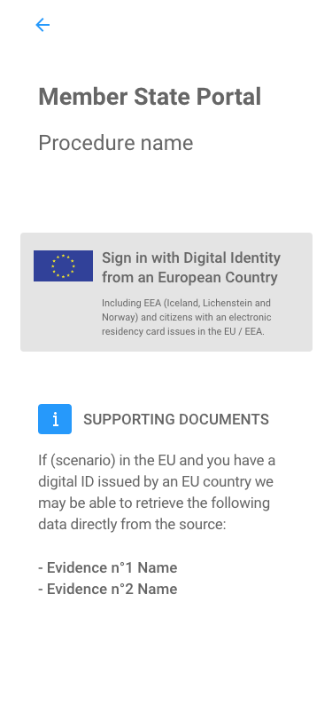
Authenticate Locate evidence User request Evidence request ID Matching Evidence response Preview Confirm
Explain the Once-Only Principle to users' pre-authentication
Users may not start an online procedure if they don’t think they have the document they need to complete it so inform users that your service may be available to retrieve evidence for them using the Once-Only Principle.
At this stage, users should also be made aware that evidence can only be retrieved if they authenticate with an eID.

Slide 15
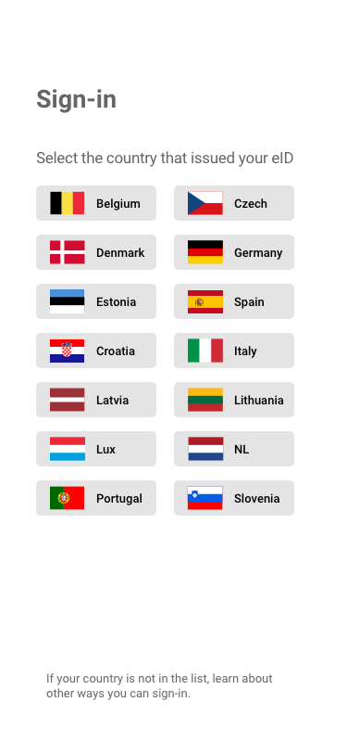
Authenticate Locate evidence User request Evidence request ID Matching Evidence response Preview Confirm
User selects country that issued eID
To start the authentication process, users must select the country that issued their eID so the procedure portal in MS A can re-direct them to their national authentication page in MS B.
Only countries with notified eID schemes will appear in the list. Learn about the status of national eID schemes.

Slide 16
Authenticate Locate evidence User request Evidence request ID Matching Evidence response Preview Confirm
Portal redirects users to eIDAS node
To retrieve this URL, the procedure portal service needs to send a request to its national eIDAS node in MS A, which will then forward the request to the eIDAS node in MS B and return its response (the correct URL) to the portal.
Evidence requester
eIDAS Node
eIDAS Node
Identity provider

Slide 17
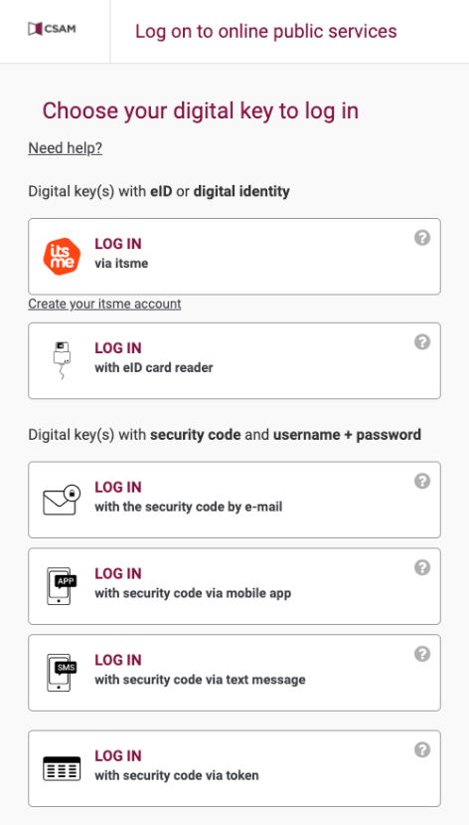
Authenticate Locate evidence User request Evidence request ID Matching Evidence response Preview Confirm
Identity provider selector
Users are re-directed to their national authentication sites where they may be more than one way they can authenticate themselves. If mobile authentication is not available, they’ll have to stop and restart the process on another device.
If they’ve never used their eID before, they’ll need to enroll with a specific eID provider to activate it. This can sometimes require a laptop and card-reader, or other means.

Slide 18
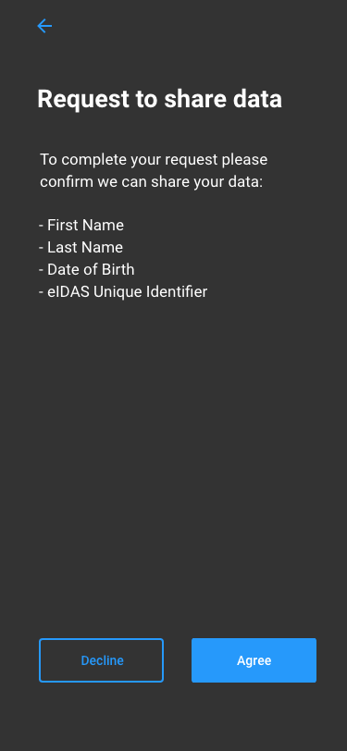
Authenticate Locate evidence User request Evidence request ID Matching Evidence response Preview Confirm
Authenticating with their identity provider
Users are redirected to their identity provider in MS B. Once they have authenticated, they will be asked to consent to share their identity attributes with the portal in MS B to complete the authentication process. The user is then redirected back to the procedure portal.

Slide 19
2 Locate evidence
The procedure portal must identify what to ask for (evidence type), and who to ask it from (evidence provider).

Slide 20
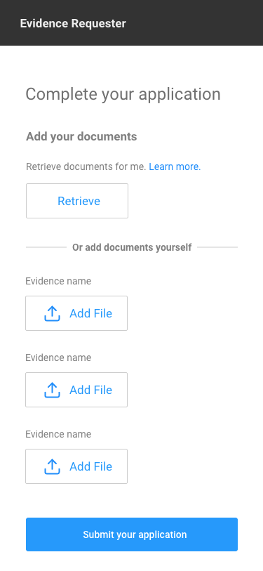
Authenticate Locate evidence User request Evidence request ID Matching Evidence response Preview Confirm
Choose to use Once-Only
Using the Once-Only technical system is not obligatory – users can still choose to upload the required documents and data manually or choose to retrieve evidence through the Once-Only technical system.

Slide 21
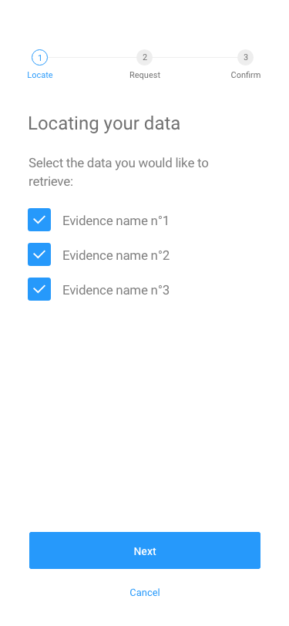
Authenticate Locate evidence User request Evidence request ID Matching Evidence response Preview Confirm
Selecting evidence for retrieval via OOP
The user needs to specify which evidence they would like the procedure portal to find for them. This does not necessarily guarantee successful retrieval, but it initiates the search.
With further user input, the procedure portal will find the equivalent of these evidences in the country where the evidence is located.

Slide 22
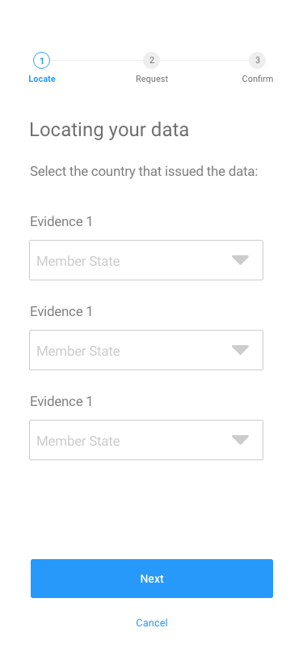
Authenticate Locate evidence User request Evidence request ID Matching Response Preview Confirm
Select the MS holding the evidence
The user needs to input the MS where their evidence is located. For example, if they need proof of birth, they will say where they were born (MS B). If they need proof of higher education, they will say where they studied (this may be a third country, MS C).
The procedure portal in MS A then sends a query to the Evidence Broker to determine the evidence type in MS B and/or C.
Evidence Broker

Slide 23
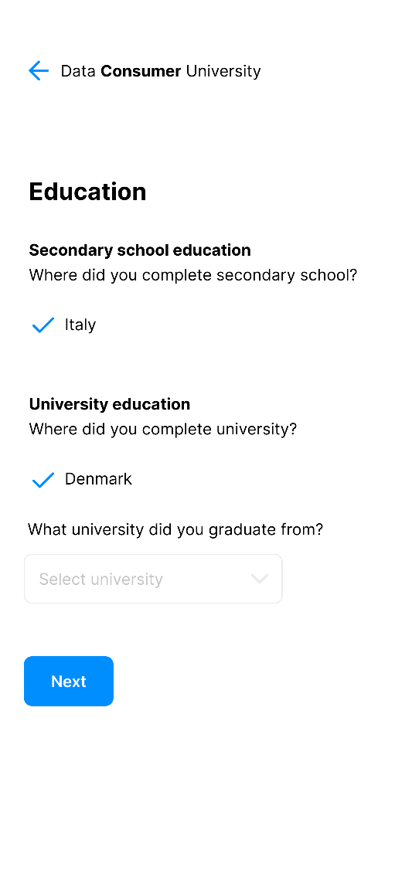

Authenticate Locate evidence User request Evidence request ID Matching Evidence response Preview Confirm
More user input needed for Evidence Broker
Sometimes, the type of evidence used isn’t the same throughout a whole country. For example, different regions might use a different type of document to prove somebody’s marital status. In these cases, the user will be asked for more input, such as the region, city, post code, etc.
Evidence Broker

Slide 24
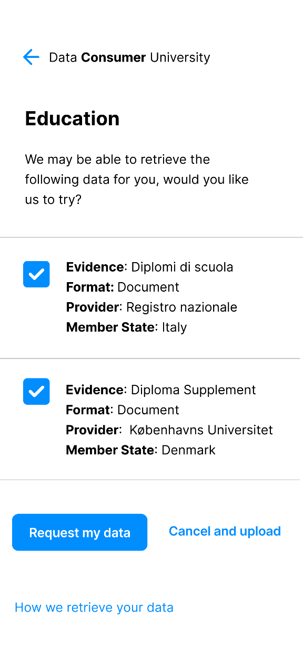
Authenticate Locate evidence User request Evidence request ID Matching Evidence response Preview Confirm
Locating the evidence provider
To find out where to send the request for evidence the portal sends a query to the Data Services Directory with the evidence type (provided by the Evidence Broker) and Member State (plus any additional user given at the Evidence Broker stage).
If the evidence type is stored centrally in the Member State in question, the DSD returns the name of the evidence provider. Extra input may be required from the user if there are multiple providers of one evidence type in the evidence provider MS.
Data Service Directory

Slide 25
Authenticate Locate evidence User request Evidence request ID Matching Evidence response Preview Confirm
More user input to identify evidence provider
If the Data Service Directory returns a list of potential evidence providers for an evidence type, depending on the length of this list the user will have:
Relatively short list: the user selects the relevant evidence provider (e.g., from a dropdown list)
Long list: based on the metadata in the DSD’s list, the user is asked for more input to narrow down the list so they can then select from a shorter list in a dropdown menu
Data Service Directory

Slide 26
3 User Request
The user explicitly requests the portal to retrieve their evidence from another MS

Slide 27
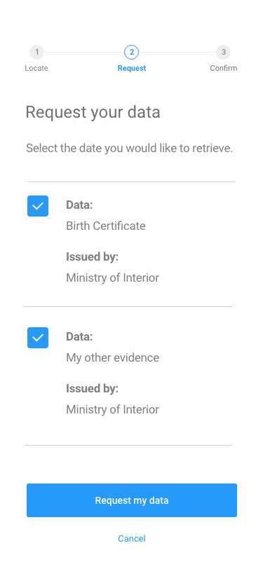
Authenticate Locate evidence User request Evidence request ID Matching Evidence response Preview Confirm
User request for evidence retrieval
The portal now knows what evidence to request and who to request it from. But the user still needs to explicitly request for the portal to do this. Once the portal has collected and logged the explicit request of the user the portal will then send the request for evidence to the relevant evidence provider.

Slide 28
4 Evidence request
The request for evidence is sent to the evidence provider

Slide 29

Authenticate Locate evidence User request Evidence request ID Matching Evidence response Preview Confirm
Sending the request for evidence
The request for evidence is sent via an eDelivery message exchange network. This request contains the requested evidence type and the eIDAS attributes of the user.
Evidence requester
preview space
eDelivery AP
eDelivery AP
Evidence provider
Request
User Request

Slide 30
5 ID Matching
The evidence provider locates the evidence in their MS

Slide 31

Authenticate Locate evidence User request Evidence request ID Matching Response Preview Confirm
Identity Matching
Evidence providers locate evidence based on request containing
Minimum
  Certificate of evidence requester
  User’s minimum eIDAS attributes
    First Name
    Last Name
    DOB
  Request for evidence
Potentially (in cases where record matching was needed)
  Additional eIDAS attributes
  Additional attributes requested from the user
Request for evidence
Evidence provider

Slide 32
6 Evidence response
The evidence provider responds to the evidence request

Slide 33
Authenticate Locate evidence User request Evidence request ID Matching Evidence response Preview Confirm
Sending the response for evidence
The response for evidence is sent via an eDelivery message exchange network to the preview space.
Evidence requester
Preview space
eDelivery AP
eDelivery AP
Evidence provider
Response
User Request

Slide 34
7 Preview
The user can check the evidence before they decide to use it

Slide 35
Authenticate Locate evidence User request Evidence request ID Matching Response Preview Confirm
Minimum requirements for the implementation of the Preview Space
Preview space
Clerks cannot access the data in the preview space
It must be a separate logical component to the procedure portal
It must have its separate storage to the procedure portal
It must have a separate data retention period
Two alternatives for the implementation of the preview space are described on the next page.

Slide 36
Alternative 1: Delegate all the key once-only steps to the Preview Space
Delegate all the key once-only steps to the Preview Space. This would mean redirecting the user to the the Preview Space when they choose to retrieve evidence using the OOP. The Preview Space would then be responsible for all the requirements in bold below. The evidence would be transferred to the procedure portal when after the user has previewed and confirmed the use of the evidence
Authenticate Locate evidence User request Evidence Request ID Matching Evidence response Preview Confirm
Alternative 2: A Preview Space with only the minimum requirements
The user would preview the evidence and confirm the use of the evidence in the preview space before it is transferred to the procedure portal. The required functionality for all other steps would remain with the procedure portal, including interactions with the common services, the request for evidence and receiving the response. The procedure portal would have to be configured to ensure that it transfers the evidence to the preview space on reception from the evidence provider.
Authenticate Locate evidence User request Evidence Request ID Matching Evidence response Preview Confirm

Slide 37
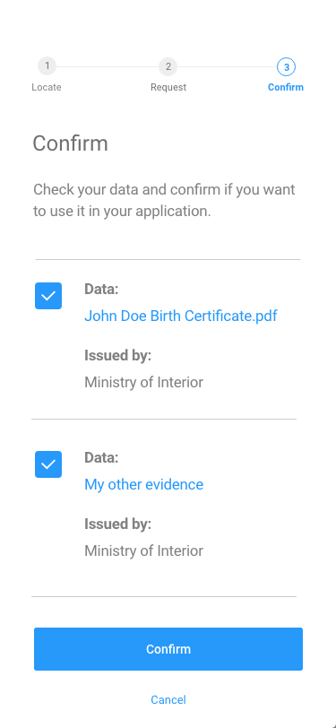
Authenticate Locate evidence User request Evidence Request ID Matching Evidence response Preview Confirm
The preview space
The evidence provider does not send the requested evidence to the portal directly – it is sent to a dedicated Once-Only preview space. The user can preview it before deciding to use it in the procedure.
Nobody but the user can see the evidence at this stage. The preview space is separate from the procedure portal and has its own storage and retention period compliant with relevant data protection regulation (i.e., GDPR).

Slide 38
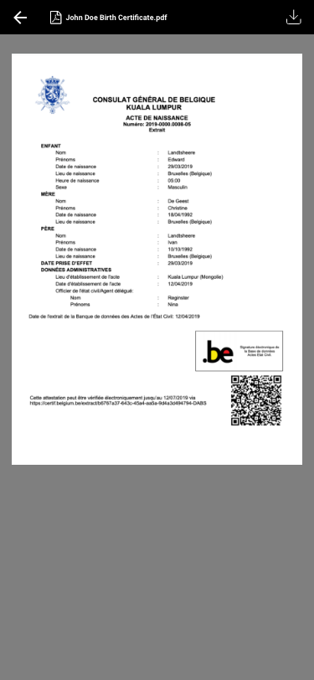
Authenticate Locate evidence User request Evidence Request ID Matching Evidence response Preview Confirm
User check
By previewing evidence, the user can check that the evidence is what they asked for and that it doesn’t contain any errors. If the user cancels the evidence exchange at this stage the retrieved evidence is immediately deleted from the OOP preview space. The user can still choose to upload their own data manually.

Slide 39
8 Confirm
If the user is happy with the retrieved evidence, they confirm they want to use it in the procedure.

Slide 40
Authenticate Locate evidence User request Evidence request ID Matching Evidence response Preview Confirm
Confirming use of evidence in procedure
If the user is happy with the retrieved evidence after previewing it, they confirm they want to use it in the procedure. It is now uploaded from the OOP preview space to the procedure portal. The portal logs the user’s confirmation to use the evidence and the user returns to the original procedure portal.
Evidence requester
preview space
User confirmation

Slide 41
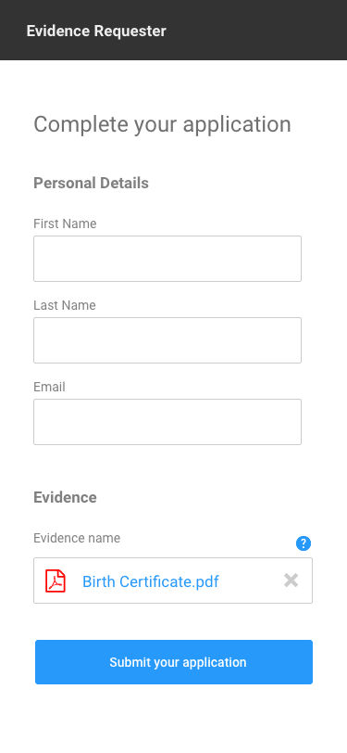
Authenticate Locate evidence User request Evidence request ID Matching Evidence response Preview Confirm
Completing the procedure
The user’s evidence has now been exchanged through the OOP system. They return to the procedure portal and, perhaps after inputting some more information manually, they can complete the procedure.

Slide 42

Authenticate Locate evidence User request Evidence request ID Matching Evidence response Preview Confirm
Receiving confirmation
After submitting the procedure, it is good practice to send the user a confirmation message. This lets them know roughly when they can expect to hear the outcome of the procedure, and the details of a helpdesk they can contact if they have questions.

Slide 43
End.

