Slide 1
V1.0
Service Offering Canvas Toolkit
A toolkit to accompany the Service Offering Canvas Playbook.

Slide 2
Introduction
Citizens and businesses are getting used to fast, user-friendly and globally accessible digital services in the private sector, and increasingly, they expect the same from the public sector. They now want to file taxes, register a business and apply for social benefits in their preferred language without having to deal with the various tokens and access cards currently needed to communicate with authorities. Public authorities not only need to digitise existing processes, they also need to strategically leverage new technologies and find new models of working to reap benefits of digital transformation - improved efficiency, reduced risks and costs and enhanced customer satisfaction.
IT providers can no longer plan their projects 10 years at a time. With our experience in the field, we realised that digital agencies need to embrace service-oriented digital transformation in a way that is agile and responsive to evolving needs.
That is why we developed the Service Offering Canvas (SOC) – a visual tool to help providers plan value propositions for politically
important digital themes, such as electronic identification or digital messaging. In essence, SOC works by making its user, the digital agency, actively think about what it does, why and for whom. By explicitly mapping services and stakeholders onto the Canvas, the user is channeled into a service mindset that ensures that stakeholders' needs are appropriately anticipated and met.
When used on a continuous basis, SOC provides a way to keep one's finger on the pulse of their value proposition. It enables digital agencies to identify what they should start doing or stop doing as stakeholders come and go and political focuses shift. SOC also helps to structure dialogue and facilitate discussion when validating value propositions and priorities, which is instrumental in closing the gap between political intent and their execution in real-life. Most importantly, SOC takes a lightweight approach with a one-page template that is easy to adapt when needs change.
For a comprehensive overview of the SOC please see our Service Offering Canvas Playbook that accompanies this toolkit.

Slide 3
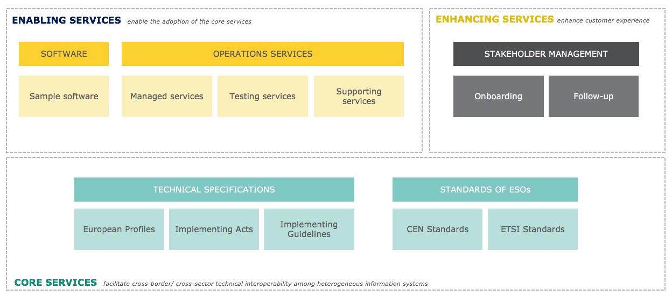
The Service Offering Canvas
A simple visual tool that helps teams design and deliver solutions in complex stakeholder environments.
The Service Offering Canvas offers:
A concise overview of the different services provided to an ecosystem of stakeholders
It was developed by the CEF programme to ensure a consistent and user-centric view of the organization
The classifications are based on ITIL V3® (Core Services, Enabling Services and Enhancing Services)
For a more information, please check out our Service Offering Canvas Playbook.
See the Playbook on our website

Slide 4
Benefits of using the Service Offering Canvas
Promotes service-oriented use centricity
Supports collaboration in multi-stakeholder ecosystems
Helps clarify value propositions and priorities
Facilitates discussions about value propositions
Links political intent with their execution
Promotes standards and for interoperability

Slide 5
Example: The CEF building blocks
The CEF progamme has a portfolio of solutions, each has a Service Offering Canvas tailored to its stakeholders
Big Data Test Infrastructure
eID
Context Broker
eInvoicing
eArchiving
eSignature
eDelivery
eTranslation

Slide 6
Step 1
Fill in the names of the different solutions you provide.
…
…
…
…
…
…
…
…

Slide 7
Example: CEF eDelivery Service Offering Canvas
The eDelivery building blocks SOC provides an overview of the different services it offers and defines who are the users though a set of icons.
ENABLING SERVICES enable the adoption of the core services
ENHANCING SERVICES enhance customer experience
SOFTWARE
OPERATIONS
STAKEHOLDER MANAGEMENT
Sample software
Managed Services
Testing
Support
Onboarding
Follow-up
P
V
P
P
V
P
P
V
P
P
V
P
P
V
P
P
V
P
Access Point (AP)
Public Key
Infrastructure (PKI)
Connectivity testing
Service desk
Self-assessment
tool
Developers
community
Service Metadata Publisher (SMP)
Service Metadata
Locator (SML)
V
P
Conformance testing
Training &
Deployment
Onboarding & stakeholders follow-up
Service Metadata
Locator (SML)
Cost estimation
tool
TECHNICAL SPECIFICATIONS
STANDARDS OF ESOs
European Profiles
Implementing Acts
Implementing Guidelines
CEN Standards
ETSI Standards
P
V
P
P
V
P
P
V
P
Access Point specifications
Security controls guidance
Connector specifications
SMP specifications
SML specifications
USER
P
Cross-border projects – Public sector entities
P
Cross-border projects – Private sector entities
CORE SERVICES facilitate cross-border/ cross-sector technical interoperability among heterogeneous information systems
V
Software vendors

Slide 8
Step 2: Create a Service Offering Canvas for your solution
Fill in the services you offer across the different categories and add icons to each in order to specify the user of each service.
ENABLING SERVICES enable the adoption of the core services
ENHANCING SERVICES enhance customer experience
SOFTWARE
OPERATIONS
STAKEHOLDER MANAGEMENT
Sample software
Managed Services
Testing
Support
Onboarding
Follow-up
…
…
…
…
…
…
TECHNICAL SPECIFICATIONS
STANDARDS OF ESOs
European Profiles
Implementing Acts
Implementing Guidelines
CEN Standards
ETSI Standards
…
…
…
…
…
USER
P
…
CORE SERVICES facilitate cross-border/ cross-sector technical interoperability among heterogeneous information systems

Slide 9
Thank you.
If you have feedback or would like to get in touch with us to discuss the Service Offering Canvas. Please send us an email. cefbuildingblocks@ec.europa.eu

